Slide 1

Machine Learning of Nonequilibrium States
Matthew Stewart
Supervisor: Prof. Richard Blythe
April 2022

Slide 2
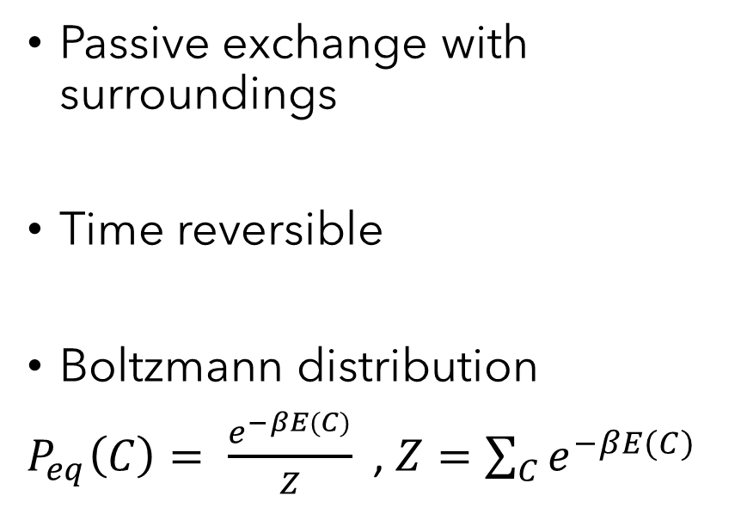
What is a Nonequilibrium state?
Equilibrium system
Nonequilibrium system
Passive exchange with surroundings
Time reversible
Boltzmann distribution
$P_{eq}\left(C\right)= \frac{e^{−βE(C)}}{Z}$ , $Z=\sum_{C}{e^{−βE(C)}}$
Current driven by surroundings
Trajectory has direction
Distribution unknown in general and likely complicated!

Slide 3
Aims of the Project
Following from work by Wetzel (2017) - Investigation of the 2D Ising model phase transition.
Use a machine learning (ML) approach to learn the distribution of a paradigm nonequilibrium system. Will it learn the physics?

Slide 4
Defining the TASEP
α
β
Current driven by surroundings
⇒ NONEQUILIBRIUM SYSTEM
Totally
Asymmetric
Simple
Exclusion
Process

Slide 5
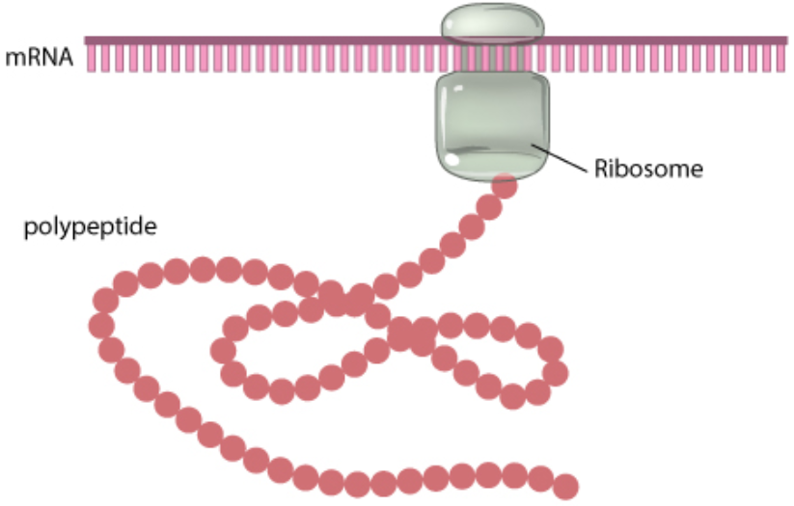
Clancy, S. & Brown, W. (2008) Nature Education 1(1):101

Slide 6
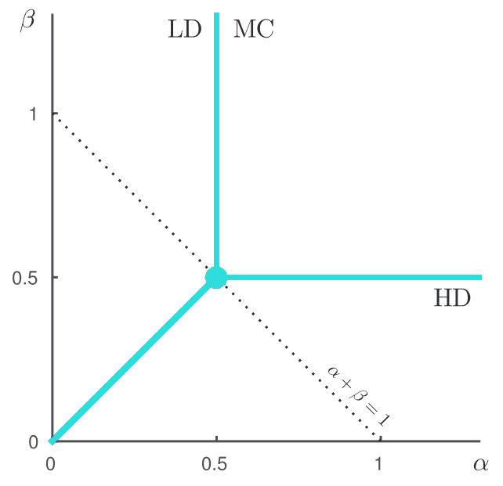
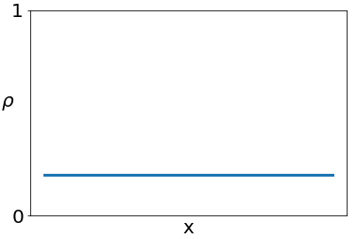
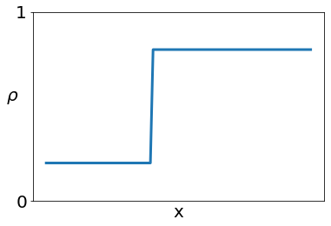
Wood, Anthony & Blythe, Richard & Evans, Martin. (2017). Journal of Physics A: Mathematical and Theoretical

Slide 7
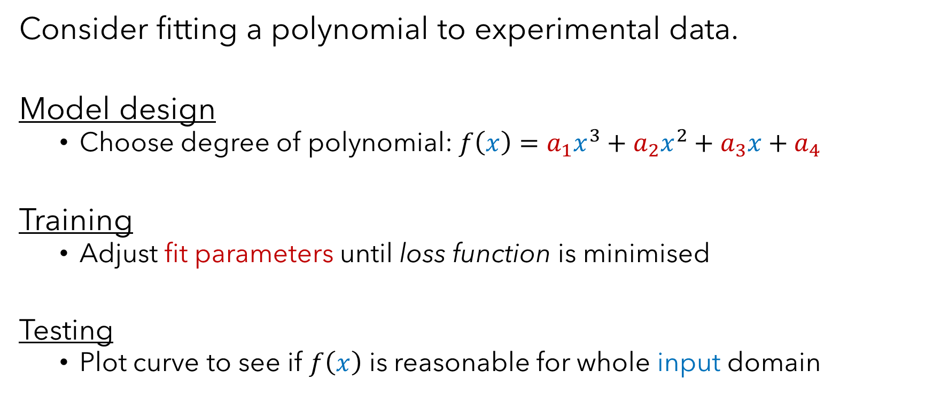
How Neural Networks Work
Consider fitting a polynomial to experimental data.
Model design
Choose degree of polynomial: $f\left(x\right)=a_{1}x^{3}+a_{2}x^{2}+a_{3}x+a_{4}$
Training
Adjust fit parameters until loss function is minimised
Testing
Plot curve to see if $f\left(x\right)$ is reasonable for whole input domain

Slide 8
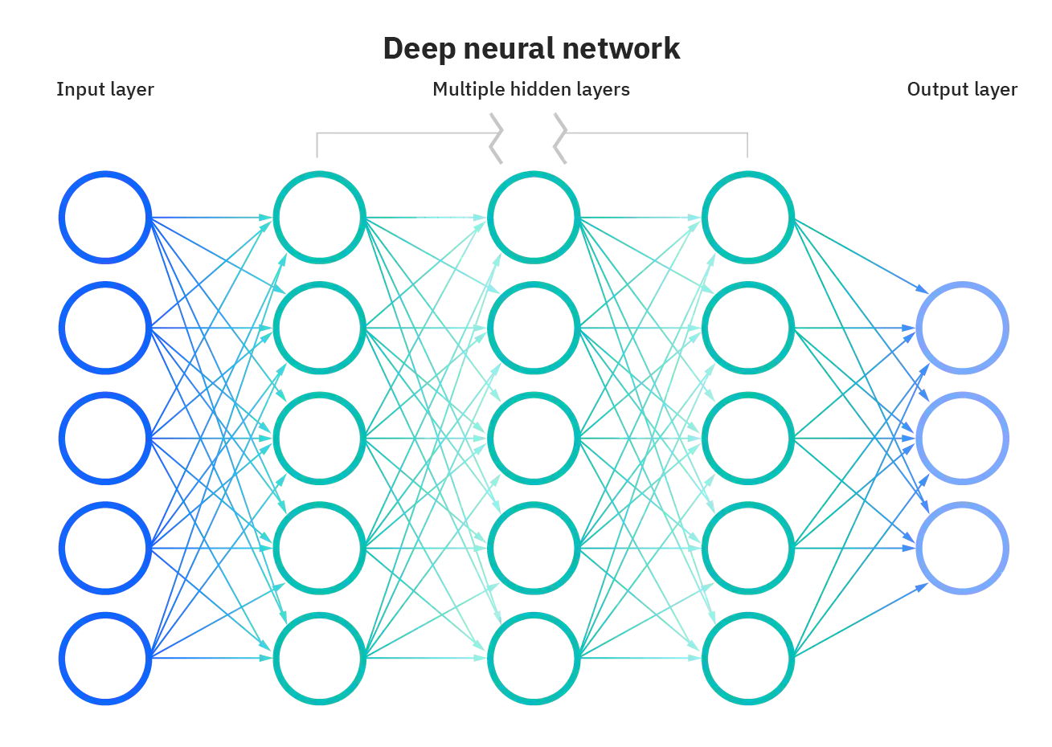

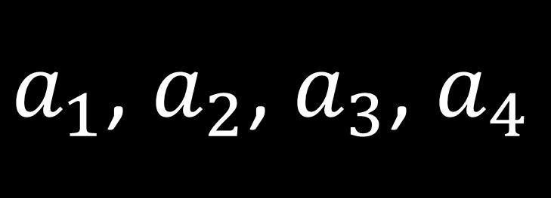

$$x$$
$a_{1}$, $a_{2}$, $a_{3}$, $a_{4}$
$$f(x)$$
https://www.ibm.com/cloud/learn/neural-networks

Slide 9
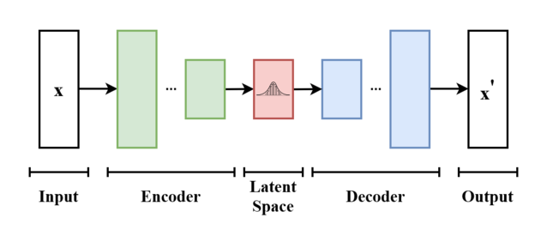


Variational Autoencoder (VAE)
$$q_{θ}(z|x)$$
$$p_{φ}(x|z)$$
https://en.wikipedia.org/wiki/Variational_autoencoder
$$Loss=KL(q_{θ}(z|x)||p\left(z\right))−E\left[logp_{φ}\left(x | z\right)\right]$$

Slide 10
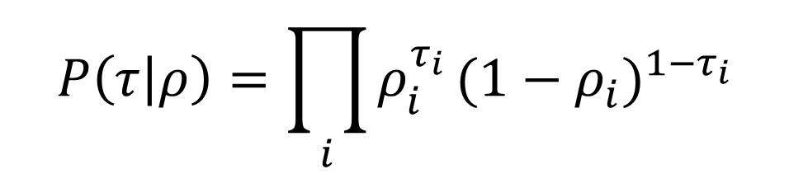
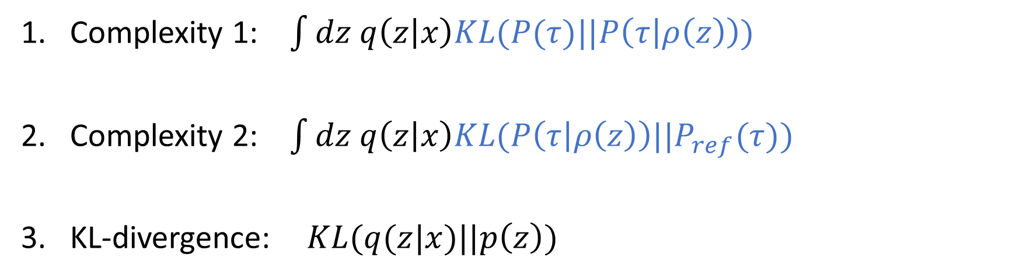
Measuring Complexity
$$P\left(τ | ρ\right)=\prod_{i}{ρ_{i}^{τ_{i}}}{(1−ρ_{i})}^{1−τ_{i}}$$
Complexity 1: $\int{dz q\left(z | x\right)KL(P(τ)||P\left(τ | ρ\left(z\right)\right))}$
Complexity 2: $\int{dz q\left(z | x\right)KL(P\left(τ | ρ\left(z\right)\right)||P_{ref}(τ))}$
KL-divergence: $KL(q(z|x)||p\left(z\right))$

Slide 11
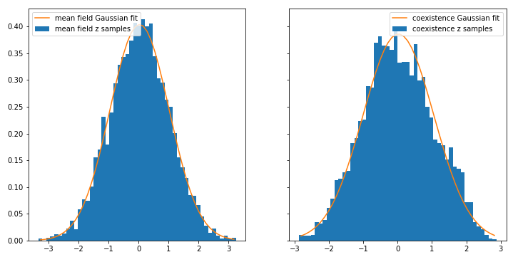
Latent Space Distributions
z

Slide 12
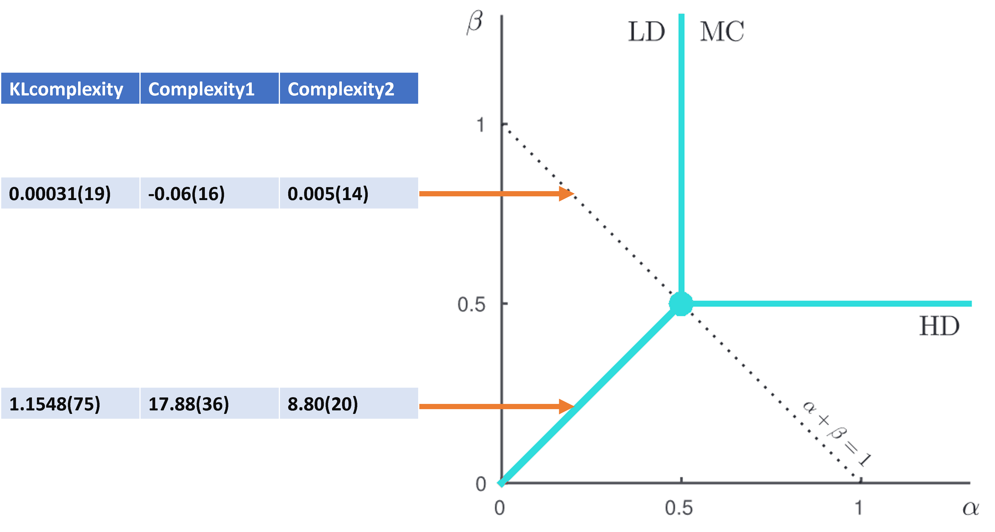

Slide 13
Mixed Mean Field Dataset
Mixed Coexistence Dataset
Wood, Anthony & Blythe, Richard & Evans, Martin. (2017). Journal of Physics A: Mathematical and Theoretical

Slide 14
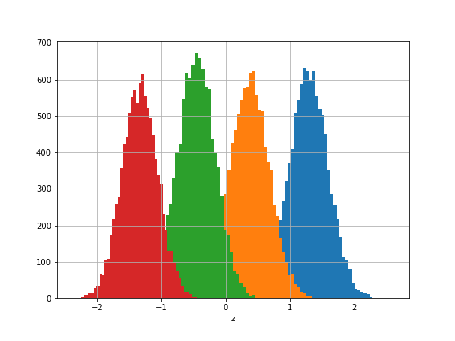
Wood, Anthony & Blythe, Richard & Evans, Martin. (2017). Journal of Physics A: Mathematical and Theoretical

Slide 15
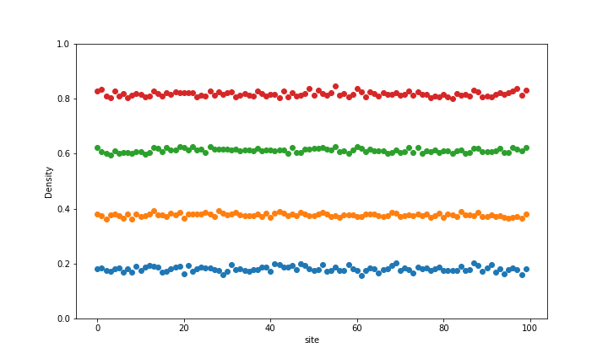

Slide 16
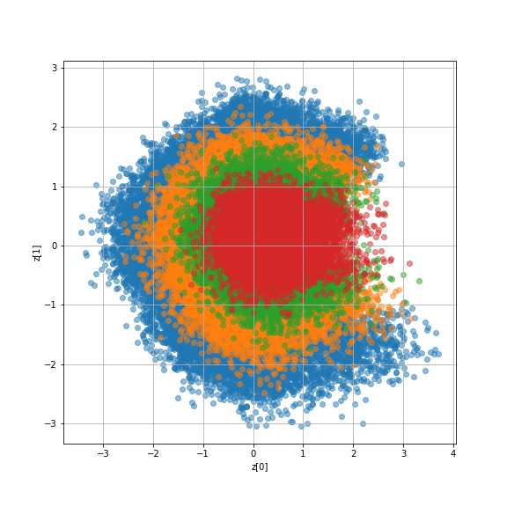
Wood, Anthony & Blythe, Richard & Evans, Martin. (2017). Journal of Physics A: Mathematical and Theoretical

Slide 17
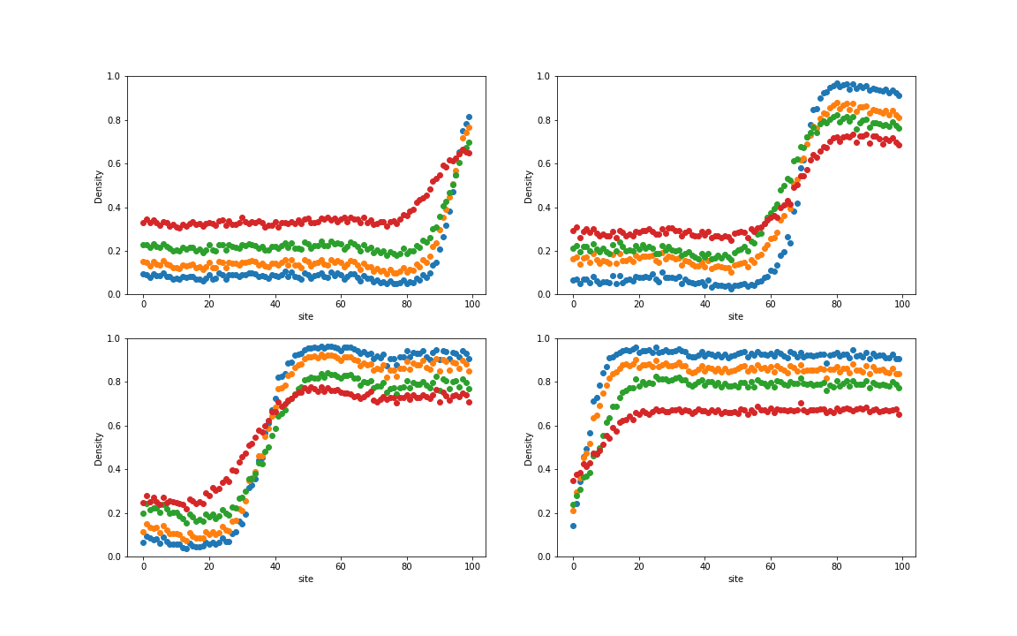

Slide 18
Conclusions and Future Work
Complexity measures and latent distributions show VAE has learned the coexistence complexity
The latent variables are physically relevant
What about more subtle correlations?
Other generative neural network models such as generative adversarial network (GAN)
Other nonequilibrium systems

