Slide 1
AfriShield AI
Last-Mile Flood Early-Warning System
Backend · Machine Learning · Mobile App · Simulation
Technical Progress Update — Team Sync · August 28, 2026

Slide 2
OVERVIEW
Agenda
▸ Backend — API, real alert channels, what's real vs. simulated
▸ Machine Learning — the dual risk model, and an honest look at the training data
▸ Mobile App — the Flutter app, and everything added this week
▸ Simulation — the Wokwi ESP32 flood-sensor prototype
▸ What's left — the honest punch list before the demo
AfriShield AI — Team Sync
2

Slide 3
BACKEND
A lightweight FastAPI service
No heavy infrastructure by design — JSON files for storage, easy to run anywhere.
Risk & regions
Real alert channels
IoT & citizen input
New this week
POST /api/risk-check
POST /api/alerts/send (SMS / voice)
POST /api/sensor-reading
POST /api/hazard-reports
GET /api/regions
GET /api/alerts
POST /api/hazard-reports (+ photo)
POST /api/push-tokens
POST /api/ussd
AfriShield AI — Team Sync
3

Slide 4
BACKEND
Real vs. simulated — said out loud, not hidden
REAL TODAY
STILL SIMULATED
▸ Rules-based + trained ML risk scoring, live
▸ Alert text in 7 languages
▸ Automatic SMS the moment a region crosses into “high” risk
▸ Hazard/help reports + photo attachment
▸ Push-notification plumbing (registration, sending code)
▸ Actual SMS/voice sending — no Africa's Talking account created yet
▸ Actual push delivery — no Firebase project created yet
▸ Every simulated send is clearly labeled as such in the UI/logs, never disguised as real
AfriShield AI — Team Sync
4

Slide 5
MACHINE LEARNING
Two risk scores, on purpose
Every reading gets scored two independent ways — shown side by side, not blended.
1. Rules-based (primary)
2. Trained ML model (second opinion)
▸ Normalized rainfall + river level, equally weighted
▸ Bucketed into low / medium / high
▸ Simple enough to explain and audit by hand
▸ Powers every alert message sent today
▸ scikit-learn: StandardScaler + LogisticRegression
▸ Runs alongside the rules-based score, not instead of it
▸ Committed model file — no retraining needed to run the app
▸ A genuine ML component for the “appropriate use of AI” criterion
AfriShield AI — Team Sync
5

Slide 6
MACHINE LEARNING
The honest story on training data
▸ We looked for real historical flood data. EM-DAT, ICPAC, NASA EONET, GDACS + Open-Meteo — all investigated.
▸ Only 14 of 41,355 assembled rows had a real confirmed label. 0.03% — not enough to train on, and part of it risked leakage.
▸ Decision: keep the synthetic-trained model. Cite real GDACS/rainfall data as external validation in the pitch instead of forcing a swap.
Why say this out loud? Because a demo that quietly claims real training data
and gets asked a follow-up question is worse than one that's upfront about the tradeoff.
AfriShield AI — Team Sync
6

Slide 7
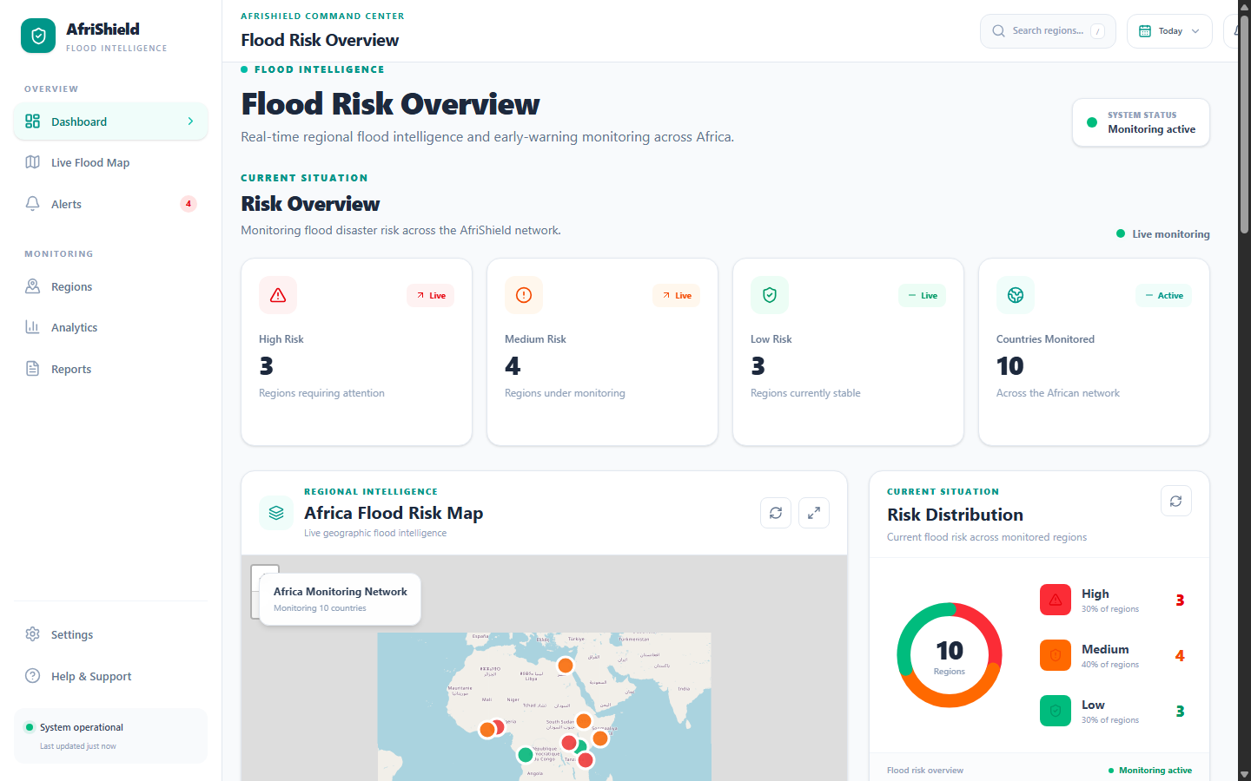
MOBILE APP
A citizen-facing Flutter app, matching Figma
▸ Onboarding: Splash → Welcome → Language (9) → Country (54) → Location
▸ Home — your region's current risk, stats, mini map
▸ Alert — every monitored region, filterable by risk level
▸ Maps — real OpenStreetMap, every region pinned
▸ Reports — report a hazard, or that you need help
(Web dashboard shown — mobile app mirrors the same live data)
AfriShield AI — Team Sync
7

Slide 8
MOBILE APP
What's actually real — not just UI
▸ Real OpenStreetMap, real offline cache with an honest “showing saved data” banner
▸ Real on-device text-to-speech “Read Aloud” for accessibility
▸ Real GPS (onboarding + hazard reports) via geolocator
▸ Real photo attachment on hazard reports (camera or gallery)
▸ Real State/City data for all 54 countries — 1,117 states, 4,638 cities, not free text anymore
▸ Real UI translation into all 7 backend languages, switched live from Settings
▸ Hazard/help reporting fully wired end-to-end to the backend
AfriShield AI — Team Sync
8

Slide 9
MOBILE APP
Push notifications — built, not yet live
▸ Firebase Cloud Messaging wired on both backend and mobile app
▸ Settings > Alert Channels > “Mobile App” toggle is real and interactive
▸ Enabling it registers your device with the backend for your region
The honest gap
No Firebase project has actually been created yet (same category of gap as the
Africa’s Talking account). Until then, the toggle honestly says “unavailable” — it never
fakes a successful registration.
AfriShield AI — Team Sync
9

Slide 10
SIMULATION
Wokwi ESP32 flood-sensor prototype
▸ A browser-based ESP32 simulation — two potentiometers standing in for a rain sensor and a water-level sensor
▸ Feeds POST /api/sensor-reading, scored exactly the way a manual risk-check is
▸ Automatically sends a real SMS the first time a device's region crosses into “high” risk
Not yet done
▸ Only tested with curl standing in for the device — never against a real running backend yet
▸ Needs a public tunnel (ngrok) since Wokwi can't reach localhost
▸ No real physical hardware yet — that's the next step after the simulation is validated
AfriShield AI — Team Sync
10

Slide 11
BEFORE THE DEMO
The honest punch list
▸ Create a real Africa's Talking sandbox account — send one real test SMS and voice call
▸ Test USSD against the real sandbox simulator — only tested locally so far
▸ Verify voice speech for non-English alerts — Arabic/Swahili/Somali untested
▸ Run the Wokwi simulation against a real running backend — needs a tunnel
▸ Create a real Firebase project — for push notifications to actually deliver
▸ Native-speaker review — alert wording (French/Portuguese/Amharic) and all mobile UI translations
AfriShield AI — Team Sync
11

Slide 12
Thank you
Questions?
Matthias — Backend / AI · Habiba, Farid, Thompson — Frontend Web Dashboard · Mohamed Zaki — Embedded Systems / Robotics

