Slide 1
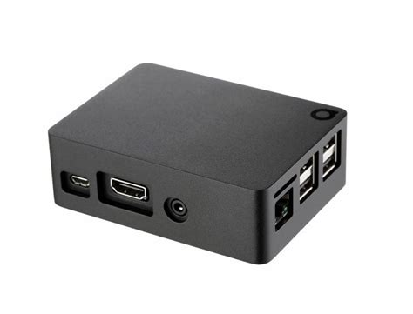
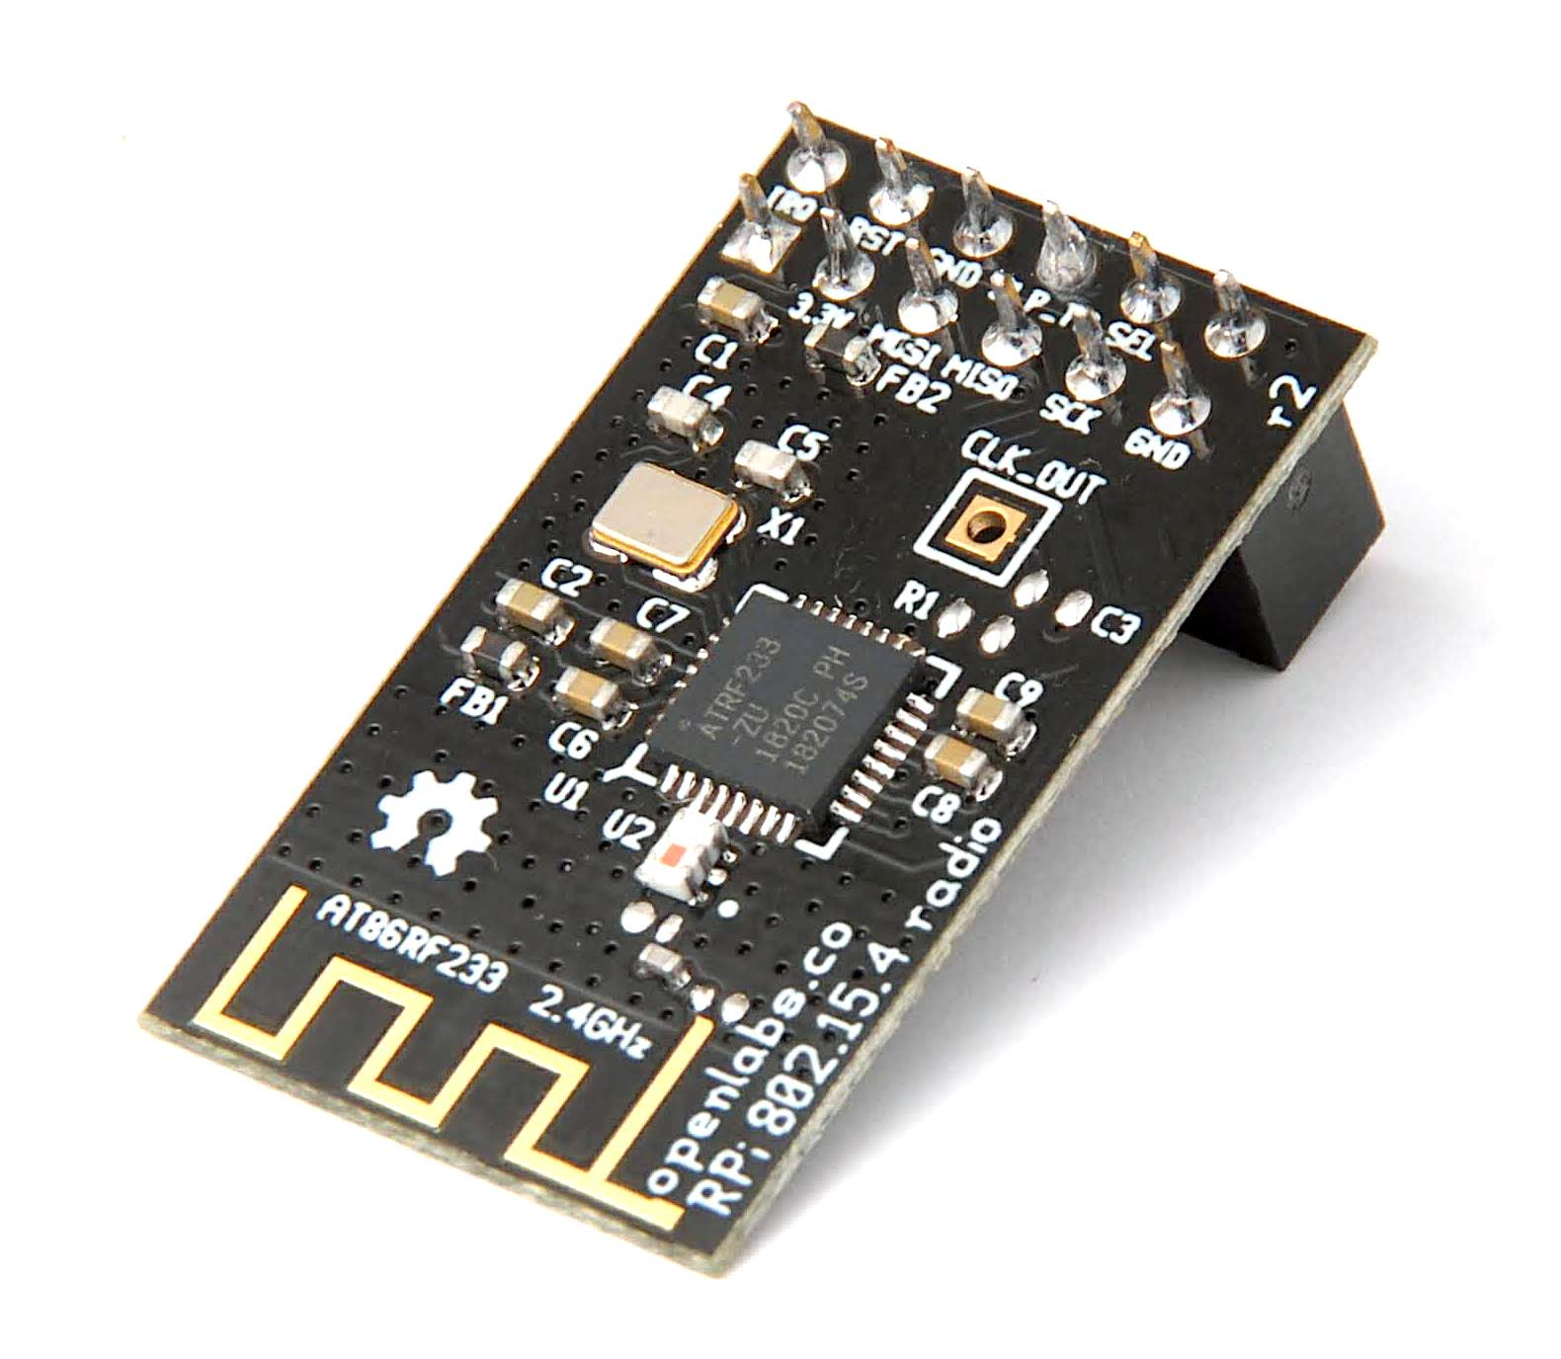
Raspberry Pi Router
Raspberry Pi 3B
OpenLabs AT86RF233

Slide 2
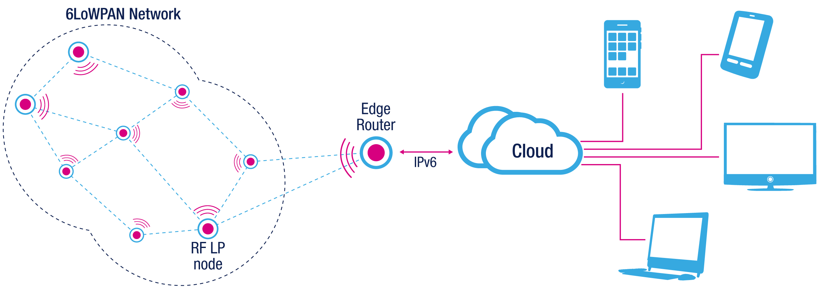
Raspberry Pi Router - Goal
1. Registering of new nodes in 6LoWPAN Network
2. Gateway to the internet

Slide 3
Raspberry Pi Router - Setup
1. Install Raspbian
2. Connect OpenLabs AT86RF233
3. Enable support for IEEE 802.15.4/6LoWPAN devices
4. Install WPAN-Tools
5. Enable autostart of 6LoWPAN network interface
Installation Guides:
- https://github.com/RIOT-Makers/wpan-raspbian/wiki/Create-a-generic-Raspbian-image-with-6LoWPAN-support
- https://github.com/RIOT-Makers/wpan-raspbian/wiki/Spice-up-Raspbian-for-the-IoT

Slide 4
Raspberry Pi Router - Issues
Emulate a network of several interconected 6LoWPAN devices but “fakelb” kernel module is missing in Raspbian → https://cateee.net/lkddb/web-lkddb/IEEE802154_FAKELB.html might be a solution.

Slide 5
Raspberry Pi Router
QUESTIONS?

