Slide 1
Succinct Representation of Labeled Graphs
Matthias Dürksen
Seminar on Algorithms for Compressed Graphs
Presentation-Date

Slide 2
Note for the Slide Discussion
graphics will be replaced in a later version by own graphics and some will be animated.
Key points are not fixed, they just represent what should be explained on the slides.

Slide 3
Motivation
Large Graphs
…
Goal/Advantage from this topic

Slide 4
Outline
Triangulated Graphs
Creation of the Spanning Trees
Generate the parenthesized representation
Extension for labels using the example of edge (or vertices) labels
Extended for planar graphs
(Rough explanation for k-page Graph)
Notes:
What i want to tell today:
Need a Model of the Intersec. => Sensors, Perception
Give the Model to use it for some algos, …

Slide 5
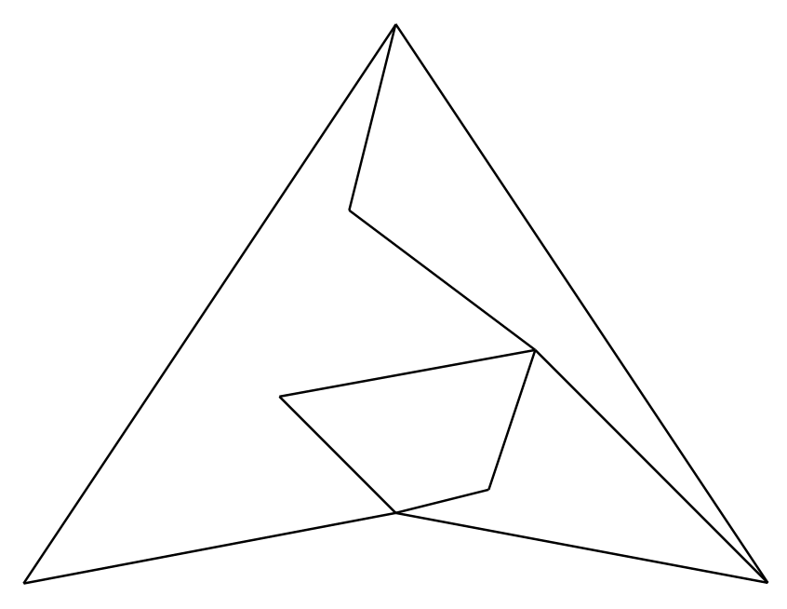
Planar Graphs
Notes:
What i want to tell today:
Need a Model of the Intersec. => Sensors, Perception
Give the Model to use it for some algos, …

Slide 6
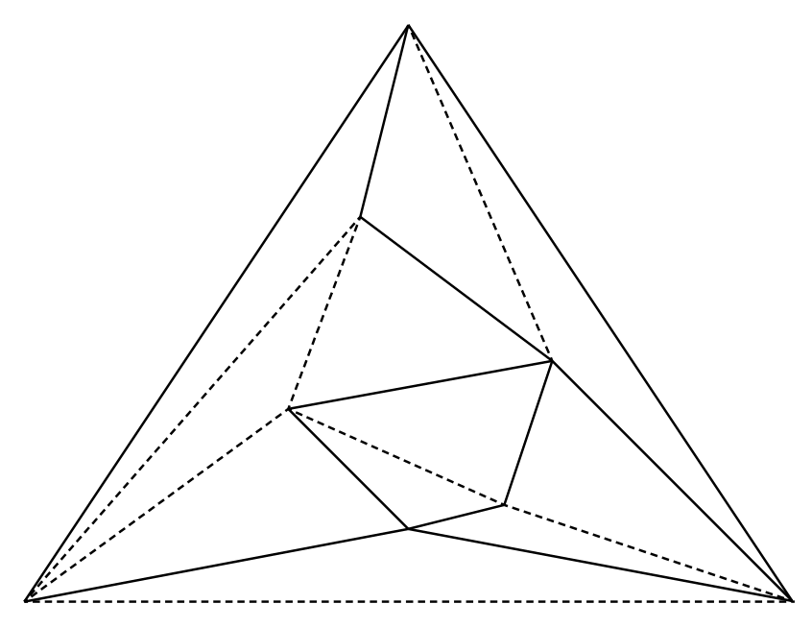
Triangulated Graphs
Effects on memory requirements
[To be inserted]
(only small)
Notes:
What i want to tell today:
Need a Model of the Intersec. => Sensors, Perception
Give the Model to use it for some algos, …

Slide 7
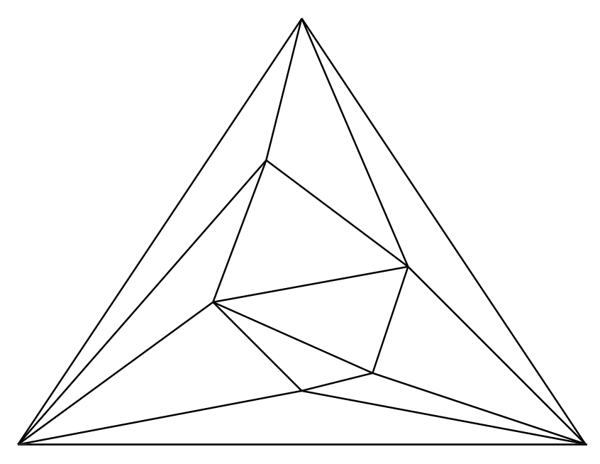
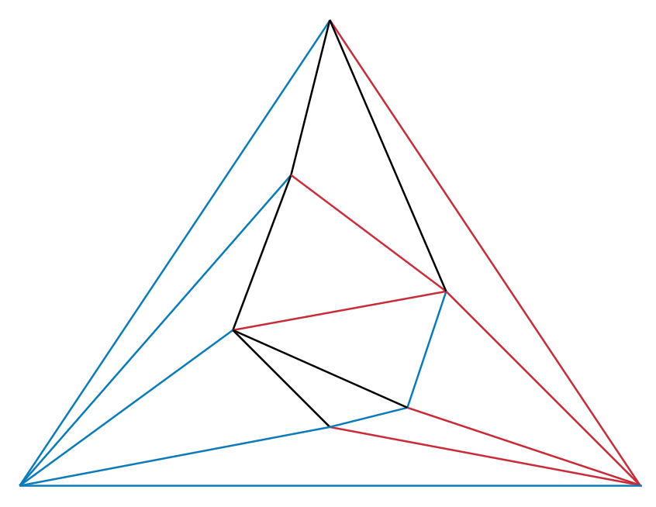
Notes:
What i want to tell today:
Need a Model of the Intersec. => Sensors, Perception
Give the Model to use it for some algos, …

Slide 8
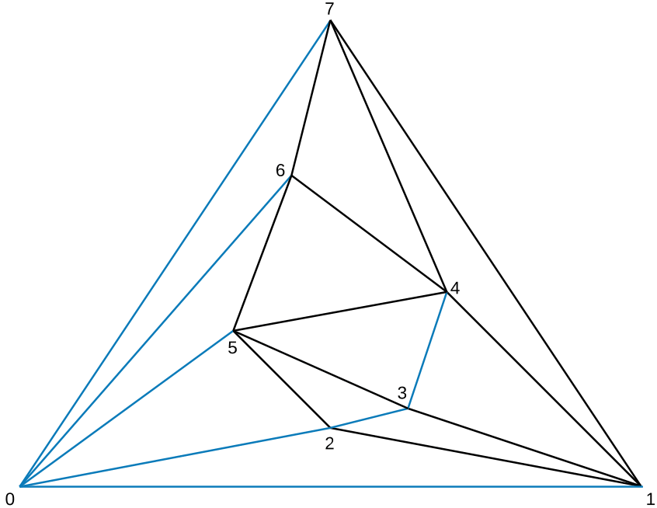
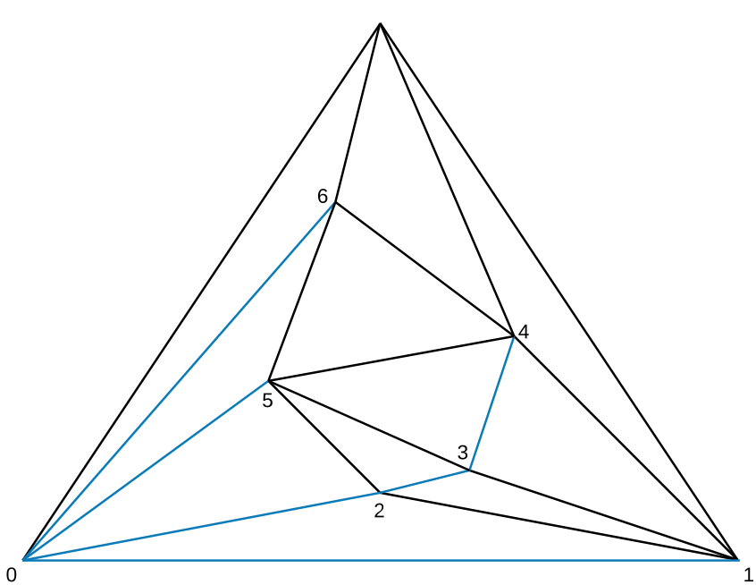
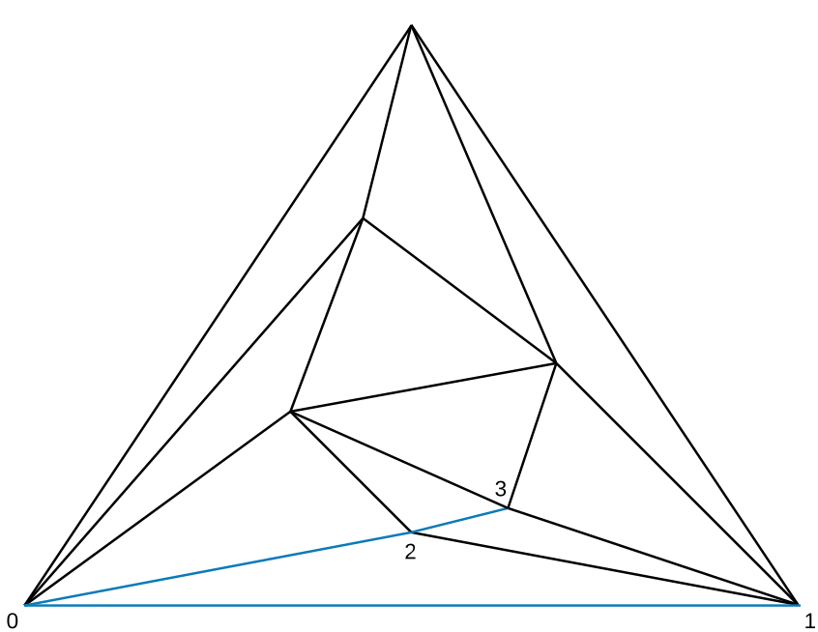
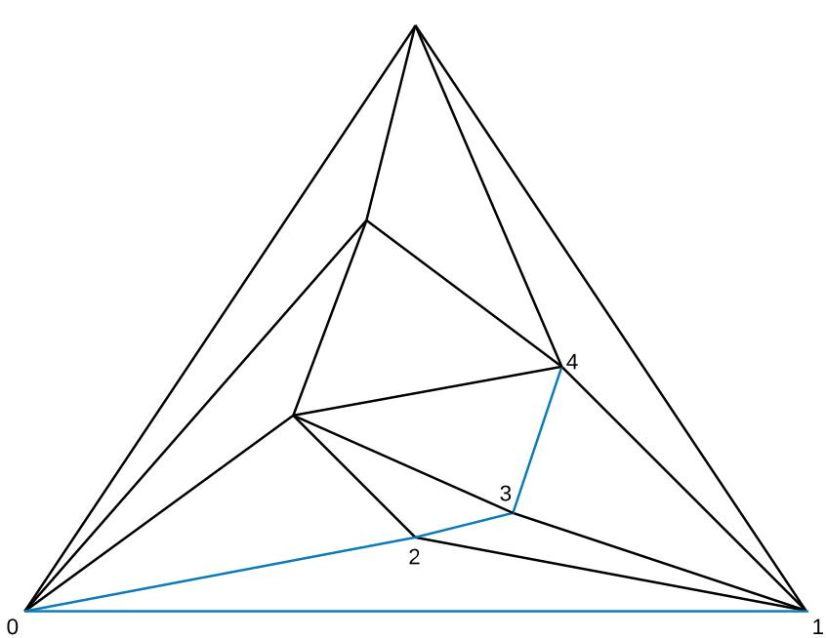
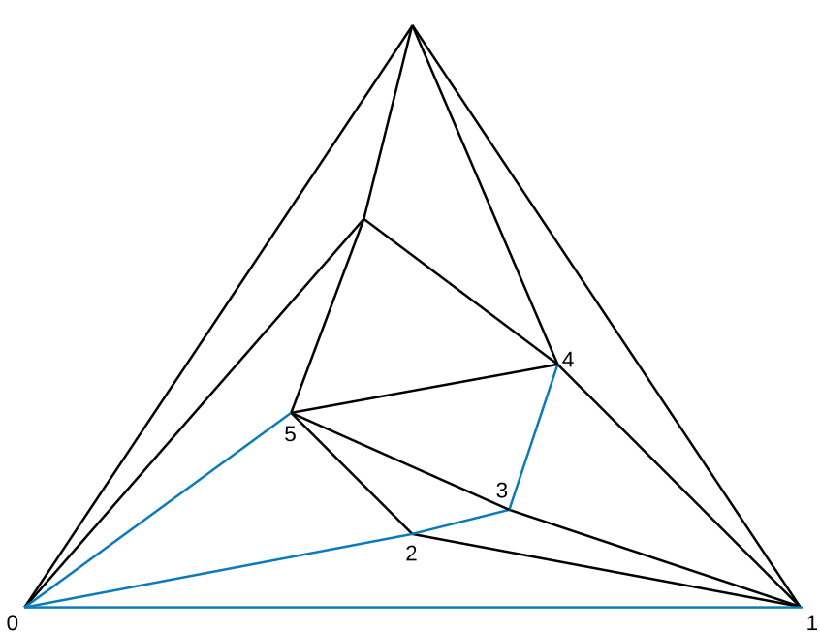
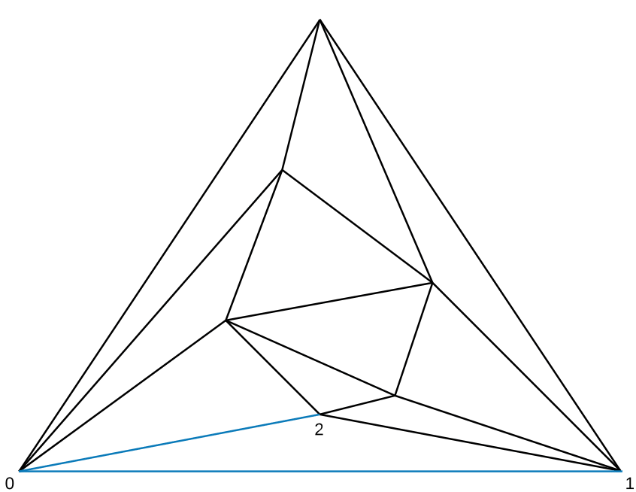
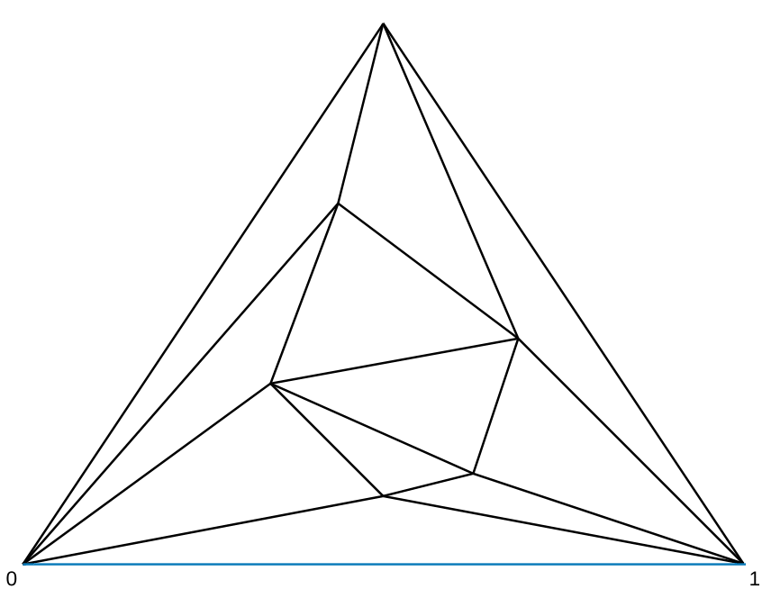
First Tree – Canonical Spanning Tree
Notes:
What i want to tell today:
Need a Model of the Intersec. => Sensors, Perception
Give the Model to use it for some algos, …

Slide 9
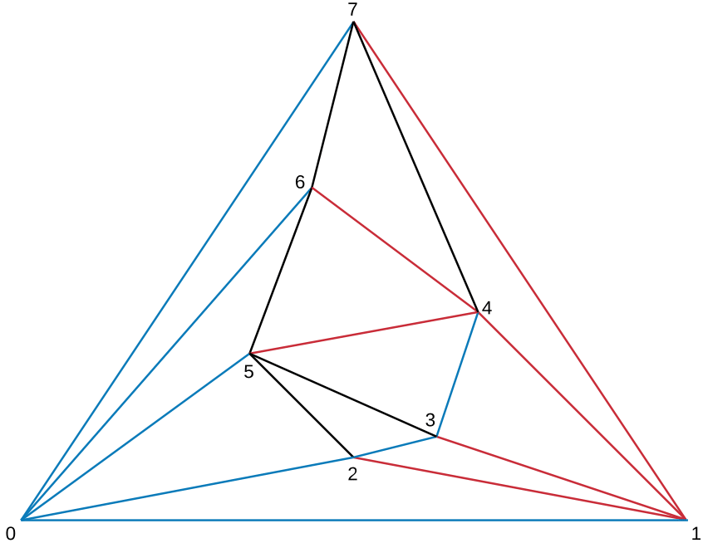
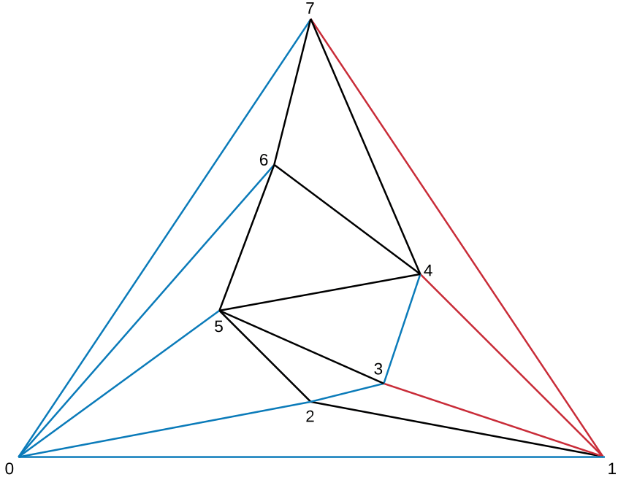
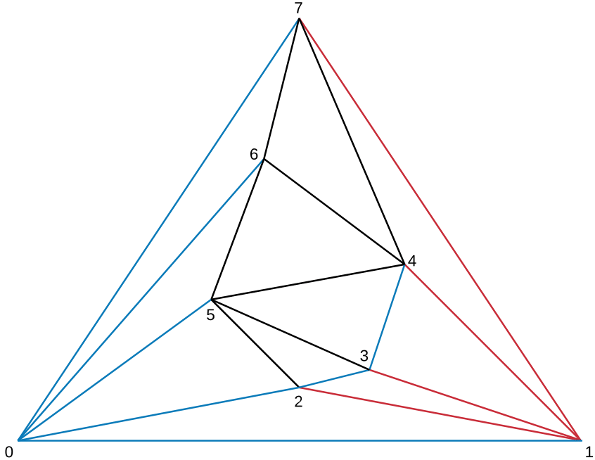
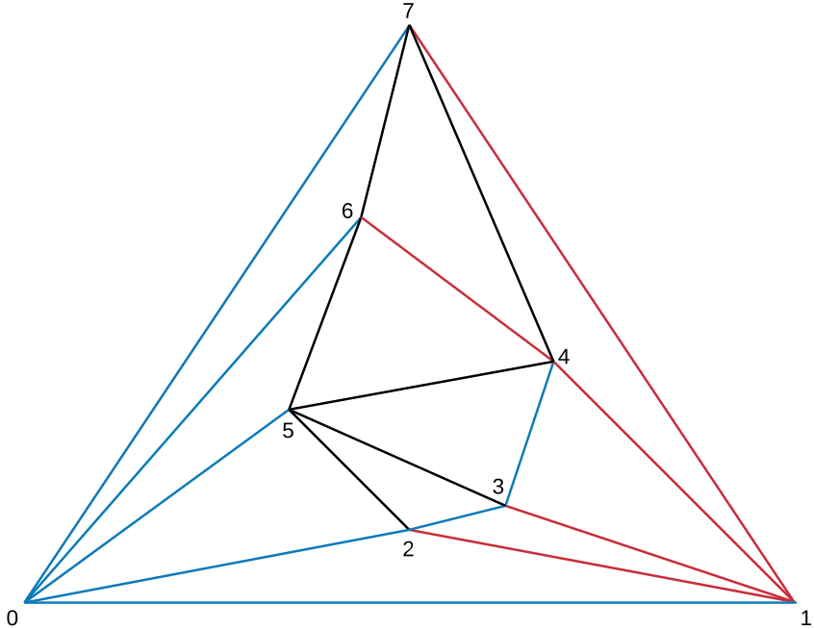
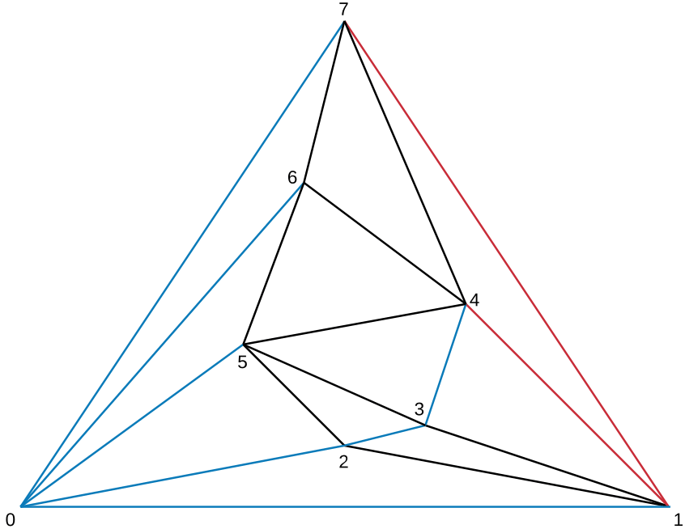
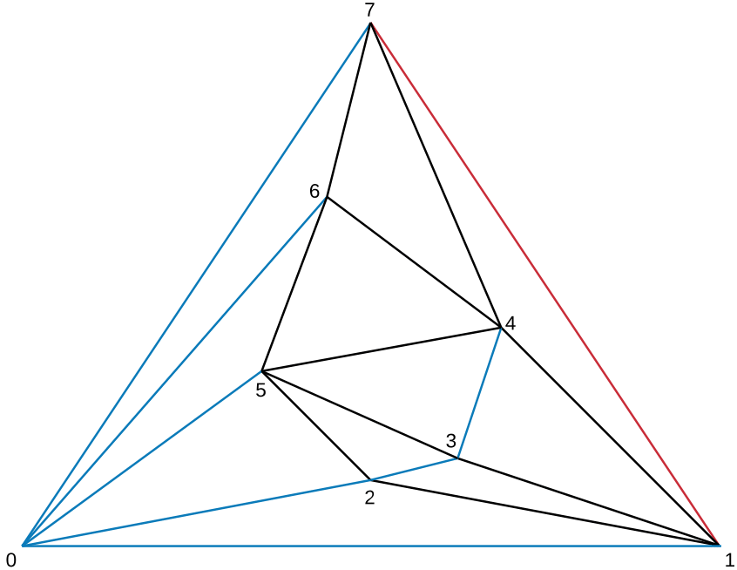
Second Tree
Notes:
What i want to tell today:
Need a Model of the Intersec. => Sensors, Perception
Give the Model to use it for some algos, …

Slide 10
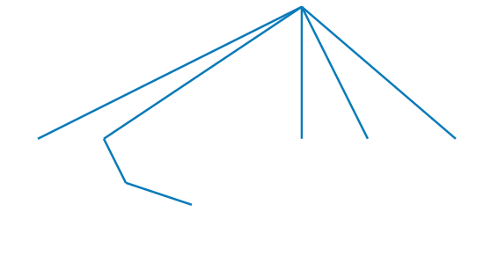
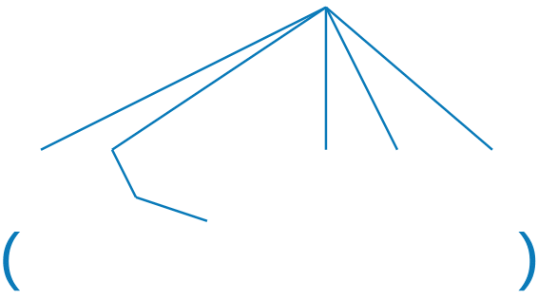
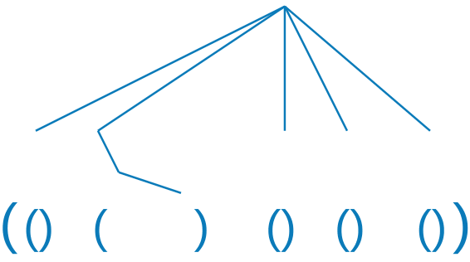
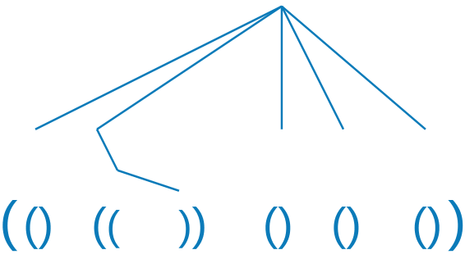
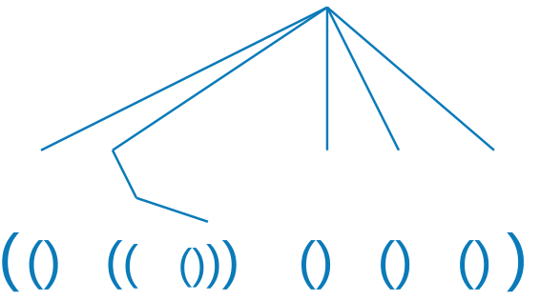
Parenthesis
Notes:
What i want to tell today:
Need a Model of the Intersec. => Sensors, Perception
Give the Model to use it for some algos, …

Slide 11
Parenthesis
Notes:
What i want to tell today:
Need a Model of the Intersec. => Sensors, Perception
Give the Model to use it for some algos, …

Slide 12
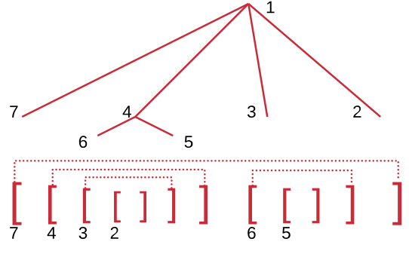
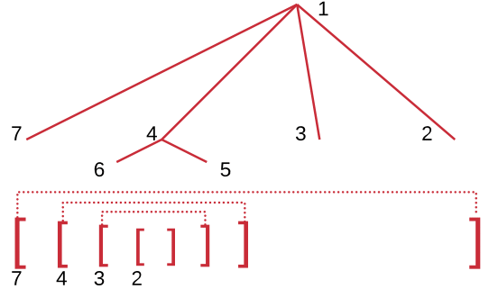
Parenthesis
Notes:
What i want to tell today:
Need a Model of the Intersec. => Sensors, Perception
Give the Model to use it for some algos, …

Slide 13
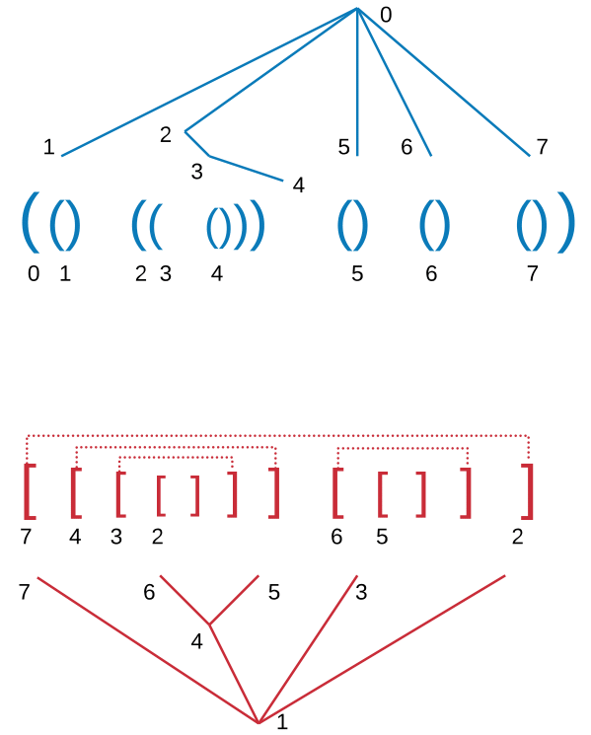
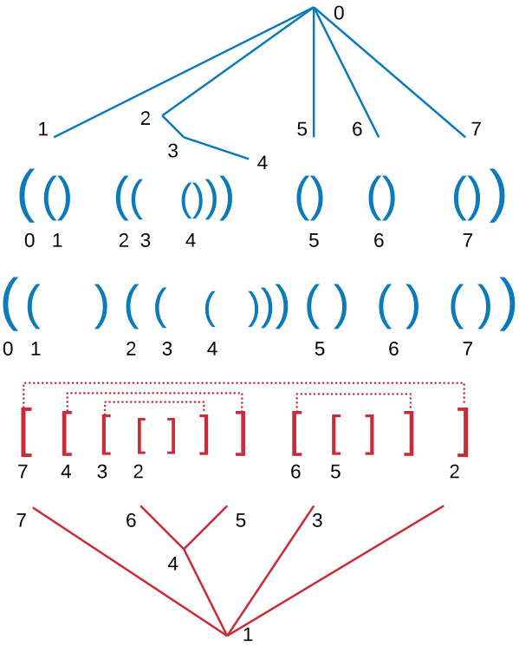
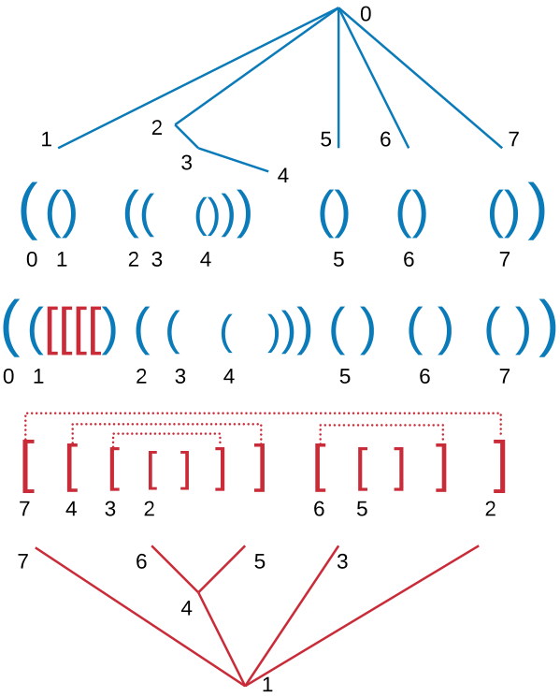
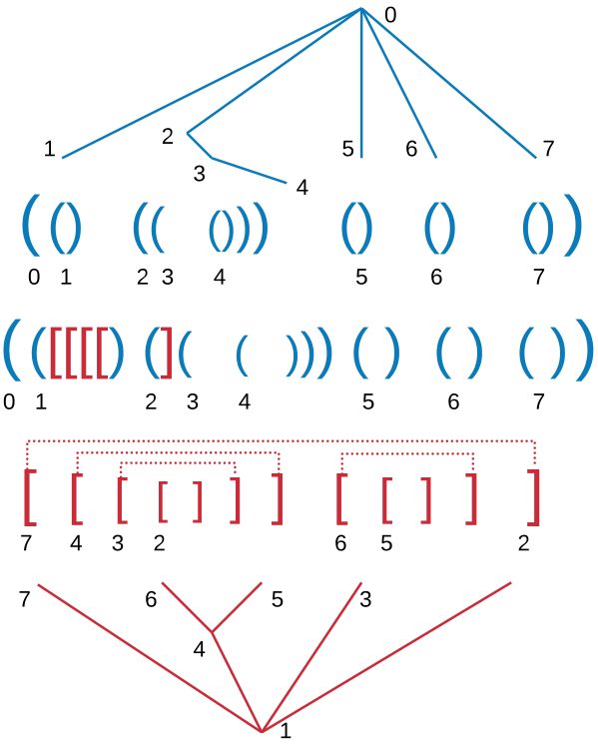
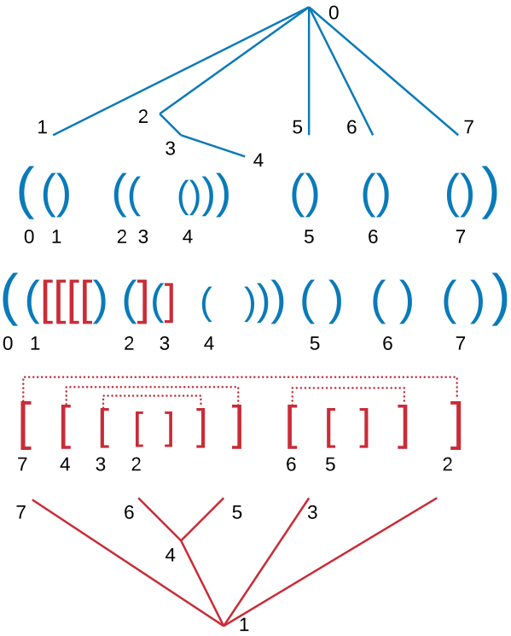
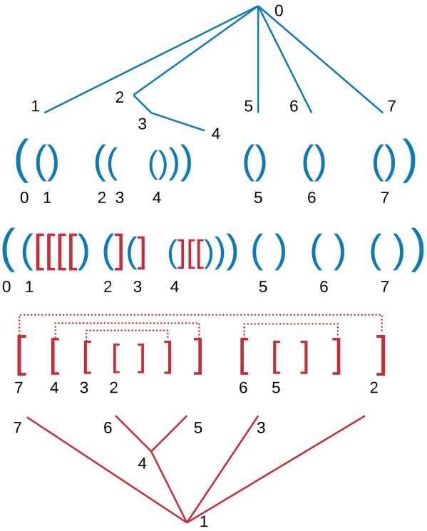
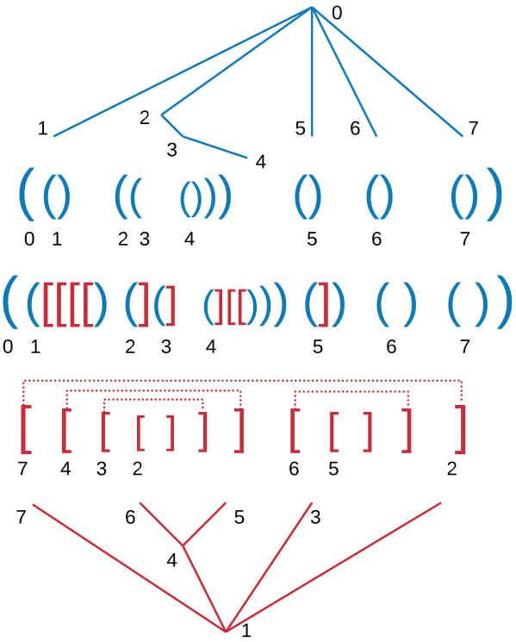
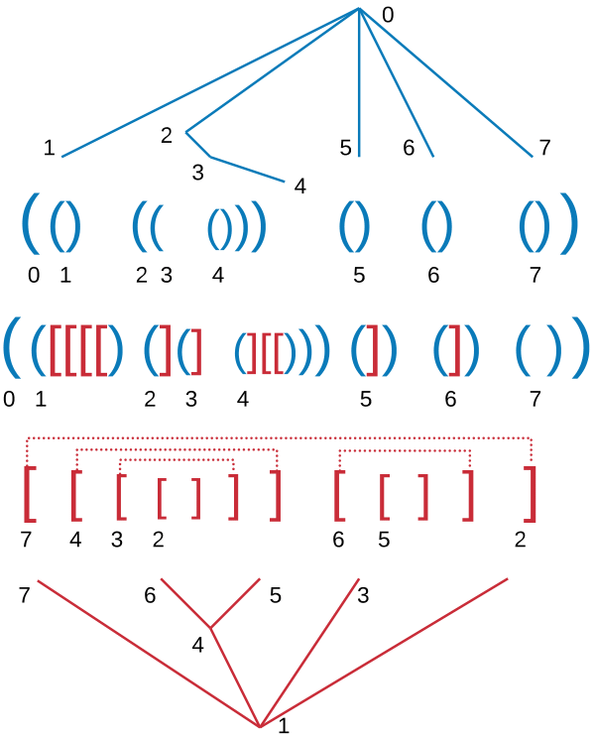
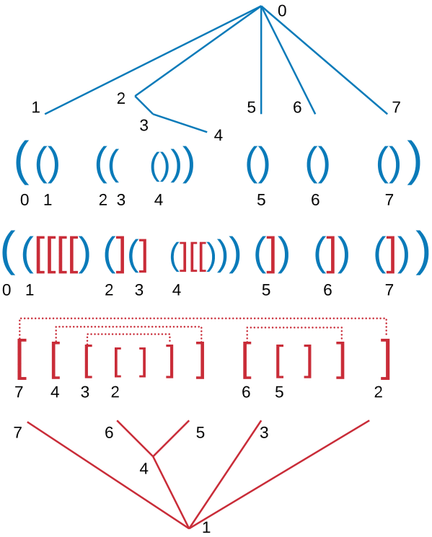
Merge
[TODO]
Also for the third parantesis
Notes:
What i want to tell today:
Need a Model of the Intersec. => Sensors, Perception
Give the Model to use it for some algos, …

Slide 14
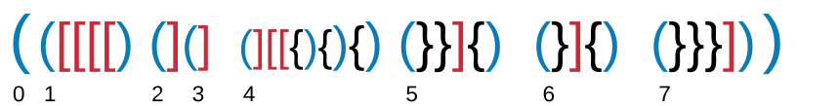
Parenthesis
Recap the parenthesis and explain
Notes:
What i want to tell today:
Need a Model of the Intersec. => Sensors, Perception
Give the Model to use it for some algos, …

Slide 15
Parenthesized representation
Some writen infos:
Eg. Each type of parenthesis alone always forms a correct parenthesis
Explain memory requirements
Supported functions
Notes:
What i want to tell today:
Need a Model of the Intersec. => Sensors, Perception
Give the Model to use it for some algos, …

Slide 16
Generate Graph
[TODO]
Animated rebuilding the graph
Notes:
What i want to tell today:
Need a Model of the Intersec. => Sensors, Perception
Give the Model to use it for some algos, …

Slide 17
Sample Query
[TODO]
Notes:
What i want to tell today:
Need a Model of the Intersec. => Sensors, Perception
Give the Model to use it for some algos, …

Slide 18
Parenthesized representation
Why to use the parentheses
Explain Results and supported functions
Notes:
What i want to tell today:
Need a Model of the Intersec. => Sensors, Perception
Give the Model to use it for some algos, …

Slide 19
Extension
Labeled Graphs: As always with a mapping from node id to Label
[Some more words to it, depending on how much time remains]
Notes:
What i want to tell today:
Need a Model of the Intersec. => Sensors, Perception
Give the Model to use it for some algos, …

Slide 20
Summary
Recap shortly
Embed results
Compression of the space to the information-theretic minimum. Runtimes like uncompressed
Notes:
What i want to tell today:
Need a Model of the Intersec. => Sensors, Perception
Give the Model to use it for some algos, …

Slide 21
End
Thank you for your attention!

