Slide 1
Succinct Representation of Labeled Graphs
Matthias Dürksen
Seminar on Algorithms for Compressed Graphs
4th February 2019

Slide 2
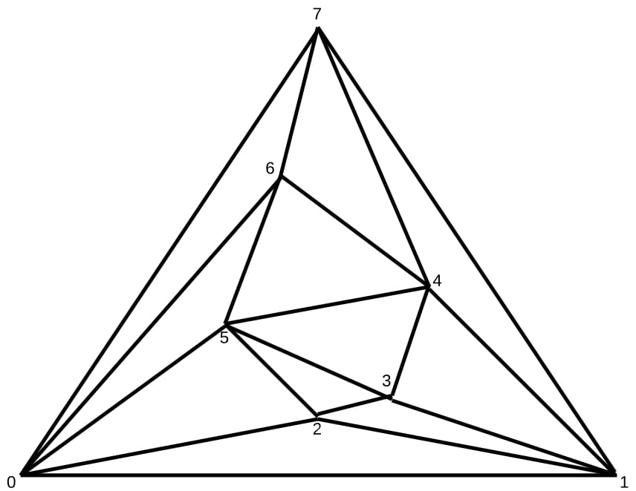
Motivation
How to encode G=(V,E) ?

Slide 3
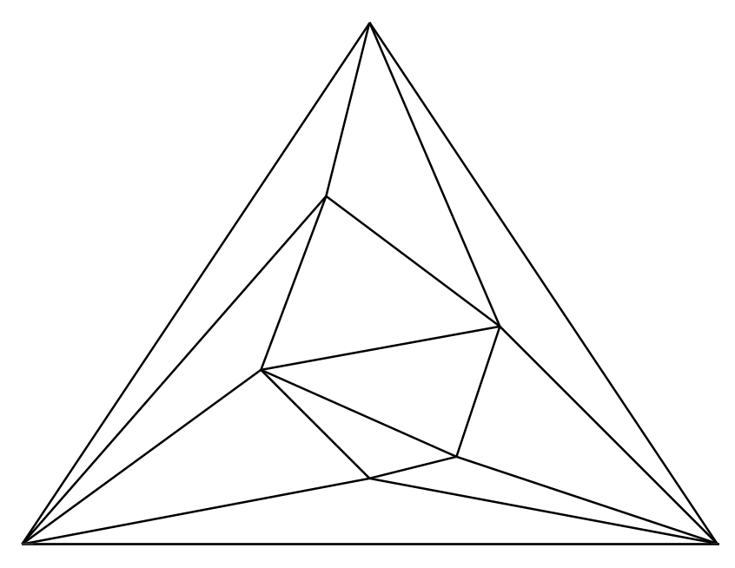
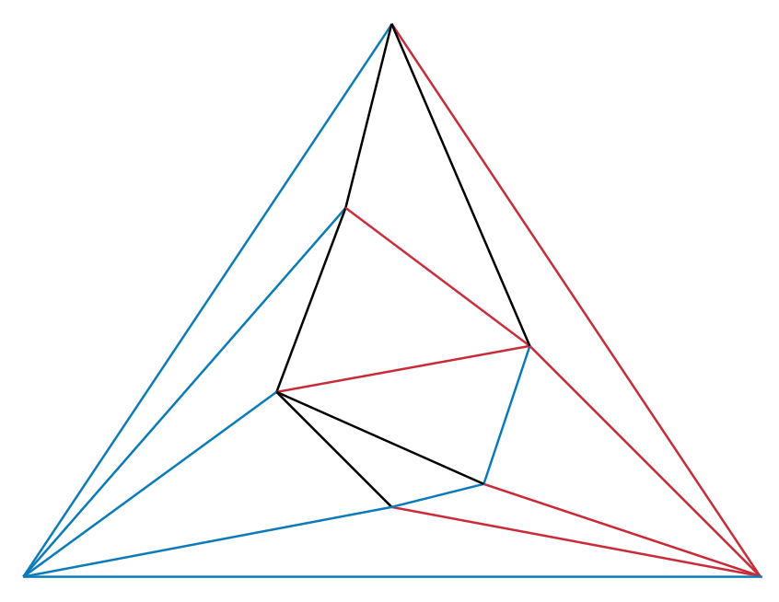
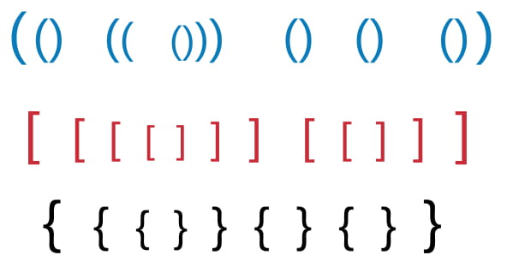
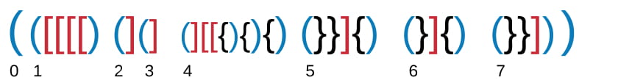
Outline
Notes:
What i want to tell today:
Need a Model of the Intersec. => Sensors, Perception
Give the Model to use it for some algos, …

Slide 4
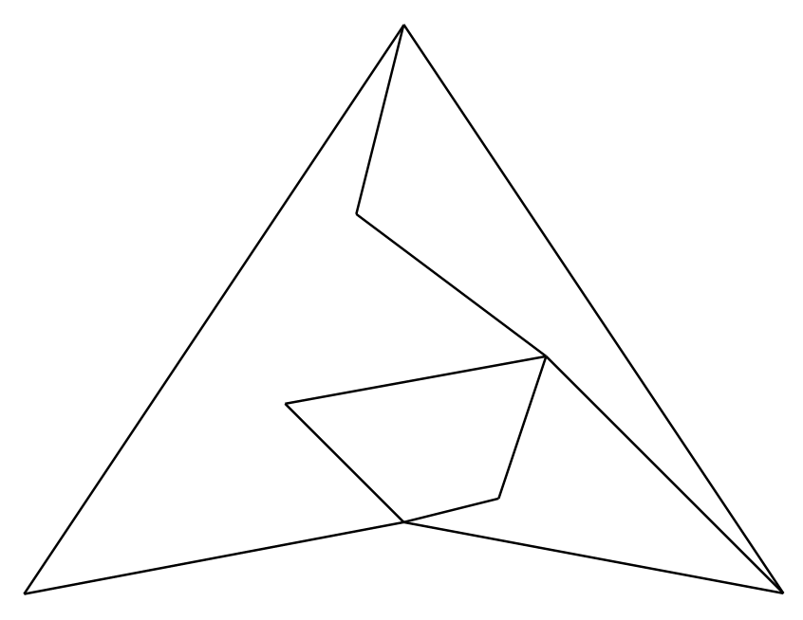
Planar Graphs
Notes:
What i want to tell today:
Need a Model of the Intersec. => Sensors, Perception
Give the Model to use it for some algos, …

Slide 5
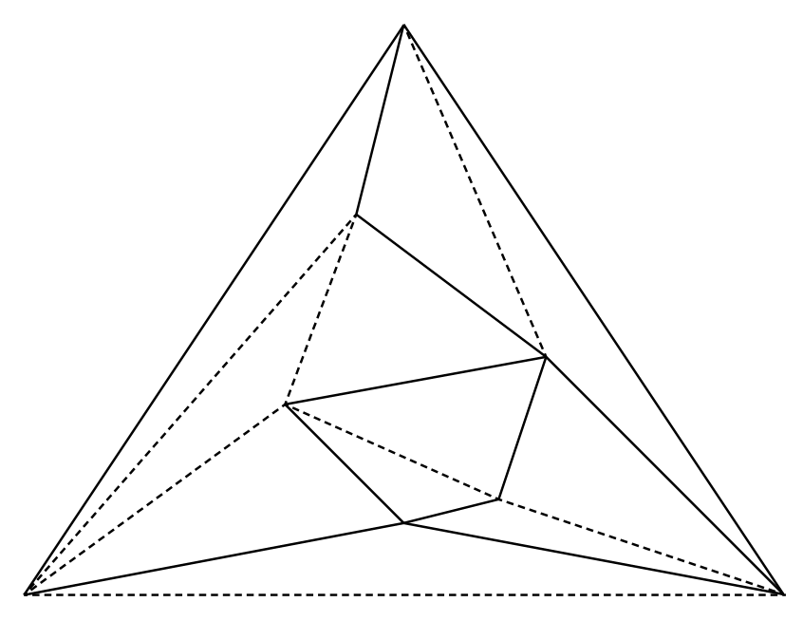
Triangulated Graphs
Graph G=(V,E)
E undirected
3 corner nodes
Notes:
Es kann immer als dreieck dargestellt werden
Ungerichtet
Ohne labels

Slide 6
Notes:
What i want to tell today:
Need a Model of the Intersec. => Sensors, Perception
Give the Model to use it for some algos, …

Slide 7
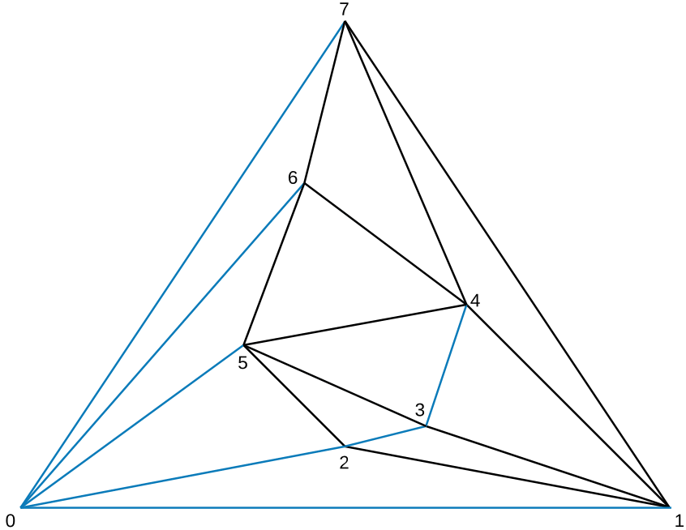
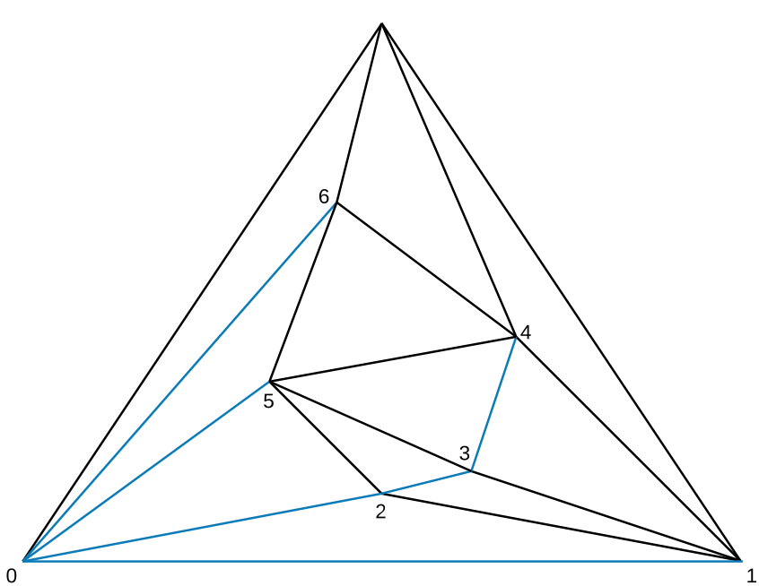
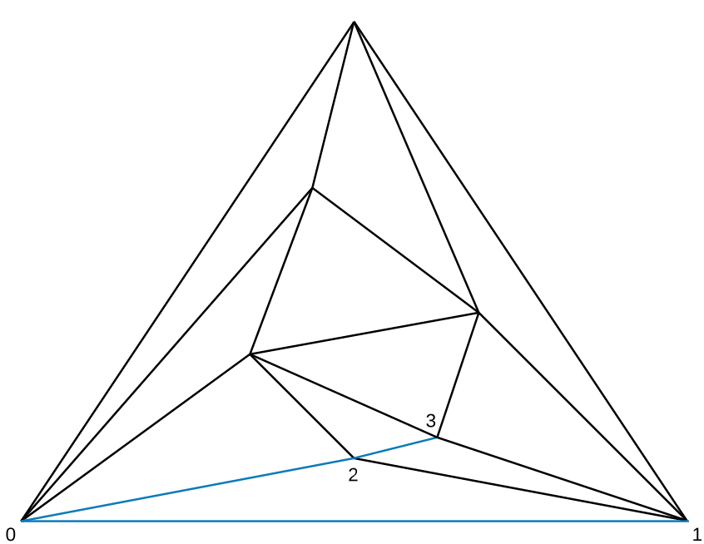
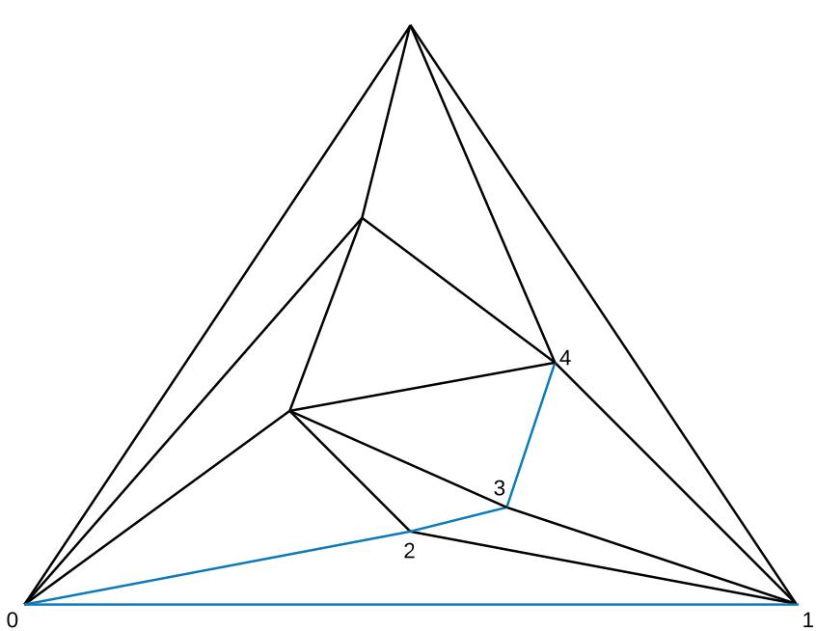
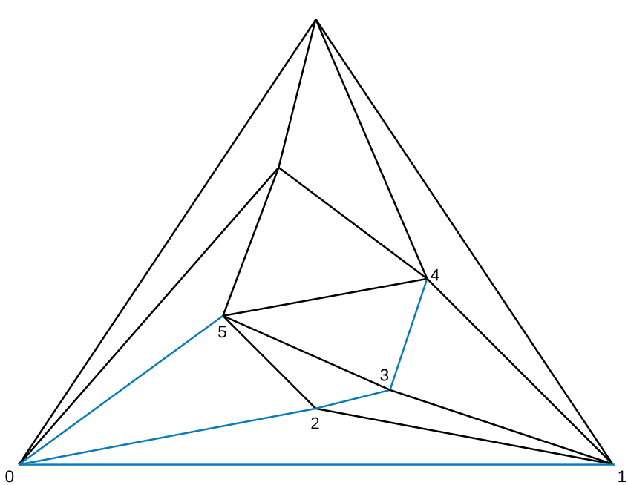
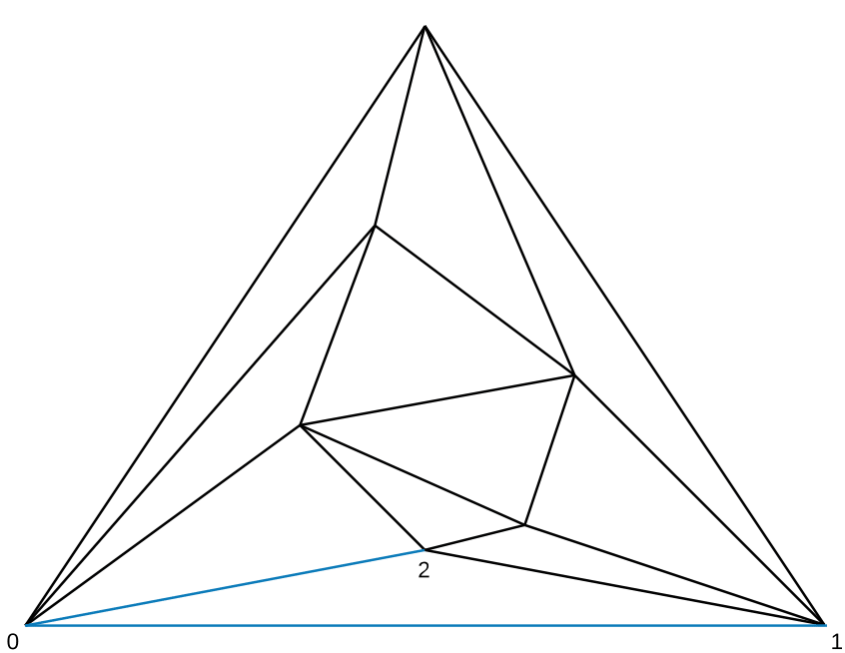
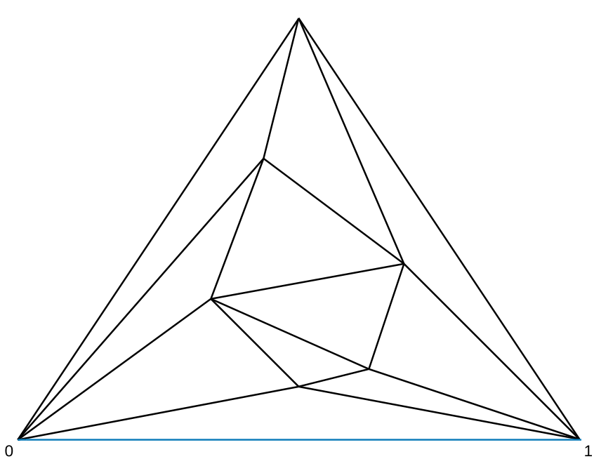
First Tree – Spanning Tree
Notes:
What i want to tell today:
Need a Model of the Intersec. => Sensors, Perception
Give the Model to use it for some algos, …

Slide 8
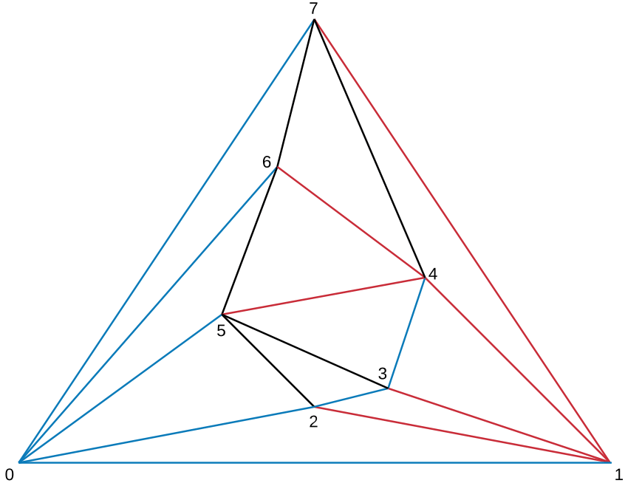
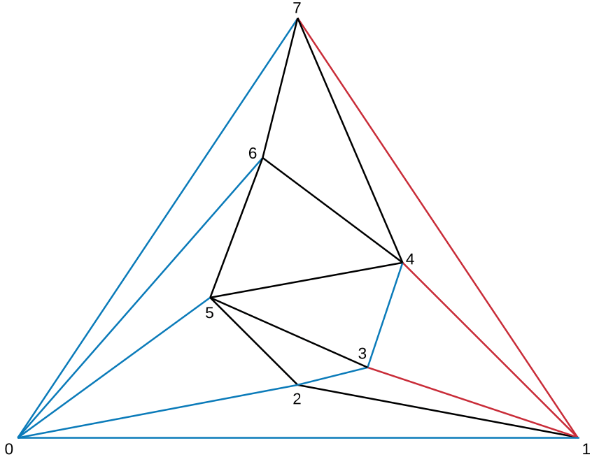
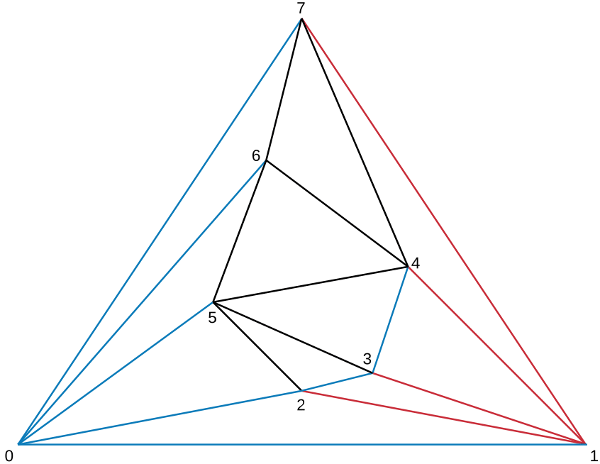
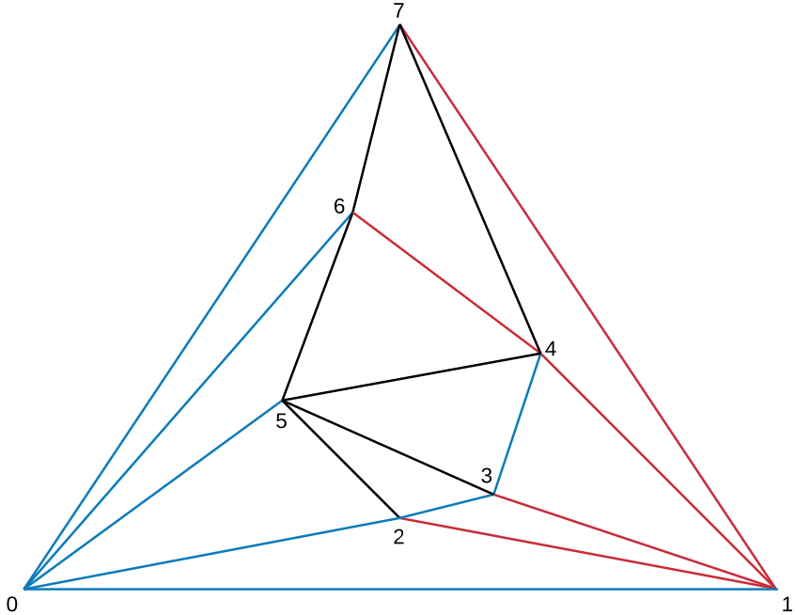
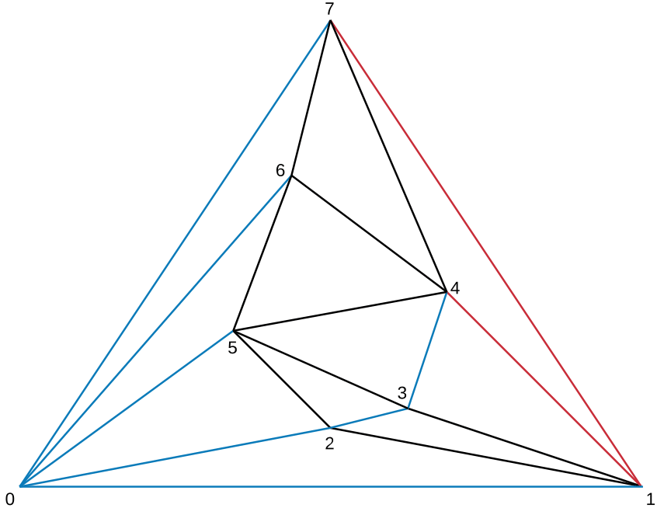
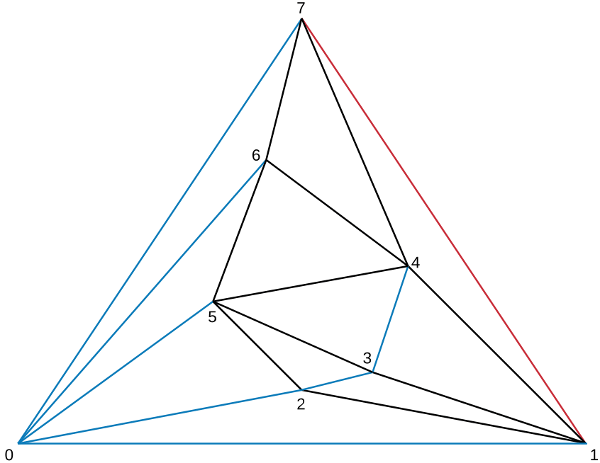
Second Tree
Notes:
What i want to tell today:
Need a Model of the Intersec. => Sensors, Perception
Give the Model to use it for some algos, …

Slide 9
Third Tree
Notes:
Implizit gegeben
Short summary (Jede Kante gehört nun zu einen Baum

Slide 10
Notes:
What i want to tell today:
Need a Model of the Intersec. => Sensors, Perception
Give the Model to use it for some algos, …

Slide 11
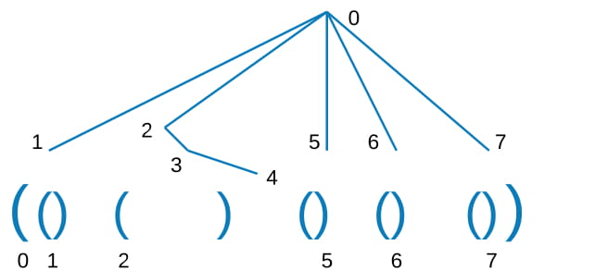
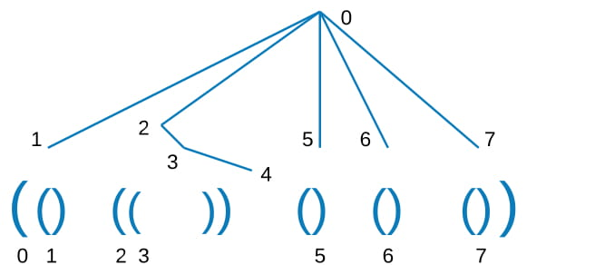
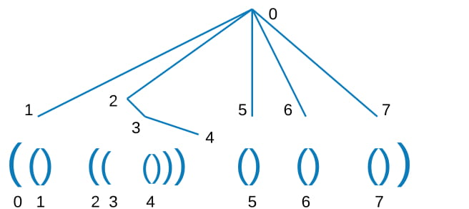
Parenthesis

Slide 12
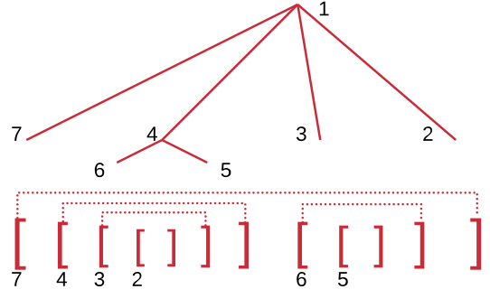
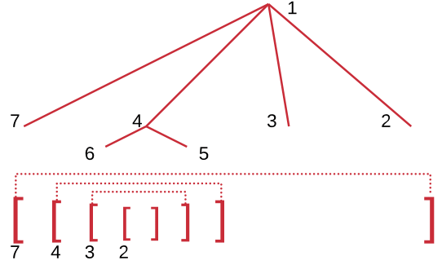
Parenthesis

Slide 13
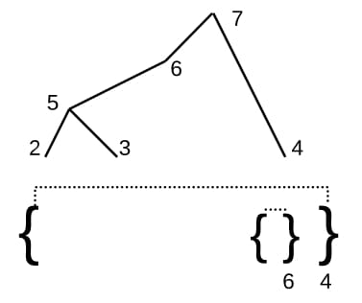
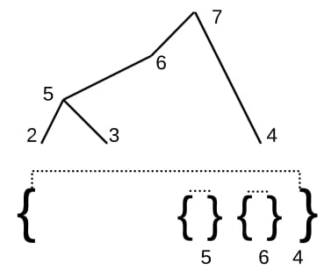
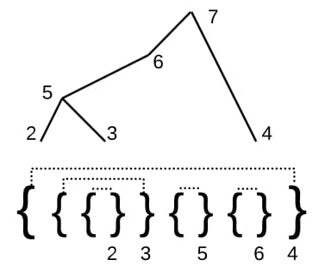
Parenthesis

Slide 14
Notes:
Wie bekommen wir die Verbindungen zwischen den Bäumen

Slide 15
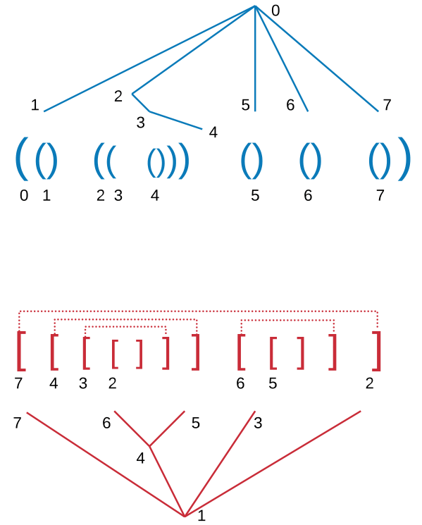
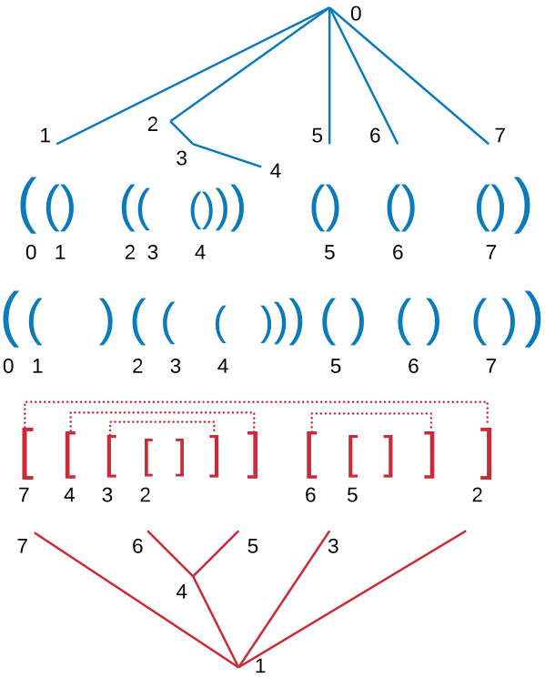
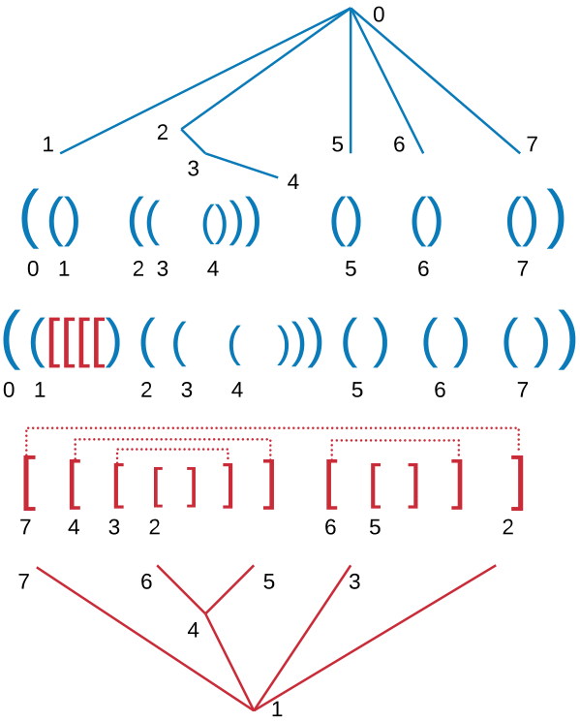
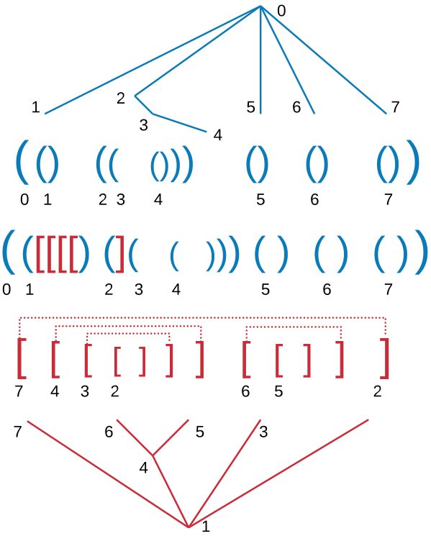
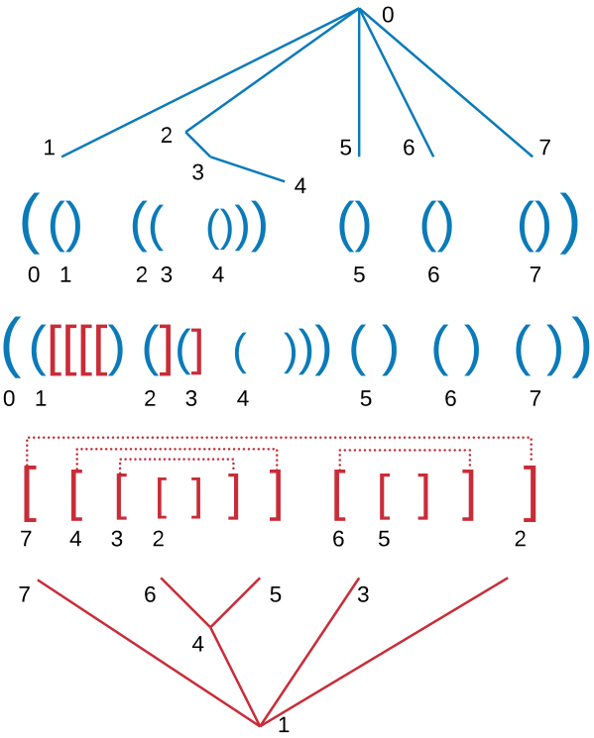
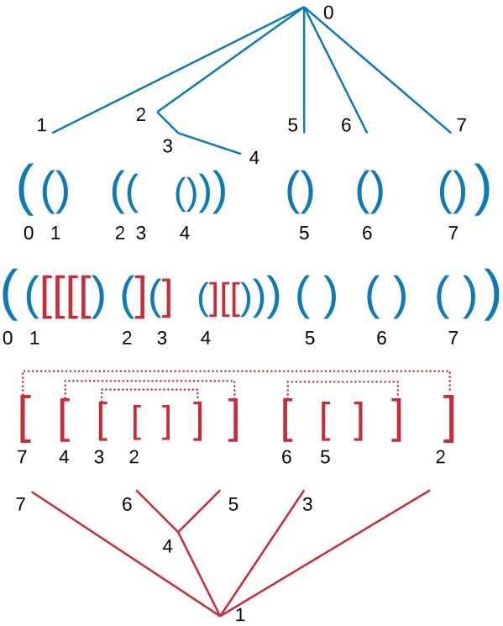
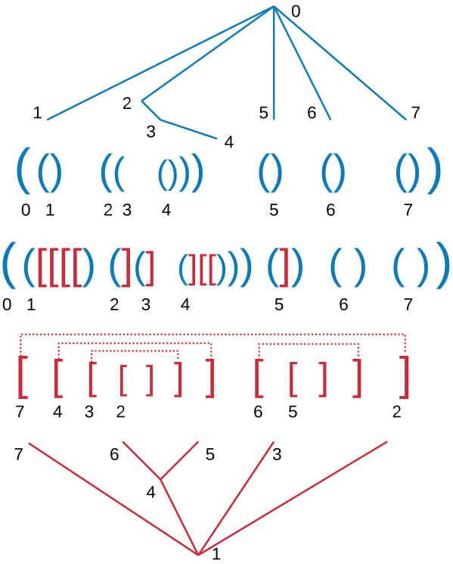
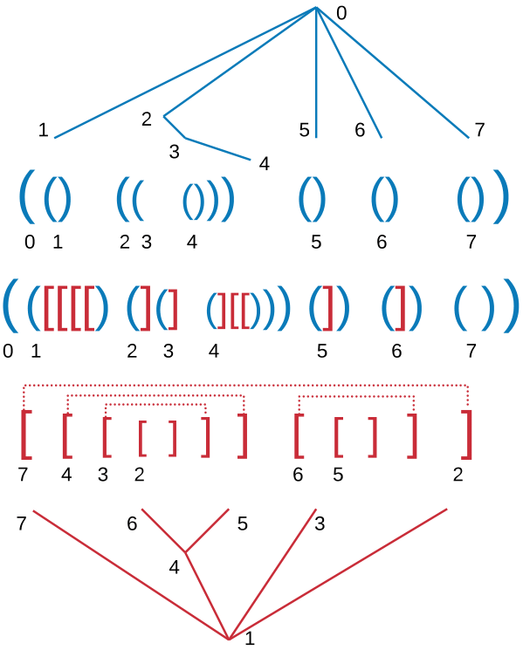
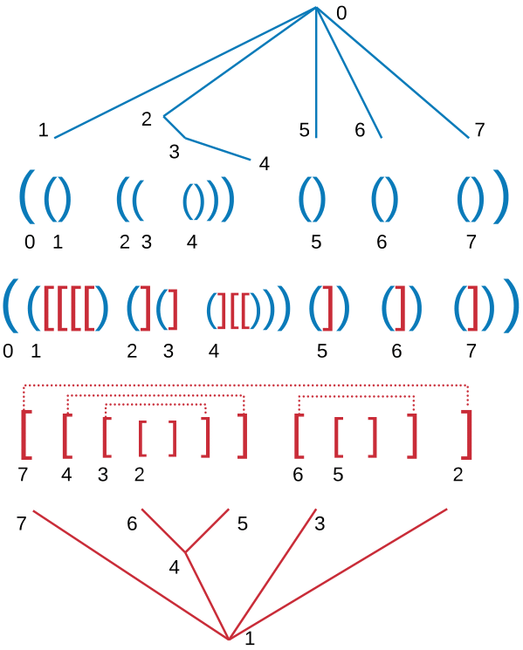
Merge

Slide 16
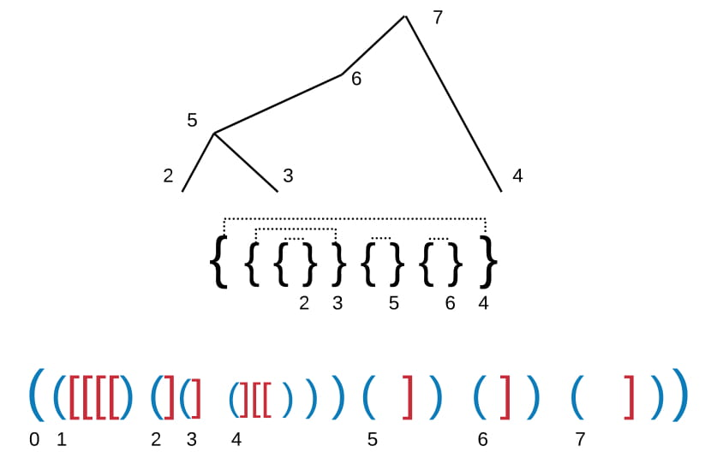
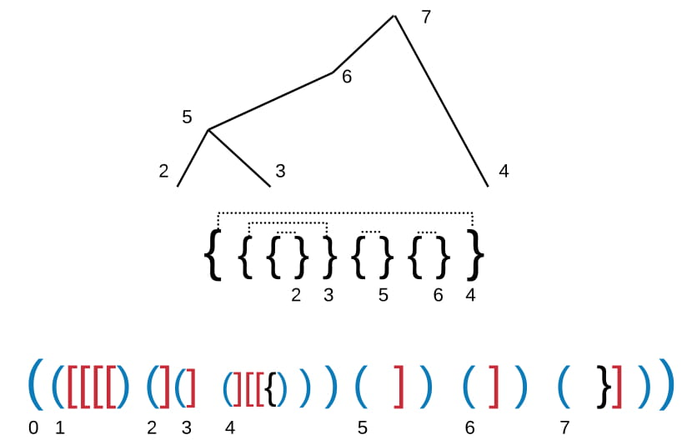
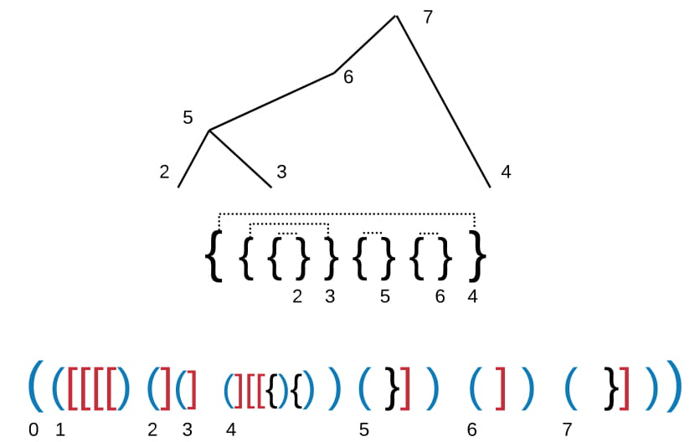
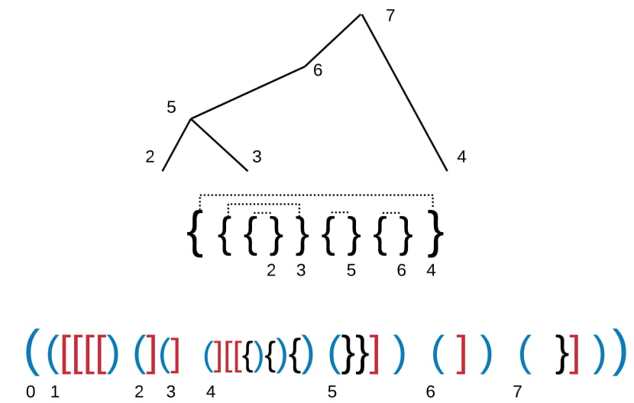
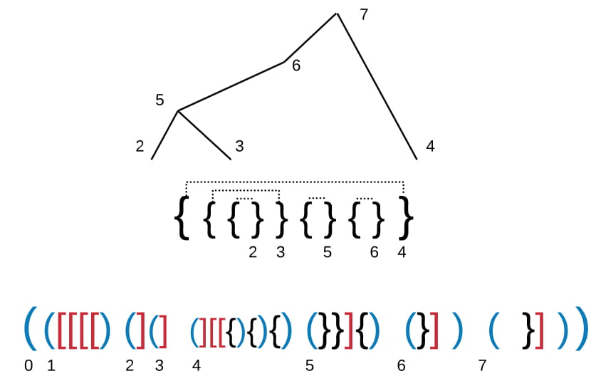
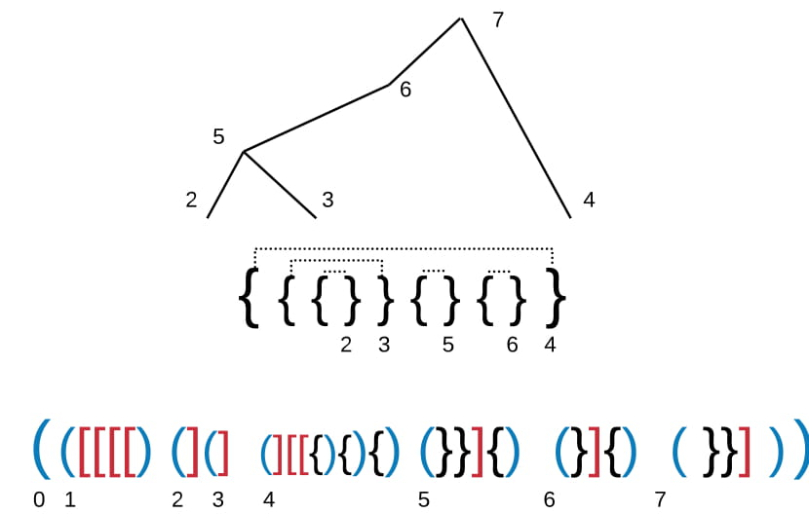
Merge

Slide 17
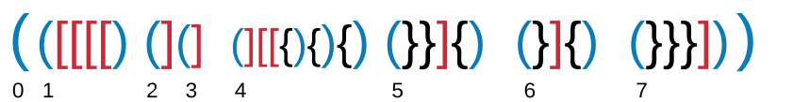
Parenthesis
Notes:
Recap (Explain how the Parenthesis can be read)

Slide 18
Parenthesized representation
Each type -> forms a correct parenthesis
Two parenthesis per Edge
=> 2m*3 Bits necessary

Slide 19
Generate Graph
[TODO]
Animated rebuilding the graph

Slide 20
Sample Query
Neighborhood Query?

Slide 21
Querys
Additional o(m) bits
=> e.g. adjacency, degree … in O(1)

Slide 22
Labeled Graphs
Dictionary!

Slide 23
Summary
6m Bits necessary
Query runtimes like uncompressed
Notes:
What i want to tell today:
Need a Model of the Intersec. => Sensors, Perception
Give the Model to use it for some algos, …

Slide 24
Future Work
Extensions for more general graphs
Evaluation and Comparison to other codings
Query Algorithms
K-Page Graph
Notes:
What i want to tell today:
Need a Model of the Intersec. => Sensors, Perception
Give the Model to use it for some algos, …

Slide 25
End
Thank you for your attention!

