Slide 1
Succinct Representation of Labeled Graphs
Matthias Dürksen
Seminar on Algorithms for Compressed Graphs
Presentation-Date

Slide 2
Note for the Slide Discussion
graphics will be replaced in a later version by own graphics and some will be animated.
Key points are not fixed, they just represent what should be explained on the slides.

Slide 3
Motivation
Large Graphs
…
Goal/Advantage from this topic

Slide 4
Outline
Triangulated Graphs
Creation of the Spanning Trees
Generate the parenthesized representation
Extension for labels using the example of edge (or vertices) labels
Extended for planar graphs
(Rough explanation for k-page Graph)
Notes:
What i want to tell today:
Need a Model of the Intersec. => Sensors, Perception
Give the Model to use it for some algos, …

Slide 5
Planar/Triangulated Graphs
Planar Graph
(Insert Picture to explain)
Triangulated Graphs
(Insert Picture to explain)
Notes:
What i want to tell today:
Need a Model of the Intersec. => Sensors, Perception
Give the Model to use it for some algos, …

Slide 6
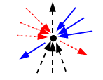
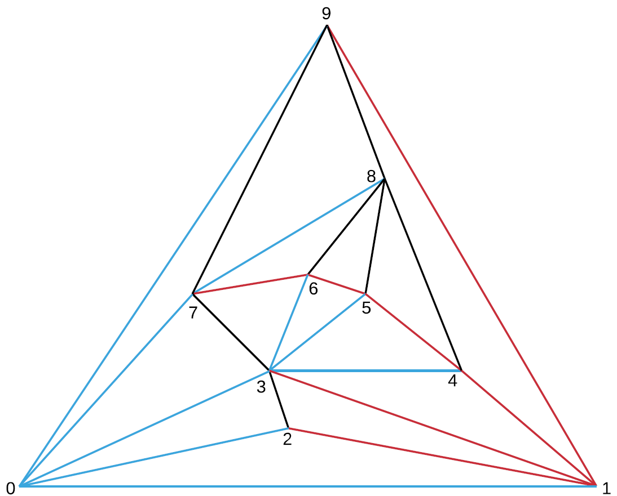
Animate graph and first explain why we do this method
Notes:
What i want to tell today:
Need a Model of the Intersec. => Sensors, Perception
Give the Model to use it for some algos, …

Slide 7
Like slide bevor but for other Trees
formally how to do that
Notes:
What i want to tell today:
Need a Model of the Intersec. => Sensors, Perception
Give the Model to use it for some algos, …

Slide 8
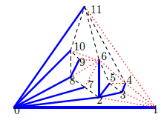

Parenthesized representation
Pics currently not for the example on the slides before
Explain and also the other cases
Notes:
What i want to tell today:
Need a Model of the Intersec. => Sensors, Perception
Give the Model to use it for some algos, …

Slide 9
Parenthesized representation
How to merge the different parentheses
As comparison insert here the Tree T1 to the compare
Notes:
What i want to tell today:
Need a Model of the Intersec. => Sensors, Perception
Give the Model to use it for some algos, …

Slide 10
Parenthesized representation
How to read the parentheses
[To be extended]
Notes:
What i want to tell today:
Need a Model of the Intersec. => Sensors, Perception
Give the Model to use it for some algos, …

Slide 11
Parenthesized representation
Why to use the parentheses
Explain Results and supported functions
Notes:
What i want to tell today:
Need a Model of the Intersec. => Sensors, Perception
Give the Model to use it for some algos, …

Slide 12
Labeled Graphs
Not yet clear how I can present this usefully
Notes:
What i want to tell today:
Need a Model of the Intersec. => Sensors, Perception
Give the Model to use it for some algos, …

Slide 13
Planar Graphs
Explain (with pic) how to transform from Planar to Triangulated
What does it mean for the space and functions-runtime?
Notes:
What i want to tell today:
Need a Model of the Intersec. => Sensors, Perception
Give the Model to use it for some algos, …

Slide 14
K-Page Graphs
Not yet clear how I can present this usefully
Non formally, only explain what k-Page graphs are and the results (e.g. that the check for adjacent will be faster (O(lg k) than for others works)
Notes:
What i want to tell today:
Need a Model of the Intersec. => Sensors, Perception
Give the Model to use it for some algos, …

Slide 15
Summary
Recap shortly
Embed results
Compression of the space to the information-theretic minimum. Runtimes like uncompressed
Notes:
What i want to tell today:
Need a Model of the Intersec. => Sensors, Perception
Give the Model to use it for some algos, …

Slide 16
End
Thank you for your attention!

Slide 17
Literature
Jérémy Barbay, Luca Castelli Aleardi, Meng He, J. Ian Munro: Succinct Representation of Labeled Graphs, ISAAC 2007.
…

