Slide 1
Health data access that explains itself
An automated Health Data Access Body for the European Health Data Space
HalfSecuredTeam · Track 3 · Regulation (EU) 2025/327
HalfSecuredTeam · EHDS Track 3
1
Notes:
Hi everyone. We are HalfSecuredTeam and we built an automated Health Data Access Body for the European Health Data Space: an app that decides health-data requests the way the law requires, and shows exactly why.

Slide 2
THE PROBLEM
Weeks of waiting, two kinds of people
Researchers
Engineers
The access body
know the medicine and the question — not how to query a database
write the query — but not the medical codes, nor whether the purpose is lawful
must check every request against the regulation and protect patients
We sit at the intersection.
HalfSecuredTeam · EHDS Track 3
2
Notes:
Researchers know the medicine and what they want to find out, but not how to query a database. Engineers can write the query but do not know the codes or whether the purpose is allowed. And the access body in between has to check every request against the regulation and protect patients. Today that takes weeks. We sit at the intersection.

Slide 3
OUR APPROACH
Four ideas
Law-grounded AI
Words → SQL by rules
Privacy inside the query
Secure room, no exit
picks the article and quotes it
no query written per request
small cells and opt-outs cannot leak
records viewed as images, never downloaded
HalfSecuredTeam · EHDS Track 3
3
Notes:
Four ideas. The AI does not decide on its own: it picks the article from the regulation and has to quote it. Definitions become SQL through fixed rules, so no one writes a query per request and the numbers are the same every run. Privacy lives inside the query: small cells and opt-outs cannot leak. And records never leave the secure room: viewed as images, never downloaded.

Slide 4
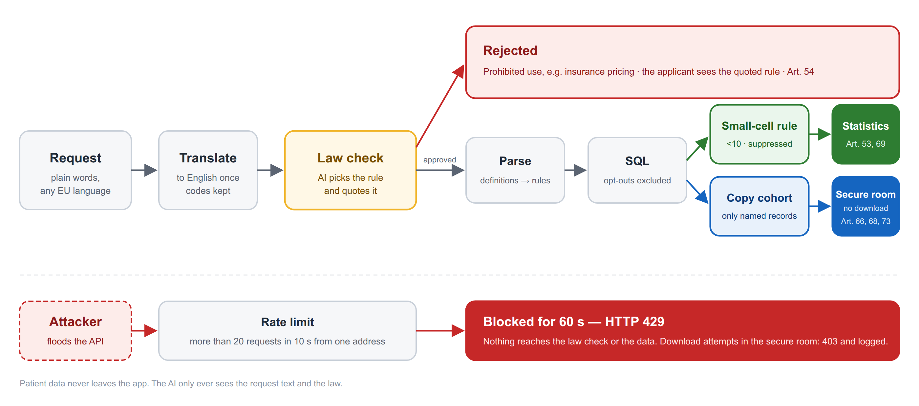
HOW IT WORKS
One pipeline, three outcomes
HalfSecuredTeam · EHDS Track 3
4
Notes:
A request in any EU language is translated once. The AI picks the rule from the law text and quotes it. Approved requests are parsed by rules into SQL; statistics go through the small-cell rule, record requests into a secure room with no download. Anyone flooding the service is blocked.

Slide 5
Demo
Four requests and one attack
R02 rejected · R01 statistics · R11 in German · R12 secure room · flood blocked
HalfSecuredTeam · EHDS Track 3
5
Notes:
Switch to the screen capture.
R02: the insurer. Rejected, Art. 54(b), quoted.
R01: diabetes by region, the table with the small-cell note.
R11: the same in German.
R12: records for a model; open the secure room; Download: 403.
flood.py: 20 served, then 429.

Slide 6
HONEST SUMMARY
What works — and what does not yet
Works
Not yet
— 10 / 10 decisions and articles
— 6 / 6 numbers, 0 privacy leaks
— 10 / 10 consistent across 3 runs, 5.7 s
— 34 / 36 unseen requests, incl. German
— Secure room: images only, download 403
— Sometimes too strict when a study mentions a prohibited topic
— Cited point within Art. 53 can vary
— Staff submission list is a placeholder
— Screens can be photographed — true of every SPE
github.com/MatthiasEbner2002/Track_3-HalfSecuredTeam
HalfSecuredTeam · EHDS Track 3
6
Notes:
What works: all ten task decisions, all six numbers, no leaks, consistent across runs, and 34 of 36 requests we had never seen. What does not yet: the law check is sometimes too strict, and the staff list is a placeholder. Everything is in the repository. Thank you.

Slide 7
Decisions in seconds instead of weeks — every one explained, identical on every run.
Thank you · github.com/MatthiasEbner2002/Track_3-HalfSecuredTeam
HalfSecuredTeam · EHDS Track 3
7

Slide 8
KICKER
Content slide title
Body text, 20 pt. One thought per line.
Second line.
Third line.
HalfSecuredTeam · EHDS Track 3
8

Slide 9
KICKER
Two columns
Left heading
Right heading
one short line
one short line
HalfSecuredTeam · EHDS Track 3
9

Slide 10
KICKER
Image slide
image
HalfSecuredTeam · EHDS Track 3
10

Slide 11
A single sentence that matters.
optional small line
HalfSecuredTeam · EHDS Track 3
11

