Slide 1
Dependent Types An Introduction for Software Engineers
Matthias Gabriel
Supervised by Prof. Dr. Farhad Mehta
Department of Computer Science

Slide 2
Goals
Each participant should be able to:
Explain what dependent types are.
Know the basics of propositions as types and proofs as programs.
Read, understand and texts the field of dependent types and program verification.

Slide 3
Motivation
Indexed datatypes
Introduction example with comparison between generic and indexed type
Propositions as types
Basic example of proposition and proof on high level

Slide 4
The Lambda Cube
Orign:
λ→ : Simply typed lambda calculus
Terms may only depend on Terms
Curry-Howard correspondence for λ→: Propositional calculus restricted to only use implication.
Going up (2):
λ2 : System F, second-order lambda calculus
Terms may depend on Types
(polymorphism, e.g. (Church-style) λα:*.λx:α.x : ∀α.α→α , or (Curry-style) λx.x:∀α.α→α)
Curry-Howard correspondence for λ2: fragment of second-order intuitionistic logic that uses only universal quantification.
Going inwards (ω):
Types may depend on Types
(type operators, e.g. "List α" is a type, where List is a type operator with kind * → *)
Not very interesting in isolation.
Normally combined with λ2 (System F) to give λω (System Fω) (a variant of this (System FC) is used in Haskell)
Curry-Howard correspondence for λω (System Fω): Higher-Order Logic
Going rightwards (Π, or P):
Types may depend on values
(dependent types, e.g. "FloatList 3" is a type denoting a list of floats with length 3, where Floatlist : Nat→* )
λΠ : also called λP, LF
Curry-Howard correspondence for λΠ: A form of predicate calculus that only uses implication and universal quantification.
Richest calculus of all 8:
λΠω : Calculus of Constructions (CC, CoC, λC)

Slide 5
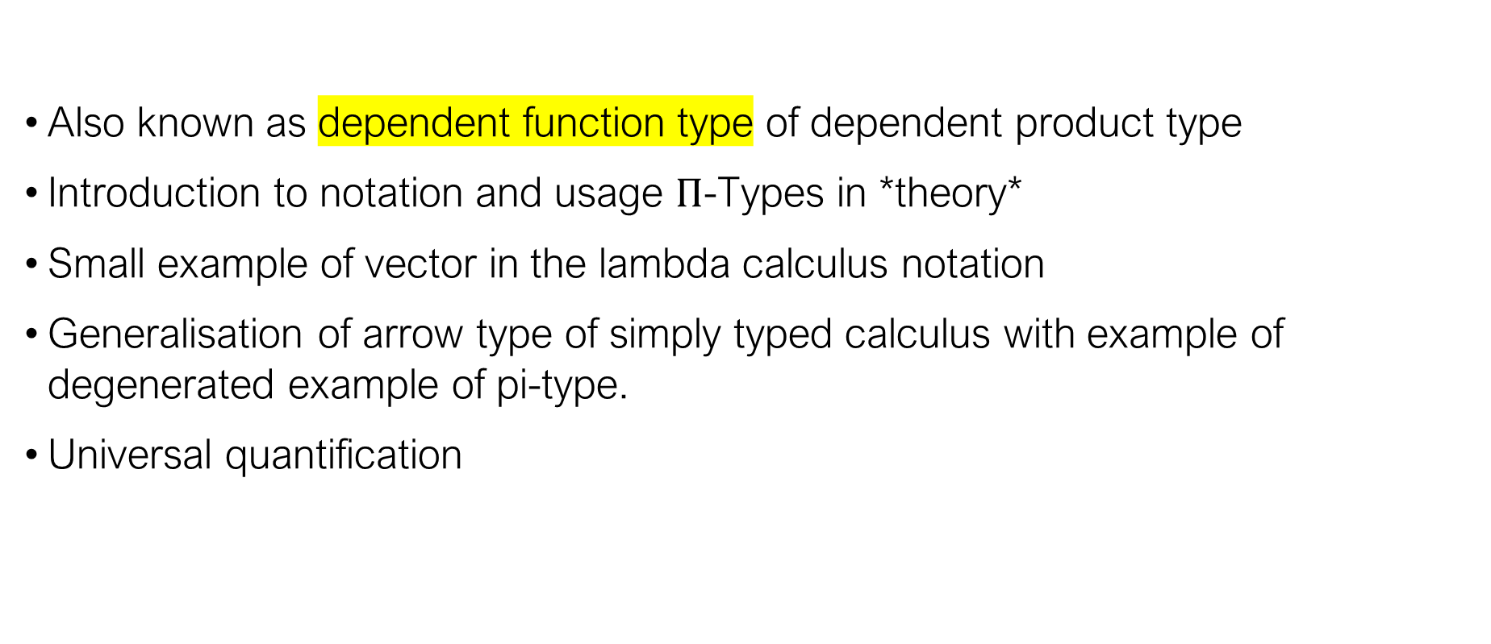
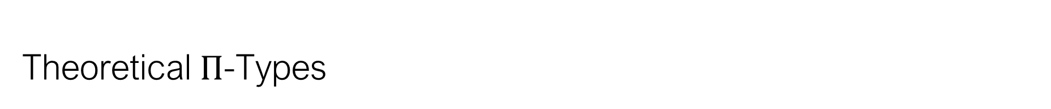
Theoretical $Π$-Types
Also known as dependent function type of dependent product type
Introduction to notation and usage $Π$-Types in *theory*
Small example of vector in the lambda calculus notation
Generalisation of arrow type of simply typed calculus with example of degenerated example of pi-type.
Universal quantification

Slide 6
Proposition as types
Also known as Curry-Howard Correspondence or Curry-Howard Isomorphism
Proposition as types
Proofs as programs
Simplification of proofs as evaluation of programs

Slide 7
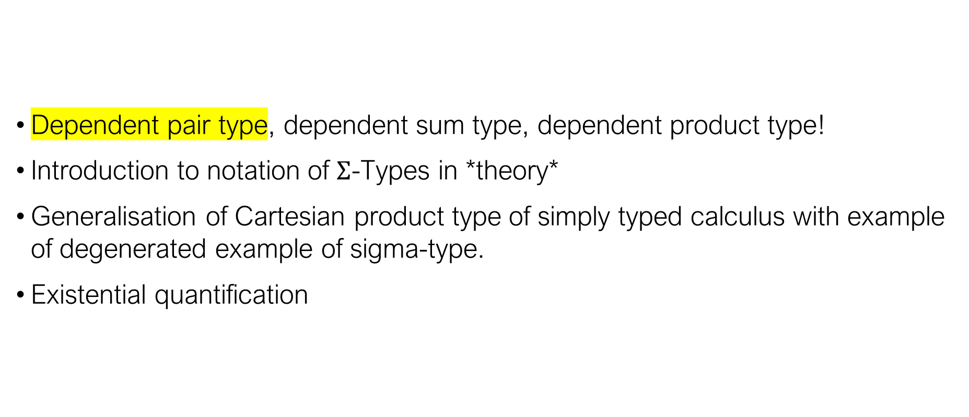
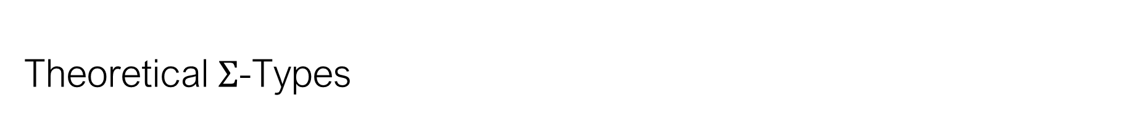
Theoretical $Σ$-Types
Dependent pair type, dependent sum type, dependent product type!
Introduction to notation of $Σ$-Types in *theory*
Generalisation of Cartesian product type of simply typed calculus with example of degenerated example of sigma-type.
Existential quantification

Slide 8
Agda Basics
Functional language
Built around dependent type support
Haskell like
Full Unicode
Pattern Matching
Recursion
Totality, no partial functions, no exceptions

Slide 9
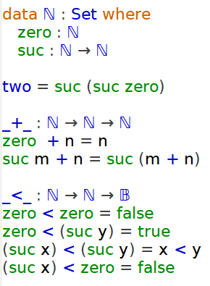
Agda Peano Numbers

Slide 10
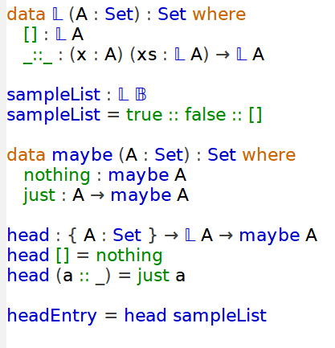
Agda List

Slide 11
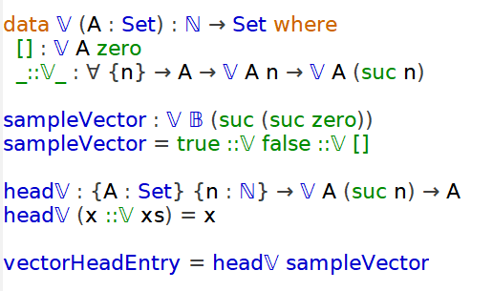
Agda Vector

Slide 12
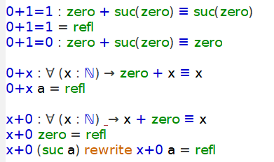
Proofs in Agda

Slide 13
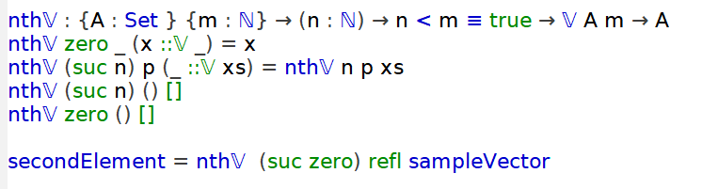
Proofs as arguments

Slide 14
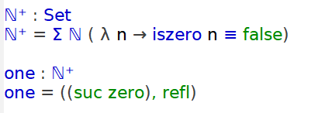

Proofs in datastructure / $Σ$-types in Agda

Slide 15
Limits
Totality
Recusive function schemes
Proofs can be very hard and are always timeconsuming

Slide 16
Projects that use dependent types
Crucible
Symbolic execution Library
Galileo
Haskell
Project Everest
Verified HTTPS stack
Microsoft
F*
Used in WireGuard, Mozilla Network Security Services

