Slide 1
State management with NGRX

Slide 2

Who am i?
Matthias Huygelen
Software Engineer .NET
DevOps Team Pareto Est. 2018 @ Realdolmen

Slide 3
Table of contents
1
What is NGRX?
2
What is Redux?
3
Components
4
Demo
5
Debugging

Slide 4
What is NGRX?
1

Slide 5

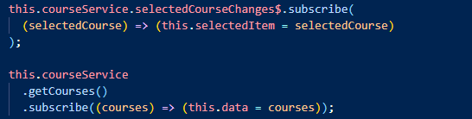
Why NGRX

Slide 6
What is NGRX
Framework
Reactive Applications
State management
Isolation of side effects
…
Libraries
Inspired by Redux

Slide 7
Libraries
@ngrx/store
@ngrx/store-devtools
@ngrx/effects
@ngrx/router-store
@ngrx/entity
@ngrx/data
@ngrx/component-store
@ngrx/schematics

Slide 8
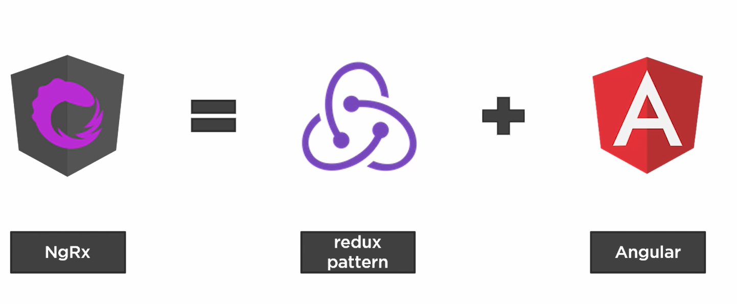
NGRX

Slide 9
What is Redux?
2

Slide 10
What is Redux
Design pattern
3 principles :
Single source of truth ( store )
State is immutable, only changable by dispatching actions
Changes are made by pure functions ( reducers )

Slide 11
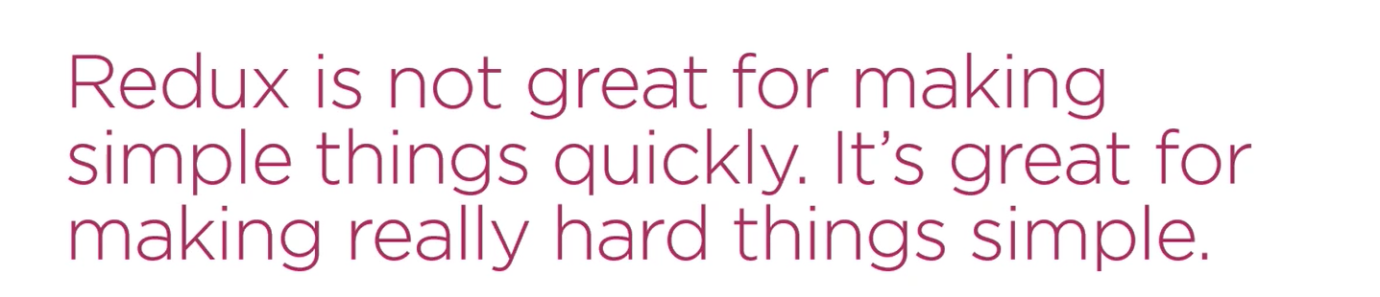

Slide 12
Components
3

Slide 13
Components
Store
Selectors
Actions
Reducers
Effects

Slide 14
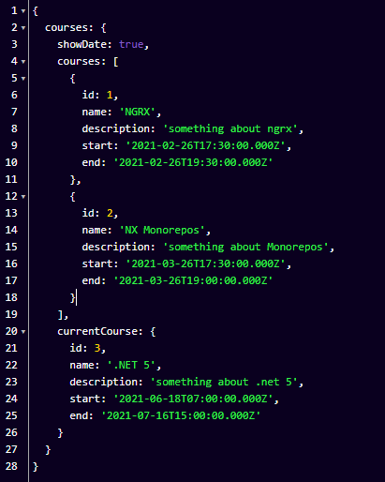
Store
Client-side database
Immutable

Slide 15
What should NOT go in the store
Unshared state
Angular form state
Non serializable state

Slide 16
Selectors
Pure functions used for obtaining slices of store state.
Decouples the store from the components
Encapsulation of complex data transformations
Reusable
Memoized (cached)

Slide 17
Actions
Relevant user actions
Examples
Login form submission
Toggle menu
Retrieve data
Starting global spinner when loading data

Slide 18
Reducers
Pure functions
Specify how state changes in response to an action
Examples
Set user details on login.
Toggle a side menu visible property on button click
Set successfully retrieved data on component initialization
Set a global spinner visible property while saving

Slide 19
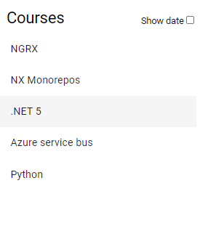
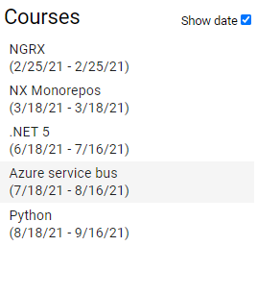
View
User event
Selector
State
Component
Dispatch
Store
State
Action
Reducers
New State

Slide 20
Effects
Manages side effects to keep components pure
Take an action , do some work and dispatch a new action

Slide 21
View
User event
Selector
State
Component
Dispatch
Store
State
Action
Reducers
New State
Server
Effects
Services

Slide 22
Demo
4

Slide 23
Debugging
5

Slide 24
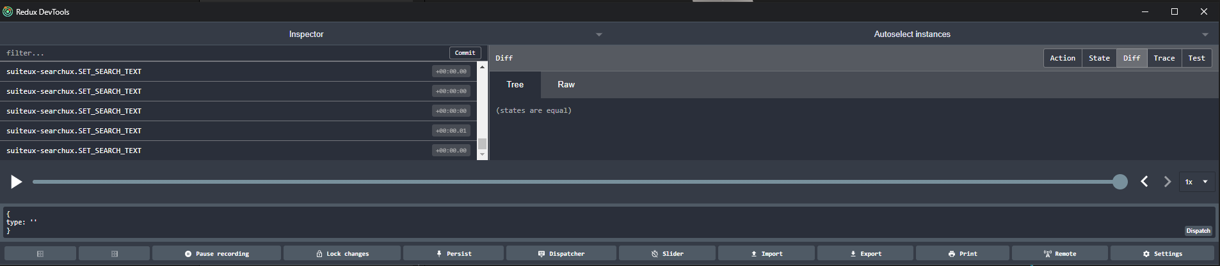
Debugging
@ngrx/store-devtools
Redux devtools
Notes:
https://chrome.google.com/webstore/detail/redux-devtools/lmhkpmbekcpmknklioeibfkpmmfibljd

Slide 25
Final words

Slide 26
When to use NGRX
Lots of state in little services
Excessive amount of http requests
Complex component interactions
Debugging

Slide 27
When to NOT use NGRX
New to angular/RXJS.
Simple applications
Already have a good state management pattern.

Slide 28
Libraries
@ngrx/router-store
@ngrx/entity
@ngrx/data
@ngrx/component-store
@ngrx/schematics
Notes:
Router-store => connects the router to the store (possibility to process navigation actions like any other action)
Entity => helper functions for managing entities and crud operations , reduces boiler plate code
Data => abstracts away all NGRX entity code ( actions , reducers , selectors ,; … ) with extension points for customization
Component-store => managing local/component state ( alternative to reactive push based approach AKA service with a subject)
Schematics => set of schematics for generating NGRX components ( store , action , … )

