Slide 1
Recap — connectivity works
Cross-view door embedding → global door assignment → room-connectivity graph
Held-out AP 0.913 (GT doors) / 0.842 (detected doors) — 197 homes, random ≈ 0.31
Which-side flip from appearance ≈ chance (0.45) → a genuine ambiguity, needs metric anchors
Notes:
Shown last time. Keep brief. Everything below is new since then.

Slide 2
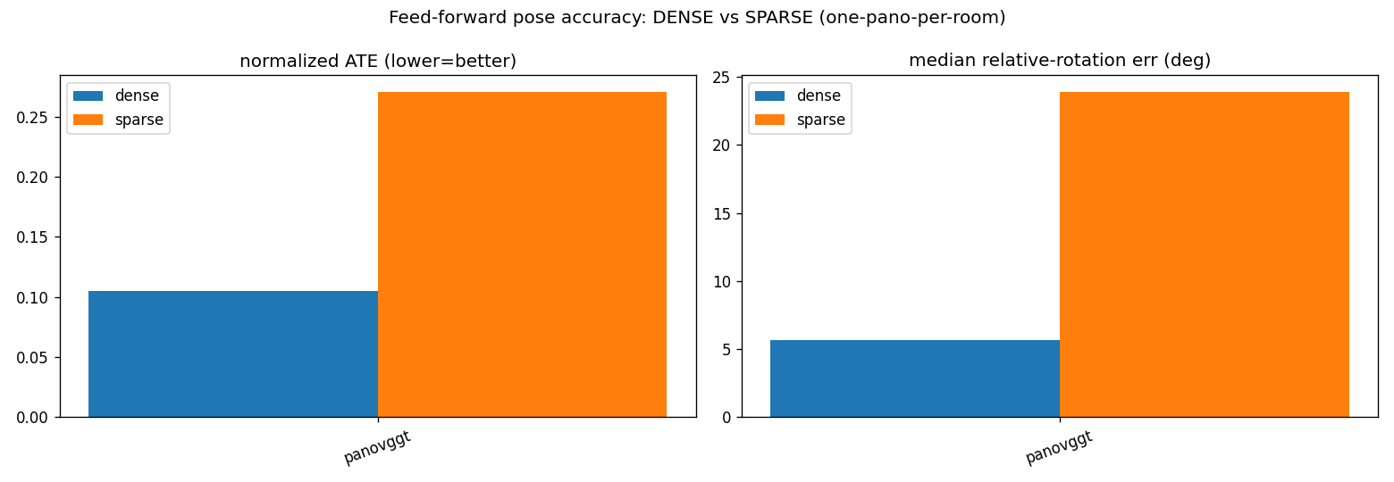
Foundation models need overlap
overlap_probe: our gauge-robust pose benchmark, dense vs sparse (one pano / room)
PanoVGGT: dense 5.7° / ATE 0.105 → sparse 23.9° / 0.271 (rotation ~4× worse)
Within-scene: same-room 1.7° → adjacent/doorway 6.9° → far 17.2° (doorway pairs survive)
Argus: rig-coupled geometry, did not transfer to ZInD (reported as a null result)
Notes:
FMs collapse as overlap->0, doorway-excepted. Alt image: results/overlap_probe/viz/*_panovggt.png.

Slide 3
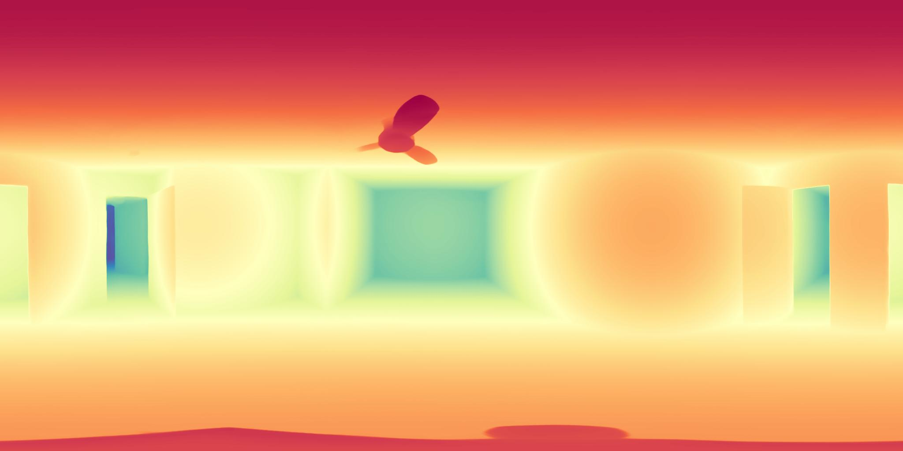
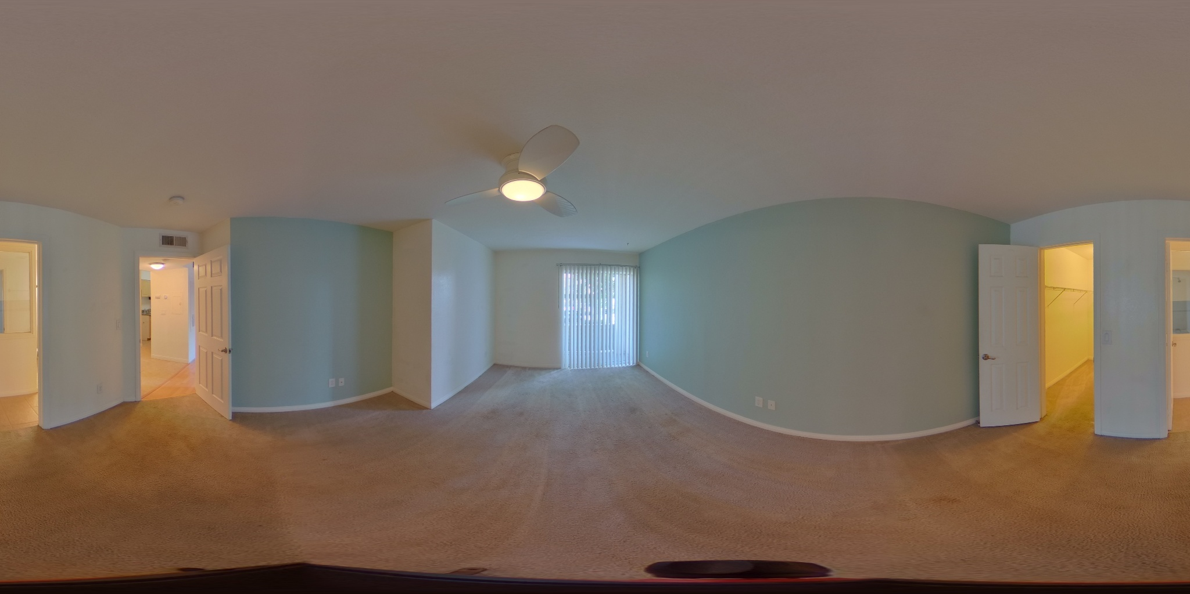
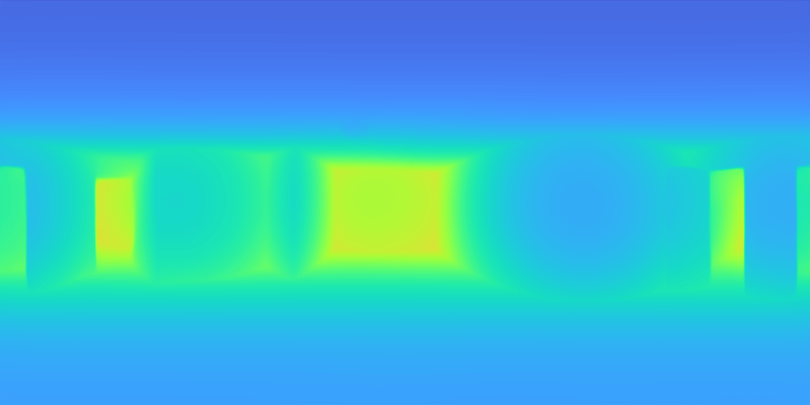
Where the metric-pose lever is
Camera→door distance (20 homes, median error):
DAP depth 0.69 m · PaGeR depth 0.93 m · depth-free door geometry 0.61 m
PaGeR looks sharper but is not better for metric distance — the data corrected the intuition
Notes:
Optional image: results/distance/distance_0025.png.

Slide 4
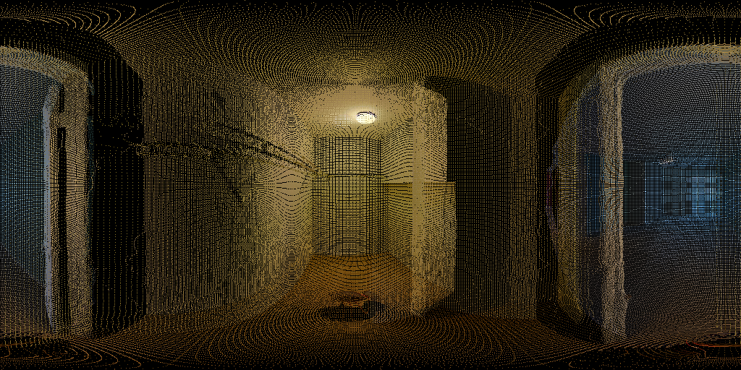
3D from one pano per room
Per-room Gaussians at GT poses → render through the doorway → measure disocclusion
Disocclusion is low (~2–10%); the renders are coherent and complete
The artifact is point sparsity, not missing geometry
→ under correct poses, coverage is NOT the bottleneck — POSE / alignment is
through-door novel view (room 0053)
Notes:
Key pivot: render is coherent -> the real problem is pose, not completion.

Slide 5
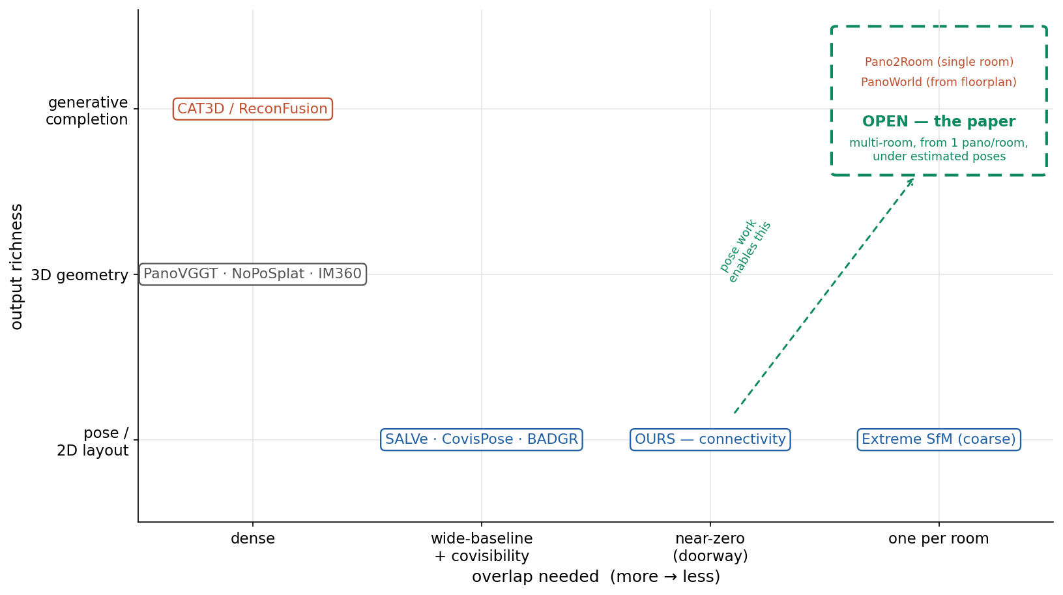
Where the white space is
Notes:
Pose row crowded; empty cell = multi-room reconstructive completion from one pano per room.

Slide 6
White-space verdict — the goal
Pose / 2D layout @ near-zero overlap — occupied (Extreme SfM, us). Crowded, small deltas.
3D reconstruction @ dense / overlap — occupied (PanoVGGT, IM360, NoPoSplat). Not our regime.
Generative completion @ single room — occupied (Pano2Room, PanoImager). Not novel alone.
Generative whole-house @ from floorplan — occupied (PanoWorld). Generative, not reconstructive.
★ The goal — the defensible cell:
Reconstructive, generative, MULTI-ROOM 3D floor from one pano per room, at near-zero overlap, conditioned on connectivity, under ESTIMATED poses → EMPTY.
Notes:
This is the endgame. Everything above is occupied; this exact intersection is open and is the paper. Connectivity/pose (our done work) is the enabler under estimated poses.

