Slide 1
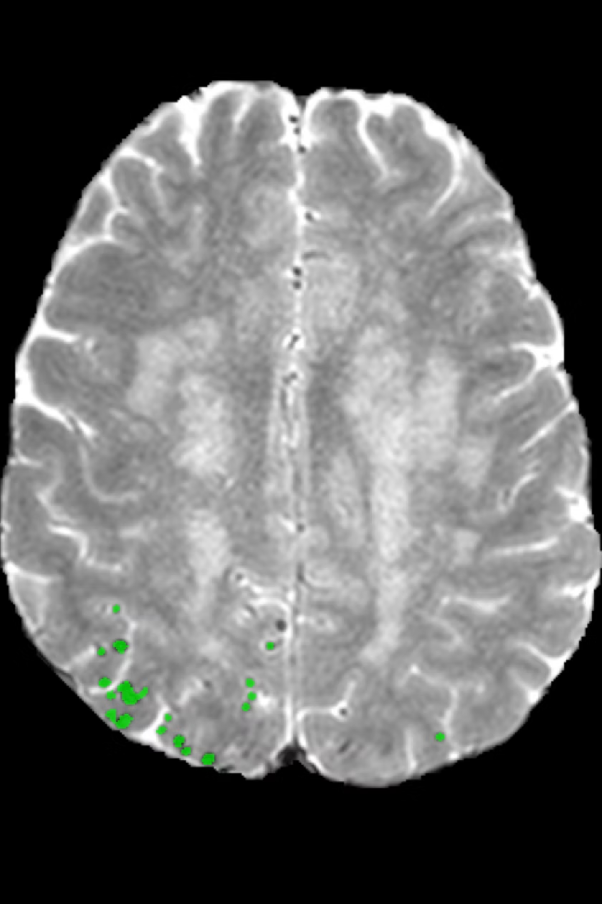
Benchmarking Small-Object Detection on Brain MRI
A Cerebral Microbleed Case Study
Matthias Mifsud · Supervisor: Prof. Charlie Abela
Faculty of ICT, University of Malta, 2026

Slide 2
Problem: Cerebral Microbleeds Are Difficult to Detect
What They Are
Why Detection Is Hard
Tiny deposits of blood visible on specialised MRI sequences such as T2*.
Associated with stroke, cognitive decline, and cerebral small-vessel disease.
Radiologists must inspect hundreds of slices per scan.
Microbleeds closely resemble blood vessels and other anatomical structures, making manual review slow, error-prone, and inconsistent.

Slide 3
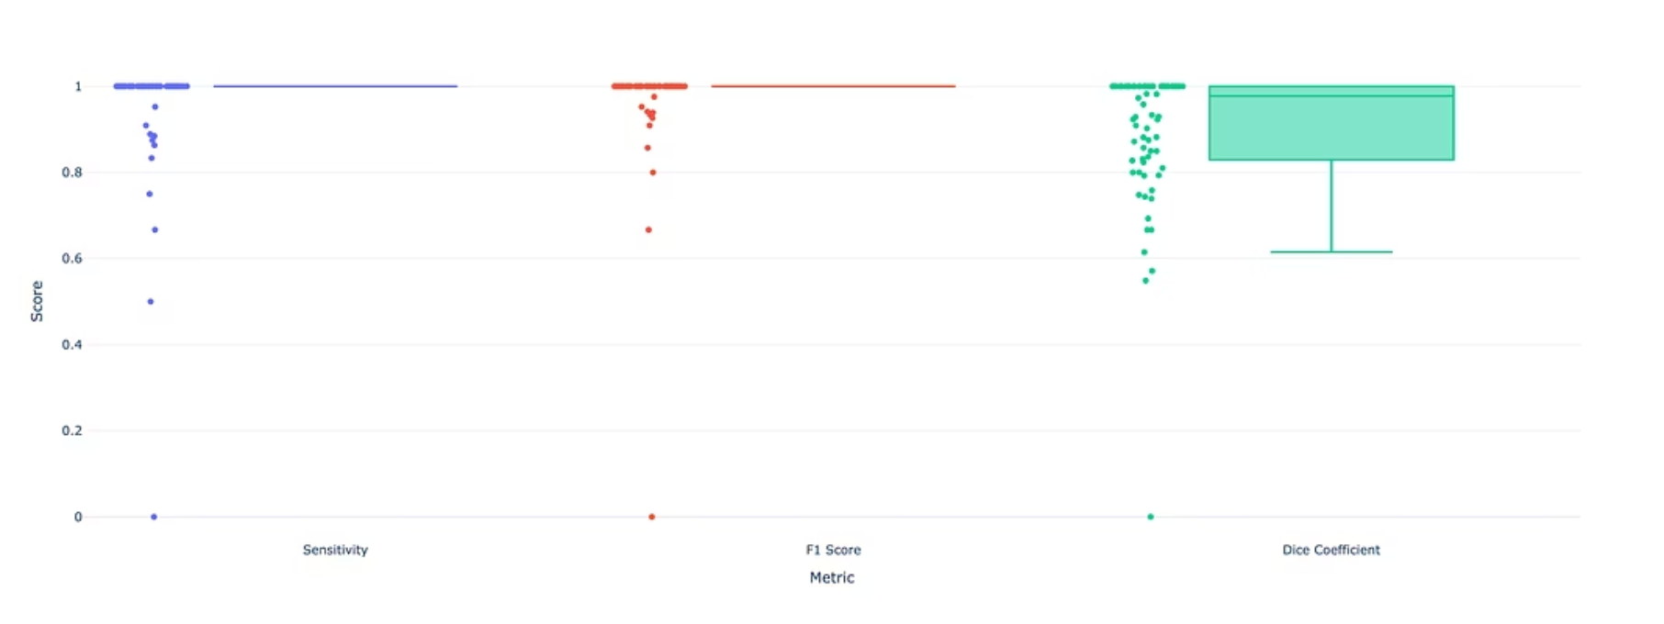
Current Limitations: High-Performing Model Is Still Difficult to Trust
The Problem with Standard Metrics
Standard metrics only provide summary numbers
Small localisation errors can heavily reduce the Dice score
Metrics do not explain where or why the model failed

Slide 4

An Automated Detection and Visual Evaluation Pipeline
Prepare Data
Train nnU-Net
Generate Masks
Explore Results

Slide 5

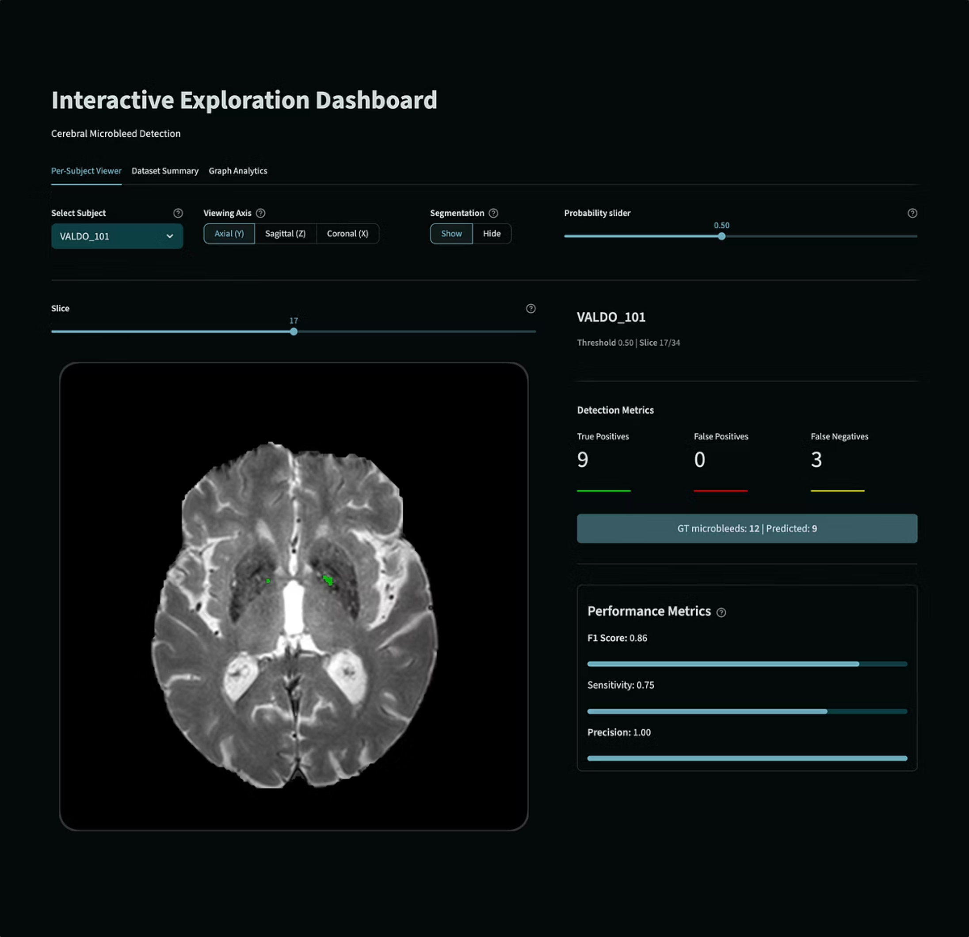




How the Dashboard Solves the Evaluation Problem
Slice-by-Slice Navigation
Inspect axial, sagittal, and coronal planes directly over the original MRI scan.
Colour-Coded Outcomes
Green = correctly detected · Red = false positive · Yellow = missed lesion
Interactive Thresholding
Adjust the probability threshold in real time to distinguish sub-threshold detections from complete misses.
Cross-Subject Comparison
Summary tables and graphs quickly identify subjects where the model underperformed

Slide 6
Findings: Detection Performance
96%
97%
Mean Sensitivity
Mean F1-Score
Across all evaluated subjects
Lesion-level detection accuracy
90%
100%
Mean Dice
Median Sensitivity
Voxel-level overlap coefficient
And median F1-score
No false-positive detections were recorded in the reported evaluation.
Some apparent false negatives were reclassified as true positives when the confidence threshold was reduced.

Slide 7
Conclusion
Power of Automation
Prefer Lesion-Level Metrics
Automation can significantly reduce the workload of manual MRI review for radiologists.
Lesion-level evaluation is more informative than voxel-level scores for tiny, sparse objects.
Visual Inspection Explains Failures
Generalisable Approach
Interactive dashboards reveal where and why a model succeeds or fails.
The pipeline can extend to other small-object detection tasks in medical imaging.

