Slide 1
Benchmarking Small-Object Detection on Brain MRI
A Cerebral Microbleed Case Study
Matthias Mifsud · Supervisor: Prof. Charlie Abela
Faculty of ICT, University of Malta, 2026

Slide 2
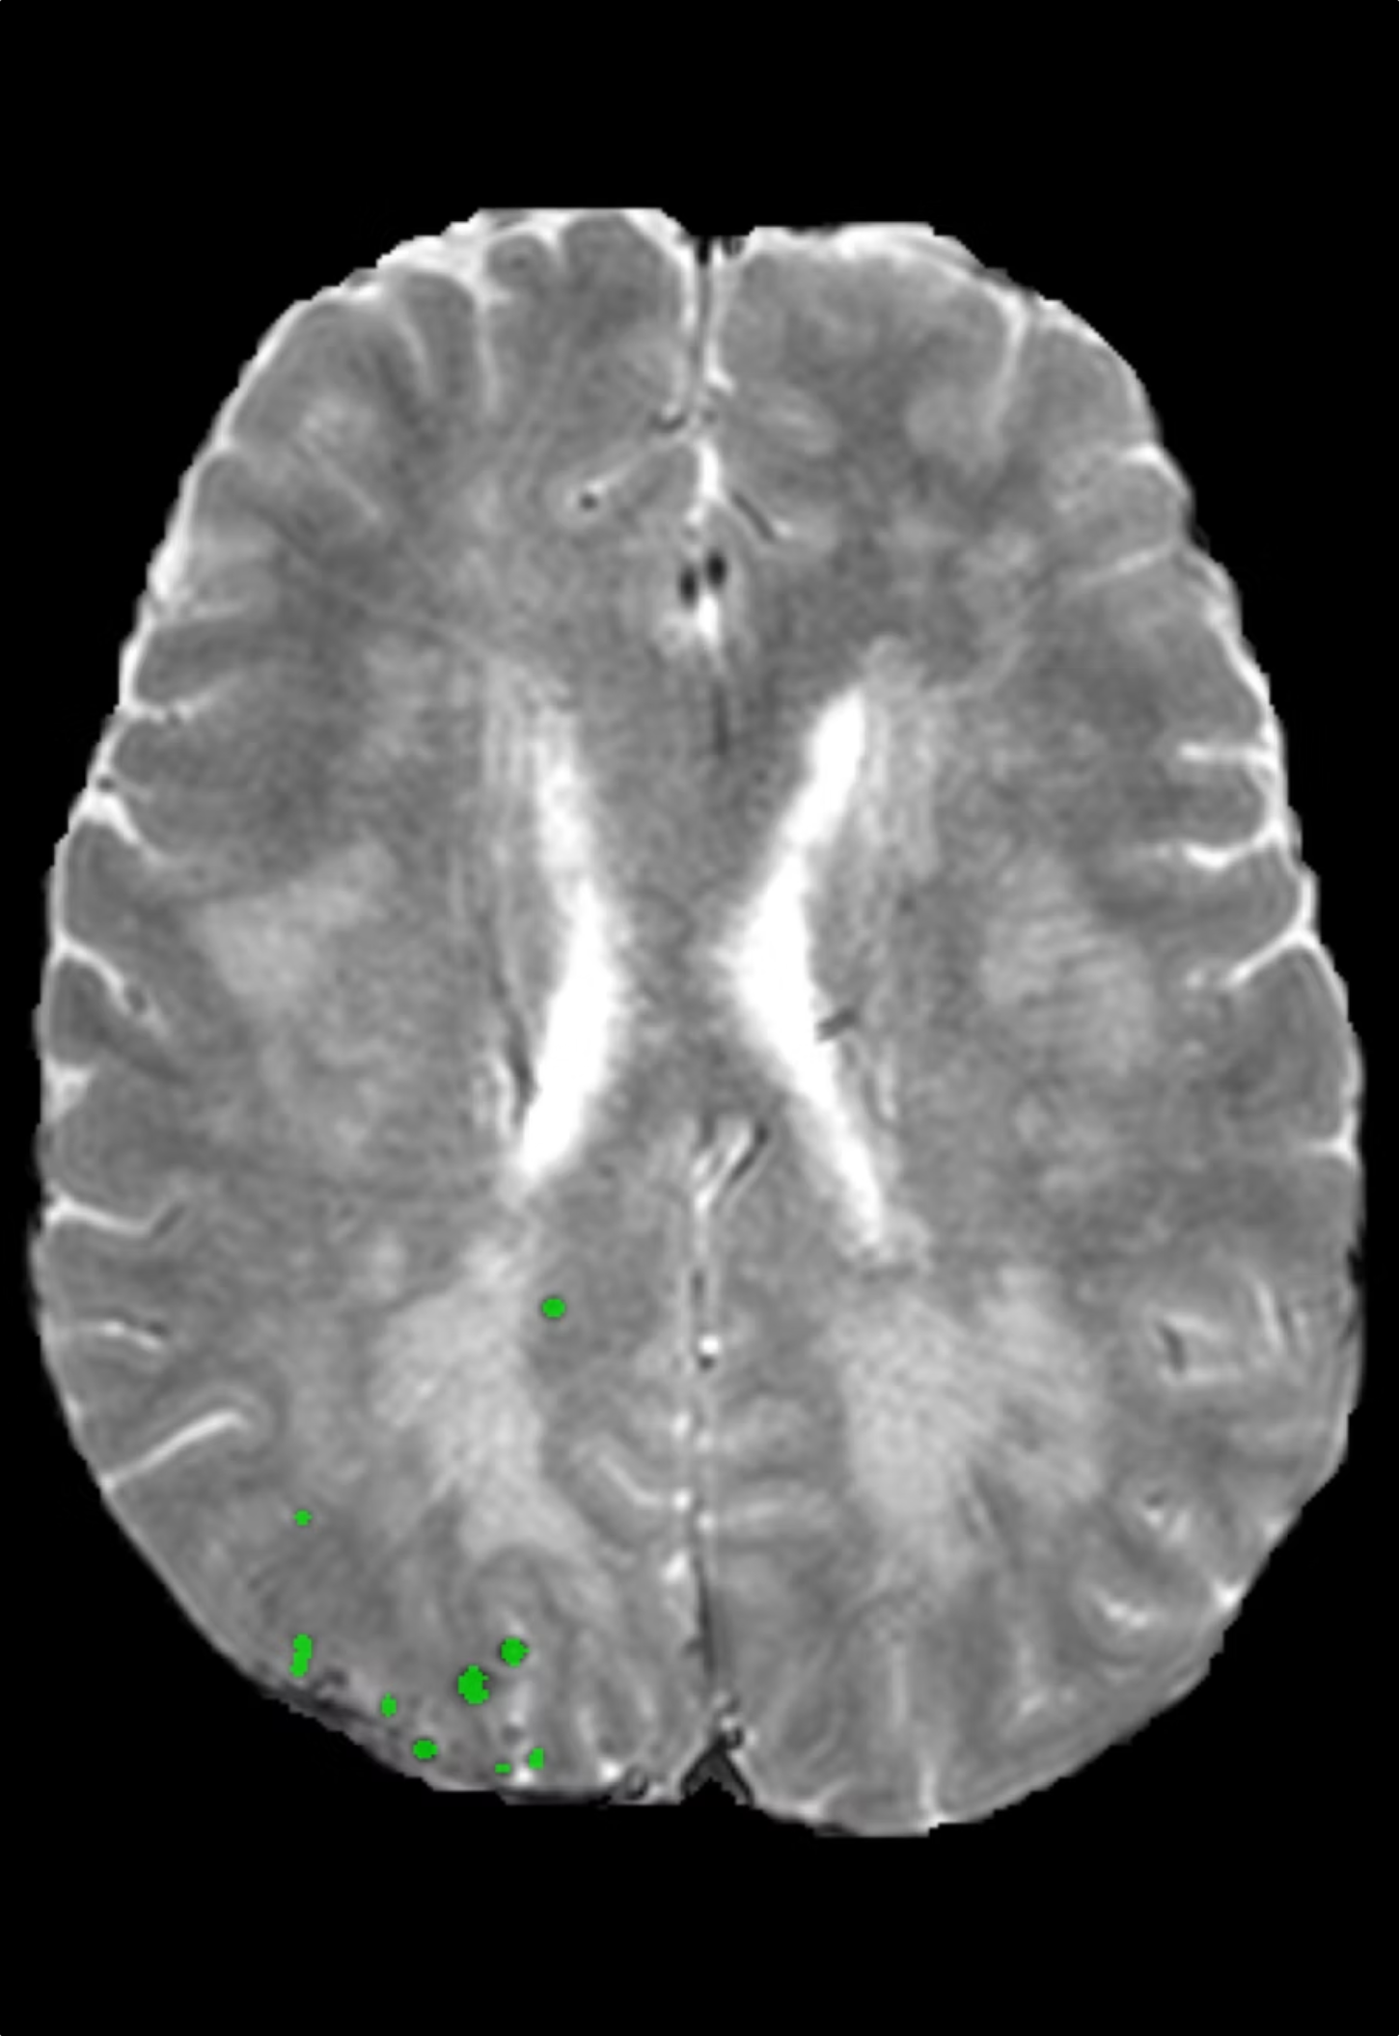


Problem & Motivation
What Are Cerebral Microbleeds?
Tiny deposits of blood visible on specialised MRI modalities such as T2*.
Linked to cerebrovascular disease, stroke risk, cognitive decline, and small vessel disease.
A Visually Challenging Task
Microbleeds resemble blood vessels and other anatomical structures, making manual review slow, error-prone, and inconsistent.
Radiologists must inspect hundreds of slices per scan and are prone to human error.
Metrics Are Incomplete
Aggregate scores hide spatial context.
A single number cannot capture where or why errors occur — clinicians need to see where errors happen, not just how many.

Slide 3
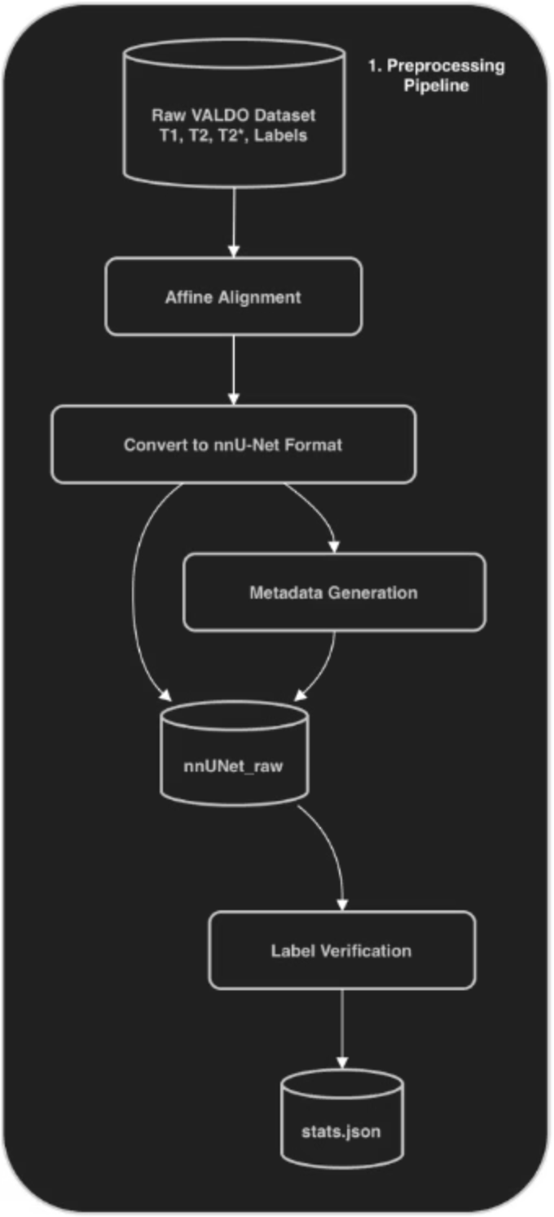

Dataset & Preprocessing
VALDO Challenge 2021
Preprocessing Steps
72 subjects
Three MRI modalities (T1, T2, T2*)
Expert binary segmentation masks.
Conversion to strict nnU-Net directory structure
Affine alignment and label verification
Connected-component analysis to characterise lesion count and size per subject

Slide 4
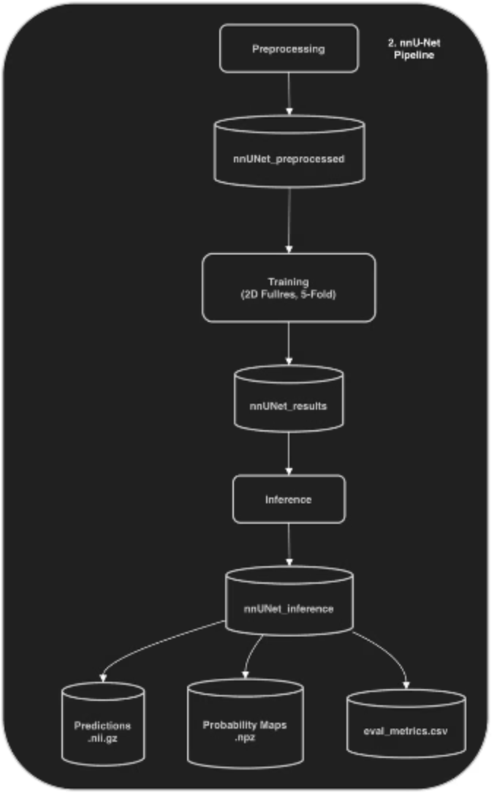
Detection Pipeline
Self-Configuring Architecture
2D Full-Resolution Setup
Selected to fit within hardware constraints whilst preserving fine spatial detail required for tiny lesion detection.
nnU-Net v2 adapts preprocessing and network design to the dataset automatically.

Slide 5

Evaluation Logic: Lesion-Level Classification
Connected-Component Analysis
Key Metrics
Each predicted and ground-truth lesion is isolated as an individual component.
Spatial overlap between components determines the classifications of:
Sensitivity: proportion of real lesions detected
Precision: proportion of predictions that are correct
F1-Score: harmonic mean of sensitivity and precision
Dice: spatial overlap coefficient; noted limitation for tiny lesions
True-positive
False-positive
True-negative
False-negative

Slide 6
Baseline Results
0.960
0.971
Mean Sensitivity
Mean F1-Score
Across all 72 subjects
Lesion-level detection
0.895
0
Mean Dice
False Positives
Spatial overlap coefficient
Across all subjects
Median sensitivity and F1-score both reached 1.000.
The primary weakness was edge cases: subjects with very high counts of tiny or clustered microbleeds (e.g. VALDO 110 with 73 ground-truth lesions).

Slide 7

Interactive Dashboard
Metrics Are Not Sufficient
Importance of Spatial Context
Thresholds Change Outcomes
A low Dice score may still represent a spatially accurate prediction.
Radiologists need to see where errors occur in the scan.
Visual inspection reveals patterns that metrics cannot.
Probability maps allow users to test how confidence thresholds affect final detections.

Slide 8
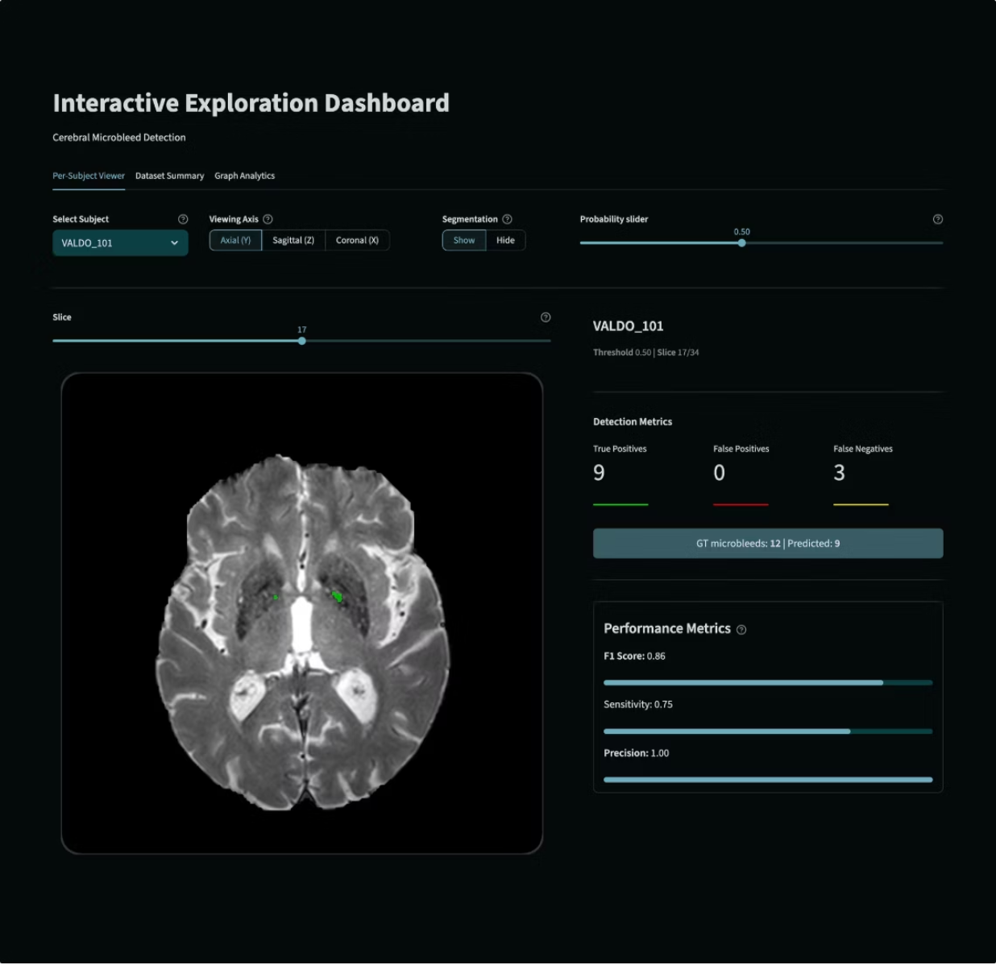
Dashboard - Per-Subject Viewer
Multi-Planar Navigation
Axial, sagittal, and coronal slice navigation enables full 3D inspection of each subject's scan.
Colour-Coded Error Overlays
True Positives — green
False Positives — red
False Negatives — yellow
Interactive Threshold Slider
Adjust the probability threshold and observe real-time metric recalculation across all slices.

Slide 9
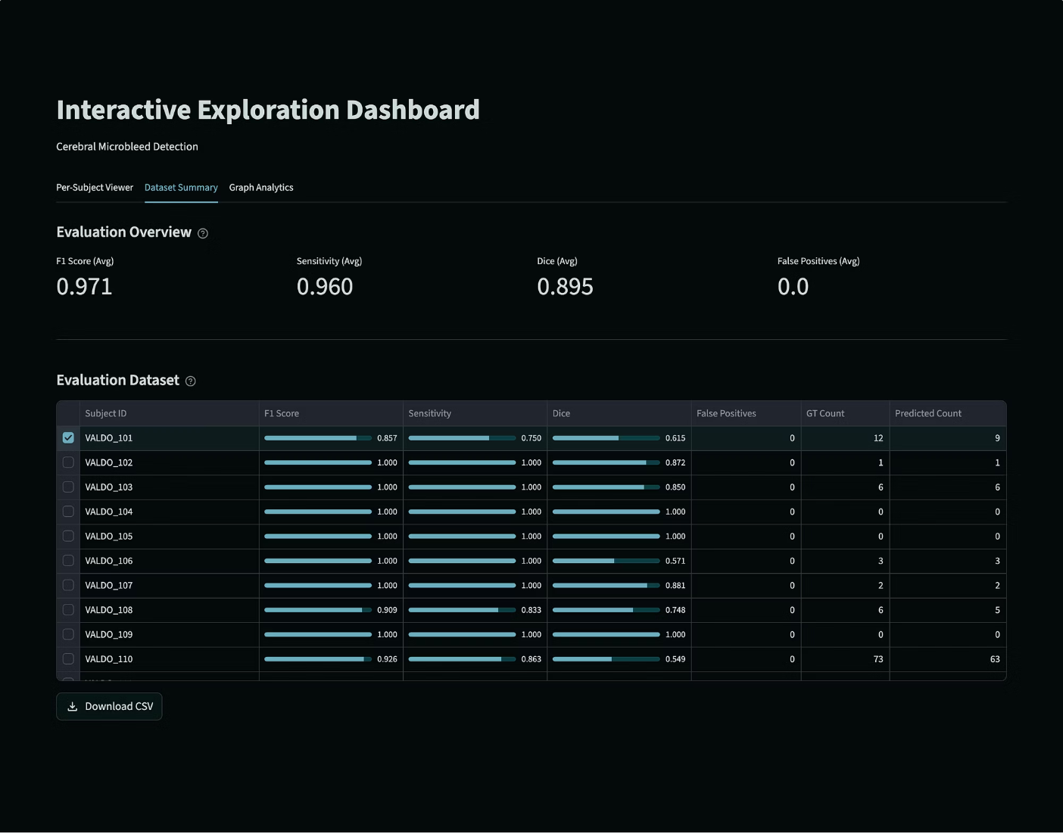
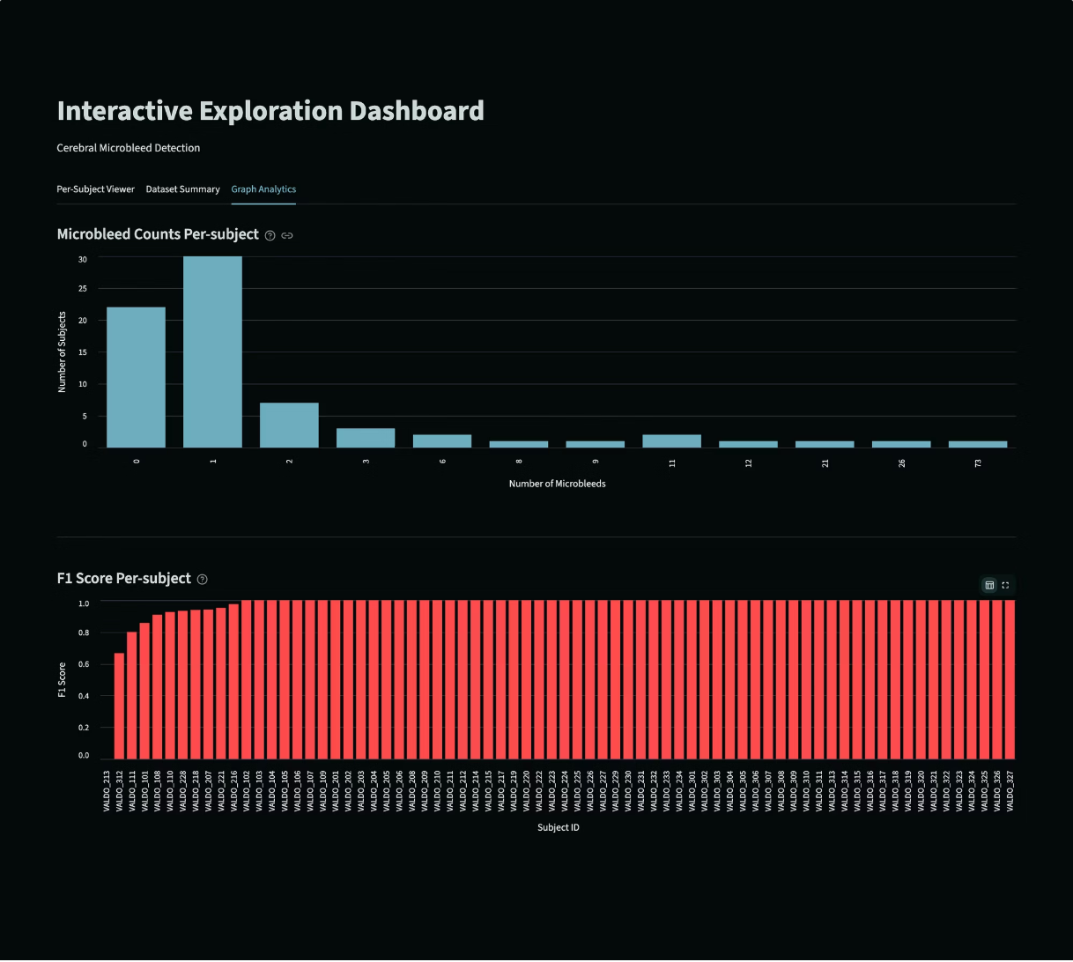
Dashboard - Dataset Summary & Analytics
Dataset Summary Page
Graph Analysis Page
Sortable metrics table across all 72 subjects, providing a clear view of dataset composition and per-subject performance.
CMB distribution and F1-score ranking views

Slide 10
Key Findings & Conclusion
Strong Baseline
Metrics Have Limits
Dashboard Adds Value
nnU-Net achieved high lesion-level performance with zero false positives across all 72 subjects
Dice is unstable for tiny lesions
Aggregate scores cannot explain spatial error patterns.
Single-number summaries are insufficient for clinical validation.
Interactive threshold analysis and visual error inspection make model outputs transparent and clinically interpretable.
Future Work
Full 3D nnU-Net configurations
Improved probability calibration
Extending the project to other small-object medical imaging tasks.

Slide 11
Thank You

