Slide 1
Dino Game
By Neo Engineering Squad
Hades Speranskaya
Matthias Ooms
Yenzo Devos

Slide 2
Table Of Contents
Input
Jumping
Multiplayer?
Background Scrolling
Sprites
Obstacles
Ducking
Highscore
Title/Death Screen
Random Number Generation
Random Obstacle
Random Background
Game Acceleration
Animations

Slide 3
Input
Simple
Directions
A Button
Notes:
Input handling was very simple as it was covered in our course material.

Slide 4
Jumping
Ch05 project
Up / Down
Bounds
Notes:
We started with the CH05 project, and changed it to work using up and down instead. We then implemented player bounds for our dino to oscillate between when jumping.

Slide 5
Multiplayer?
Multiplayer!!!
Oh wait… This is a lot of work
Notes:
Let’s make it work with 4 people!
Or maybe 2 peoples?
Ok 1 person.
Also, background scrolling makes it really hard to have multiple players, cause if 1 dies only their background part needs to stop scrolling, which requires scroll y and a lot of fancy logic.

Slide 6
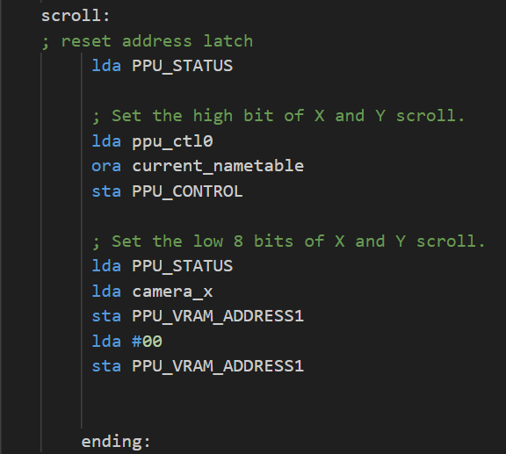
Background Scrolling
Regularly incrementing the camera x position and then writing it to the $2005 address
Last thing before rendering as $2006 writes can override relevant parts of memory

Slide 7
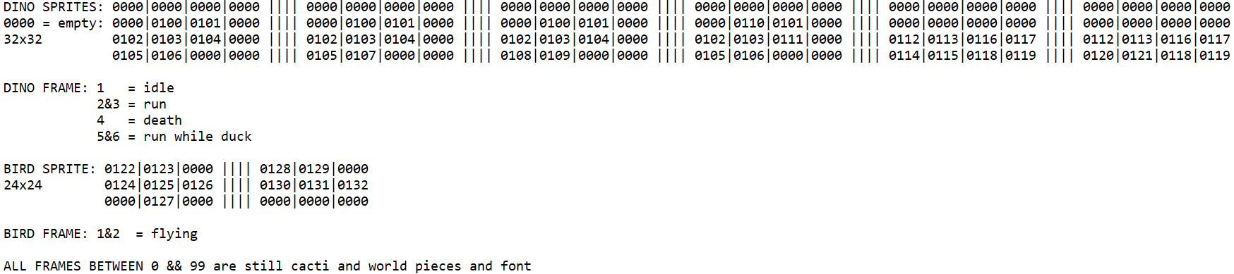
Sprites
Creation
Guide
Notes:
They were created by Hades and Yenzo.
Yenzo even made a guide for the Dino and Bird sprites.

Slide 8
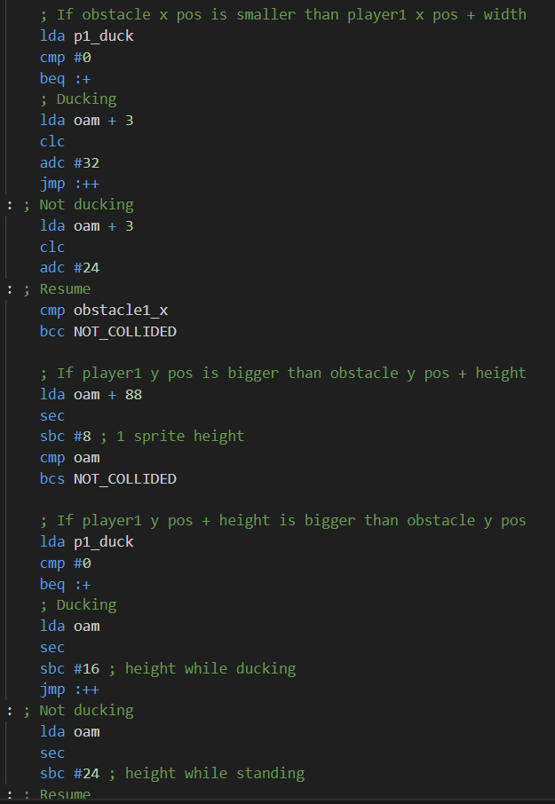
Obstacles
Collisions
Moving left
Notes:
Collisions were a painful thing to program.
Many issues were met, such as properly understanding how to write statements such as “if A > B”.
Moving the objects left was a lot easier.

Slide 9
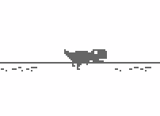
Ducking
Changes some things
Sprite
Height
Width
Boolean logic
Notes:
The ducking was a pretty interesting feature to implement, as it changes the look and size of the player.
It was also an interesting Boolean logic to implement, as we had to start ducking on Down input press, until it was released.

Slide 10

Highscore
Part of background?
Oh wait, scrolling prevents that.
Sprites that cycle through numbers

Slide 11
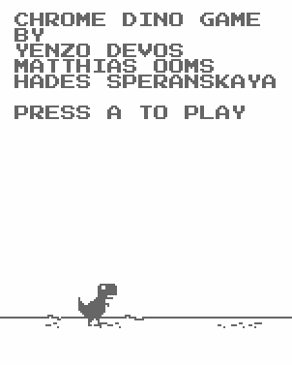
Title/Death Screen
Pause game until button press
Display name + credits
Reset current score + speed

Slide 12
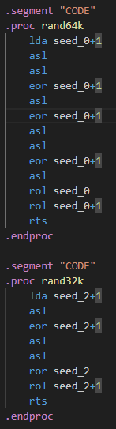
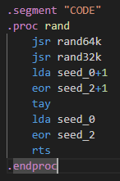
Random Number Generation
Seed calculated by starting game
Return 2 8bit-numbers
1 in A register
1 in Y register
Notes:
The seed is calculated by the time it takes from startup of the game to pressing the jump
The rand function concept is called Linear-Feedback- Shift Register
It return 2 8-bit numbers
One returns in the A register the other in Y register
It’s basically the randomization from in the book

Slide 13
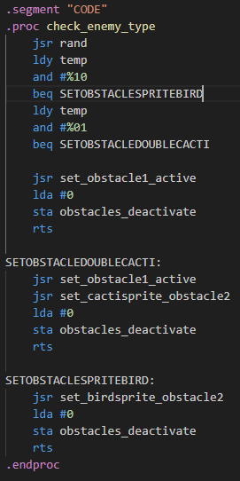
Random Obstacle
Checks the 2 lowest bits
Spawn type of enemy in afterwards
Notes:
If the lowest bit only is set a bird spawns
If the second bit only is set 2 cacti spawn
and if both bits or no bits are set a single cacti spawn

Slide 14
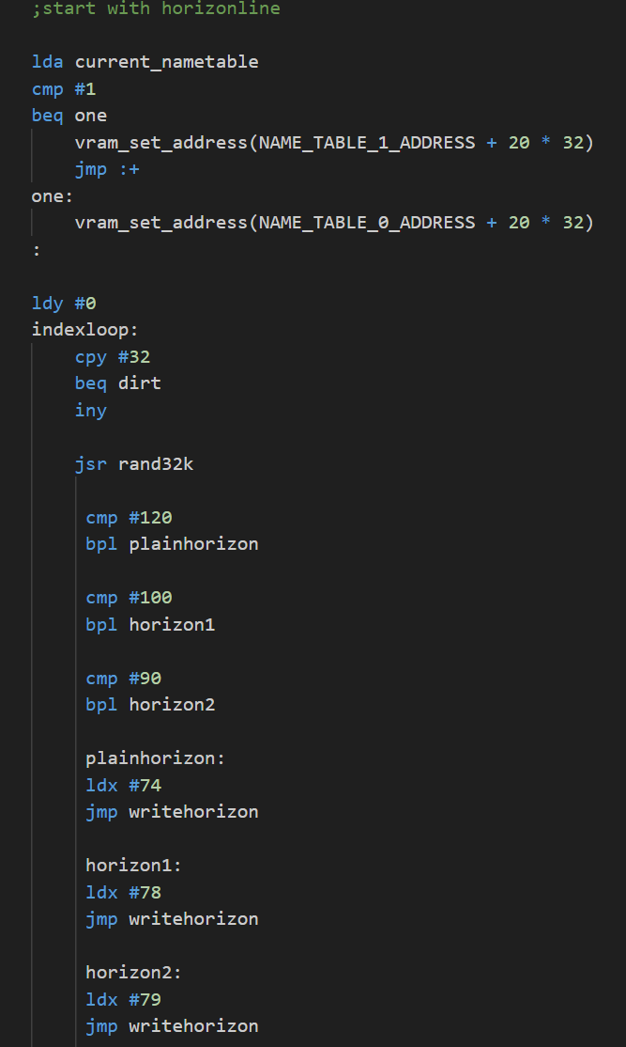
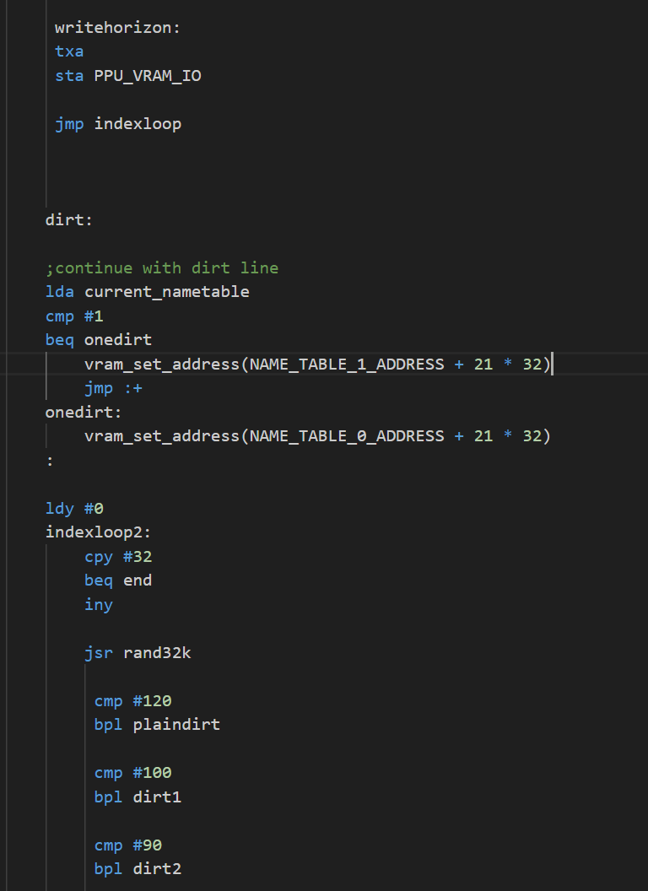
Random Background
Whenever the previous nametable scrolls fully out of view, the code loops over the horizon and dirt parts of the nametable, using random numbers to decide which tile index to put in them
Etc….

Slide 15
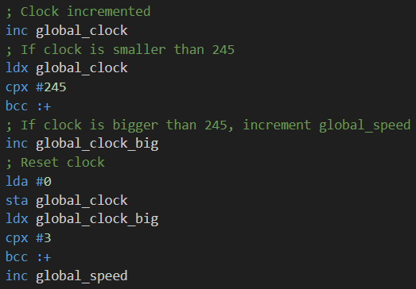
Game Acceleration
Over time, speed goes up
Notes:
Clock goes up
If clock goes over 245 (just a picked value, no real relevance)
Increment big clock
If big clock is over 3
Increment the global speed

Slide 16
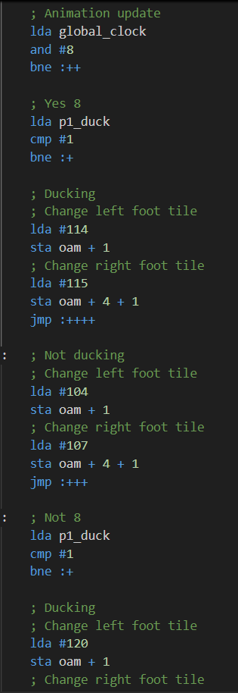
Animations
Every 8 frames, change the sprite
Keep walking/ducking in mind!
Notes:
Animations just trigger every 8 frames.
They change the current sprite between 2 values.

Slide 17

THE END

