Slide 1
Movie Descriptions
Erlacher, Remta, Schachinger, Zechmeister

Slide 2
Research question
Using NLP techniques, how accurately can movies be assigned to their genre based on a short summary of the movies plot?

Slide 3
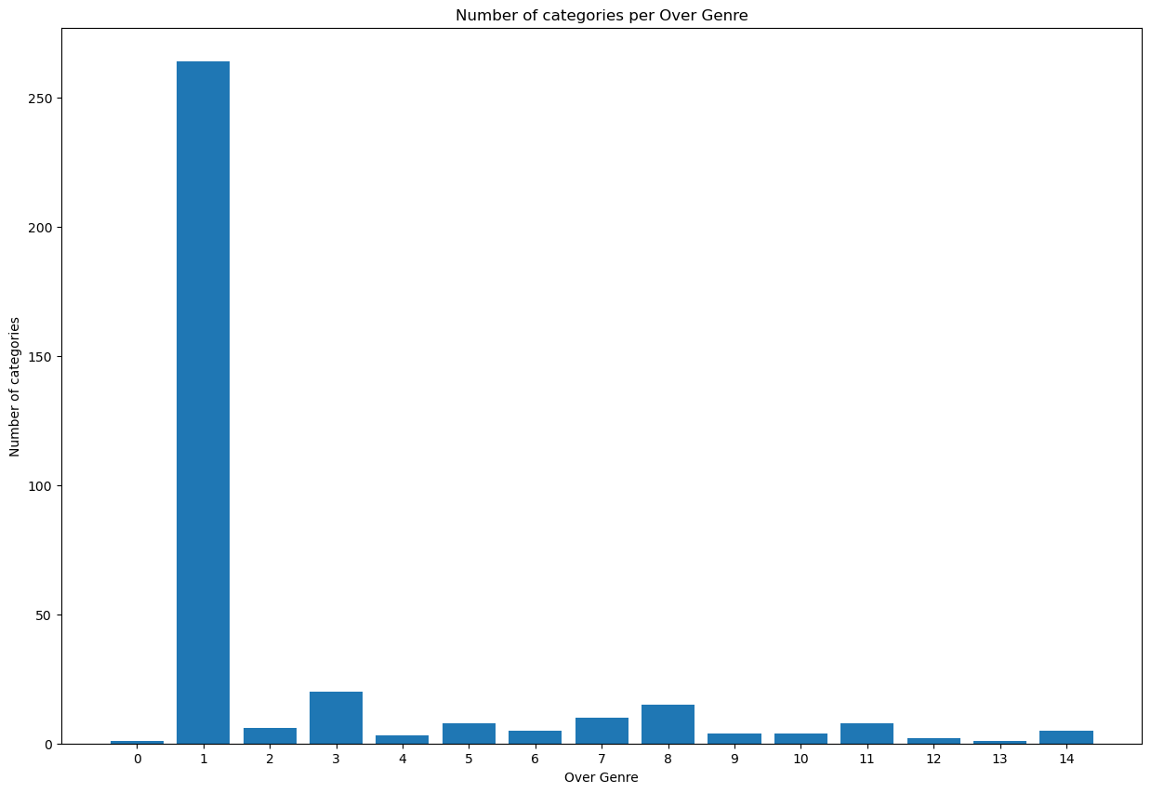
Additional Data Cleaning – Reducing number of Categories (?)
SciKit - TF-IDF (Term Frequency-Inverse Document Frequency)
or
gensim.models import Word2Vec
-> K-means

Slide 4
Additional Data Cleaning – Removing Movies with minor genres (?)
363 genres in original data
Reduced to 56 genres
4917 movies were removed (16.2% of the data)

Slide 5
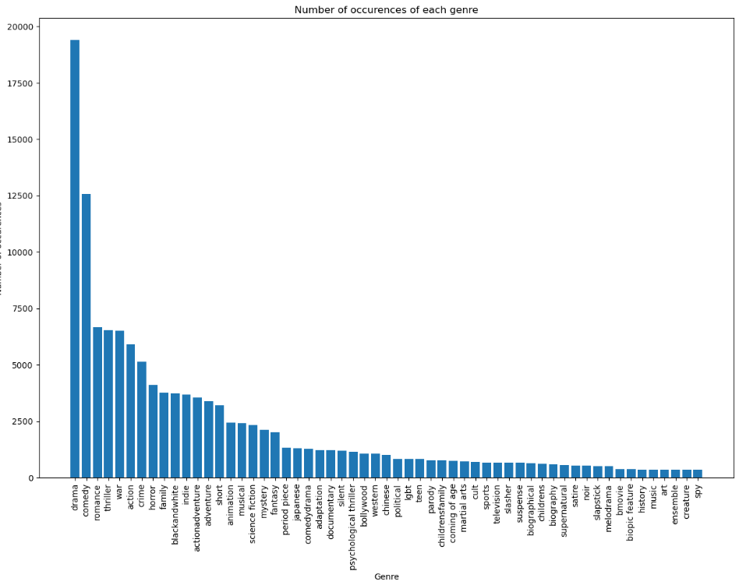
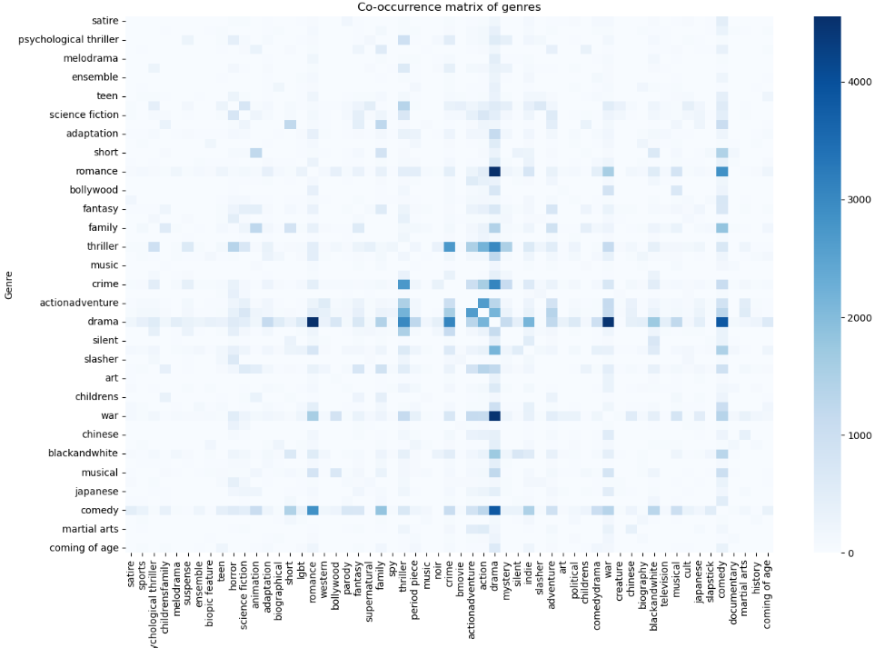
Additional Data Cleaning

Slide 6
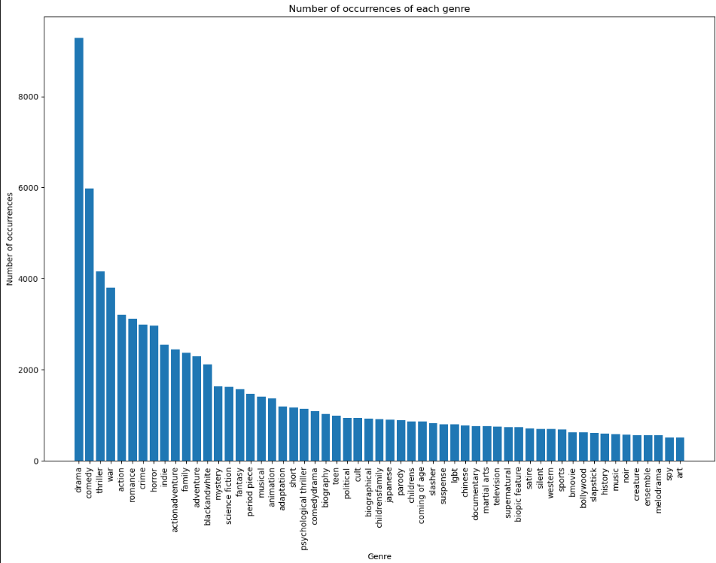
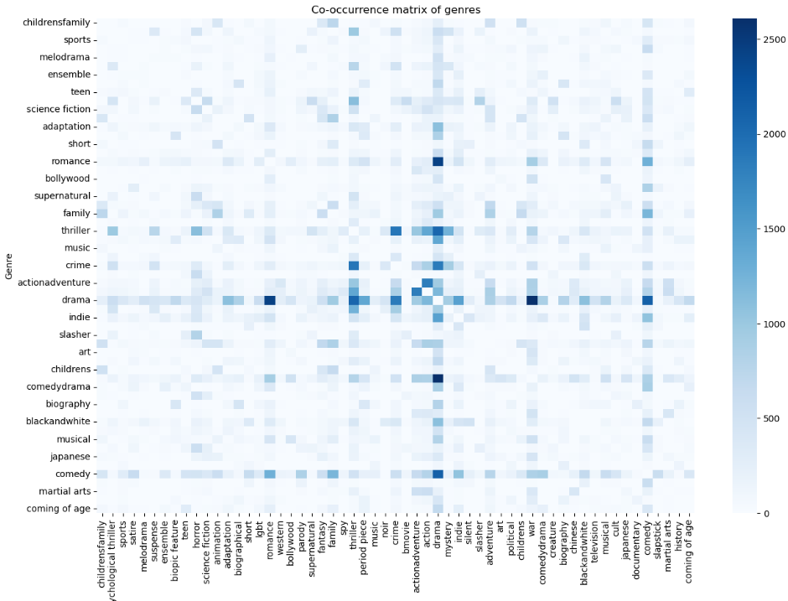
Additional Data Cleaning & balancing

Slide 7
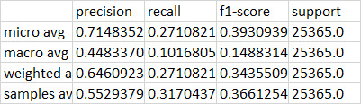
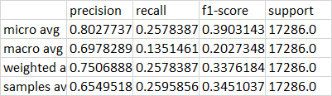
Multi-Label Logistic Regression Model - Performance
Before additional data cleaning
After additional data cleaning
60 categories
~42000 entries
Highes/lowest category ~ 50
60 categories
~19500 entries
Highes/lowest category ~18

Slide 8
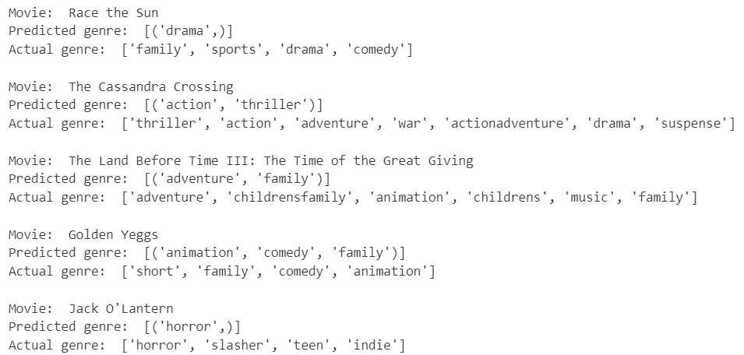
Multi-Label Logistic Regression Model - Predictions

Slide 9
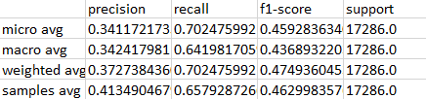
Naive Bayes SVM
Does not converge

Slide 10
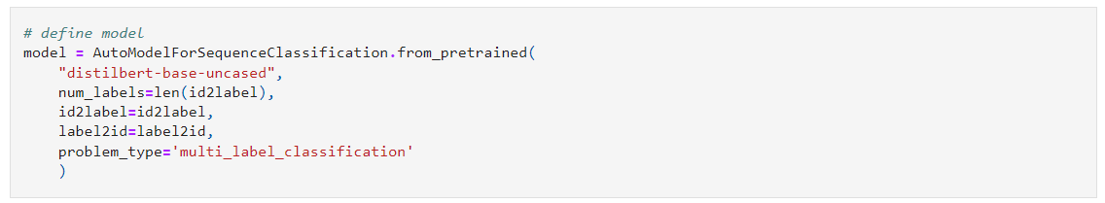

Transformer model with Distilbert
Test run on one epoch only

