Slide 1
Movie Descriptions
Erlacher, Remta, Schachinger, Zechmeister

Slide 2
Data
CMU Movie Summary Corpus¹:
42306 plot summaries from Wikipedia
Metadata: run time, revenue, genres, etc.
Character metadata: name, actor, etc.

Slide 3
Research question
Using NLP techniques, how can movies be assigned to their genre based on a short summary of the movies plot?

Slide 4
Preprocessing steps
Transfer to lowercase
Remove numbers
Lemmatization
Document Term matrix

Slide 5
EDA

Slide 6
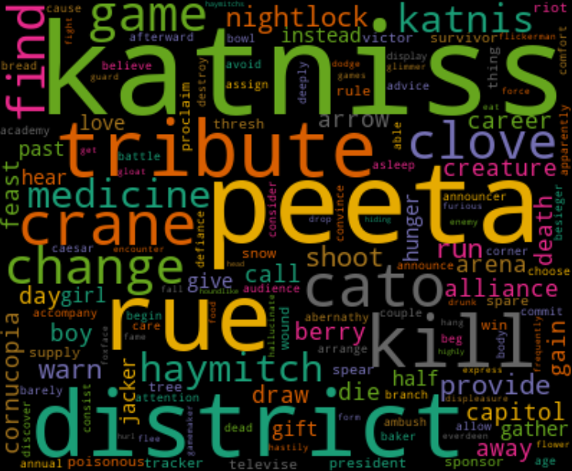
EDA cont‘d

