Slide 1
Movie Descriptions
Erlacher, Remta, Schachinger, Zechmeister

Slide 2
Data
CMU Movie Summary Corpus¹:
42306 plot summaries from Wikipedia
Metadata: genres, run time, revenue, etc.
Character metadata: name, actors, etc.

Slide 3
Research question
Using NLP techniques, how accurately can movies be assigned to their genre based on a short summary of the movies plot?

Slide 4
Preprocessing steps
Transfer to lowercase
Remove numbers
Lemmatization
Document Term matrix

Slide 5
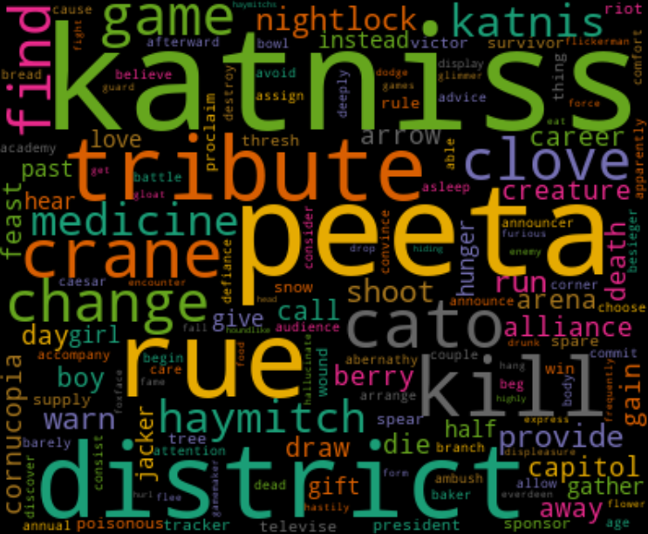
EDA - wordcloud

Slide 6
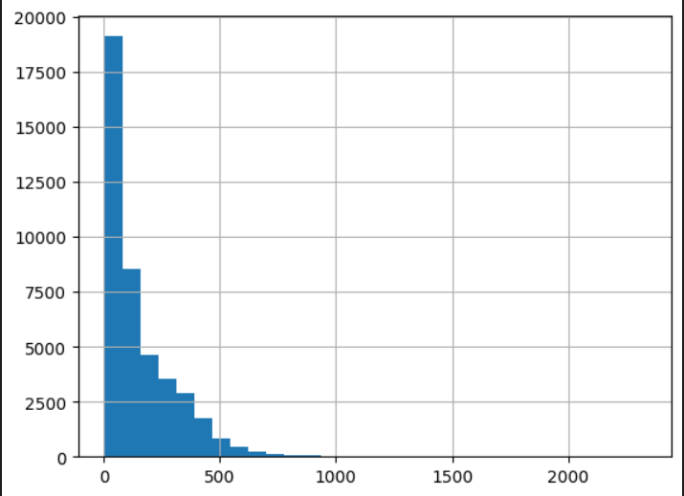
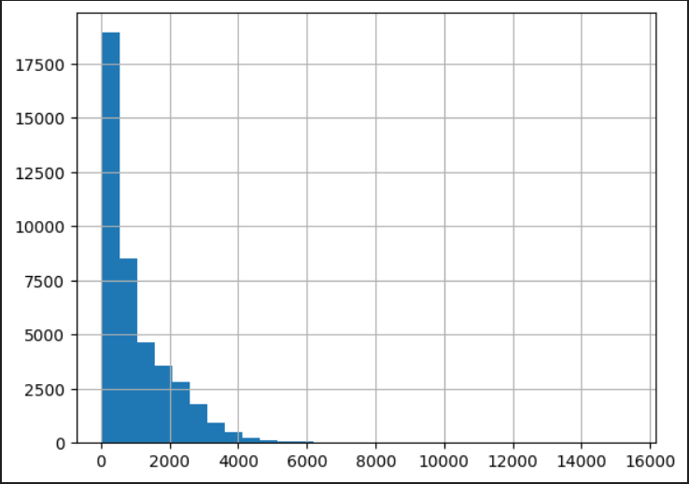
EDA – word and character counts
number of movies
number of movies
word count
character count

Slide 7
EDA - genres
Total number of 363 genres
Each movie can have multiple genres assigned
Max. number of genres : 17
Min. number of genres: 0 -> data cleaning
Average number of genres: 2.97
10 most common genres:
[('Drama', 34007),
('Comedy', 16349),
('Romance Film', 10234), ('Black-and-white', 9094), ('Action', 8798),
('Thriller', 8744),
('Short Film', 8141),
('World cinema', 7155), ('Crime Fiction', 6948), ('Indie', 6897)]

Slide 8
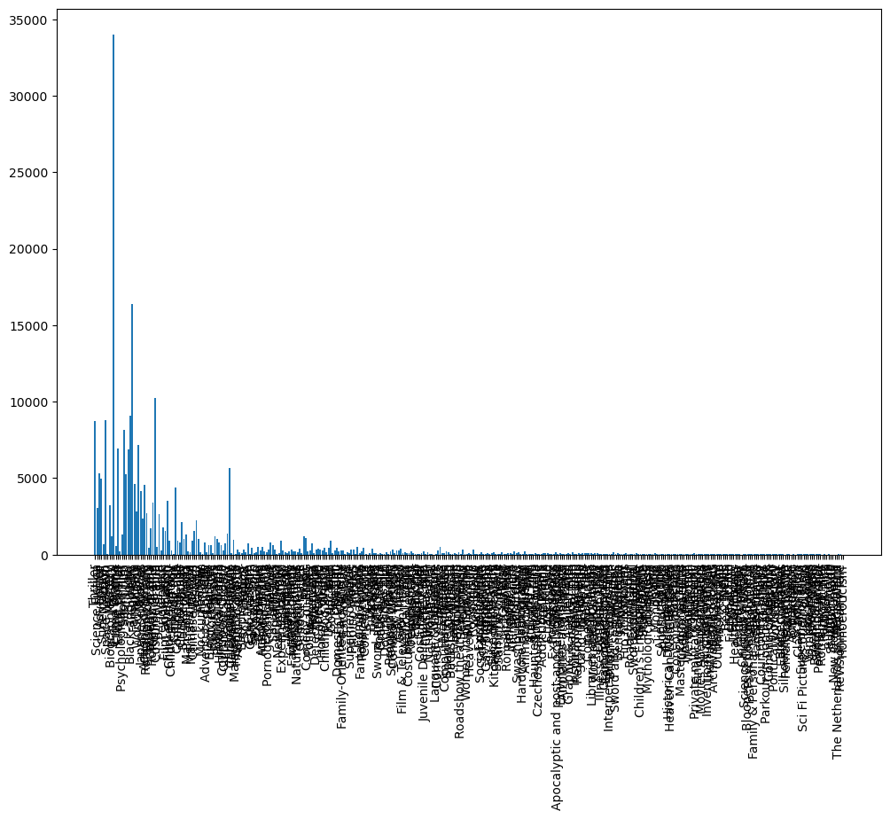
Balance of the 356 Genres

Slide 9
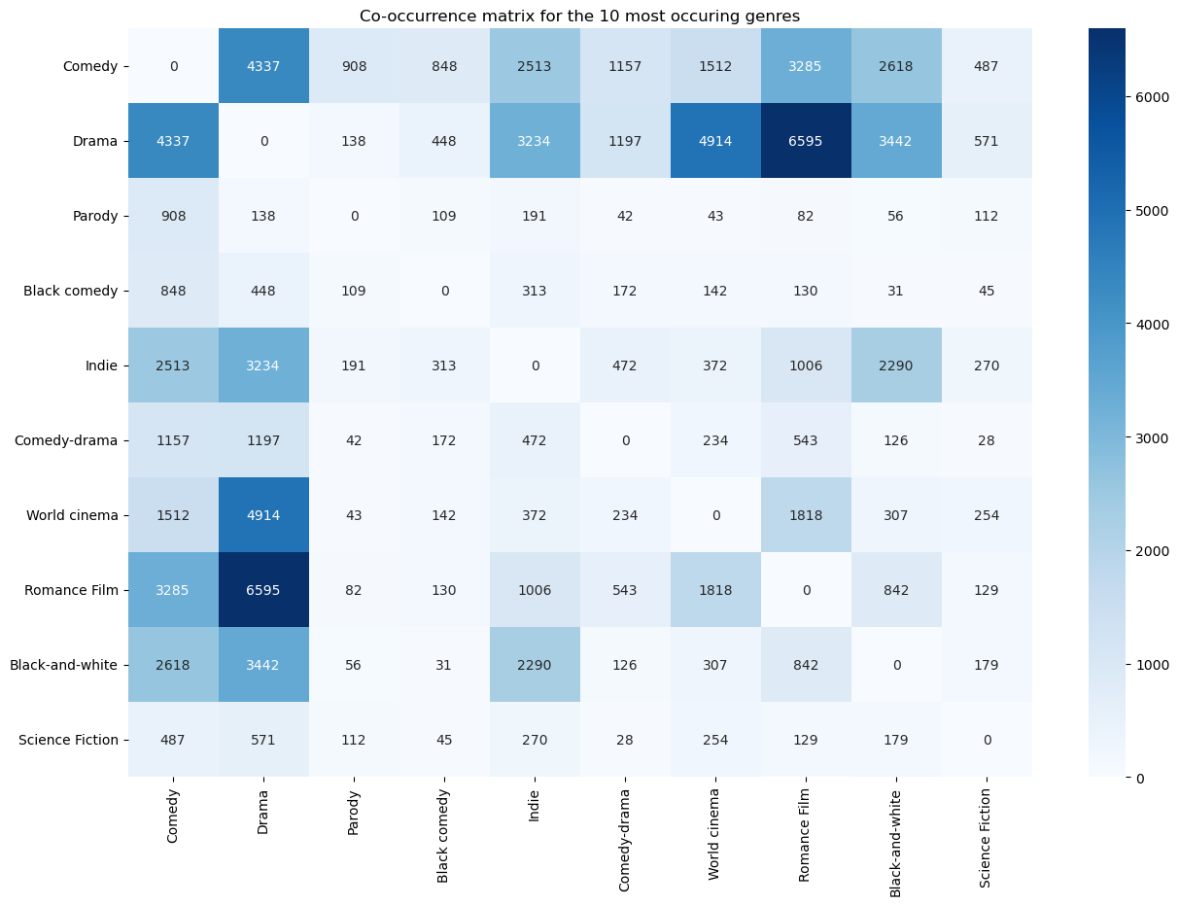
Coocurence Matrix for Genres

Slide 10
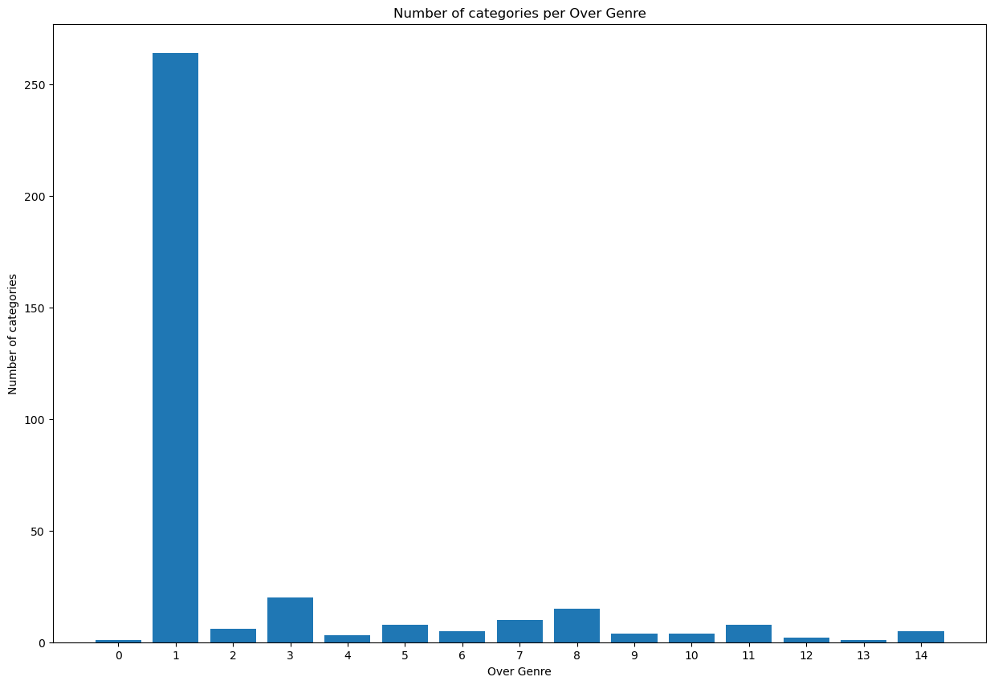
Reducing number of Categories
SciKit - TF-IDF (Term Frequency-Inverse Document Frequency)
or
gensim.models import Word2Vec
-> K-means

