Slide 1
Movie Descriptions
Erlacher, Remta, Schachinger, Zechmeister

Slide 2
Research question
Using NLP techniques, how accurately can movies be assigned to their genre based on a short summary of the movies plot?

Slide 3
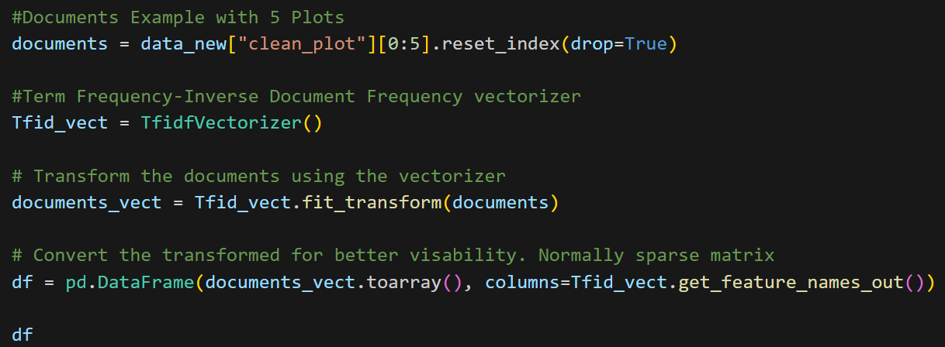
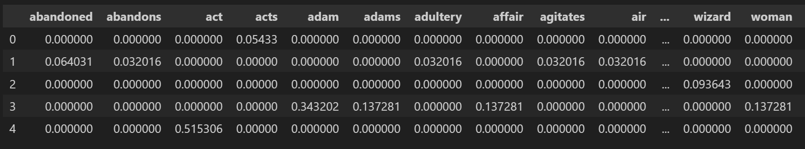
Term Frequency-Inverse Document Frequency (TF-IDF)

Slide 4
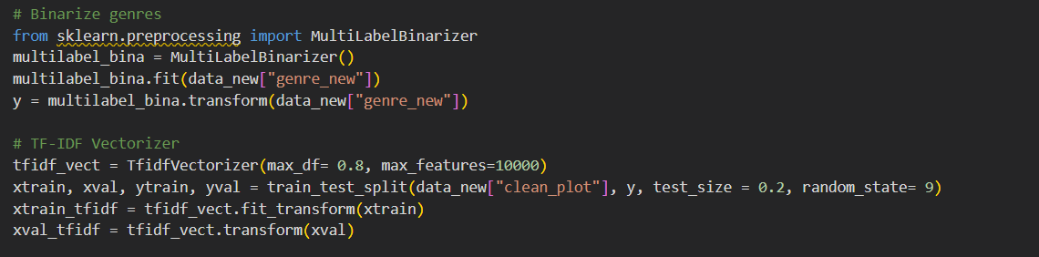
IF-IDF application on the full dataset

Slide 5
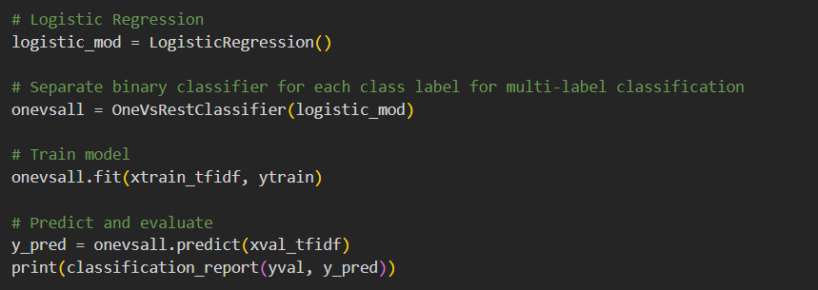
First Model: Logistic Regression

Slide 6
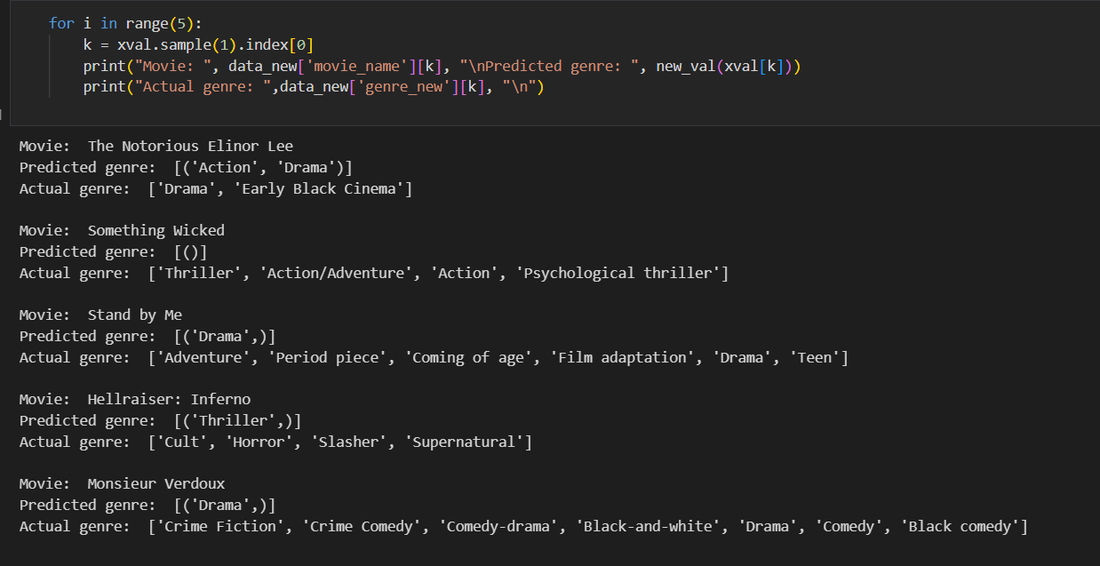
Predicted results

Slide 7
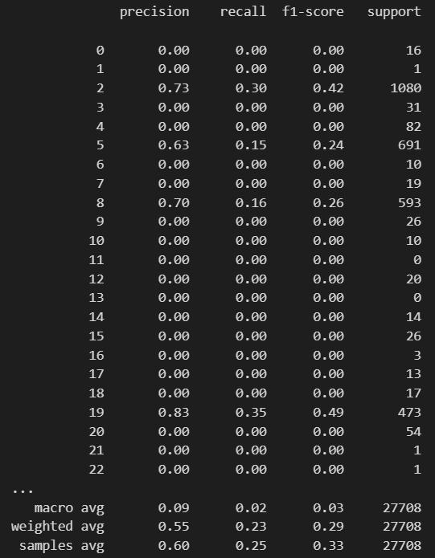
Performance
Macro average is poor
Performance of minority classes is poor
More cleaning of these genres is necessary
Sample and weighted average may also improve with more genre cleaning

