Slide 1
Movie Descriptions
Erlacher, Remta, Schachinger, Zechmeister

Slide 2
Research question
Using NLP techniques, how accurately can movies be assigned to their genre based on a short summary of the movies plot?

Slide 3
Additional Data Cleaning – Removing Movies with minor genres
363 genres in original data
TDF-IDF + KNN 15 categories -> 14 usefull 1 rest
Reduced to 57 genres
Deleted all with less than 341 occurences
41793 to 41549 entries

Slide 4
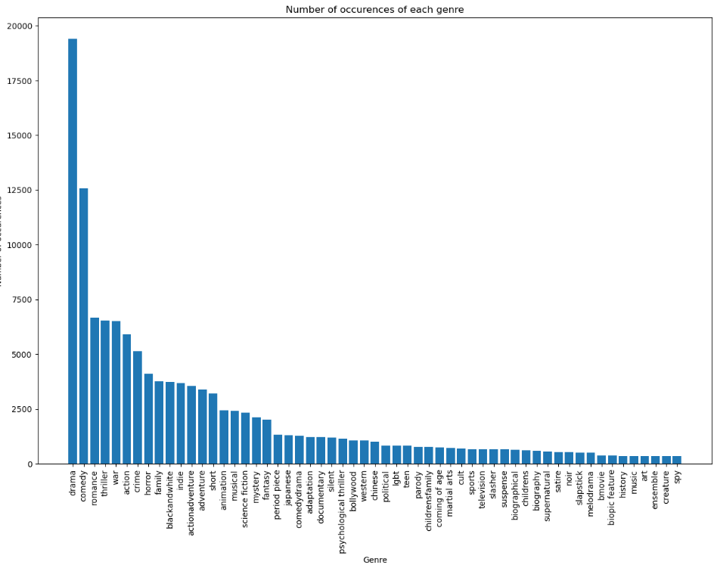
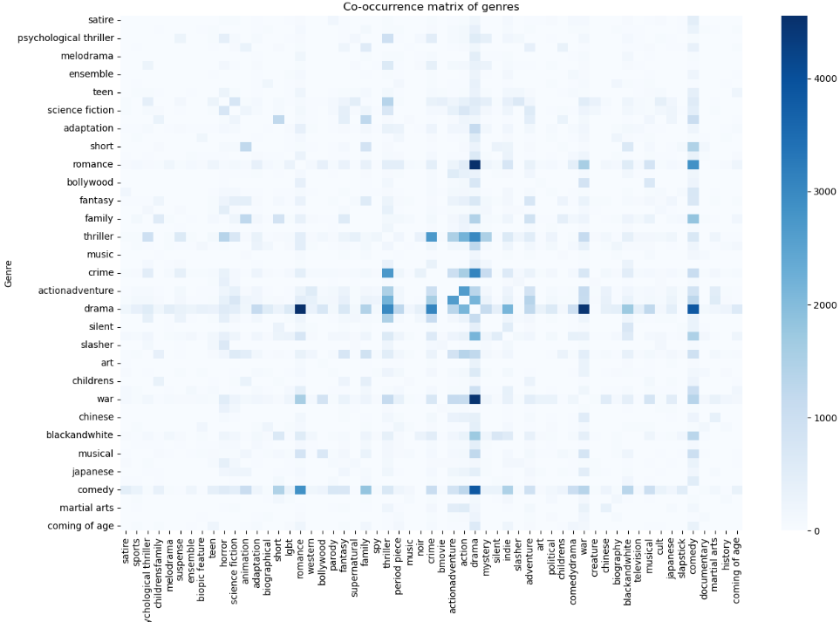
Additional Data Cleaning

Slide 5
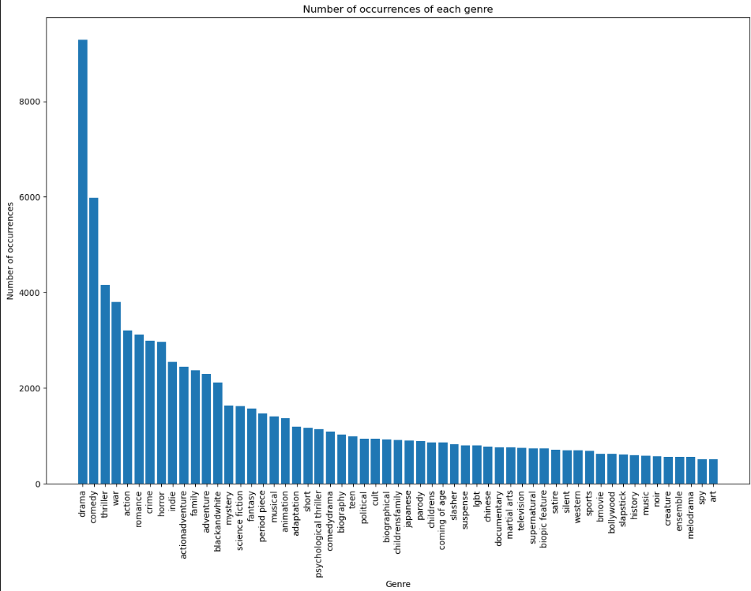
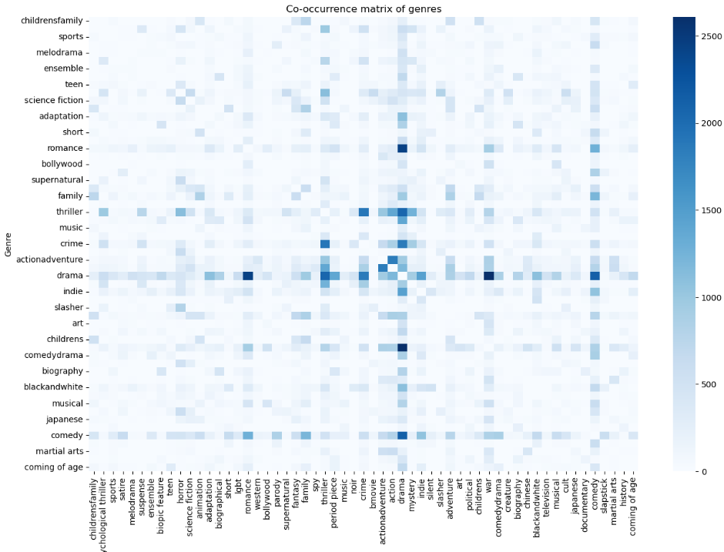
Additional Data Cleaning & balancing
Take random sample with number of least frequent genres from dataset for each genre

Slide 6
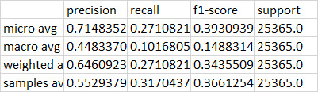
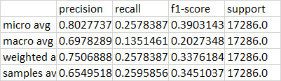
Multi-Label Logistic Regression Model - Performance
Before additional data cleaning
After additional data cleaning
57 categories
~42000 entries
Highest/lowest category ~ 56
57 categories
~19500 entries
Highest/lowest category ~18

Slide 7
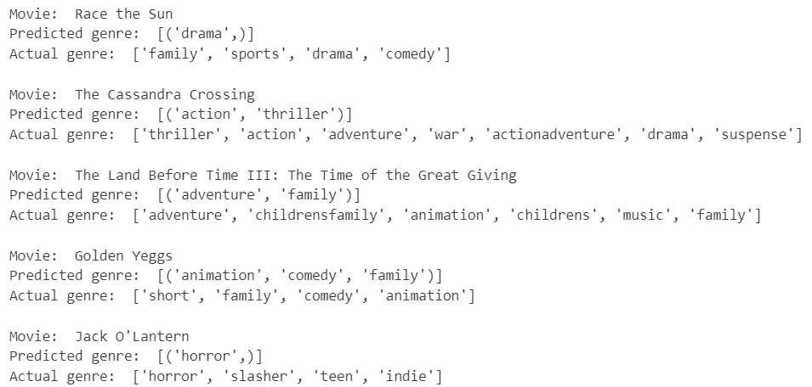
Multi-Label Logistic Regression Model - Predictions

Slide 8
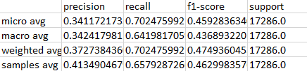
Naive Bayes SVM
Does not converge

Slide 9
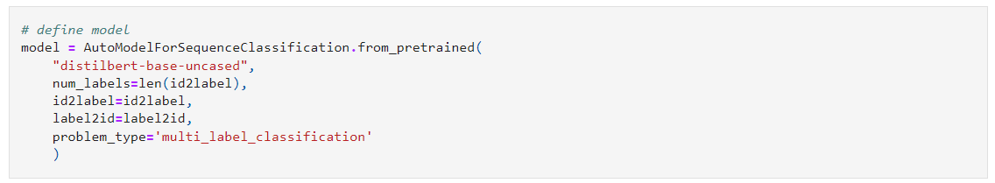

Transformer model with Distilbert
Test run on one epoch only

