Slide 1
Movie Descriptions
Erlacher, Remta, Schachinger, Zechmeister

Slide 2
Data
CMU Movie Summary Corpus¹:
42306 plot summaries from Wikipedia
Metadata: run time, revenue, genres, …
Character metadata: name, actor, …

Slide 3
Research question

Slide 4
EDA
Preprocessing:
lowercase, remove numbers, …
Lemmatization
Document Term Matrix

Slide 5
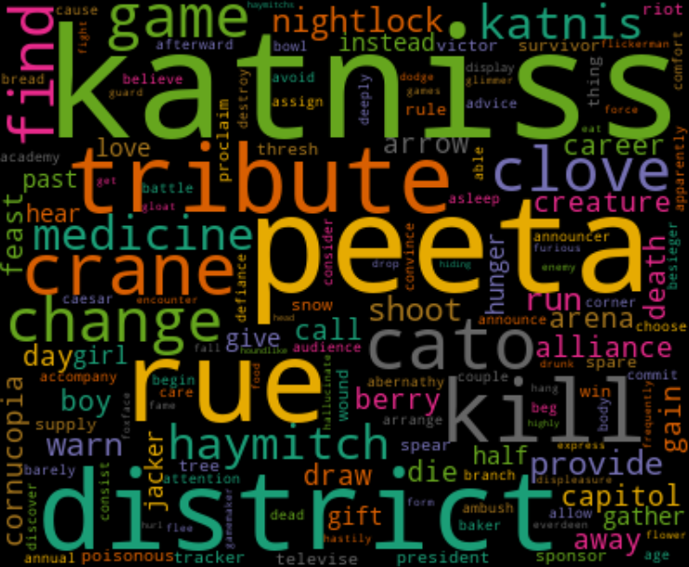
EDA cont‘d

