Slide 1
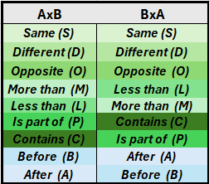
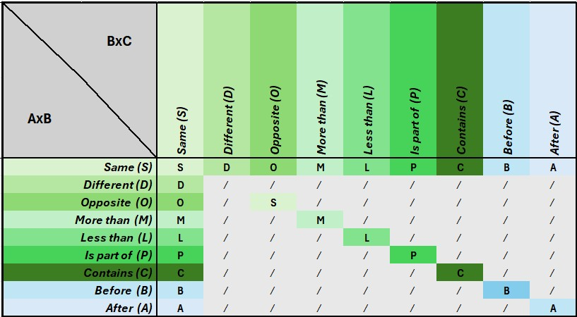
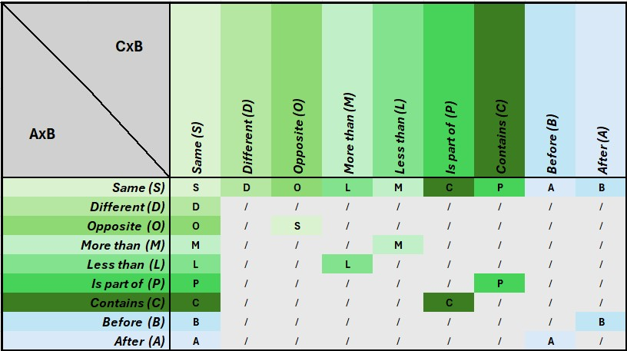
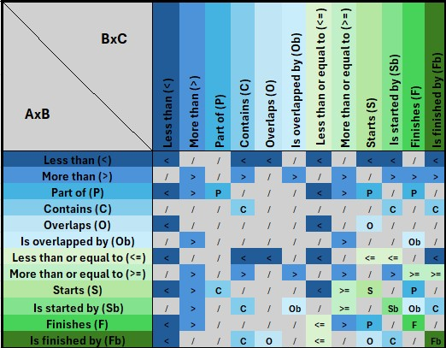
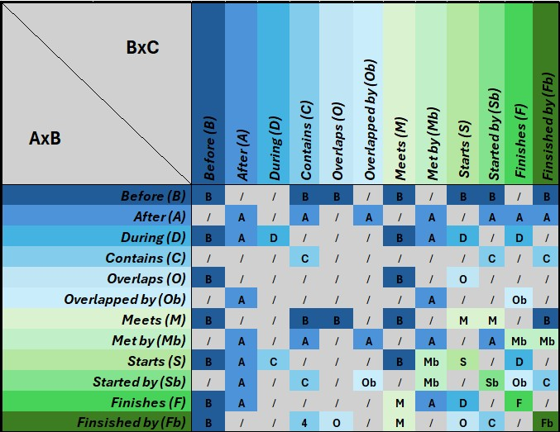
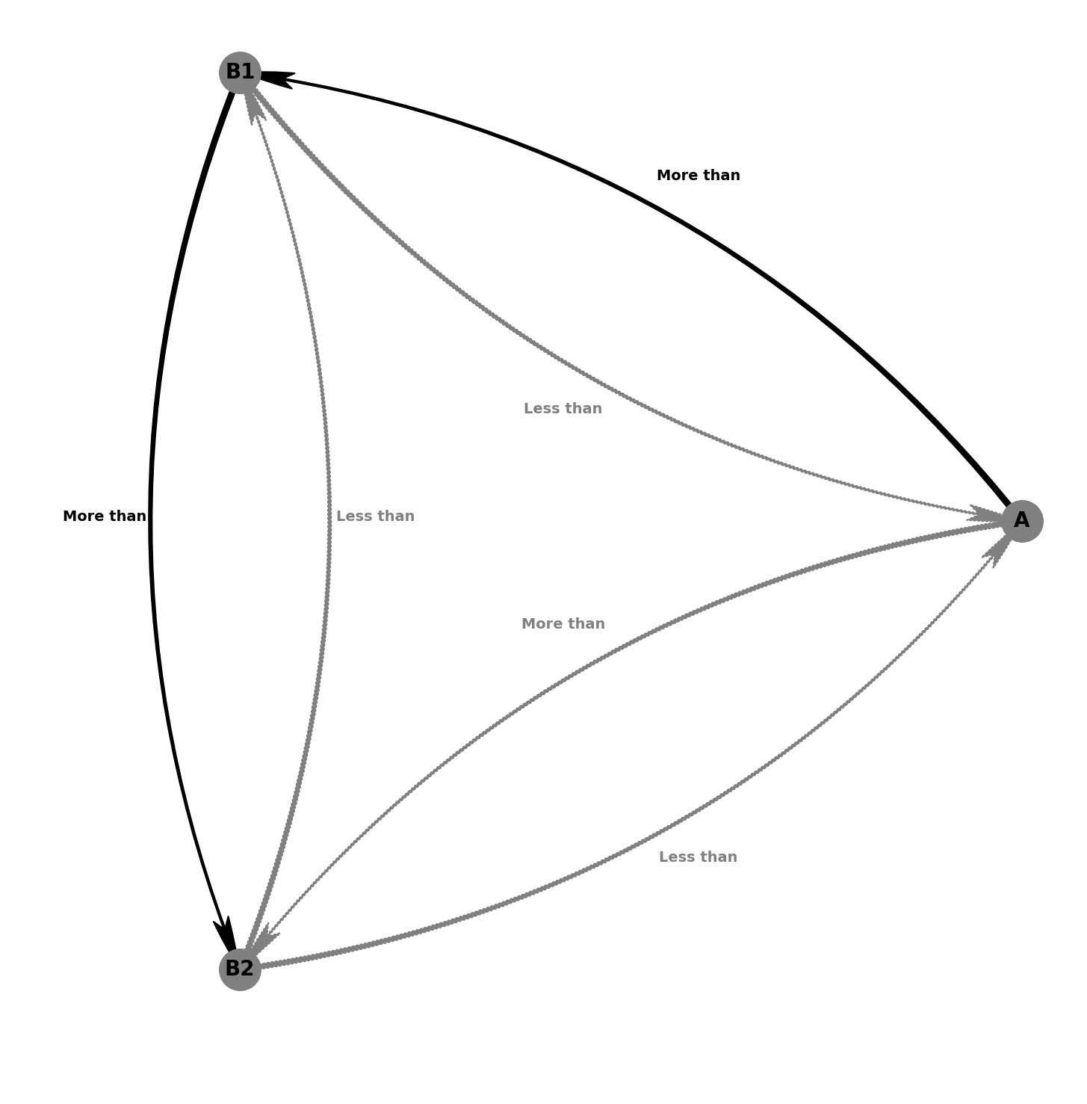
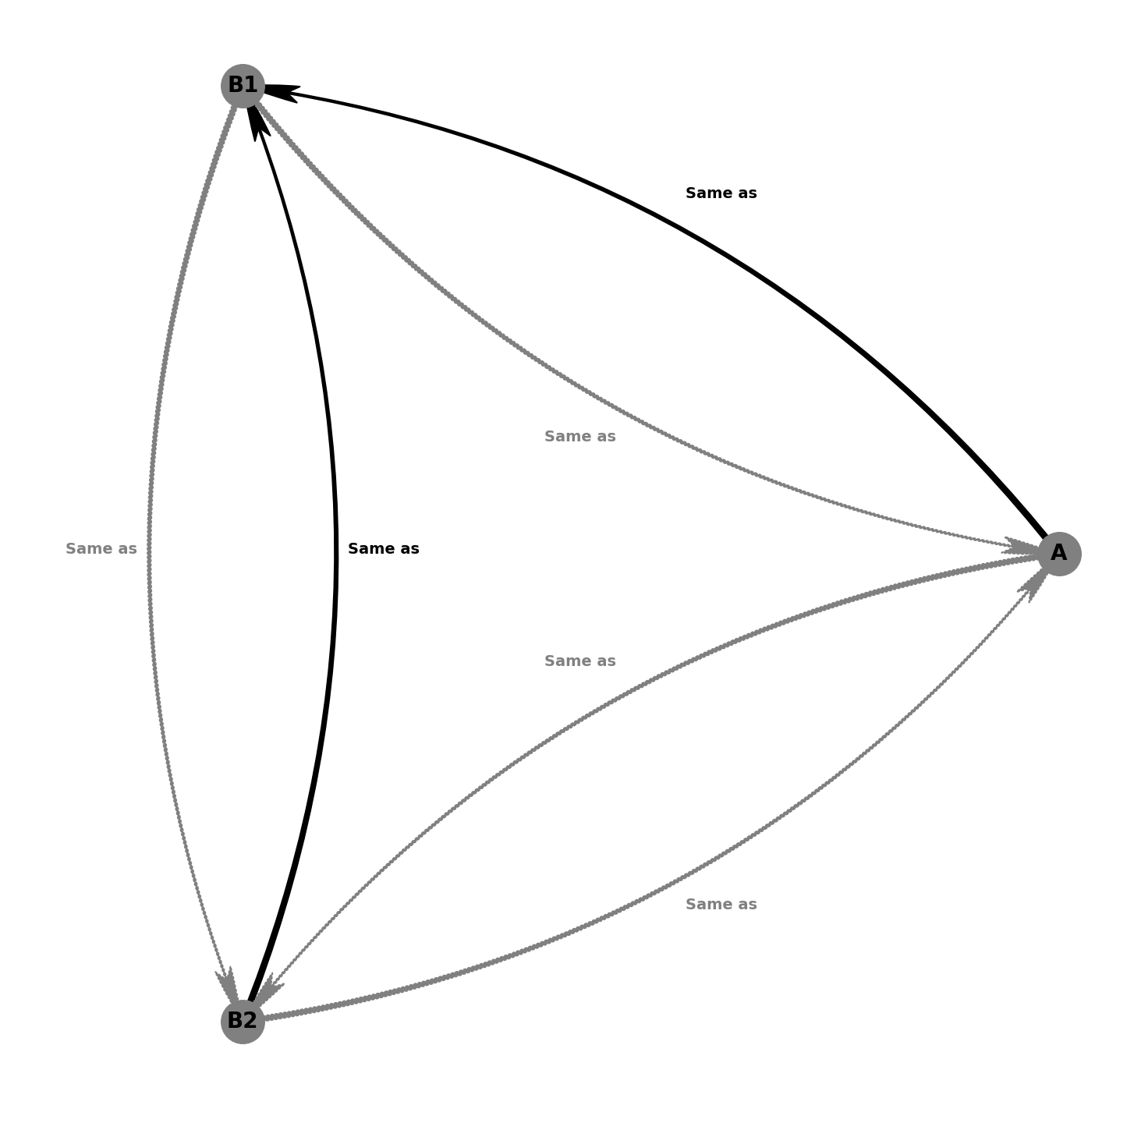
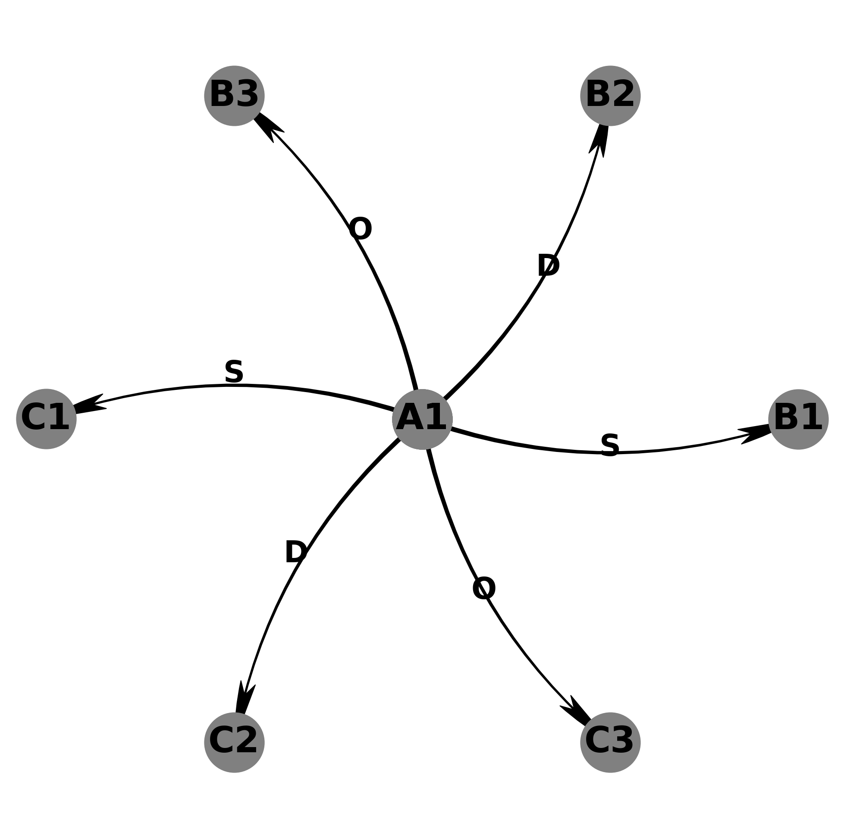
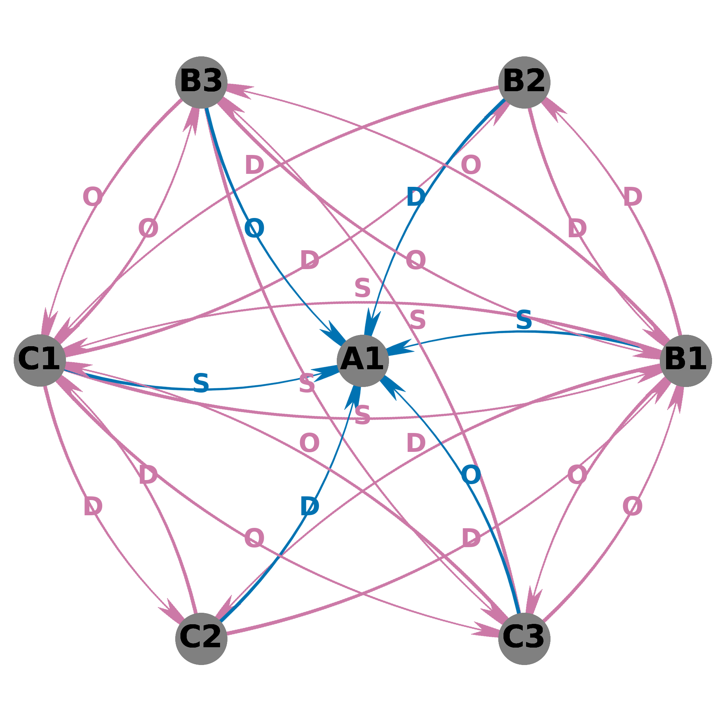





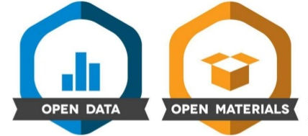
Automating RELATIONAL DERIVATION: tools for visualization and task generation
Matthias Raemaekers, Martin Finn and Jan De Houwer
HIGHLIGHTS
Researchers in various fields of psychological and computer science research agree that relational abilities are a cornerstone of human cognition and intelligence (McLoughlin et al., 2020), and many procedures have been developped to measure it (e.g., Colbert et al., 2020; Alexander et al., 2016; Raven & Raven, 2003, …).
We developped a set of open-source tools to facilitate research on relational abilities in both humans and artificial systems, allowing users to:
Automatically derive relations
Plot relational networks
Automatically generate syllogistic reasoning and match-to-sample tasks
DERIVATION TABLES
Derivation tables store patterns of relational derivation (mutual and combinatorial entailment) for different combinations of relations.
→ Digital versions of the tables can be used for automated relational derivation
→ Could be used in machine learning research, or to facilitate research on relational abilities
Mutual Entailment
Combinatorial Entailment (Linear)
Combinatorial Entailment (Many to one)
Comparative Relations (Linear)
Temporal Relations (Linear)
RELATIONAL TASK GENERATION
SYLLOGISTIC PROBLEMS
Syllogistic reasoning is considered a hallmark of human intelligence (e.g., Aristotle) and is studied in behavior-analytic research (e.g., Cassidy et al., 2011; Colbert et al., 2020), cognitive neuroscience (e.g., Goel & Dolan, 2001) and computer science (e.g., Hummel & Holyoak, 2001; Eisape et al., 2024).
Automated relation derivation allows for generating syllogistic reasoning problems :
Involving various (combinations of) relations
With user-specified problem variations (number of premises, premise order; irrelevant premise, …) and response format (open format, forced choice)
MATCH-TO-SAMPLE PROCEDURES
Match-to-sample procedures are very prevalent in research on stimulus equivalence (e.g., Sidman, 1994), Perez et al., 2023) and relational frame theory (e.g., Steele & Hayes, 1991)
Automated relation derivation allows for generating MTS procedures
Presets like Steele & Hayes (1992) or any user-defined constellation of relations
User-specified task parameters (training order, comparison stimuli, number of trials, …)
RELATIONAL NETWORK VISUALIZATION
Automated relation derivation for plotting user-specified relational networks
Presets like Steele & Hayes (1992) or any user-defined relations
Plot baseline and derived relations separately or together and modify plot visuals
Linear More Than Relations
Many-to-One Sameness Relations
LEB is the same as BEX. Is BEX the same as LEB?
GUB is before BIR.
BIR is before LOP. Is GUB to BIR the same as BIR to LOP?
GUB is more than BIR.
BIR is more than LOP. LOP is more than PAF. Is PAF more than GUB?
LEB is the same as BEX. BEX is opposite to PAF. PAF is opposite to GOR.
GOR is the same as NIB. GUK is the same as BEX Is BUR the same as DAV?
Steele and Hayes (1991) Trained
Steele and Hayes (1991) Derived
Training Baseline Relations
Mutual Entailment
Combinatorial Entailment
Contact OSF Project
matthias.raemaekers@ugent.be
@liplab.bsky.social
Matthias Raemaekers
(1)
S
A1
B1 B2 B3
(3)
O
A1
B1 B2 B3
(4)
S
A1
C1 C2 C3
(6)
O
A1
C3 C1 C2
(7)
S
B1
B2 A1 B3
(9)
O
B3
A1 B2 N1
(13)
O
B3
B2 B1 N1
(15)
O
C3
N1 C2 C1
(17)
S
B1
C2 C1 C3
(18)
O
B1
C1 C2 C3

