Slide 1

AIRLINE DATA ENGINEERING PLATFORM
A live medallion pipeline for airline & flight data
DataScientest Data Engineer Bootcamp — Capstone Project · Final Defense
Matthias Köhler · Pavel · Chaithra
20 July 2026

Slide 2




INTRODUCTION
The Challenge
Build a complete, production-style Data Engineering architecture around live airline / flight data — collection, storage, transformation, an API, automation, containerization, and a live dashboard.
Machine Learning performance is NOT the main objective. The main evaluation criterion is Data Engineering mastery.
No premium API access
Lufthansa's public API stayed closed — no token was ever issued to the project.
A partially network-restricted VM
OpenSky blocks the training/production VM's egress outright — the pipeline had to design around it, not ignore it.
— Nicolas, Mentor (DataScientest)
An evolving team and feature set
The team started at four, dropped to three mid-project, and scope shifted with it.
Recommended ML effort: 1–2 days max, Kaggle-inspired, ship and move on.
02

Slide 3

INTRODUCTION
The Team & Ownership
Matthias Köhler
Chaithra Varambaly
Pavel Borovskikh
Data Eng, Infra, Deployment, GitOps
Data Eng, ETL, Data Warehousing
Data Eng, API Integration, Dash, ML
Owns MongoDB (bronze layer), cloud infra, CI/CD, GitOps, ingress, and the Q staging environment.
ETL development and scheduling; warehouse exploration (Redshift silver & gold layers)
PostgreSQL on Supabase (silver layer); API integration; ML flight-delay service; the Dash dashboard
03
Supervised by mentor Nicolas (DataScientest). The team started at four; one member left early to focus on remaining bootcamp coursework.

Slide 4


PROJECT MANAGEMENT
Milestones & Workflow
0
1
2
3
4
🎓
Scoping
Data Discovery
API & Consumption
Automation
Deployment
Final Defense
07 May
20 May
10 Jun
16 Jun
02 Jul
20 Jul
GitHub Flow
Lesson learned — PR #24 → #25
Feature branches (feature/ · fix/ · chore/), never pushed to main
Every change reviewed and merged through a PR
Squash-and-merge — one commit per PR, linear history
A clean, “obviously safe” hotfix was merged on sight — it turned out to belong inside a larger effort instead, and had to be reverted.
Now codified as policy: never merge without asking — even a clean hotfix.
04

Slide 5

ARCHITECTURE
The Data Platform Architecture
OpenSky + adsb.lol
MongoDB Atlas
Python ETL
Supabase Postgres
Streamlit + FastAPI/Dash
Live states, ~50s cycle
Bronze — raw landing zone
silver.py, freshest-wins
Silver — map1
Gold — two live stacks
Bronze — raw · Silver — normalized · Gold — consumption
Cloudflare Tunnel — the only ingress
Outbound-only connection to the edge — zero inbound web ports on either VM.
Data stores are managed cloud services; every application service is one Docker container, deployed as its own Portainer GitOps stack auto-pulling main.
06

Slide 6
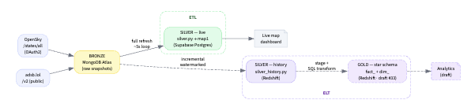
ARCHITECTURE
The Data Platform Architecture
06

Slide 7

DEEP DIVE — PILLAR 1 OF 4
Bronze — Ingestion
Dual-stream: OpenSky /states/all (primary, OAuth2) + adsb.lol (secondary, no auth) — every cycle, both sources
Lands raw and untransformed in MongoDB Atlas — “ingestion ≠ modeling,” Silver decides what to keep
Frankfurt bounding box (~150×150 km); adsb.lol's radius was tuned down after it filled the free-tier cluster in under a day
2 feeds
every ~50 seconds
WHY TWO SOURCES
OpenSky is richer but gets blocked outright from the production VM's AWS IP range. adsb.lol needs no auth and covers the same geography — built in as a safety net from day one.
07

Slide 8

DEEP DIVE — PILLAR 2 OF 4
Silver — Transform & Warehouse
silver.py flattens the freshest Bronze snapshot into a single live table, map1, on Supabase Postgres
Freshest-wins fallback by fetched_at — no manual failover branching, no environment-specific code
Real incident: OpenSky blocked the whole production VM IP range — adsb.lol took over automatically, dashboard never went dark
Target star schema (fact_states + dimension tables) is designed and documented — build-out is next
map1 live
since 2026-06-09
NEXT UP
The flat map1 table works for a live map today. The dimensional model (dim_aircraft, dim_airlines, dim_airports) is the next Silver milestone.
08

Slide 9

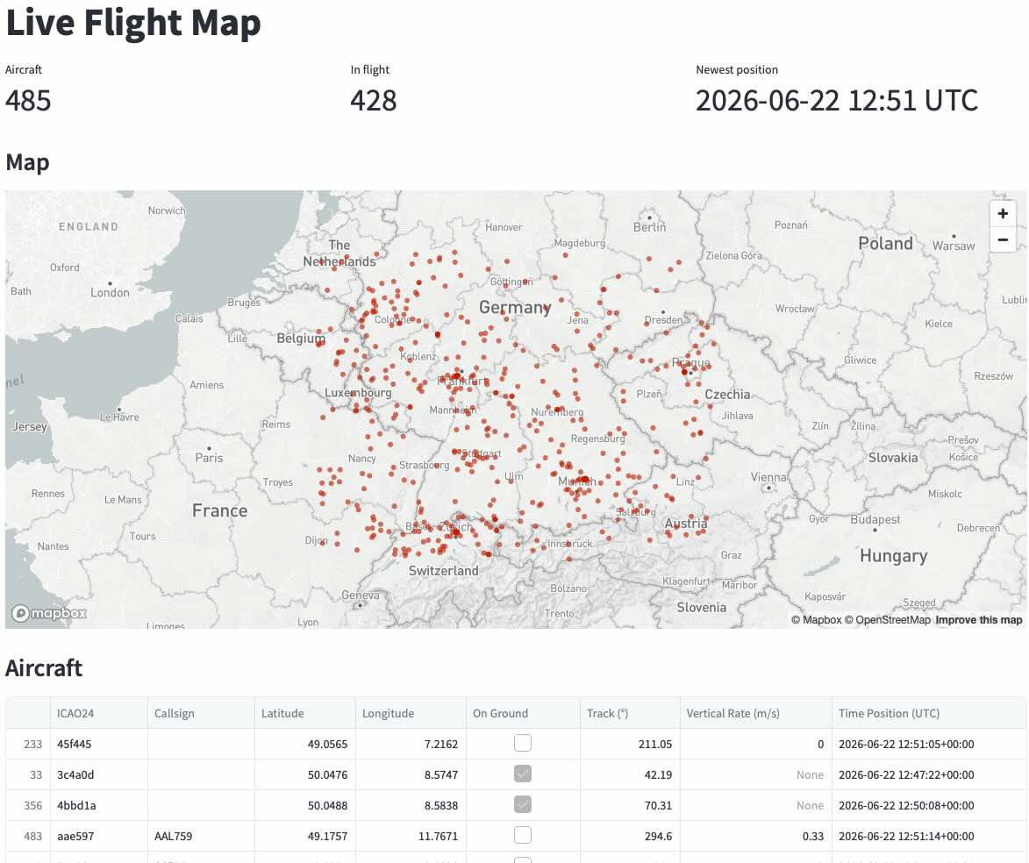
DEEP DIVE — PILLAR 3 OF 4
Data Consumption
Streamlit Dashboard
FastAPI + Dash
Two independent stacks, one source of truth
Reads map1 directly via psycopg2
Cached queries, live map + metrics
airline-dashboard.matthiaskoehler.com
Read-only API
Dash frontend polls every 45s
airlive.matthiaskoehler.com
Both read the same map1 table, built and deployed independently. Scope is deliberately positions, aircraft, and airline only — the live States feed carries no origin/destination or scheduled times, so no route or delay analytics.
09

Slide 10

DEEP DIVE — PILLAR 4 OF 4
Deployment & Infrastructure
Every service is one Docker container, one Portainer GitOps stack, auto-pulled from main
Images built once by CI and pushed to GHCR — nothing is ever built on the VM
Cloudflare Tunnel is the only ingress: outbound-only, zero inbound web ports, nginx removed
A full Q (staging) environment, Terraform-managed, mirrors production for PR previews
0 open ports
GitOps everywhere
SECURITY POSTURE
With cloudflared handling all public ingress, the only thing reachable from the open internet by IP is SSH — everything else is edge-routed.
10

Slide 11


BONUS — BEYOND SCOPE
ML: Flight Delay Prediction
Built despite the mentor explicitly de-prioritizing ML performance as an evaluation criterion
Kaggle Airlines Delay dataset — 539,382 flights, no missing values
Three candidates compared; HistGradientBoostingClassifier selected on validation ROC-AUC
Shipped as its own live FastAPI service — /predict and /predict/batch, deployed via Portainer
539,382
0.721
0.667
training flights
test ROC-AUC
test accuracy
HONEST LIMITATION
An ROC-AUC around 0.72 is in line with published results on this dataset: delays are driven heavily by factors it doesn't capture — weather, ATC, mechanical issues, cascading delays from an aircraft's earlier leg.
11

Slide 12

CONCLUSION
Next Steps — Taking It Further
1
Build the target star schema
2
Ship the planned FastAPI
Promote map1 into fact_states + dim_aircraft / dim_airlines / dim_airports, as already designed in ADR 008/009.
03-gold/api's /states, /aircraft, /airlines, /airports endpoints are designed but not yet built — the current APIs are narrower, read-only services.
3
Route & delay analytics
4
Orchestrated automation
Needs a data source with origin/destination and scheduled times — the live States feed doesn't carry them.
Move batch scheduling from a Docker sleep-loop toward Airflow as volume and complexity grow.
5
Redshift silver-history warehouse
6
Harden CI/CD
Chaithra's exploratory draft (PR #33) — a historical analytics store alongside the live Silver table.
Broaden automated test coverage and formalize the release pipeline beyond lint + build.
13

Slide 13
Thank You
Live Demo
airline-dashboard.matthiaskoehler.com · airlive.matthiaskoehler.com
Matthias · Pavel · Chaithra
14

Slide 14
RESULTS
Where We Stand Today
16
2
2
ADRs documenting every major decision
live ingestion sources, dual-stream
independent Gold consumption stacks
1
0
1
ML service live in production
inbound web ports open on either VM
full staging environment (Q) for PR previews
12

Slide 15
PROJECT MANAGEMENT
Task Ownership
Area | Owner | Status
Cloud infrastructure, deployment, GitOps, CI/CD, ingress | Matthias | Live in production
API integration; ML flight-delay prediction service; Dash dashboard; PostgreSQL (Supabase) | Pavel | Live in production
ETL development and scheduling; warehouse exploration (Redshift silver & gold layers) | Chaithra | Live in production Exploratory / draft
Architecture decisions — 16 ADRs documenting the why | Shared | Ongoing
05

