Slide 1
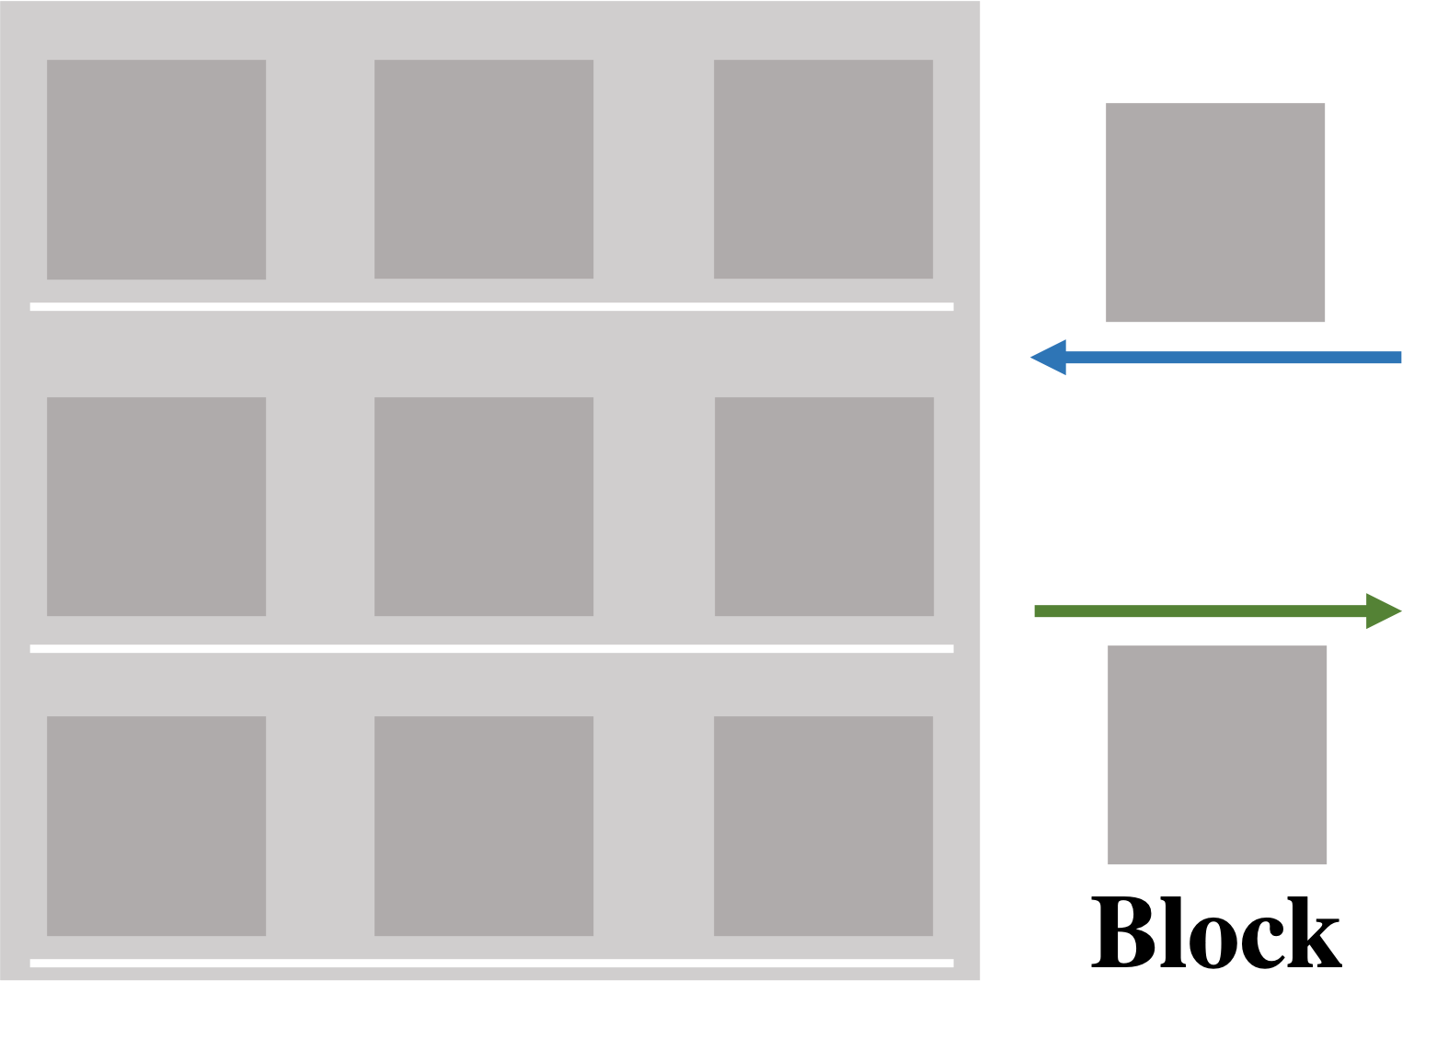
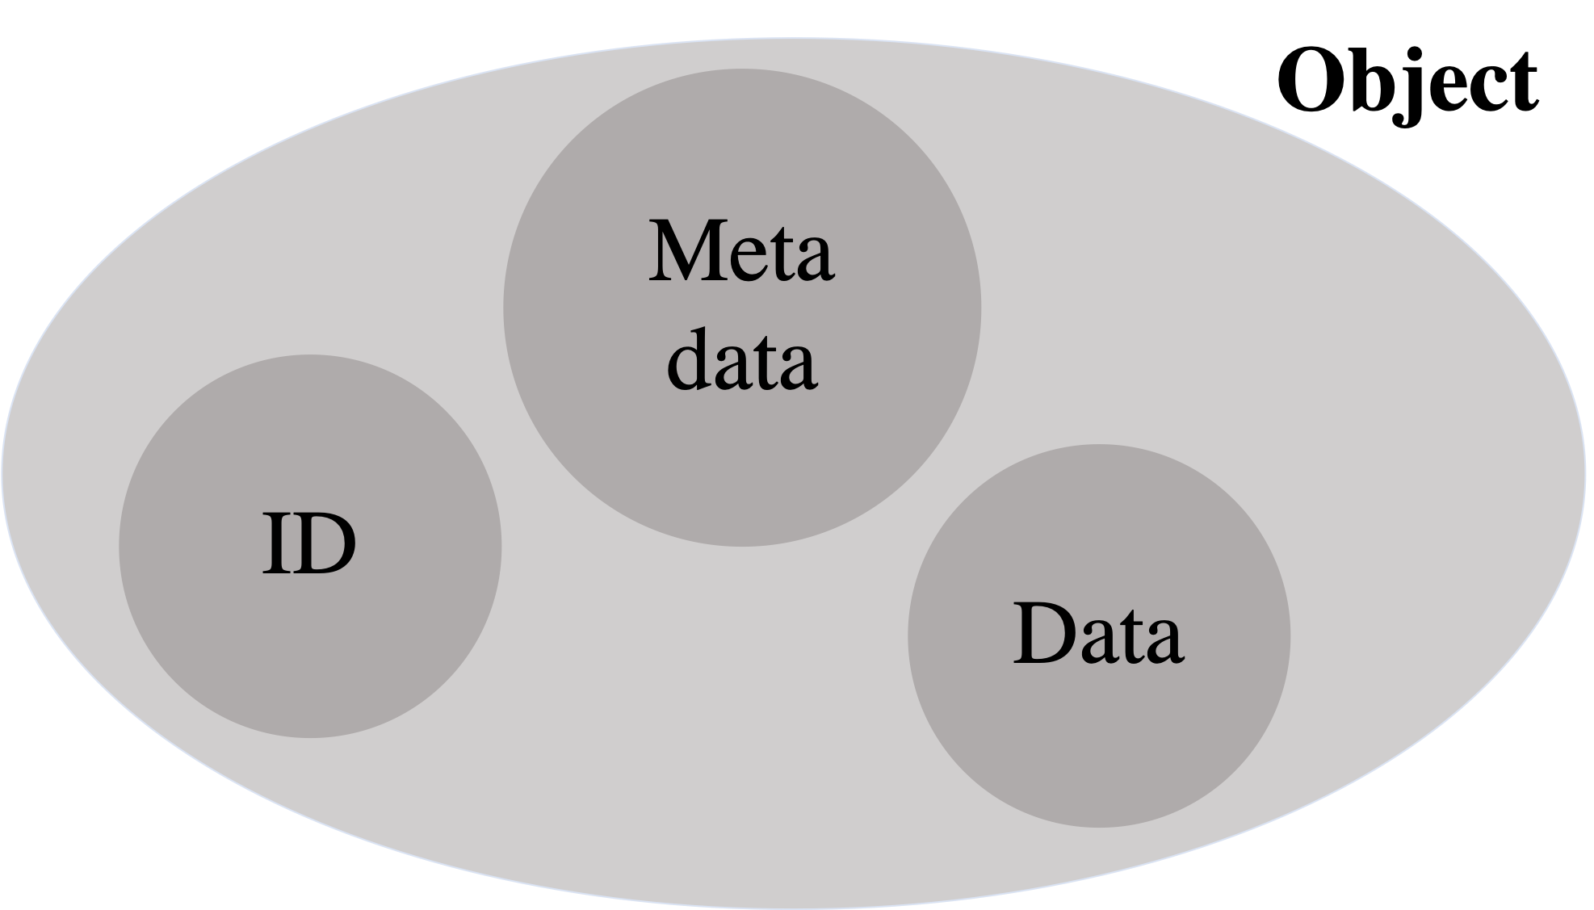
Block storage
Object storage
Files stored as split fixed-sized blocks
Blocks combined into original file upon request
Useful for:
Databases
Data which is constantly altered
Scalability issues
Data stored in ”objects” containing…
Identifier (unique)
Data No limitation on
Metadata type or amount
Useful for:
Large amounts of data
Data in need of high availability/durability.
Altering issues
Notes:
Block storage
Files stored as split fixed-sized blocks
Each block own address – combined into original file upon request
No additional metadata
Use case: Structured data e.g. databases, constantly altered data.
Scalability issues
Object storage
Data stored in ”objects” containing…
Identifier (unique)
Data No limitation on
Metadata type or amount
Highly scalable – additional nodes added
Useful for:
Large amounts of data
Data in need of high availability and durability.
Altering issues

Slide 2
Safespring Storage
Key-pair
Access key: ”username”
Secret key: grants access
Access by
Generated by and received from Safespring.
Contact: onboarding@cloud.ipnett.com
Packages
GUIs
s3cmd
CloudBerry
s3fs
etc…
etc…
CyberDuck
Notes:
To access safespring – need key pair: Access key + Secret key --> stored in configuration file.
Accessing s3 can be done by using bash (or other languages) packages, or with specific interfaces → more user friendly.

Slide 3
S3cmd example
List your buckets
Create bucket (object)
$ s3cmd ls
date time s3://my-first-bucket
$ s3cmd mb s3://my-bucket-name
Bucket ‘s3://my-bucket-name/’ created
Upload
$ s3cmd put my-local-file s3://my-bucket-name/my-uploaded-file
upload: 'my-local-file.txt' -> 's3://my-bucket-name/my-uploaded-file.txt' [1 of 1]
20 of 20 100% in 0s 1144.30 B/s done

Slide 4






Cloud based storage
Data Delivery from facilities to users
Components:
Web interface
Command line interface
Graphical user interface?

