Slide 1
Handling schema drift in Eventhouse
A reusable pattern for JSON that changes over time Accept new data without making downstream schemas unpredictable
PUBLIC REFERENCE IMPLEMENTATION

Slide 2
Schema drift is more than a new field
02
• A producer adds a measurement
• A number starts arriving as text
• A property disappears from some messages
• A nested object changes shape
• An array contains a different number of items
ADD | REMOVE | RETYPE

Slide 3
Flexible input, stable output
03
• Producers need room to evolve their messages
• Reports and APIs need columns they can rely on
• Rejecting every change loses useful data
• Accepting every key as a column creates an unstable contract
• The design has to serve both sides
FLEXIBLE → STABLE

Slide 4
The five principles
04
• Keep the original message for investigation and replay
• Separate the input shape from the consumer contract
• Preserve unfamiliar values in residual JSON
• Detect drift without stopping known-field processing
• Promote a field only after review
KEEP → DETECT → REVIEW

Slide 5
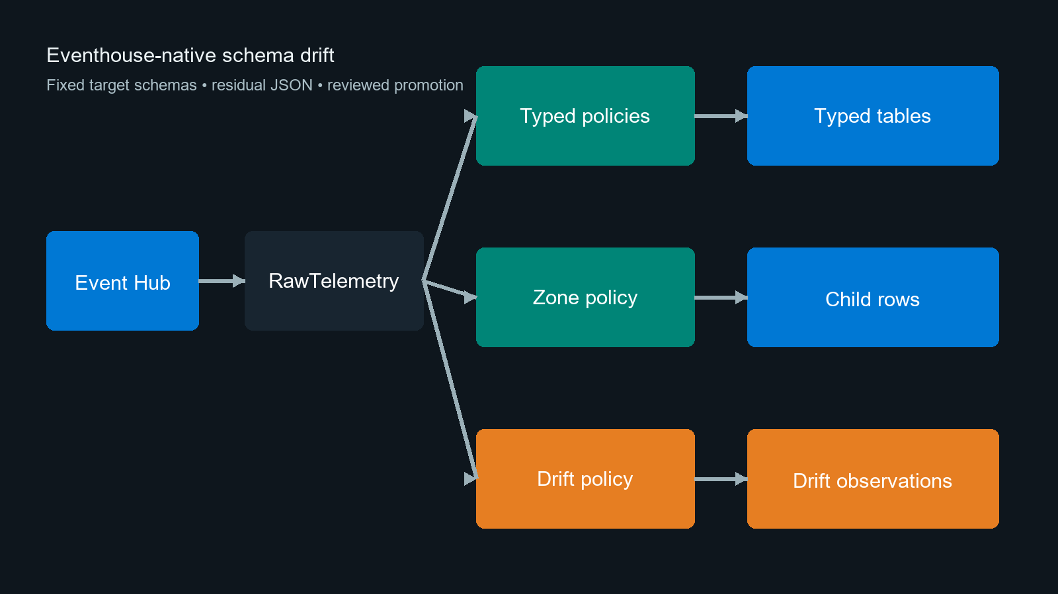
How the pieces fit together
05
• RawTelemetry is the recovery point
• Stored functions create fixed typed rows
• Update policies run those functions on arrival
• A separate path records drift for review
• Arrays are written as child rows
No routine telemetry export

Slide 6
A new field arrives
06
• Controller 01 is still reporting its usual measurements
• Firmware version 2 adds serviceCountdownHours: 120
• There is no matching target column yet
• The value must survive without holding up the rest of the row
"sourceType":"controller", "schemaVersion":2, "telemetry": { "controllerStatus":"running", "engineHours":1251.0, "fuelConsumption":8.2, "serviceCountdownHours":120 }

Slide 7
First, keep the whole payload
07
• A few envelope values are mapped to columns
• DropMappedFields leaves everything else in RawRecord
• The landing table does not change when the payload does
SourceType controller SchemaVersion 2 RawRecord { "payload":{"telemetry":{ ..., "serviceCountdownHours":120 }}}

Slide 8
Then write the fields we know
08
• The transform casts each approved value explicitly
• bag_remove_keys leaves the new property in ResidualTelemetry
• Reports continue to see the same columns as before
ControllerStatus running EngineHours 1251.0 FuelConsumption 8.2 ResidualTelemetry { "serviceCountdownHours":120 }

Slide 9
Update policies do the routine work
09
• One policy writes the controller row
• Another checks the same message for unknown fields
• There is no notebook schedule or export watermark in between
{"Source":"RawTelemetry", "Query":"TransformControllerTelemetry()", "IsTransactional":false} Raw row → typed row → drift observation

Slide 10
The new field goes onto the review list
10
• bag_keys finds serviceCountdownHours
• gettype records long; the sample value is 120
• Normal controller processing carries on while the team reviews it
SourceType controller FieldPath serviceCountdownHours ObservedType long SampleValue 120 bag_keys + mv-expand + set_has_element + gettype

Slide 11
Arrays are handled as rows
11
• This cooling-unit message has two zones
• mv-expand writes two child rows and keeps the zone IDs
• A message with an empty zones array writes no child rows
Device Zone Mode Return Setpoint cooling-01 1 cool 2.8 2.0 cooling-01 2 defrost 5.1 4.0 | mv-expand Zone=Zones

Slide 12
Promotion is a normal code change
12
• The team agrees the name, meaning, unit, and type
• The PR adds the column and updates the stored function
• After a schema check, only the agreed history is replayed
BEFORE Residual {"serviceCountdownHours":120} AFTER ServiceCountdownHours 120.0 Residual {} .alter-merge + .set-or-append

Slide 13
An alert starts the conversation
13
• Do not alert for every message; aggregate first
• Here, 10 observations in 15 minutes is enough to open a ticket
• The ticket carries the type, sample, asset count, and time range
controller serviceCountdownHours Type long Sample 120 Assets 47 Events 8,212 → Teams → DATA-1842

Slide 14
Who looks at the ticket?
14
• Operations checks that ingestion is healthy
• The source owner confirms the firmware change
• The domain owner explains what the field means
• Engineering profiles the data and prepares the change
• Consumer and change owners sign off before deployment
PROFILE → APPROVE

Slide 15
What the on-call engineer sees
15
• Is data arriving, and are typed tables keeping up?
• Which new fields appeared after the latest release?
• Are known fields failing type conversion?
• How large is the residual backlog?
• Are arrays producing an unexpected number of rows?
OPERATIONS VIEW

Slide 16
Not every field becomes a column
16
• Promote it when the meaning is stable and consumers need it
• Keep it in residual JSON when it is sparse or diagnostic
• Reject or quarantine accidental, malformed, or sensitive data
• Record the decision so the same ticket does not return tomorrow
3 DECISIONS

Slide 17
Where this can simplify an existing design
17
• Some teams currently flatten JSON in Spark, pipelines, or application code
• Keep that processing when it adds capabilities KQL does not provide
• Move routine parsing and drift observation closer to ingestion when it reduces data movement
• Compare both paths with representative volume before cutting over
MOVE ONLY WHAT FITS

Slide 18
A sensible way to start
18
• Shadow one source type before changing the current path
• Measure ingestion cost, latency, array growth, and completeness
• Exercise failure and replay while the blast radius is small
• Change the existing process only after the numbers and outputs agree
SHADOW → BENCHMARK

