Slide 1
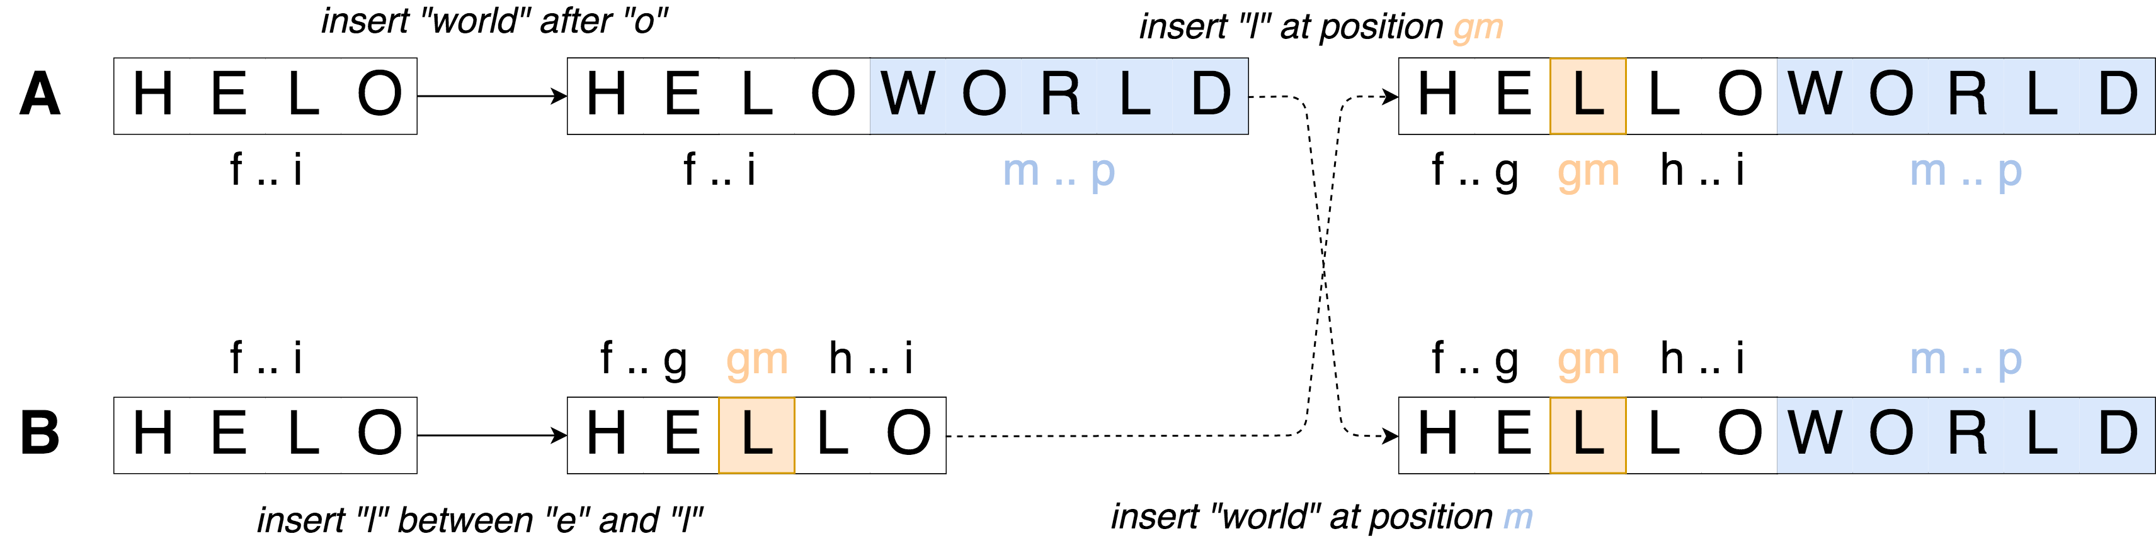
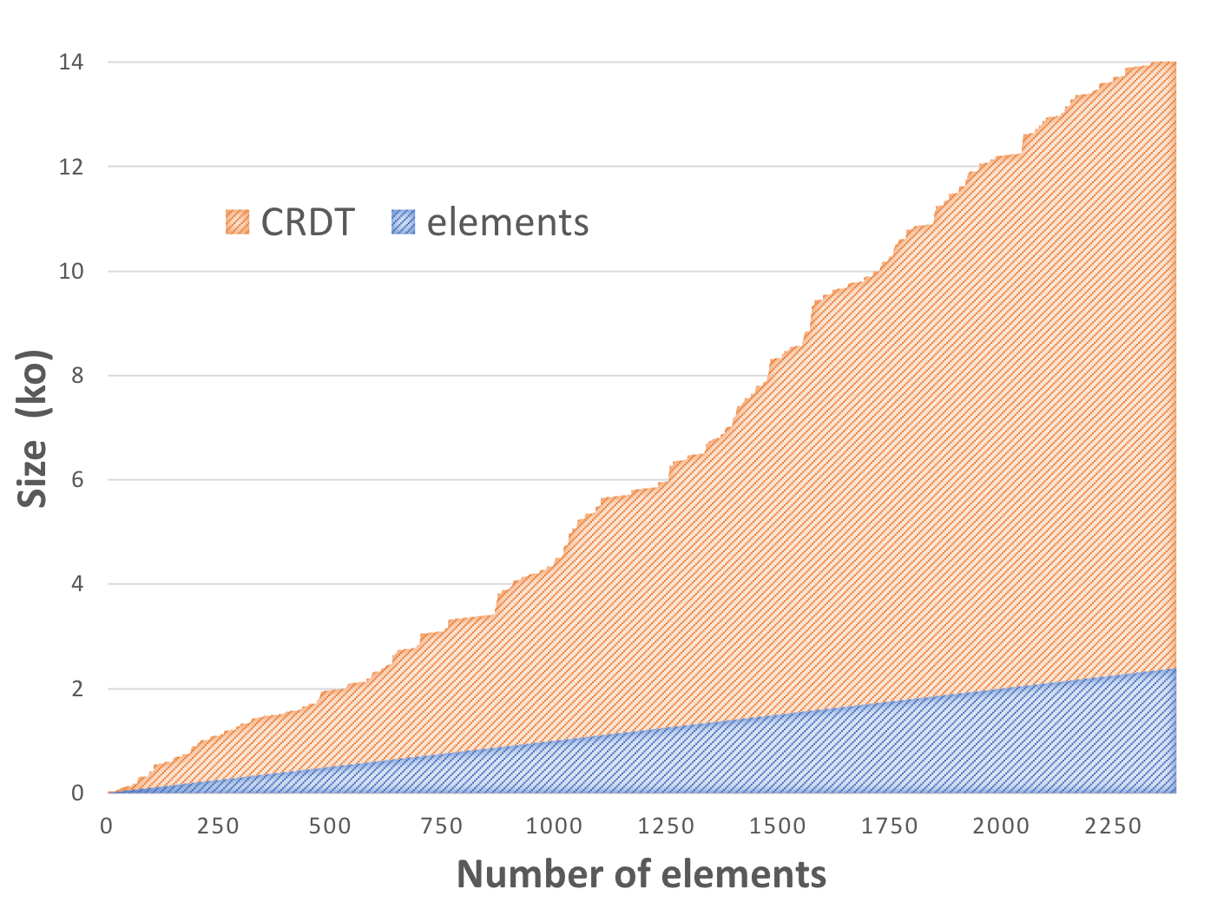
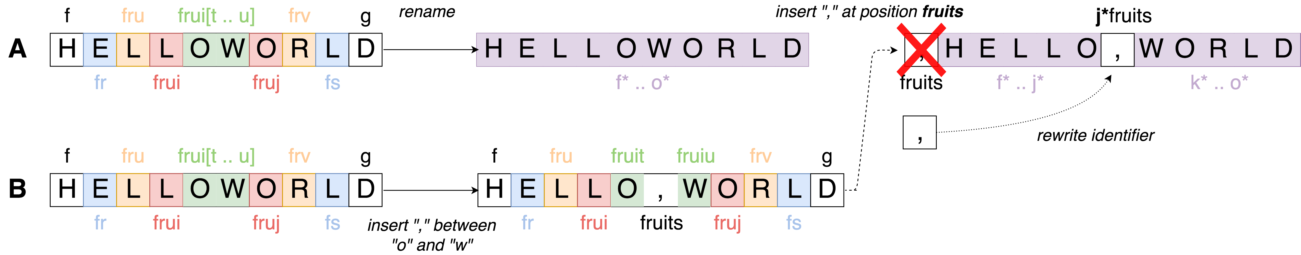




Efficient Renaming in Conflict-Free Replicated Data Types (CRDTs)
Case Study of a Sequence CRDT : LogootSplit
Matthieu Nicolas (matthieu.nicolas@inria.fr), Gérald Oster, Olivier Perrin
CRDTs [2]
Limits
Replicated data structure
Updates performed without coordination
Strong Eventual Consistency [2]
Attach an identifier to each element
Size of identifiers not bounded
Overhead of the data structure increasing over time
How to reduce the overhead introduced by the data structure ?
Reassign shorter identifiers in a fully distributed manner
Rename operation
Rewriting rules
Reassign shorter identifiers to whole current state
Concurrent insert or delete can not be applied as such
Define rewriting rules for concurrent updates
Concurrent rename operations
Define a total order on rename operations
Pick a “winner” operation between concurrent renames
Add rewriting rules to undo effects of “losing” ones
Propose a fully distributed renaming mechanism for LogootSplit [1]
Designed the rename operation
Defined rewriting rules to deal with concurrent updates
WIP: Implementation in MUTE (https://coedit.re/)
WIP: Design the strategy to trigger the renaming
Prove formally its correctness
Benchmark its performances
Next Steps
References
Generalize the approach to other CRDTs
To other Sequence CRDTs
To other types (Counter, Set, …)
[1] L. André, S. Martin, G. Oster, and C.-L. Ignat.
Supporting adaptable granularity of changes for massive-scale collaborative editing.
In International Conference on Collaborative Computing: Networking, Applications and Worksharing - CollaborateCom 2013.
[2] M. Shapiro, N. M. Preguiça, C. Baquero, and M. Zawirski.
Conflict-free replicated data types.
In Proceedings of the 13th International Symposium on Stabilization, Safety, and Security of Distributed Systems, SSS 2011.

