Slide 1
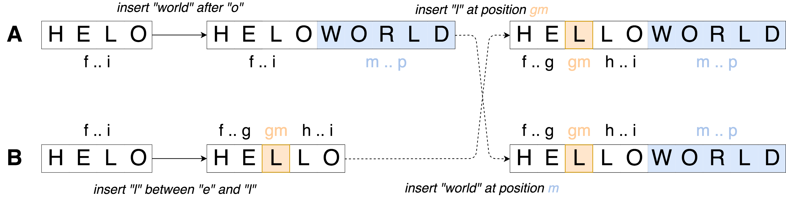
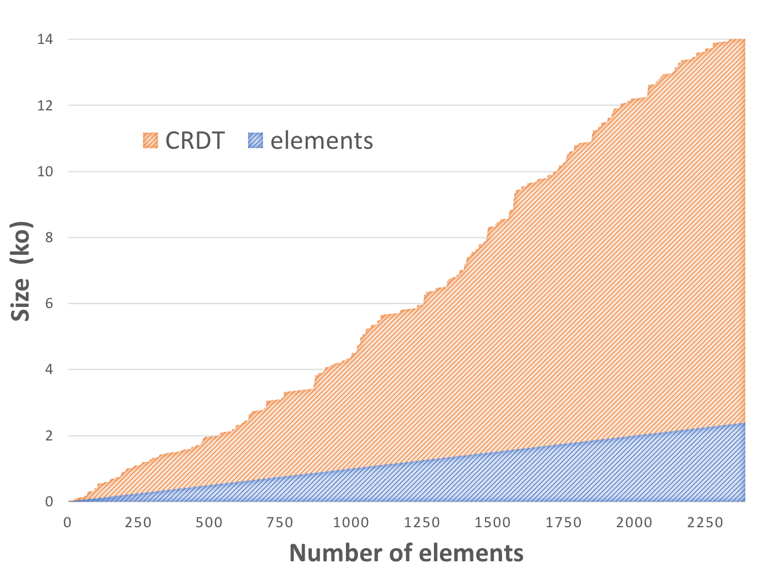
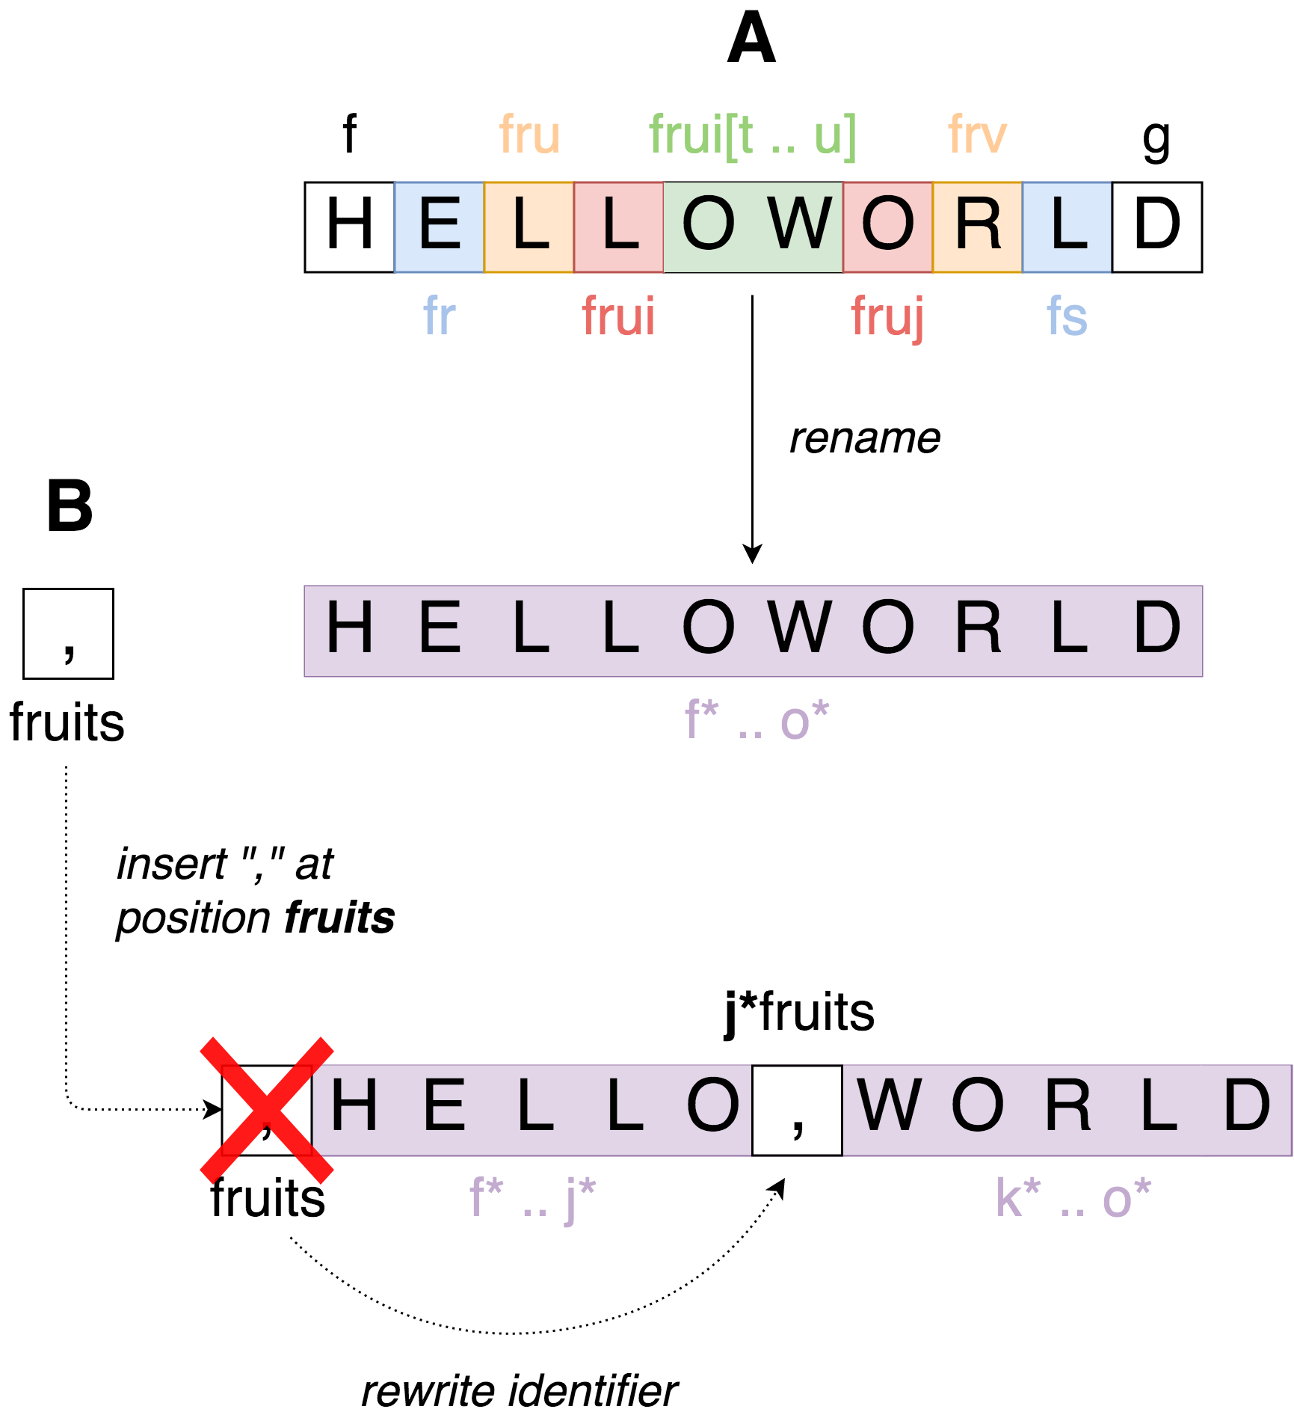







Efficient Renaming in Conflict-Free Replicated Data Types (CRDTs)
Case Study of a Sequence CRDT : LogootSplit
Matthieu Nicolas (matthieu.nicolas@inria.fr), Gérald Oster, Olivier Perrin
CRDTs [1]
Replicated data structure
Updates performed without coordination
Strong Eventual Consistency [1]
Limits
How to reduce the overhead introduced
by the data structure ?
Attach an identifier to each element
Size of identifiers not bounded
Overhead of the data structure increasing over time
Reassign shorter identifiers in a fully distributed manner
Rename operation
Reassign shorter identifiers to whole current state
Can be performed without coordination
Rewriting rules
Can not apply concurrent insert or delete as such
Define rewriting rules to handle concurrent updates
Concurrent rename operations
Proposed rename operation not commutative
Define a total order on rename operations
Pick a “winner” operation between concurrent renames
Add rewriting rules to undo effects of “losing” ones
Propose a fully distributed renaming mechanism for LogootSplit [2]
Designed the rename operation
Defined rewriting rules to deal with concurrent updates
Implementing in MUTE (https://coedit.re/)
Designing the strategy to trigger the renaming
Prove formally the correctness of the renaming mechanism
Benchmark its performances (Memory, CPU, Bandwidth, …)
[1] M. Shapiro, N. M. Preguiça, C. Baquero, and M. Zawirski.
Conflict-free replicated data types.
In Proceedings of the 13th International Symposium on Stabilization, Safety, and Security of Distributed Systems, SSS 2011.
[2] L. André, S. Martin, G. Oster, and C.-L. Ignat.
Supporting adaptable granularity of changes for massive-scale collaborative editing.
In International Conference on Collaborative Computing: Networking, Applications and Worksharing - CollaborateCom 2013.

