Slide 1
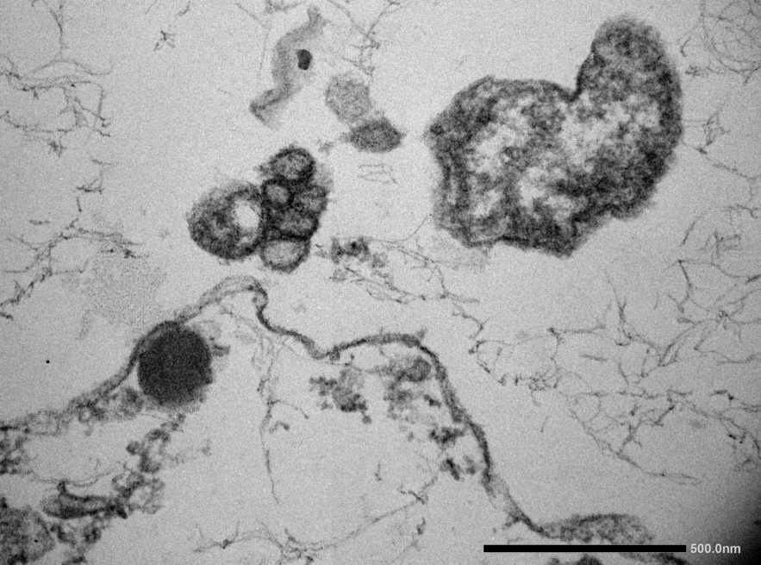
Group of virus praticles (arrow) between hemocytes.

