Slide 1





Laboratory of Viral Metagenomics
&
Molecular and Cell Biology Laboratory
Presents a training:
Introduction
to
7th - 9th November 2023

Slide 2
What is R ?
Computer language to allow manipulation of data, statistical analysis and visualization
Good things about R
It's free
It works on Windows, Mac and Linux
It can deal with very large datasets Supports all statistical analyses
Bad things about R
As difficult as learning any language
Low consistency
Poor documentation

Slide 3
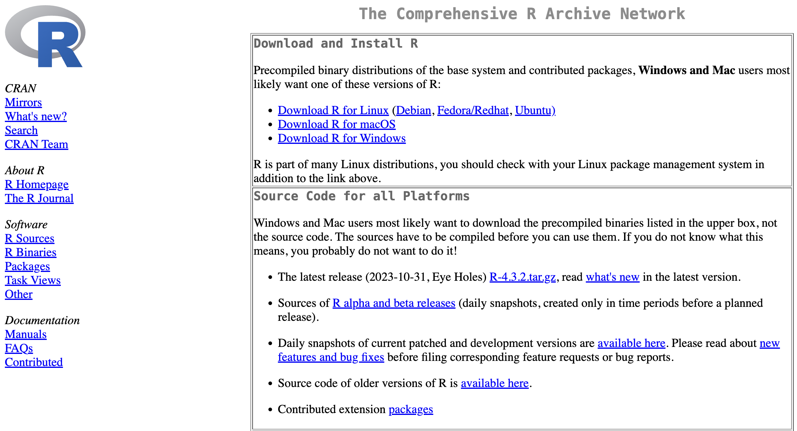
Installation
Installing R
https://cran.r-project.org/
Installing Rstudio
https://www.rstudio.com/

Slide 4
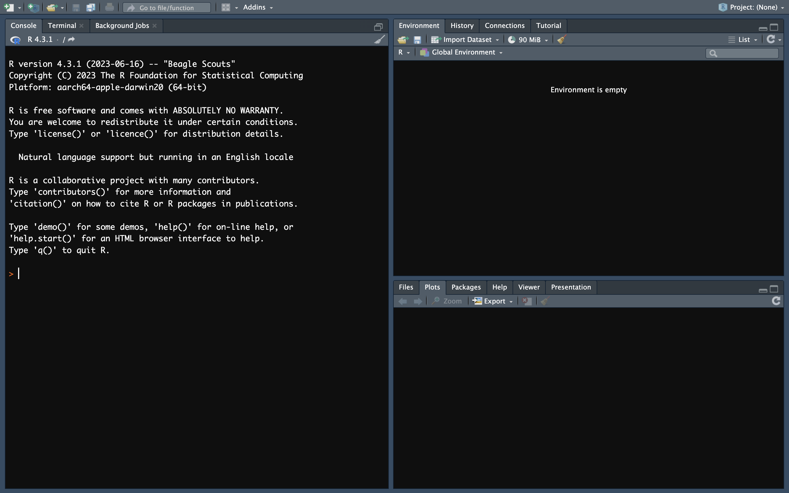
User interface

Slide 5
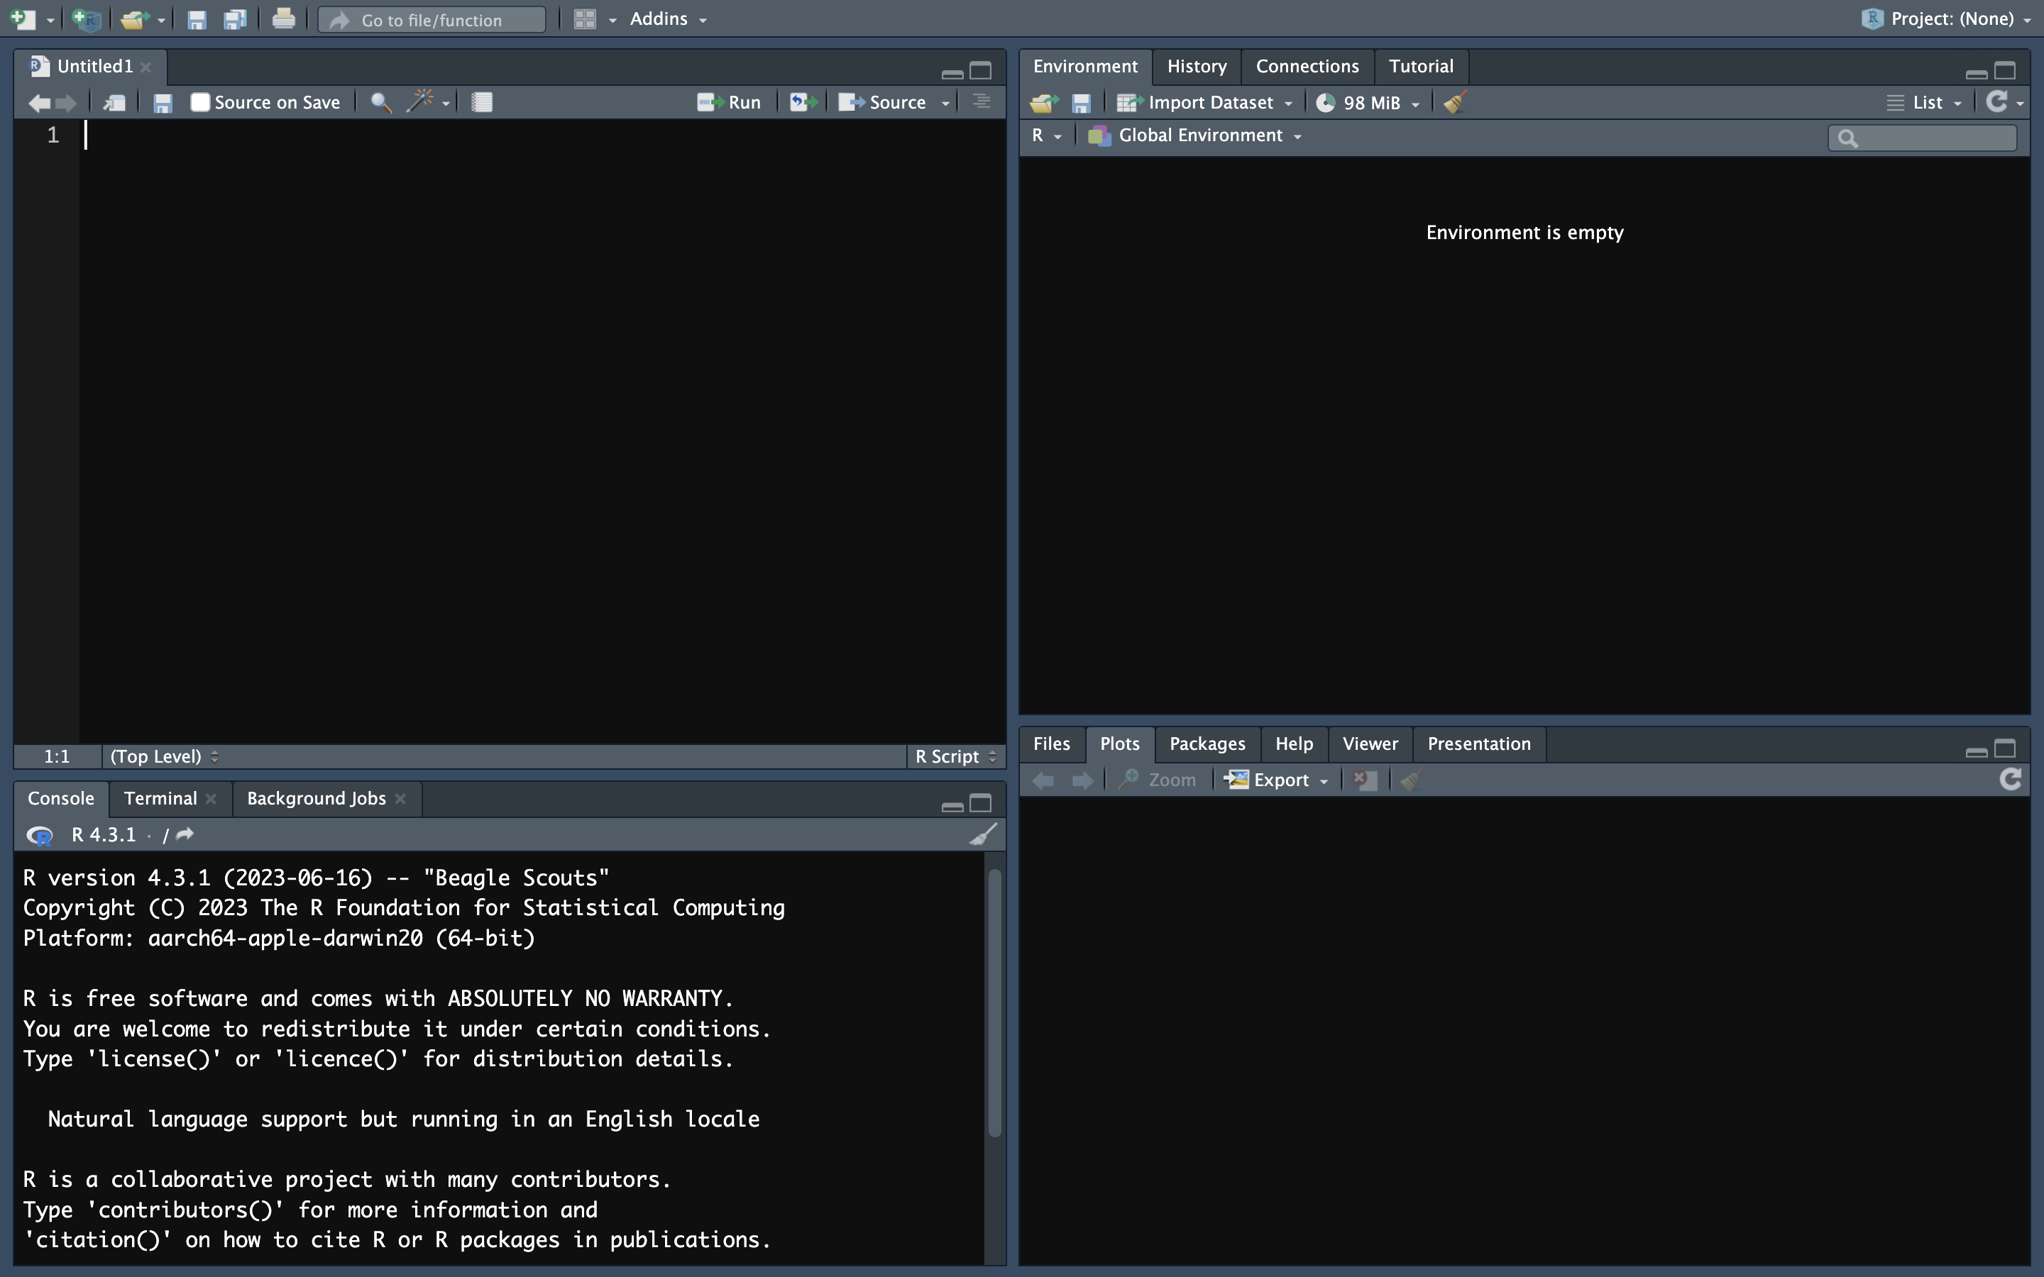
User interface
Scripts Editor
Write or Load scripts
Run commands

Slide 6
User interface
Console
Execute R scirpts/commands

Slide 7
User interface
Workspace browser
Overview of all data/variables imported/generated

Slide 8
User interface
Folders and their content on your computer
Generated figures

Slide 9
Script editor
👉🏾
👉🏾
New script
Save script
Save As: Rscript.R
Notes:
A script is a text file that contains all the commands you want to run.

Slide 10
Script editor
👉🏾
New script
Notes:
A script is a text file that contains all the commands you want to run.

Slide 11
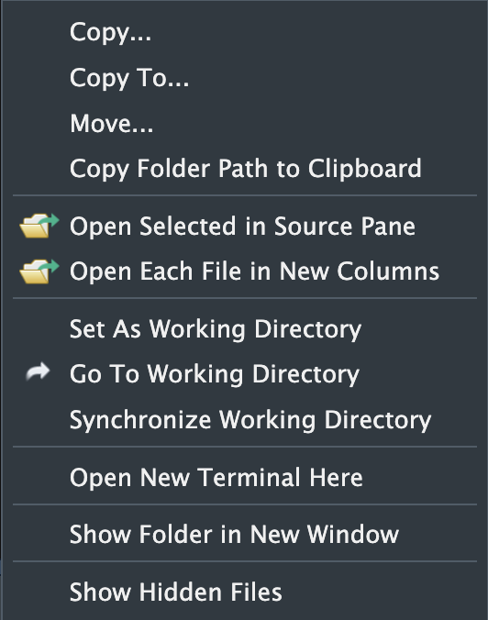
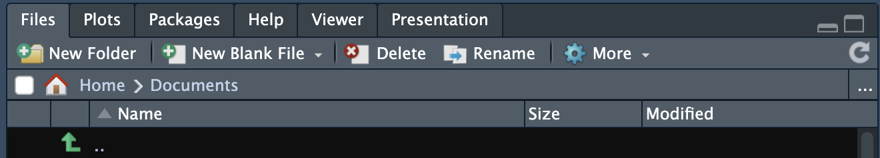
Set working directory
New script
#Set working directory
getwd()
setwd("~/Desktop")
👈🏾
👈🏾
👉🏾
Notes:
A script is a text file that contains all the commands you want to run.

Slide 12
Basic syntax in R
Character data
Text should be inside quotes (single or double)
"Hello"
"say \"Hello\""
Booleans
Boolean values are TRUE and FALSE but NOT inside quotes
TRUE = 1
FALSE = 0
Missing values
Represented by NA (Not Available) without quotes.
NA represents both missing character and numeric data.

Slide 13
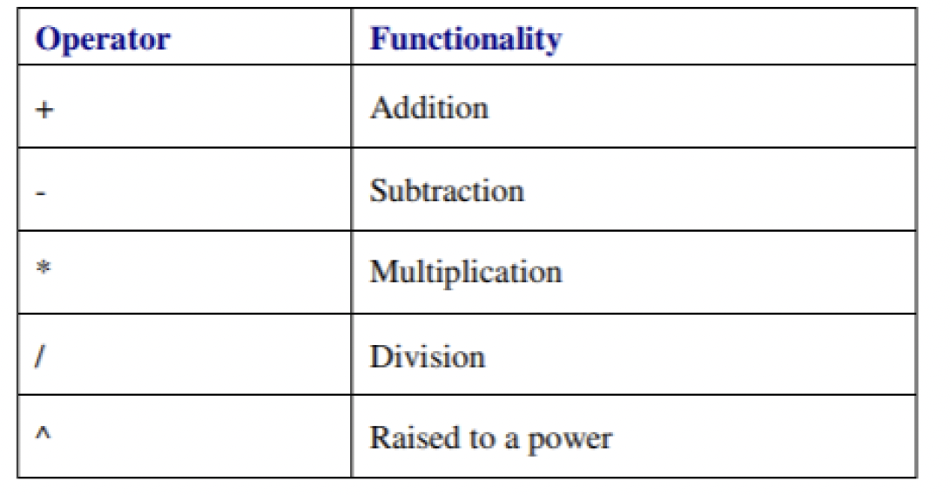
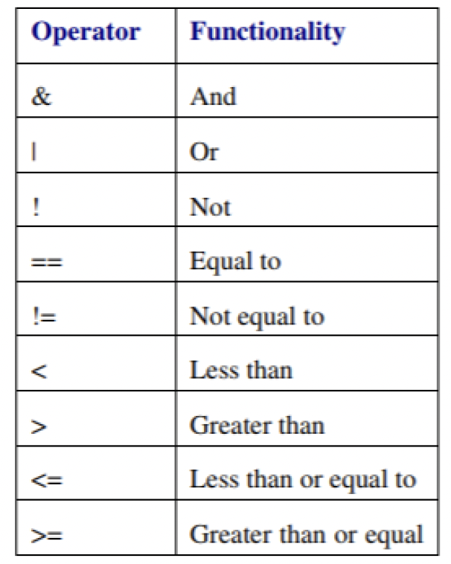
Arithmetic operators
Follows EDMAS
Logical operators
used to selectively execute code

Slide 14
Useful links
Documentation: https://www.rdocumentation.org/
Google for R: https://rseek.org/
Programming rules for R: https://google.github.io/styleguide/Rguide.xml

Slide 15
Quiz
1. You can set the working directory via the Files tab but you can also use a command: setwd() stands for set working directory. This command needs to know the path to the folder on your computer that you want to use as working directory.
Which of the options below will set the working directory?
setwd(/Users/Desktop)
setwd("/Users/Desktop")
2. What will be the output of this line of code?
“useR” == “user”
FALSE
Nothing
TRUE
3. What will be the output of this line of code?
TRUE == 1
FALSE
Nothing
TRUE
1

