Slide 1
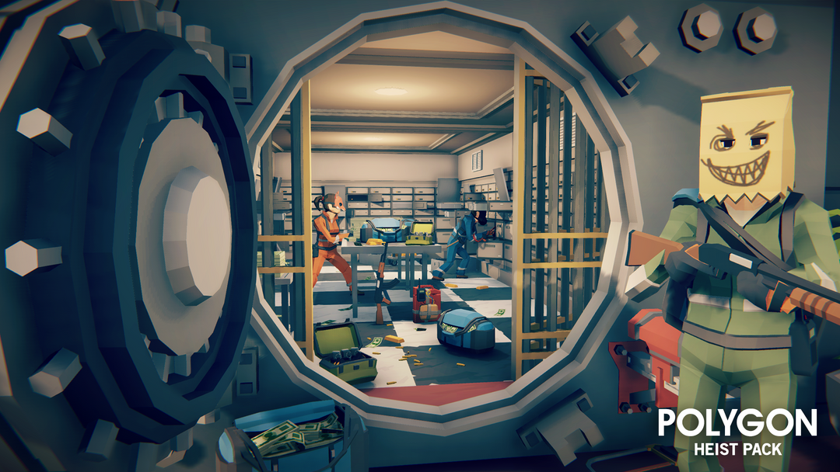
Heist of Reckoning
By Ethan, Matthius and Paul

Slide 2
Matthius

Slide 3

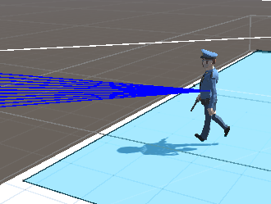
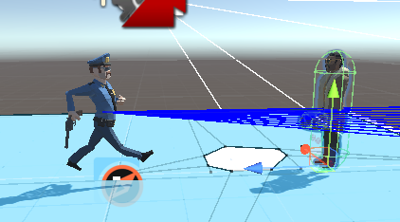
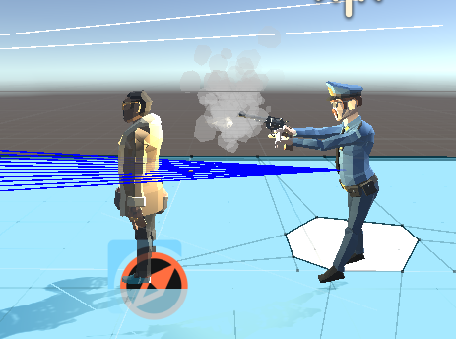
NPC - Police
Police is made using a finite state machine and has 3 states
Pursue – where they will chase the player if they have been detected for at least 0.5 seconds
Wander – where they will walk to random locations
Shoot – once the player is in range the police will shoot at them.
If they get out of range they return to pursue

Slide 4
Paul

Slide 5
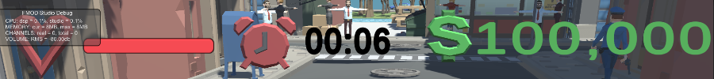
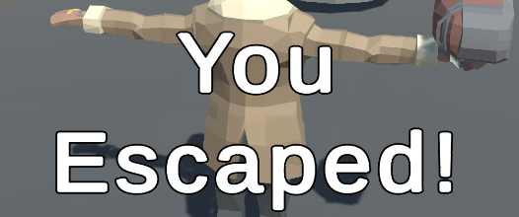
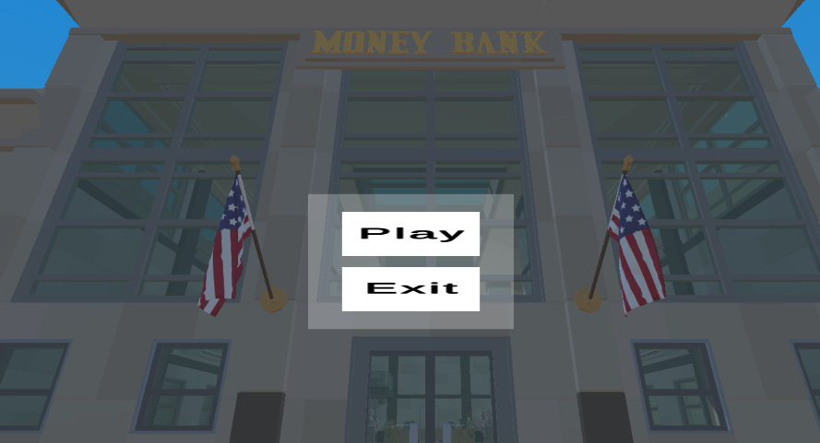
Full UI implementation
Health timer and money UI is fully implemented and functioning
Win dialogue for escaping accessible from the car and on top of the hotel.
UI navigation – Main menu can be used in editor to exit and in build to close it.

Slide 6
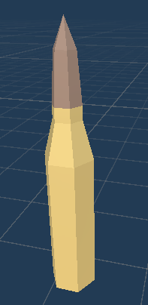

Damage implementation
Bullets fired from police officers can collide with player and damage them.
Bar can decrease in response to the player taking damage from the police shooting them

Slide 7
Ethan

Slide 8
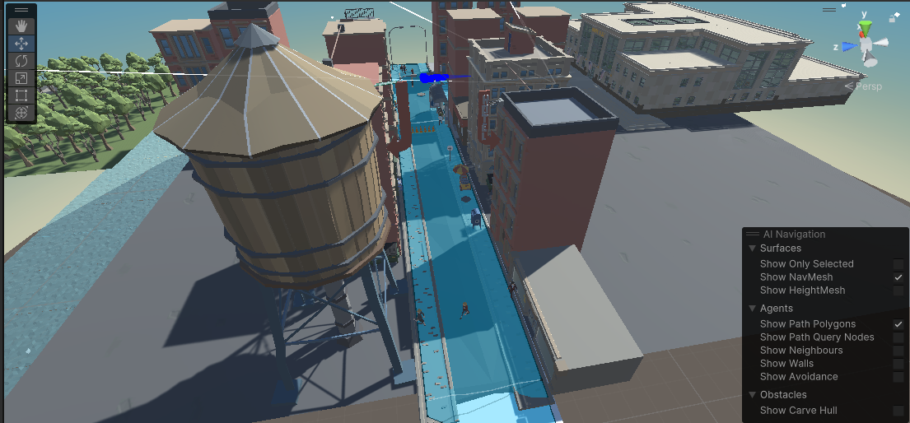
Secondary route added
Figure 1.0
The second route that the player can use to escape the police is via the rooftops of various hotels. The player can reach this new route by climbing the fire escape stairs attached to one of the hotels.

Slide 9
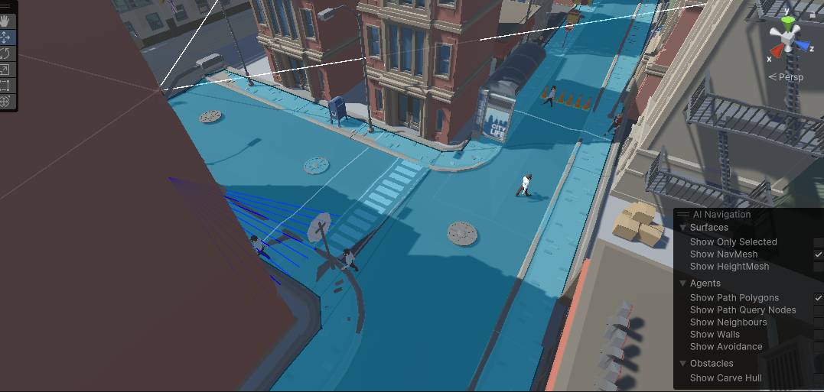
NPC’s
Added NPC’s that use behavior bricks. The NPC’s will wander around the street and slow the player down if they happen to bump in to any of them.
Figure 2.0

