Slide 1
Heist of Reckoning
By Ethan, Matthius and Paul

Slide 2
Themes
Platformer
RPG
Stealth

Slide 3
Game Mechanics Core gameplay: Get to the getaway vehicle while escaping the police
Difficulty (Change the time of day)
Different routes (Building, Sewers)
Local Multiplayer

Slide 4
Player Abilities
Throw money (Attract civilians to the area)
Disable camera (Hide from view)
Hide in box (to avoid camera)

Slide 5
NPCs
Police
Helicopter Police
Civilians

Slide 6
Inspiration
Yakuza 0 – money throwing
Payday
Shrek 2
GTA 5
Spiderman 2019 – get stealth mission
Batman arkham knight -
Metal gear – sneak under box
Watch dogs: Legion – disable cameras

Slide 7
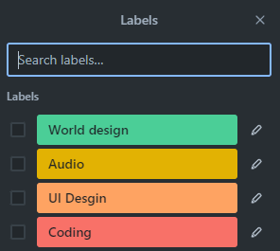
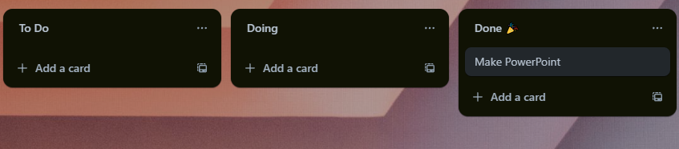
Breakdown of workload
Using Trello for Kanban
Allowing us to assign ourselves to tasks
Using labels to keep tasks clear

Slide 8
Assets
Synty Store. (n.d.). Simple Sky Cartoon Assets | Free Low-Poly Game Assets. [online] Available at: https://syntystore.com/en-gb/products/simple-sky-cartoon-assets?_pos=1&_psq=sky&_ss=e&_v=1.0 [Accessed 2 Feb. 2024].
‌Synty Store. (n.d.). POLYGON - Heist Pack Game Assets - Find the Unity Asset in Store. [online] Available at: https://syntystore.com/en-gb/products/polygon-heist-pack?_pos=1&_psq=heist&_ss=e&_v=1.0 [Accessed 2 Feb. 2024].
‌Synty Store. (n.d.). POLYGON - Icons Pack Game Assets - Find the Unity Asset in Store. [online] Available at: https://syntystore.com/en-gb/products/polygon-icons-pack?_pos=1&_psq=icon&_ss=e&_v=1.0 [Accessed 2 Feb. 2024].
‌Synty Store. (n.d.). POLYGON | Gang Warfare Game Assets | SyntyTM Official Store. [online] Available at: https://syntystore.com/en-gb/products/polygon-gang-warfare-pack?_pos=1&_psq=gang&_ss=e&_v=1.0 [Accessed 2 Feb. 2024].
‌Synty Store. (n.d.). POLYGON | City Pack Game Assets | SyntyTM Official Store. [online] Available at: https://syntystore.com/en-gb/products/polygon-city-pack?_pos=1&_psq=city&_ss=e&_v=1.0 [Accessed 2 Feb. 2024].
‌Synty Store. (n.d.). POLYGON - Nature Biomes - Season One Game Assets - Find the Unity Asset in Store. [online] Available at: https://syntystore.com/en-gb/products/polygon-nature-biomes-season-one?_pos=1&_psq=nature&_ss=e&_v=1.0 [Accessed 2 Feb. 2024].

