Slide 1
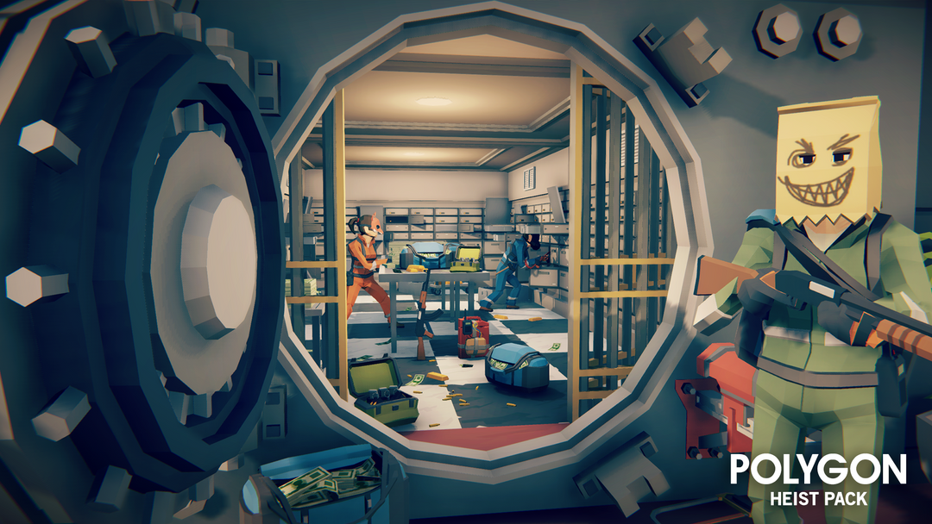
Heist of Reckoning
By Ethan, Matthius and Paul

Slide 2
Matthius

Slide 3

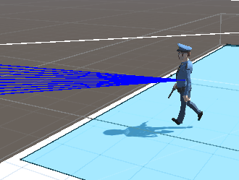
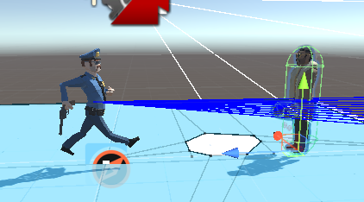
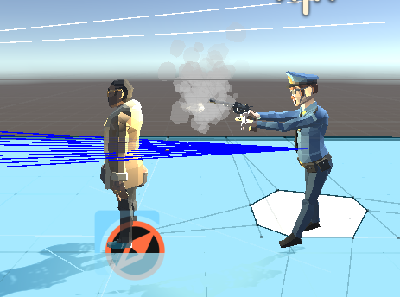
NPC - Police
Police is made using a finite state machine and has 3 states
Pursue – where they will chase the player if they have been detected for at least 0.5 seconds
Wander – where they will walk to random locations
Shoot – once the player is in range the police will shoot at them.
If they get out of range they return to pursue

Slide 4
Paul

Slide 5
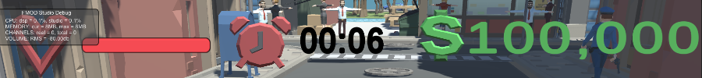
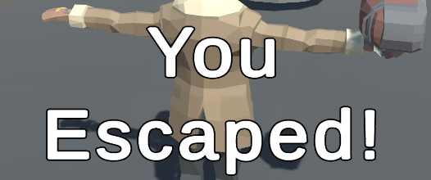
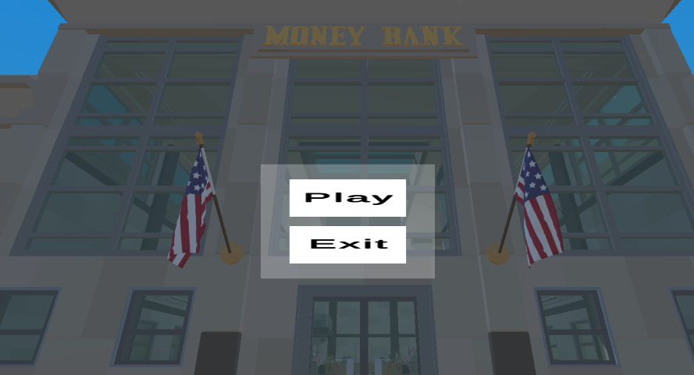
Full UI implementation
Health timer and money UI is fully implemented and functioning
Win dialogue for escaping accessible from the car and on top of the hotel.
UI navigation – Main menu can be used in editor to exit and in build to close it.

Slide 6
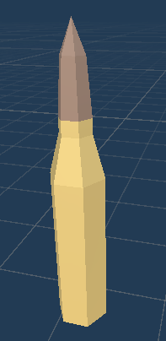

Damage implementation
Bullets fired from police officers can collide with player and damage them.
Bar can decrease in response to the player taking damage from the police shooting them

