Slide 1
Plymouth Internship 2019 Meeting 1
14/06/2019, week 1

Slide 2
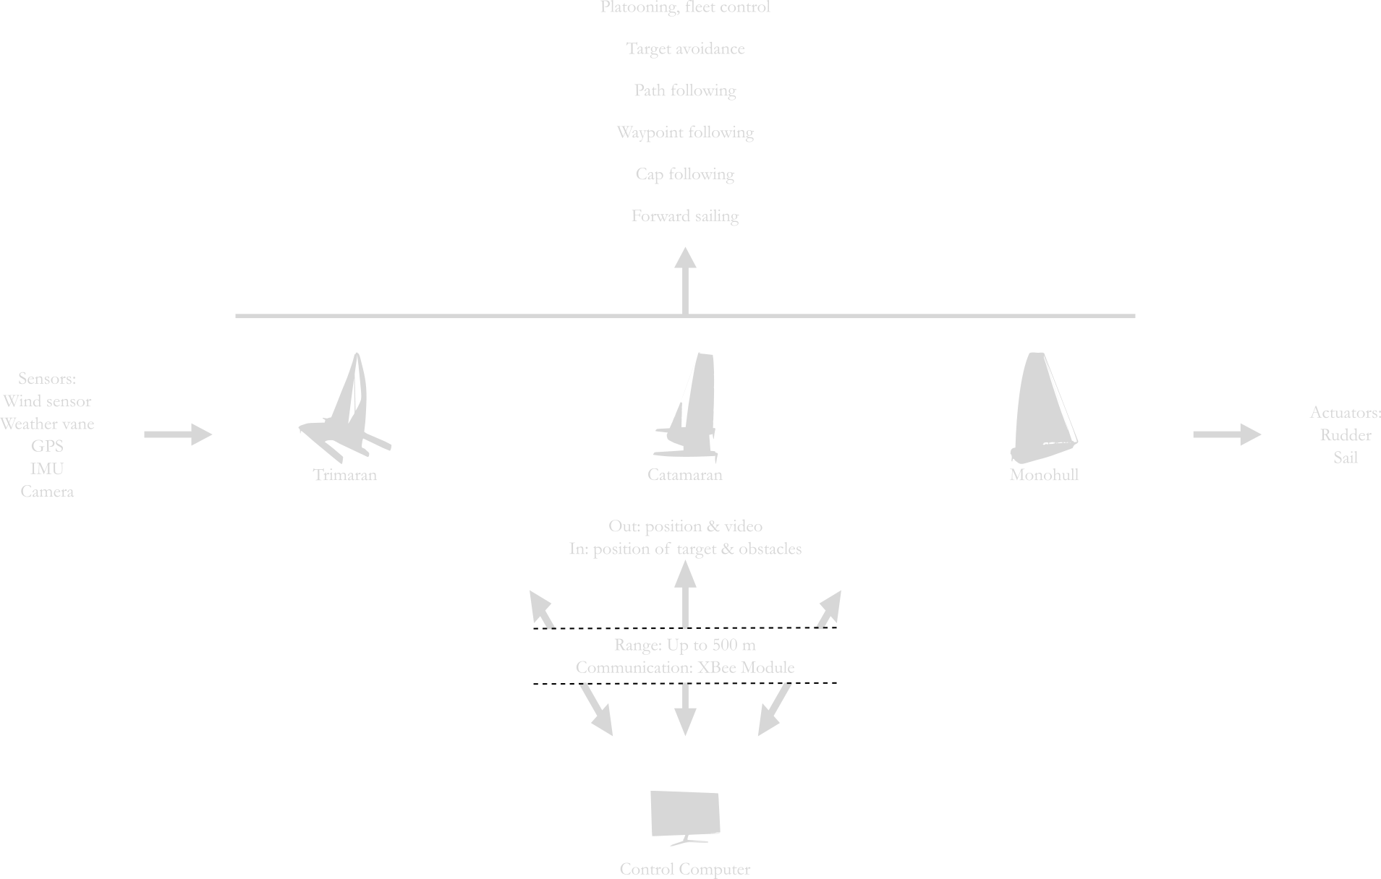
Overview

Slide 3
Organisation / GitHub
https://github.com/Matthix7/Plymouth-Internship-2019
ROS package style
Subfolders for main tasks

Slide 4
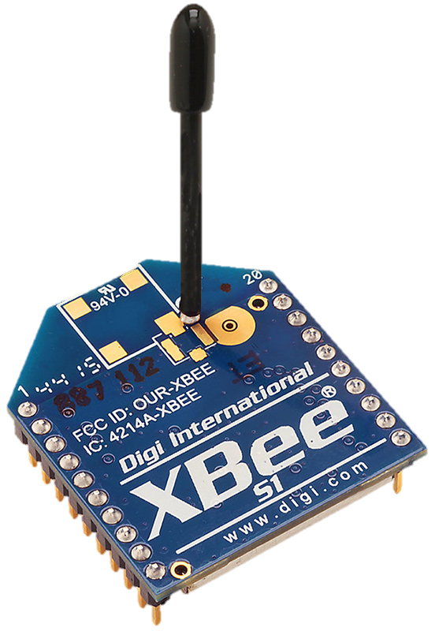
Communication / XBEEs
Dialog between Coordinator and EndPoint
ROS nodes and synchronisation with a topic
Working on image transfer

Slide 5
Monohull
Corentin will arrive on Saturday

Slide 6
Catamaran

Slide 7
Trimaran

