Slide 1

AI AGENT FRAMEWORK FOR BUSINESS
Autonomous AI for Enterprise Data Intelligence
Executive Briefing
2026 Strategy
Confidential

Slide 2














THE PROBLEM
The Data Intelligence Gap
Data Silos
CHALLENGE: DATA CHAOS
Fragmented data systems prevent unified business visibility across departments and functions.
Manual Analytics
Repetitive manual data gathering and cleaning consume over 40% of valuable analyst time.
Slow Decision-Making
Critical strategic decisions are delayed by days due to reporting bottlenecks.
RESULT: MISSED VALUE
Complex BI Tools
Insight Latency
Legacy dashboard tools require specialized technical training, limiting access for leaders.
Days to answer simple questions
Resource Waste
Missed Opportunities
High cost of manual reporting
Delayed insights result in lost revenue and slower competitive responses.

Slide 3









OUR VISION
Intelligence at the Speed of a Question
Natural Language Intelligence
THE TRANSFORMATION FLOW
Transform everyday business questions into complex data queries instantly, requiring no technical syntax.
Autonomous Workflows
The Question
AI agents autonomously handle repetitive tasks, replacing manual data gathering and cleaning processes.
"How did sales perform in Q3?"
Unified Data Layer
Connects disjointed silos into a single intelligence layer, accessible through one simple interface.
AI Agents Process
Analyze, Query, Calculate
Instant Execution
Accelerate time-to-insight from days to seconds, enabling real-time decision making.
Strategic Insight
Actionable answer + Visuals
Democratized Analytics
Empower every business user—from executives to frontline managers—with data science capabilities.
Total Time: < 30 Seconds

Slide 4







PLATFORM OVERVIEW
How it Works
1
Ask Question
User interacts via natural language in the Chat Interface (e.g., “Show Q3 sales”).
2
Process Context
ChatPipeline parses the request, enriching it with user history and business context.
3
Route Intent
RouterAgent identifies the intent and directs the query to the correct specialized agent.
Execute Analysis
USER
CHAT UI
PIPELINE
ROUTER
AGENTS
INSIGHT
4
Input
Interface
Context
Brain
Analysis
Result
Specialized agents (e.g., SQLAgent) execute code or queries on live data sources.
5
Deliver Insight
Results are formatted into charts, summaries, or narratives and returned to the user.

Slide 5











ARCHITECTURE OVERVIEW
Layered Intelligence
CHAT INTERFACE
Natural Language User Interaction
1
Interaction Layer
2
CHATPIPELINE
Request Parsing
Context Management
Security Check
Orchestration Layer
ROUTERAGENT
Intent Classification & Agent Selection
3
Intelligence Layer
SPECIALIZED AGENTS
4
Analysis Layer
SQL Agent
Excel Agent
Forecasting
Anomaly
TOOLS & DATA
Spreadsheets
API’s
Docs
5
Foundation Layer
SQL DBs
Docs

Slide 6







AI AGENT ECOSYSTEM
Specialized Intelligence Agents
SQL Agent
Excel Analytics Agent
Data Exploration Agent
Forecasting Agent
Translates natural language questions into complex SQL queries to extract data from enterprise databases.
Parses, cleans, and analyzes uploaded Excel/CSV files, performing calculations and pivot-like summaries.
Automatically discovers patterns, correlations, and distributions within datasets to reveal hidden trends.
Uses machine learning models to predict future trends, revenue, and KPIs based on historical time-series data.
DATA ACCESS
DATA ACCESS
ANALYSIS
PREDICTIVE
Anomaly Detection Agent
Data Segmentation Agent
What If Simulation Agent
Executive Insight Agent
Identifies statistical outliers and irregularities in data that may indicate fraud, errors, or opportunities.
Clusters customers, products, or regions into meaningful segments using unsupervised learning algorithms.
Models the impact of potential business decisions by running simulations on key variables.
Synthesizes findings from all other agents into concise, strategic narratives for leadership.
DIAGNOSTIC
ANALYSIS
SIMULATION
STRATEGIC

Slide 7







INTELLIGENT ROUTING
RouterAgent: The Brain
Intent Recognition
User Query
Analyzes user queries using LLMs to understand underlying business intent beyond simple keywords.
"Forecast Q4 revenue"
Contextual Mapping
Dynamically maps requests to the most appropriate specialized agent based on data needs and query type.
Router Agent
Analyzing Intent...
Real-Time Routing
Sub-second decision making to ensure fluid conversation and immediate analysis initiation.
Database Intent
Prediction Intent
Anomaly Intent
Multi-Agent Orchestration
Coordinates collaboration between multiple agents (e.g., SQL + Forecasting) for complex questions.
SQLAgent
Forecasting
Anomaly Agent
Query Execution
Trend Model
Outlier Scan
Conversation Memory
Maintains full context across interactions, allowing follow-up questions without re-stating details.

Slide 8
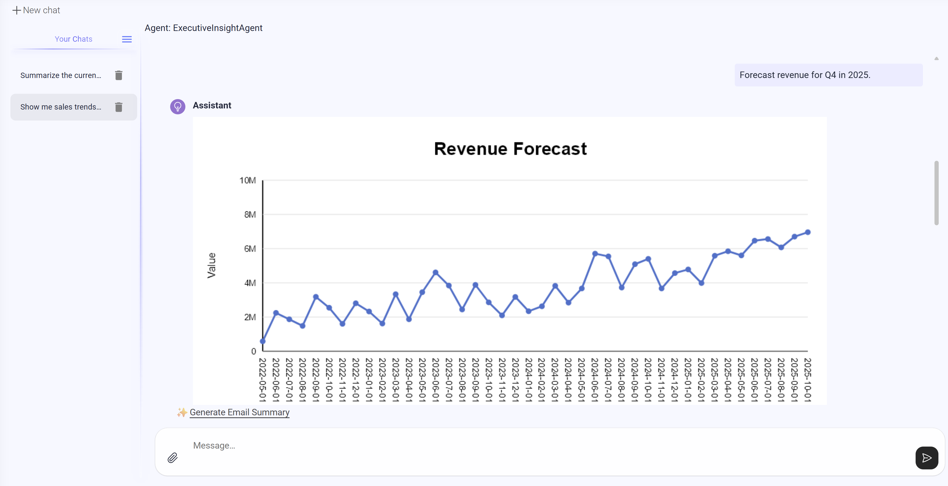

NATURAL LANGUAGE ANALYTICS
Ask Questions. Get Answers. Instantly.
Zero-Code Analytics
Allows anyone to query complex data using plain English, removing the technical barrier to entry.
Trend Analysis & Forecasting
Anomaly Detection
Segmentation & Filtering
Executive Summaries

Slide 9


ADVANCED ANALYTICS AGENTS
Enterprise-Grade Analytics Capabilities
Forecasting
Anomaly Detection
Multi-Agent Collaboration
ML-powered time-series predictions for critical KPIs like revenue, inventory demand, and customer growth with confidence intervals.
Statistical and AI-driven identification of outliers in real-time data streams to flag fraud, errors, or operational issues.
Advanced orchestration where multiple
specialized agents work together to solve
complex, multi-step business problems that
no single model could handle alone.
Cross-domain analysis
Sequential task execution
Consensus-based insights
Unified reporting output
Scenario Simulation
Data Segmentation
“What-if” analysis engine that models the impact of business decisions (pricing, expansion) before they are implemented.
Automatic clustering of complex datasets to discover customer personas, product categories, and regional performance tiers.
SYSTEM POWER

Slide 10
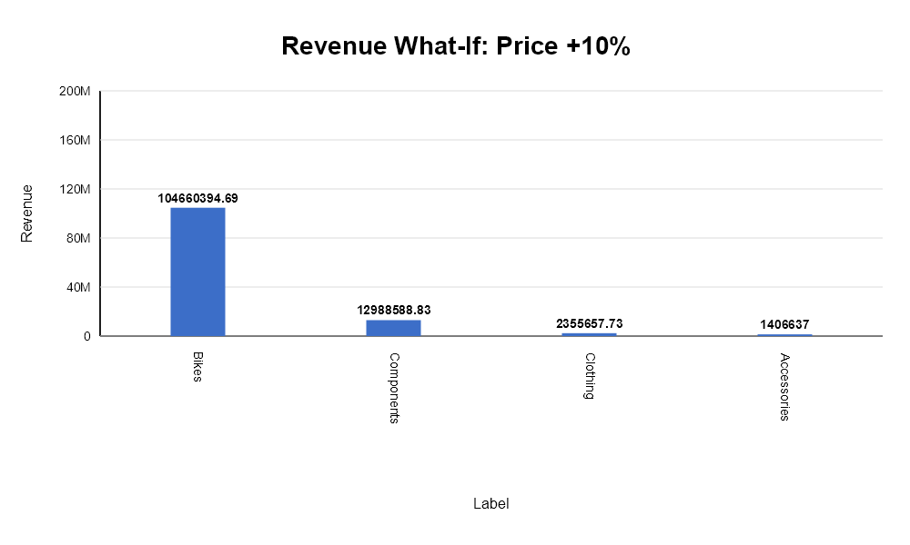
WHAT-IF SIMULATION
Scenario Intelligence: Model Before You Decide
Simulate a 10% price increase by product category.
Run Simulation
What-If Simulation Summary Applying 10% upside to price changes the total Revenue from 110373889.31 to 121411278.24. That is a +11037388.93 change, or 10% versus the baseline. The largest modeled shift is on Bikes, with a delta of +9514581.34.
Assumptions • A uniform 10% increase was applied to the baseline values. • The simulation assumes all other drivers remain unchanged unless explicitly stated in the prompt. • This is a sensitivity-style estimate, not a causal forecast.
Series | Label | Baseline | Scenario | Delta | Delta %
Overall | Accessories | 1278760.91 | 1406637 | +127876.09 | 10%
Overall | Bikes | 95145813.35 | 104660394.69 | +9514581.34 | 10%
Overall | Clothing | 2141507.02 | 2355657.73 | +214150.7 | 10%
Overall | Components | 11807808.02 | 12988588.83 | +1180780.8 | 10%

Slide 11



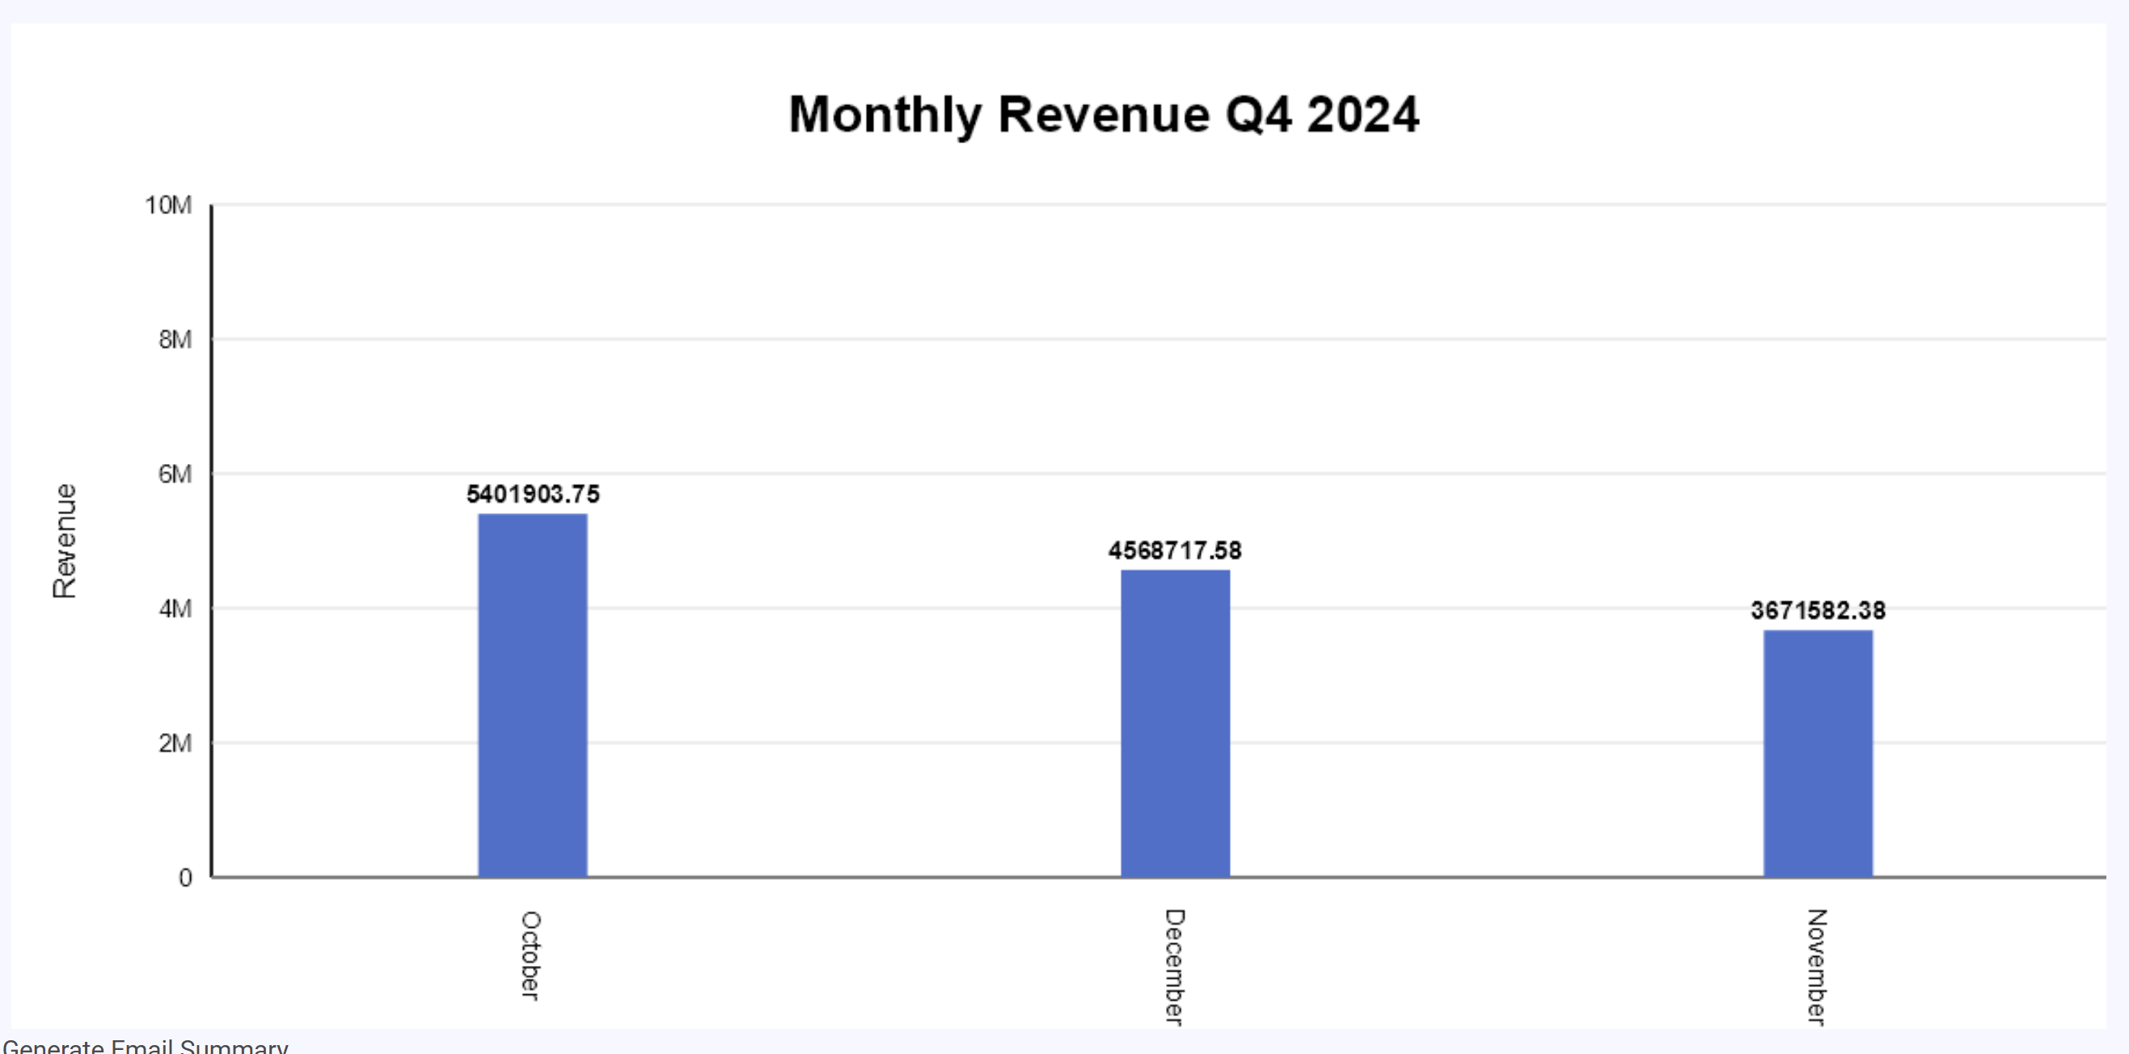

EXECUTIVE INSIGHTS
Boardroom-Ready Intelligence, Automatically
Automated Synthesis
Show me the Executive Summary for Q4 2024, included total revenue vs plan, Opex Efficiency, supply risk and Executive Summary
AI ingests data from all departments to synthesize complex reports without manual effort.
Assistant
Executive Summary
Q4 2024 sales revenue totaled $13.64M from 6,124 orders, with the Southwest region leading contributions. Revenue peaked in October, with a downward trend through December. No data is provided for revenue versus plan, Opex efficiency, or supply risk.
Key Insights
Q4 2024 achieved $13.64M in sales with an average order value of $2,228 across 6,124 orders.
The Southwest region generated the highest sales revenue, followed by the Northwest and Canada.
Monthly revenue peaked in October before declining through the rest of the quarter.
Risks
No data is available on performance against revenue plan or on Opex efficiency.
Supply risk information is not provided, limiting operational risk evaluation.
Opportunities
The Southwest region’s lead could be further leveraged for targeted growth or best-practice sharing.
Monthly sales pattern analysis may identify factors influencing Q4’s downward trend for corrective action.
Recommended Actions
Obtain and review missing data on revenue versus plan, Opex efficiency, and supply chain risk for a fuller Q4 performance picture.
Analyze regional and monthly trends to inform targeted commercial and operational strategies.
Risk & Opportunity Highlights
Automatically flags critical variances and emerging trends that require immediate leadership attention.
Narrative Generation
Converts raw numbers into clear, strategic narratives tailored for non-technical stakeholders.
80% Time Reduction
Drastically reduces the “data-to-decision” cycle from days of analyst work to seconds.

Slide 12


DATA SOURCES
Connect to Your Data Ecosystem
SQL Databases
Direct query execution on PostgreSQL, MySQL, SQL Server, and Oracle DBs.
DBs
Excel & CSV Files
Analysis for spreadsheets and local data files.
Excel / CSV
Cloud WH
Attachments
AI
Parses PDF reports, Word documents, and text files for unstructured data.
Future Integrations
Extensible architecture for REST APIs, ERP systems, and CRM platforms.
Docs & PDF
REST APIs

Slide 13





SECURITY AND GOVERNANCE
Enterprise Security at Every Layer
v
Role-Based Access Control (RBAC)
Granular permission settings ensure users only access data they are authorized to see.
Access Layer
Safe Query Handling
Strict read-only enforcement prevents accidental data modification. SQLAgent uses parameterized queries to block injection attacks.
Sensitive Data Protection
Logic Guardrails
Automatic PII detection and masking for compensation, HR records, and customer details before data leaves the secure enclave.
Comprehensive Audit Trails
Every query, agent thought process, and data retrieval action is logged for full governance and compliance review.
Data core

Slide 14
BUSINESS IMPACT
Measurable Value for the Enterprise
↑ Speed
↓ Efficiency
↓ Spend
10x
-60%
-30%
Faster Insights
Reduced Workload
Lower BI Costs
Accelerate data-to-decision cycles from days of manual reporting to seconds of instant AI analysis.
Automate routine reporting tasks, freeing up data analysts to focus on high-value strategic initiatives.
Consolidate fragmented tools and reduce dependency on expensive, specialized BI seat licenses.
↑ Quality
High
Decision
Confidence
Evidence-based leadership empowered by
comprehensive data coverage and instant “what-if”
scenario modeling.

