Slide 1

Hack The Waste
GROUP 6: THE DIRT BAGS
Ivan Vadimar
Leslie Crielaard
Matthys van Rooyen
Raykhona Murodova
Jolanta Gundega Broka

Slide 2
HOW TO SELL RECYCLED PLASTIC PROFITABLY WHEN OIL PRICES DROP?

Slide 3
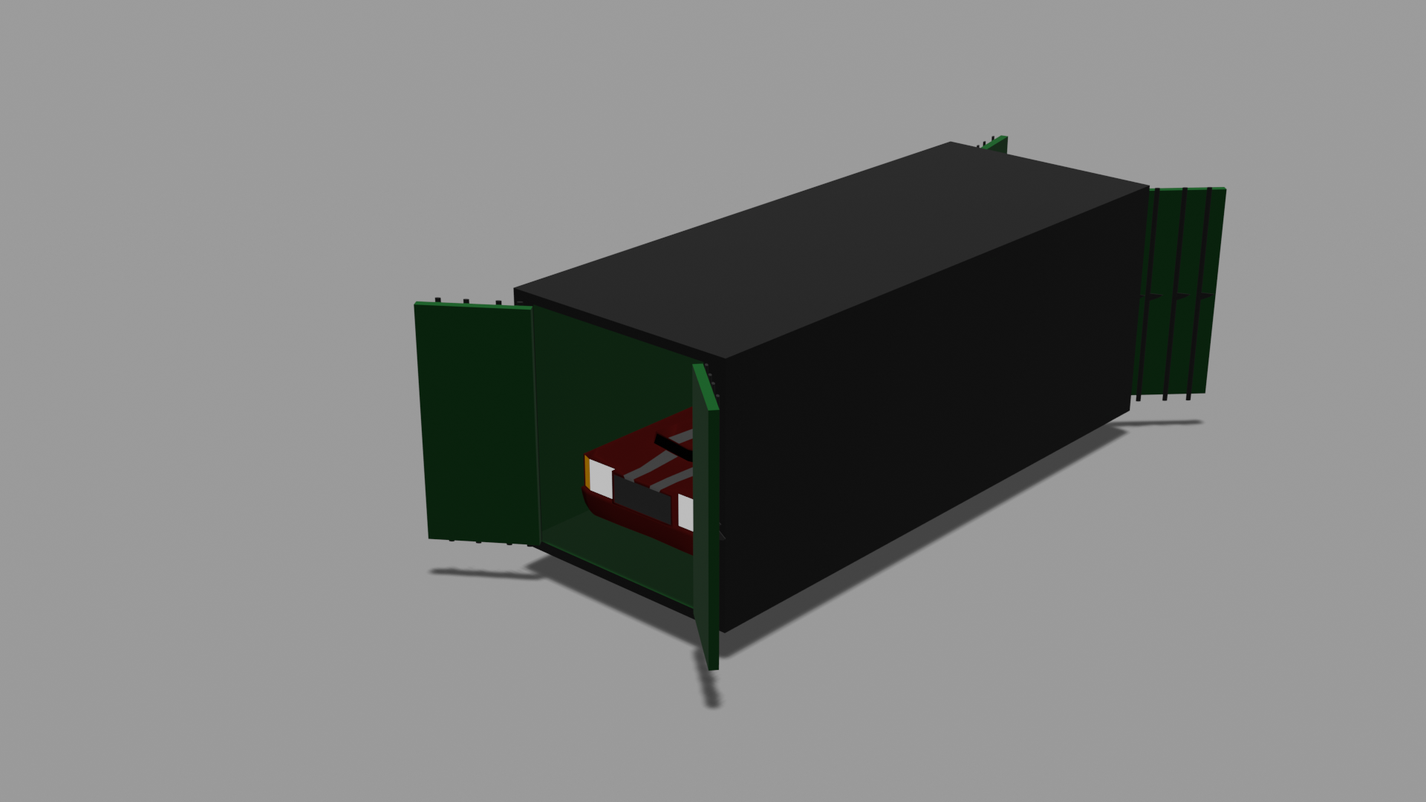
IN-LAND RECYCLED PLASTIC SHIPPING CONTAINERS!

Slide 4
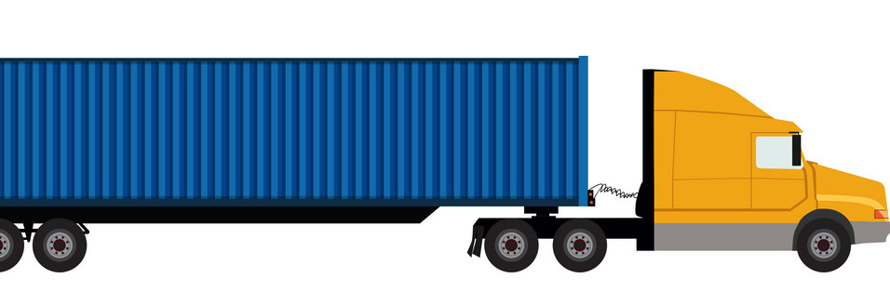
PRODUCT
Weight efficient (up to 68% less than metal counterpart)
Reduction of fuel costs
Reusable materials
Material itself is abundant
Modifiable to fit client’s needs

Slide 5
TARGET CUSTOMER
EUROPEAN SHIPPING AND TRANSPORT COMPANIES ORIENTED ON IN-LAND LOGISTICS

Slide 6
SWOT
Strength | Weaknesses
Unique product Light weight Low costs Environmentally friendly | Lower strength Not proven for shipping in water Could be perceived as low quality
Opportunities | Threats
Packaging for future shipping - drones Way to differentiate and diversify risks of the company | Low pricing could be perceived as low quality Difficulty to gain loyalty High labor costs What to do when economy recovers?

Slide 7
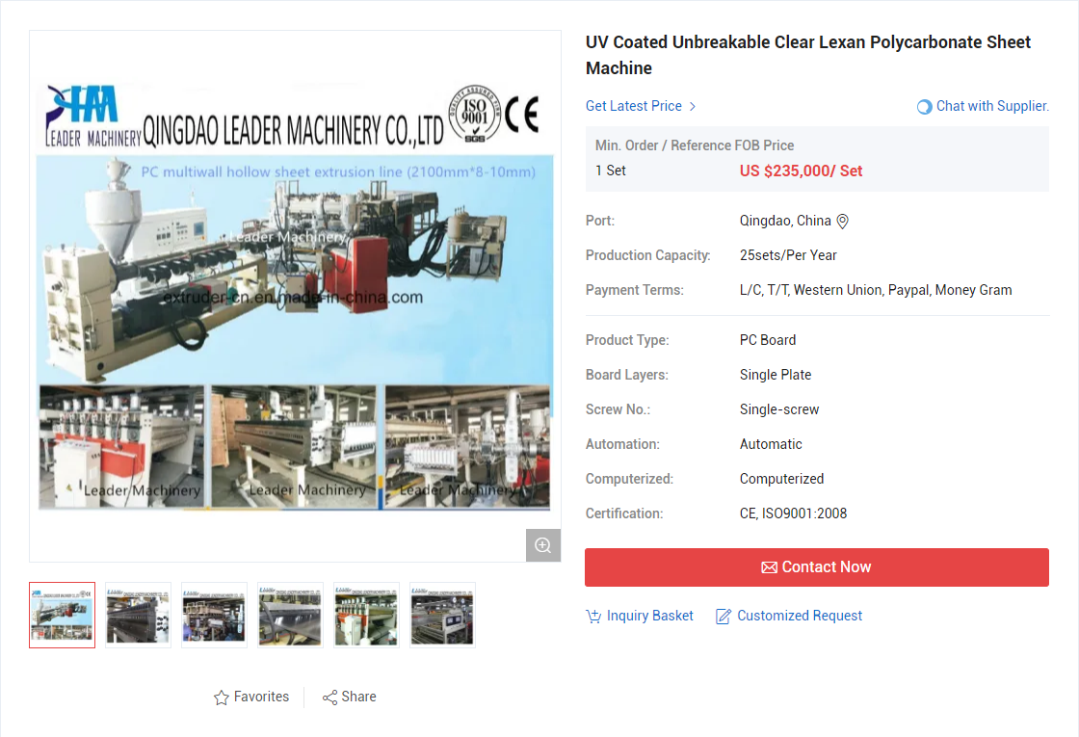
PRODUCTION
The machine to produce the lexan panels from the polycarbonate pallets would be a computerised lexan smelter and press
This machine would create the panels able to serve as the side panels for the transport crates/containers.
The panels would then be mounted on a variety of base platforms to form the sides, doors and top of the container.
The panels can also then be modified, eg. sealed or cut to extend its use to serving goods such as livestock and unprepared food.

Slide 8
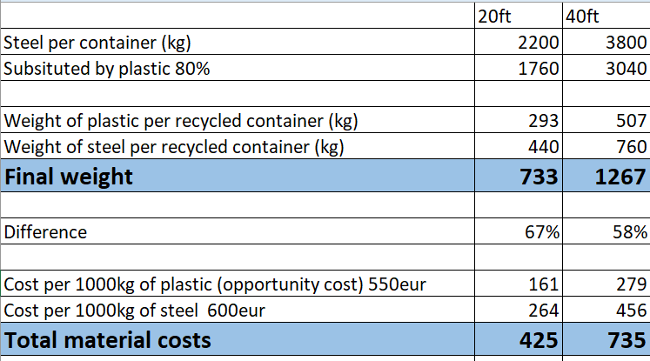
CALCULATIONS

Slide 9
Thank you for your attention!
Q&A

