Slide 1
Mobile Detection of Artificial Images: Attribution and Rejection
A project by Aquilina Mattia and Angelo Trifelli

Slide 2
Introduction: the idea
01.
Efficiency Techniques
Dataset Creation
04.
02.
Rejection Score
Training the model
05.
03.
Mobile Deployment
06.
Key points and concept
Pruning and Fine tuning to improve the model
Steps to create the dataset used for trainig
How we deduced the rejection score
The models trained for the project
Deployment of the model on a mobile app

Slide 3

The Idea
This project aims to create a lightweight CNN that detects and classifies AI-generated images, performs attribution on the models, and rejects unseen generative models.

Slide 4

Key Points
MobileNet V2
A
A lightweight convolutional neural network designed for efficient mobile and embedded vision applications.
B
Effeciency Techniques
Use fine tuning and pruning to improve efficiency, performance and train our models.
C
Rejection and Attribution
Attribution is implemented during the training phase.
The rejection score is derived from the model performance.
D
Mobile Deployment
Deployment of the light weight model on a mobile app.

Slide 5
Dataset Creation
Structure
We have build a dataset of 46000 samples of both fake and real images.
Fakes images
The fake samples come from the dataset: Diffusion-generated Deepfake Detection dataset [1].
Real images
Real images come directly from ImageNet.
[1] https://aimagelab.ing.unimore.it/imagelab/page.asp?IdPage=57.

Slide 6
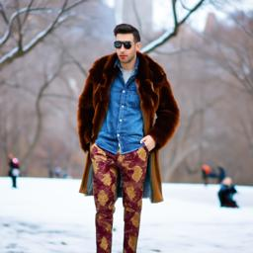

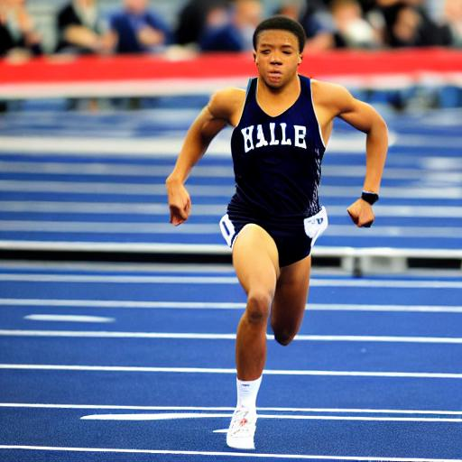
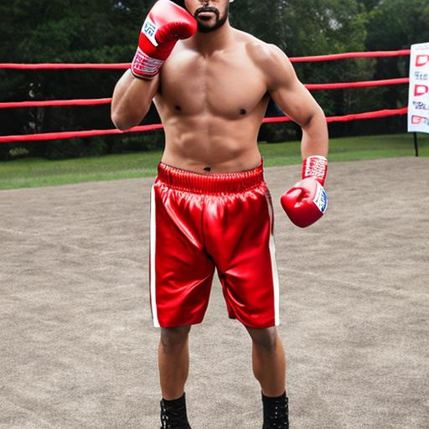
Dataset: some samples
Stable Diffusion 1.4
Stable Diffusion 2.1
DeepFloyd IF
Stable Diffusion xl

Slide 7
Training the model
Base network
We used MobileNetv2 as a base model and trained it using a split of (0.8, 0.1 , 0.1) of the dataset.
Different Approaches
We explored different model in order to achieve the best accuracy with the limited resources of colab.
Monitoring Performances
Each model has been evaluated so to have an overview of its performance.

Slide 8
The models: v1
224x224 image
Model : it consisted of MobileNet v2 connected to two fully connected layers of 256 and 128 neurons respectly.
Output : consisted of 5 neurons and used softmax as activation function.
Parameters : Tested on batch size of 32/128.
Fine tuning : Tested with both MobileNet locked and the last 5 layers unlocked.
ImageNet v2
Global Average Pooling
FCC 256 Neurons
FCC 128 Neurons
Output Layer
(softmax)

Slide 9
The models: v2
224x224 image
Model : it consisted of MobileNet v2 connected to two fully connected layers of 256 and 128 neurons respectly.
Output : consisted of 5 neurons and used softmax as activation function.
Parameters : Tested on batch size of 32/64/128.
Fine tuning : Tested with both MobileNet locked and the last 5 layers unlocked.
ImageNet v2
Global Average Pooling
FCC 128 Neurons
Output Layer
(softmax)

Slide 10
The models: v3
224x224 image
Model : it consisted of MobileNet v2 connected to two fully connected layers of 256 and 128 neurons respectly.
Output : consisted of 5 neurons and used softmax as activation function.
Parameters : Tested on batch size of 64/128.
Fine tuning : Tested with 6 and 8 unlocked layer of MobileNet.
ImageNet v2
Global Average Pooling
Output Layer
(softmax)

Slide 11
Training Results
Model | Batch Size | N. Layer unlocked | Loss | Training accuracy | Validation Loss | Validation Accuracy
v1 | 32 | 0 | 0.3722 | 0.8256 | 0.6674 | 0.7626
v2 | 32 | 5 | 0.3753 | 0.8300 | 0.6751 | 0.7282
v3 | 128 | 8 | 0.4278 | 0.8172 | 0.8726 | 0.7125
All model were trained for a number of epochs that varied between 15/20.

Slide 12
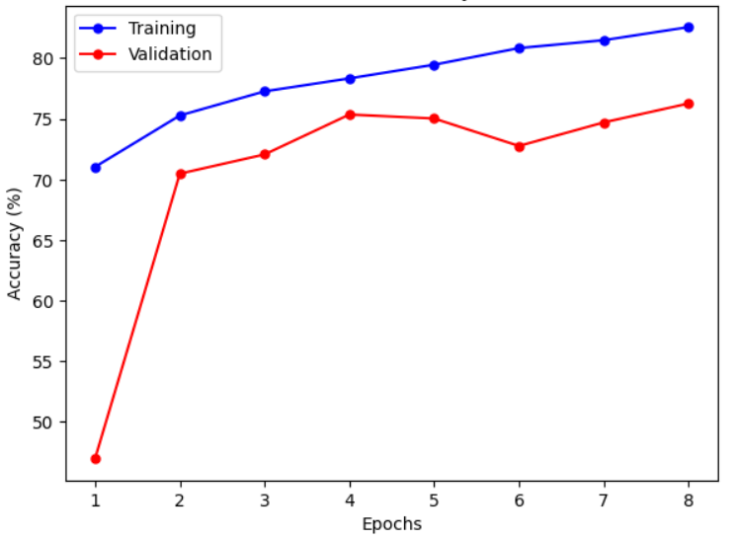
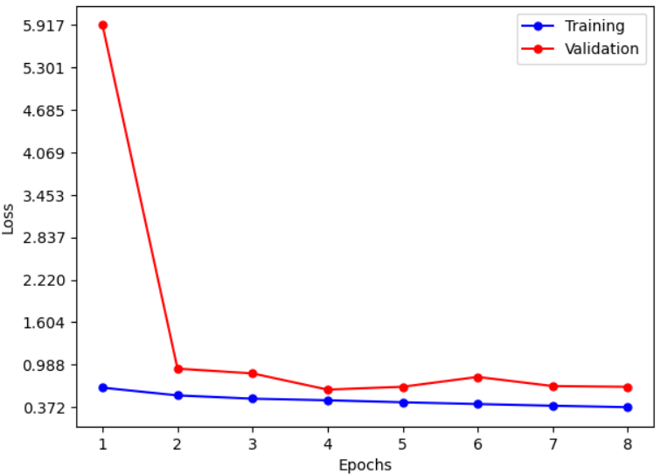
Training Results
Model Accuracy
Model loss

Slide 13
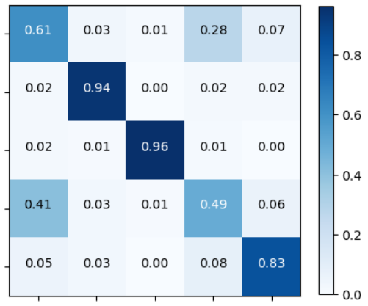
Training Results
Sd-1.4
Df-If 1.0
Real
Sd-2.1
Sd-xl-1.0
Sd-1.4
Sd-2.1
Sd-xl-1.0
Real
Df-If 1.0

Slide 14
Efficency techniques
The best model obtained in the training was Pruned and Fine tuned.
Pruning to reduce the model complexity and to make it mobile-ready.
Fine tuned the lighter model to adjust its new weights.
Performances before and after have monitored and compared.

Slide 15
Efficiency Techniques
Before
After
Model summary with parameters
Model size
Accuracy e loss
Model summary with parameters
Model size
Accuracy e loss

Slide 16
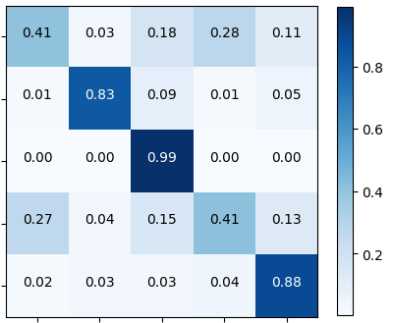
Efficiency Techniques
Before
After
Sd-1.4
Sd-1.4
Df-If 1.0
Df-If 1.0
Real
Real
Sd-2.1
Sd-2.1
Sd-xl-1.0
Sd-xl-1.0
Sd-1.4
Df-If 1.0
Sd-xl-1.0
Sd-1.4
Df-If 1.0
Real
Sd-2.1
Sd-xl-1.0
Real
Sd-2.1

Slide 17
Rejection score
The rejection score is the threshold under which the model infer that a sample belongs to an unseen class.
To compute this value the performance of the model on a dataset of Dall-E/Midjourney images was analyzed [2].
[2] https://www.kaggle.com/datasets/superpotato9/dalle-recognition-dataset.

Slide 18
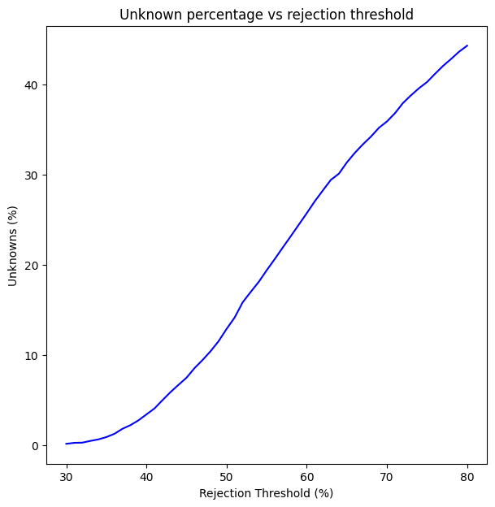
Rejection score estimation
To estimate the value of the rejection score, the values of unknown accuracy as a function of the score were graphed;
As can be observed, the value of 0.6 proved to be an optimal one in terms of maintaining the model's accuracy on the classes for which it was trained.;

Slide 19
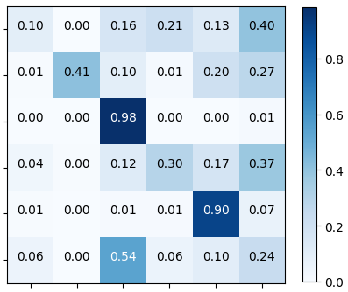
Rejection Accuracy
Full Model
Pruned Model

Slide 20
Mobile Deployement
The mobile deployment was done using TensorFlow Lite.
A Conversion using TensorFlow lite was required to proceed with the deployment.
A straightforward application has been developed using Android Studio, offering both the pruned and the full model for utilization.

Slide 21
Mobile Deployement
The app features two main screens: Detection and Evaluation;
Through the Detection screen, the user can load image, choose the model, and let it perform the evaluation;
Through the Evaluation screen, the user can run a benchmark of the two models offered by the application;

Slide 22

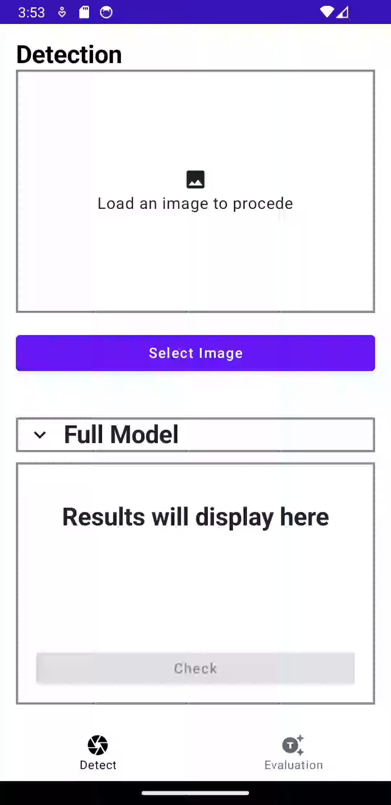
Mobile deployment Detection Screen

Slide 23
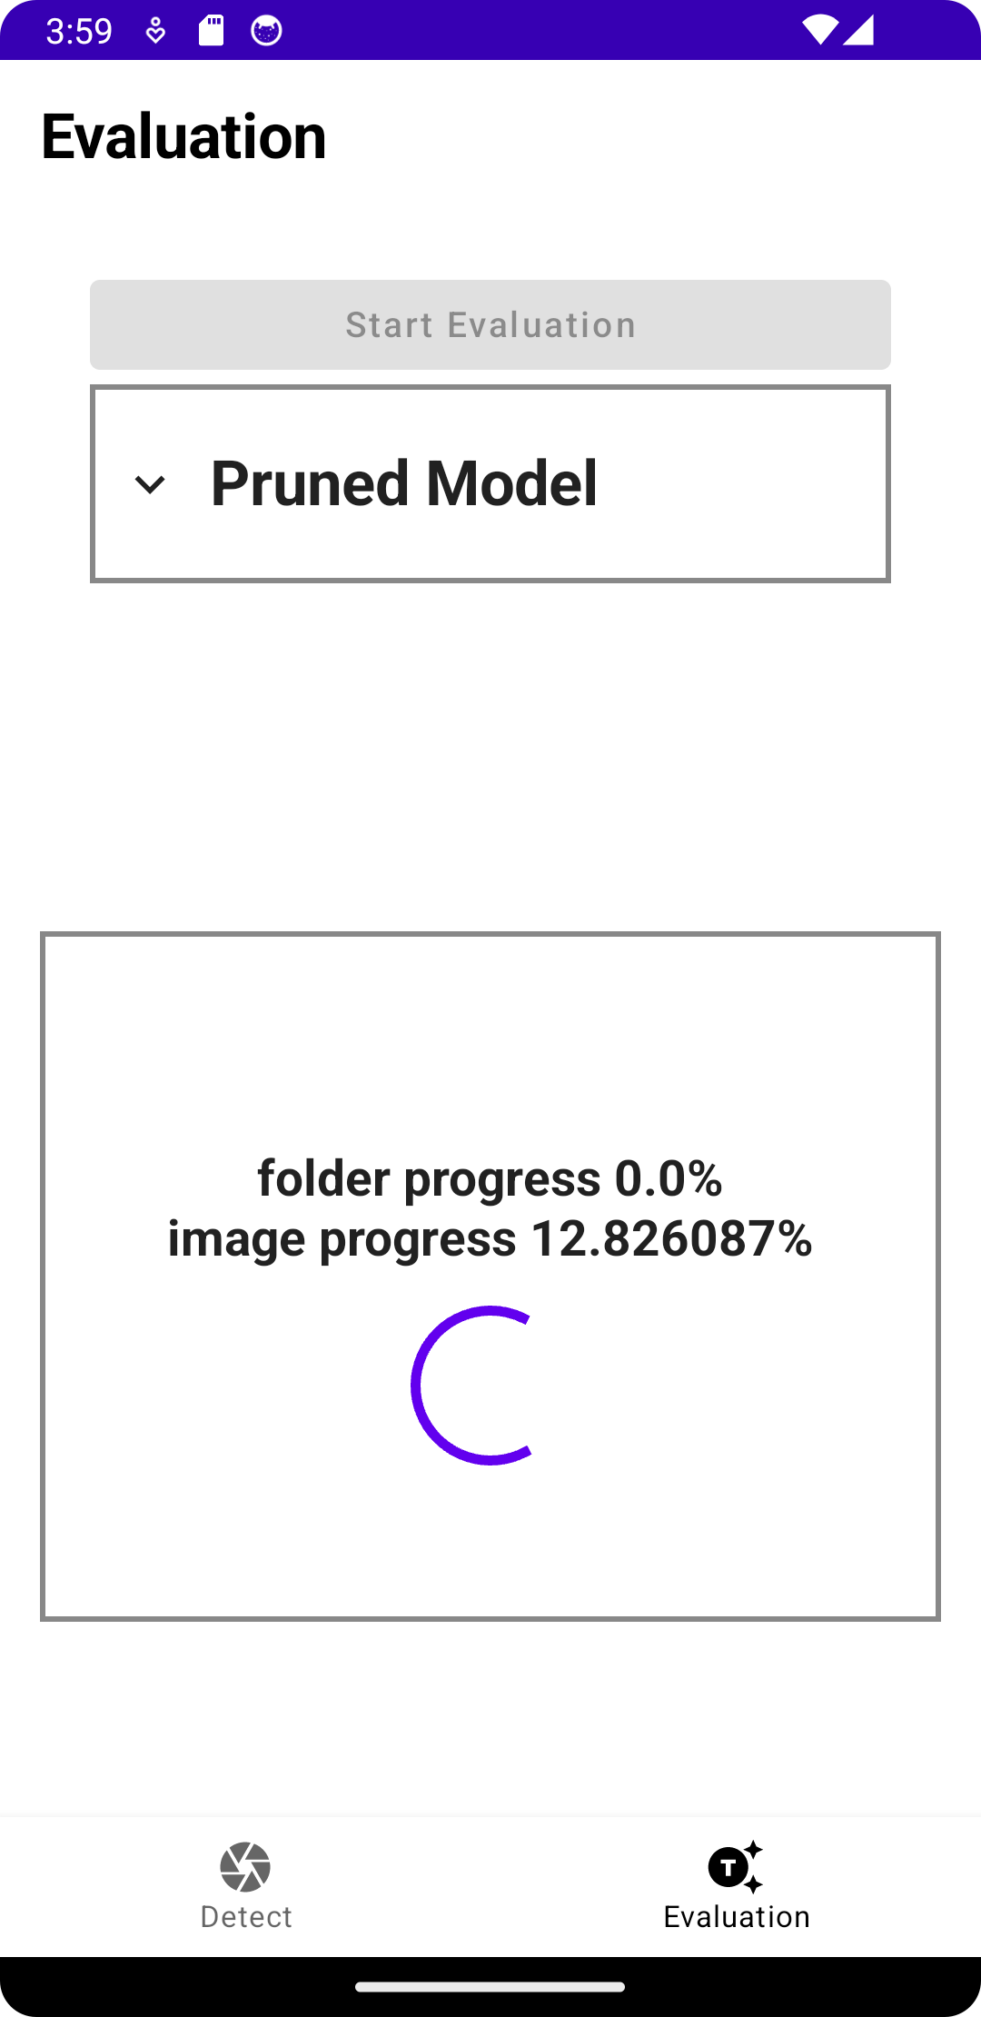
Mobile deployment Evaluation Screen

Slide 24
Thanks for your attention!

