Slide 1
Language comprehension and integration
AIS 2023

Slide 2
Taking stock
We have seen that people easily learn associations, and can use them for prediction about the future
People integrate information from the recent past to make predictions
We also know that human memory systems are optimized for storing 7+- 3 items, and that chunking is one of the main tools used to construct these items
All this suggests that our ability to use learned associations, keep track of the recent past, and make predictions would be fundamental for language comprehension as well.

Slide 3
The core question is: do we store language associations at all?
And if so, how do we use them for comprehension. These are two main questions underlying modern and less modern theories of language.

Slide 4
How do we learn ‘the rules’ of language?
From experience, we memorize structures: which can be words or types of phrases that go together
We learn abstract rules that specify constraints on grammaticality
We acquire statistical knowledge on co-occurrence of language entities.
Notes:
I put ‘the rules’ in quotation marks because this is related to the very debate. Better to say ‘what is a grammatically valid sentence in a language’.

Slide 5
Behavioral psychology: Memorization of structures.
Behavioral psychology research applied S-R models for language: Each word is thought of being a stimulus for the next, building up an overall structure out of local associative relations.
In language comprehension: the learned sequences of adjacent elements are internally represented as automatically characterizing a sentence as it is encountered. Allows to determine if it is grammatical.
We would say (today) that on behaviorism, knowledge of language is knowing which words/elements are followed by other words.
It doesn’t explain how ‘meaning’ is made, but it explains how people produce valid sentences to communicate an idea: they know which words/elements can come after others.

Slide 6
Elements in s-r approaches to language
S-R approaches claimed we learn which words come after each other
Horse -> races (relation between specific lexical items)
But they also allowed for some abstraction, which allowed for ‘slots’. E.g., patterns such as
The -> X -> Y-es (relation between def article, noun [sing] verb [sing]
The -> Xes – Y_ (relation between def, plural noun, plural verb)

Slide 7
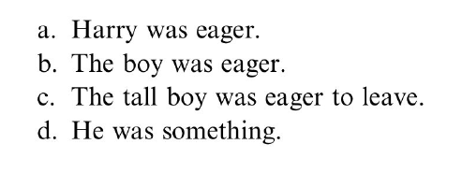
Abstract elements in sentence level
At certain point, Behaviorists accepted some level of abstraction.
Attempted to describe different types of phrases.
They accepted that longer phrases seemed to resolve into combinations of shorter ones, which in turn could resolve into single words.

Slide 8
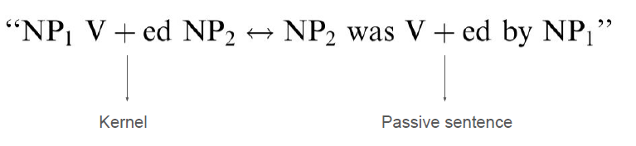
Abstract elements at discourse level
Just as phrases are components of a sentence, sentences can be treated as components within larger discourse structures
It is possible to learn sets of sentences that are substitutable within a given context
Kernel sentence - simple declarative construction.
Co-occurrence “transformations” express the relation between the kernel sentence and its variants.
That is, we learn transformations

Slide 9
Meaning in s-r approaches to language
Behaviorists did not develop theories about mental phenomenon (e.g., theories of conceptual representation). They had several parallel ideas:
Substitution view: Words (‘signs’) substituted for the objects in the world. Objects in the world produce a real reaction, and the sign produces a similar reaction
Disposition view: Language produces a tendency (disposition) towards certain behaviors ‘The meaning of a linguistic expression is therefore ‘disposition towards response sequence’ (Osgood, 1952)
*Other views: tried to explain how we understand words that refer to objects we have not directly experienced. Words associated with direct experience: Sign. Indirect experience: Assign. These obtain meanings by ‘compositional effects’ of lower level features (zebra = horse + stripes). Beginning of cognitive approach.

Slide 10
Chomsky’s challenges to s-r learning and behaviorism: abstract rules
Chomsky (1959) identified multiple weaknesses, including
inability to explain comprehension of sentences not heard previously,
Inability to handle hierarchical structure and long-distance dependencies
Example : The horse[s]…..[long clause] is/are falling.
The ability of an algorithm to determine whether a new, never-hear-before expression sensible remains a strong benchmark for the validity of an NLP algorithm.

Slide 11
Evidence for rule (grammar) -driven compositionality
When put (strung) together words in noise are perceived more clearly than when presented randomly (“Horses”, “eat”) : 25% accurate per word, but 50% when put together. “Acoustic representation” not mapped independently per word.
This opened the door to the question of how does knowledge of sentences impact comprehension, where ‘top-down’ explanation have been battling bottom-up ones for over 60 years.
And why are things clearer in sentences? They cannot be stored in a mental lexicon as words are, so how do they impact comprehension?
The answer: The constraints are not from rote memory but from more abstract systems of rules:
So adults develop representations that cannot directly derived from prior experience.

Slide 12
Chomsky and transformational grammar
What is a sentence?
Chomsky (1957): A sentence is what the grammar describes it as a sentence.
The grammar was generative: it described the sentence structures of a language as a natural and creative part of human knowledge.
Grammar constitutes a theory of the speaker’s underlying linguistic knowledge. It is much less (=not) concerned with the (noisy) actual behavior or its importance for the study of language

Slide 13
Sentence meaning is captured by its structure
The structure is a configuration that is allowed by the language.
Structures ‘licensed’ by the grammar of a language are ones that can be produced by the language’s grammar (rewrite rules)
S -> NP VP NP -> Det N VP -> V NP VP -> V PP

Slide 14
The transformation from kernel sentences is key
John is easy to please
John is eager to please
In (1), John is (unstated) object of pleasing
In 2, he is the subject who pleases
Rephrasing:
It is easy to please john
** it is eager to please john
Sentences with very similar surface structures may have very different kernels

Slide 15
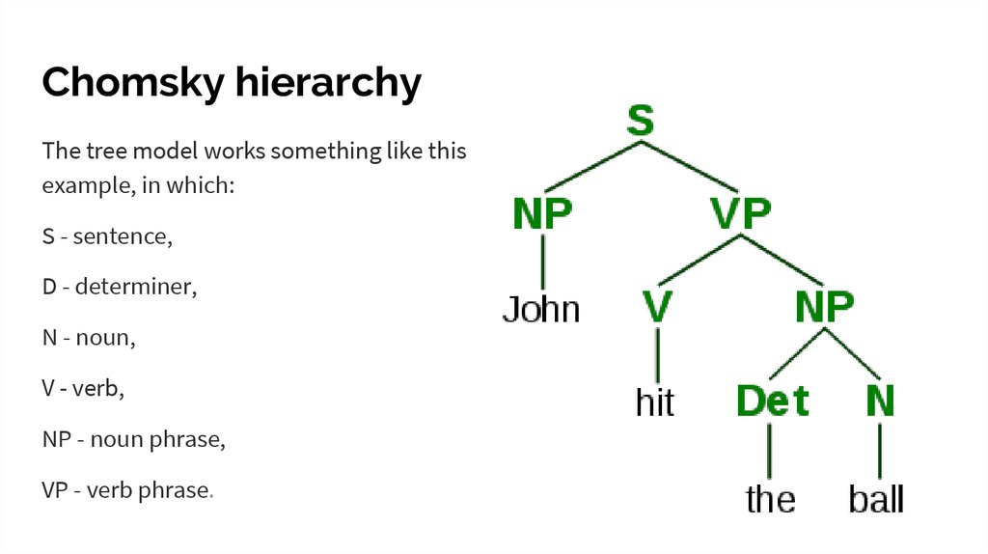
Sentence meaning is related to its structure
Structures are represented as trees.

Slide 16
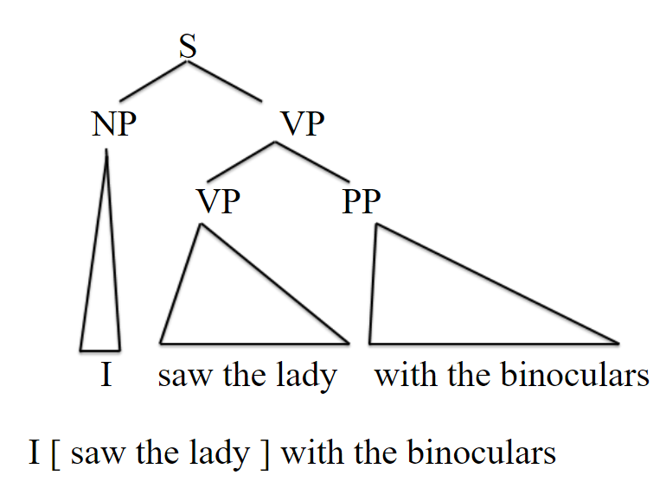
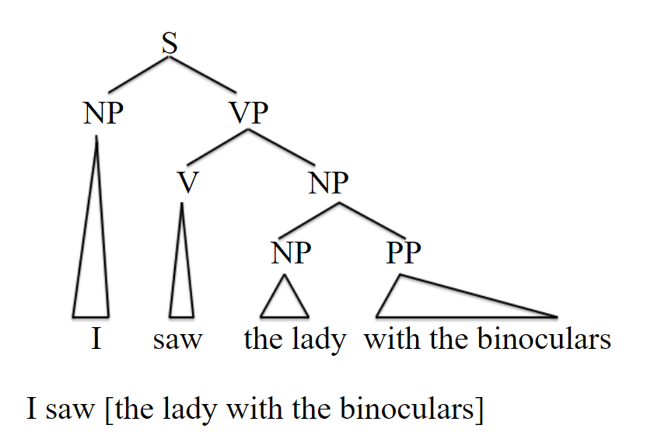
Sentence meaning is related to its structure
An ambiguous string of words means there are two possible meanings

Slide 17
Derivational Theory of (psychological) Complexity (I)
The first theory that tried to account for difficulty of sentence comprehension
Innovative in that it
Identified an objective metric on which complexity can vary
Examined correlations between value of this metric and human behavior
The metric was the number of transformations needed to transform a kernel sentence to a given sentence.
The entire sentence was taken as a unit, and a set of pre-set rules (a grammar) was used to see if the given sentence can be derived from the kernel sentence. No incremental parsing

Slide 18
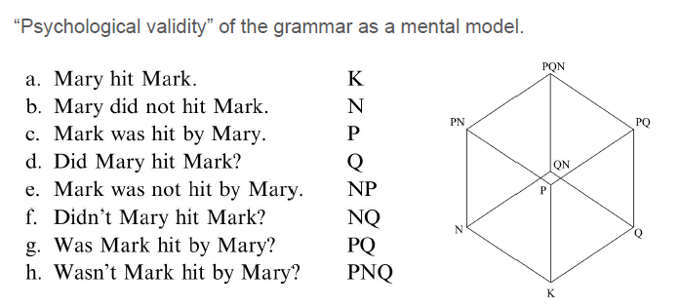
Psychology and transformation: psychological validity? Derivational theory of complexity

Slide 19

Derivational Theory of (psychological) Complexity (II)
DCT enjoyed some early success, particularly when using sentence -picture verification studies
Verification times
“The boy smelled the flower” <
“The flower was smelled by the boy”
DTC abandoned eventually because criticisms of method (construct validity) and findings suggesting these effects have to do with how the photo might be encoded into language.

Slide 20
Parsing based accounts
Parsing is an incremental process by which we try assign a structure to what we have read/heard
In many cases the ambiguity is local and is disambiguated by later content.
Parsing based accounts try to explain why some tentative interpretations are preferred and why some sentences are more difficult
Why is the following sentence difficult?
“The horse raced past the barn fell”
Notes:
“the horse that was raced past the barn was the one that fell”

Slide 21
Parsing based accounts
Parsing is an incremental process by which we try assign a structure to what we have read/heard
In many cases the ambiguity is local and is disambiguated by later content.
Parsing based accounts try to explain why some tentative interpretations are preferred
Some parsing accounts hold that each new word is preferably incorporated into the nearest clause. ‘fell’ refers to ‘horse’ rather than barn, causing difficulty
Easy: “The horse raced past the barn with the door”
Difficult: “The horse raced past the barn fell” . There is an initial structural interpretation that needs to be revised (“barn fell??”). Costly!
Notes:
“the horse that was raced past the barn was the one that fell”

Slide 22
Parsing explains for difficulty due to movements of elements (I)
According to linguistics theory and parsing, parts of a sentence have a natural original position elsewhere, and when they shift position, they leave a grammatical ‘pointer’ (trace)
No trace: “Which sword is sharpest”
Trace: Which sword did Vlad [tons of stuff here] sharpen (trace) yesterday?
The argument of sharpen appears before the transitive verb, in a moved position.
Parsing accounts explain that trace sentences are more difficult because of memory demands: the argument of the verb (sword, dislocated element) has to kept in mind till the trace is reached.

Slide 23
Parsing accounts for difficulty due to movements of elements (II)
There is psychological evidence for the link between the trace and the element it refers to: automatic reactivation of the trace content.
The astute lawyer, who faced the female judge was certain (trace) to argue during the trial
The astute lawyer, who faced the female judge, hated the long speeches during the trial.
Participant read 1 or 2 and then indicated whether the word ‘astute’ was in the sentence. Faster response times in sentence 1, suggesting a ‘refresh’ of relevant content by the trace.
Notes:
The faster response times are in responding to whether the word was present in the sentence; not the reading time.

Slide 24
LevY’s (2008) theory of structure revision and surprisal
Levy’s theory starts from premise of incremental parsing. As we understand a sentence, we construct a representation of what it means in a way that constrains potential continuations.
Perhaps the strongest evidence for active incremental parsing is from a paradigm that asks people to look at pictures while hearing sentences, while their eyes are tracked. (short detour follows)

Slide 25
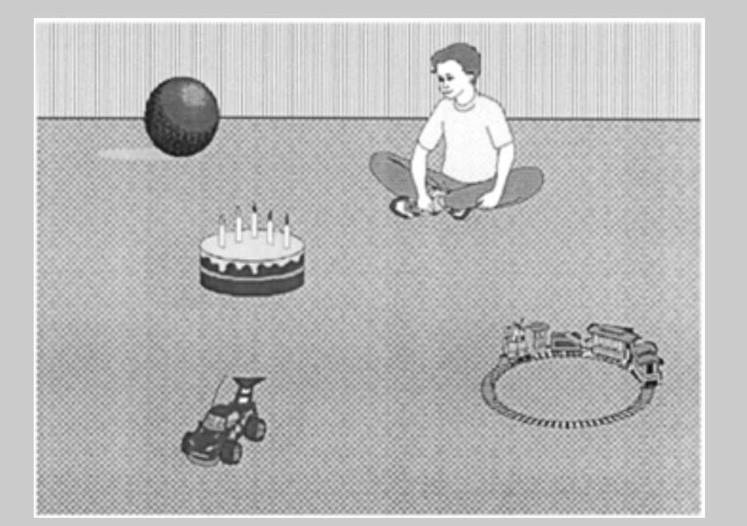
‘visual world paradigm’: evidence for anticipation
Look at the picture while hearing “the boy will move the cake”
Altmann, G., & Kamide, Y. (1999). Incremental interpretation at verbs: restricting the domain of subsequent reference. Cognition, 73, 247-264

Slide 26
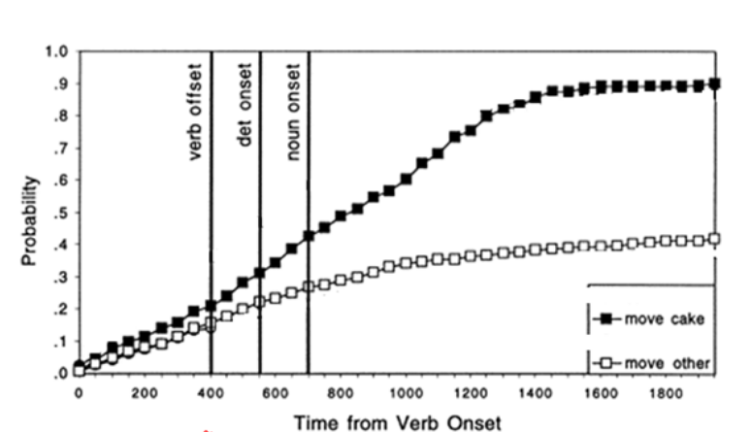
Visual world paradigm: reading results. % time looking at ‘cake’ and ‘other’
Notes:
‘move cake’ – looking at cake.
‘move other’ looking at other object. Slight advantage even before noun offset, maybe because the boy is looking at it.

Slide 27
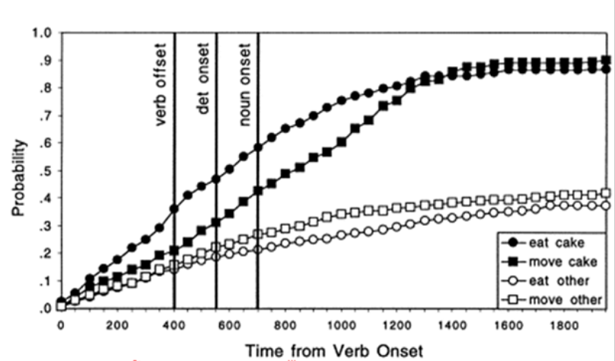
Visual world paradigm: Evidence for prediction at verb
Notes:
Difference in fixation times on ‘cake’ become very large when the verb is ‘eat’.. That’s when a massive amount of fixation starts being on cake vs other objects (black vs. white circles).

Slide 28
LevY’s theory of structure revision and surprisal
Levy’s theory starts from premise of incremental parsing. As we understand a sentence, we construct a representation of what it means in a way that puts a constraint on potential continuations.
Perhaps the strongest evidence is from a paradigm that asks people to look at pictures while hearing sentences, while their eyes are tracked.
Back to Levy’s work

Slide 29
Main points
Describes prior approaches to parsing as ‘resource based’: some syntactic structures require more memory than others, which is the source of difficulty
Develops an alternative which focuses on the role of expectation in parsing.
Levy’s proposal: “the possible structural analyses consistent with a partial input are preferentially ranked in parallel, and the difficulty of a new word corresponds to the amount of reallocation necessary to reflect the word’s effect on the preference ranking.”

Slide 30
The impact of a New word:
Formally, Levy takes surprisal to be related to the difference between to possible sets of sentence continuations:
The set that existed based on all words up to current word w. (1.. w-1)
The set that existed after learning the current word w (1.. w).
The difference is quantified via Kulback-Liebler divergence of 2 distributions: how much does the probability of each possible event change between the two distribution.
Or: to what extent does the distribution of completions at time w-1 approximate the distribution of completions at w
Given some assumptions on updating of distributions in language, Levy shows that this is just the surprisal of the word. - log(p(word))
The more potential completions are trimmed, the more difficult is the update. This also means the word encountered was more surprising in context. Less surprising words will be consistent with more possible completions.

Slide 31
Levy on why word-surprise correlates with processing difficulty
“It might be thought that calculating expectations about upcoming structures in a sentence can be computationally expensive, so why would the human parser waste resources on constantly calculating and updating the likelihood of upcoming words and/or structures in a sentence? [Levy argue that ppl do not] For those who are inclined to think of incremental structure building and disambiguation as the fundamental type of work that needs to be done in sentence comprehension, we now have a clear answer to this challenge: surprisal as the predicted difficulty of word [the fact that surprise correlates with difficulty] falls out [mathematical feature] of the incremental update process itself.
Expectations about upcoming words in a sentence need not be explicitly calculated; rather, they are implicit in the partial parse of an incomplete input.”

Slide 32
Support for structure-pruning / surprisal
And a few words on PCFGs

Slide 33
Modeling grammars with probabilistic context free grammars
A PCFG is a probabilistic set of production rules that determine how to compose a left-side constituent from right-side constituent.
A simple set of rules for composting Sentences from NP, VP, Auxiliary (e.g., ‘does)
• S → NP VP 0.8
• S → Aux NP VP 0.1
• S → VP 0.1
PCFG assigns a Probability to each production rule.
For each ‘non-terminal’ element in the grammar (any phrase or sentence), the probabilities must sum to 1.

Slide 34
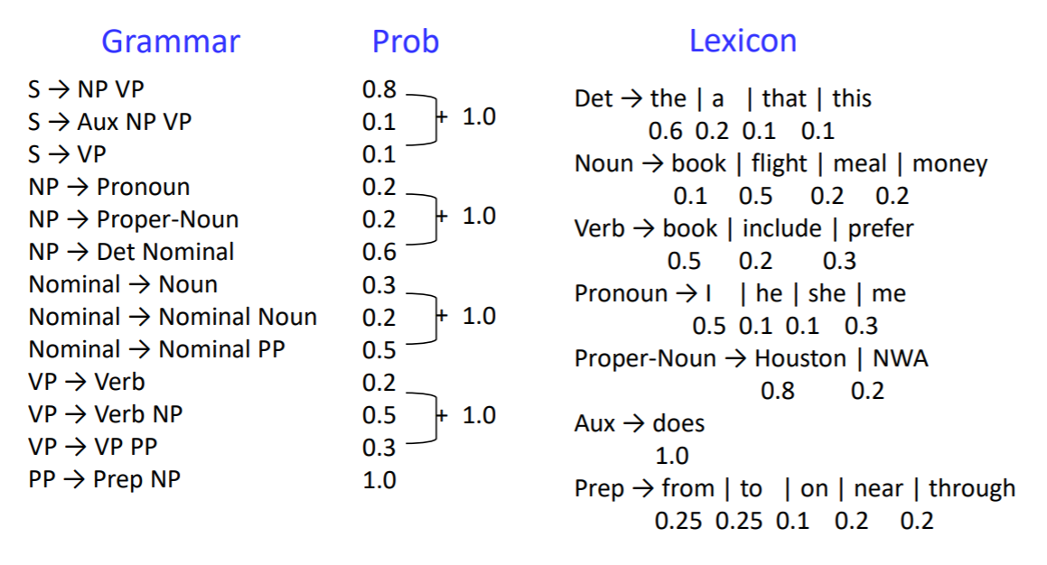
Toy PCFG for English
| ate
0.2
0.2

Slide 35
Some advantages of surprisal theory
Explaining updating via surprisal assumes that the relation between cognitive effort and stimulus probability is related to log(p) not linearF(p).
So difference in between 2 stimuli with ps [0.5, 1] is just like between 2 stimuli with ps [0.05, 0.1]. This is supported by psychological evidence

Slide 36
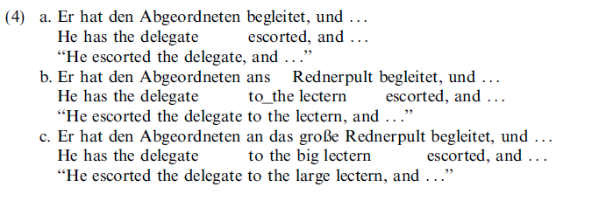
Some advantages of surprisal theory
It can explain why, in some cases, sentences that require more working memory, and figuring out long-range dependency might be easier to understand

Slide 37
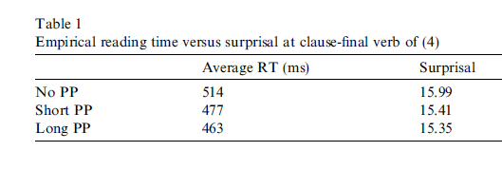
Some advantages of surprisal theory
It can explain why, in some cases, sentences that require more working memory, and figuring out long-range dependency might be easier to understand
Notes:
Intuition here: the probability to see the final verb is relatively higher after learning each word because the set of possible completions is trimmed, and so P(verb) becomes *relatively* higher.

Slide 38
the extra preverbal constituent[s].. sharpens next-constituent expectations and thereby decreases surprisal at the final verb itself

Slide 39
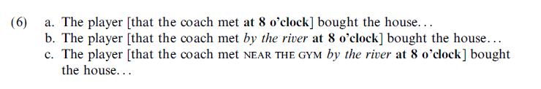
Some advantages of surprisal theory: example 2
Predictions don’t need to be about a specific word: they can be abstract about when to expect a type of word, like a verb
Resource theories think the verb is more difficult to understand the farther away it is from the agent.
But Surprise theories argue the final clause is easier to expect the longer the clause before it! So this comes out of unlexicalized Part Of Speech parse, no need to model with word co-occurrence.
Notes:
The longer the clause is, the less likely it can be modified by anything; you used space, time etc’, it should end now.

Slide 40
Summary: parsing as updating (I)
Assigning a syntactic structure to a sentence (a parse tree) is an incremental process.
We do not wait till the end of the sentence.
This idea is shared with prior parsing approaches that explain difficulty in terms of integration costs.
The computation is done in parallel: at each point all possible completion structures are represented
When new content is introduced, the entropy-difference between set of prior and current completions indicates difficulty of integration, and this is mathematically computable as Surprise (-log(p))

Slide 41
Summary: parsing as updating (II)
1. Consequently: The source of difficulty of understanding a certain phrase type is not a direct function of any intrinsic aspects of the phrase (number of words; word order etc’), but of how difficult it is to integrate it into prior context: “the primary source of difficulty incurred in processing a given word is determined by the degree of update in the preference distribution over interpretations of the sentence that the word requires”
.2 Levy used Surprisal theory to explain syntactic processing, using predictions made from PCFGs. But as we will see, the next step in idea of language comprehension wanted to get rid of this assumption as well.
In the surprisal theory.. , structural representations affect processing difficulty only through the mediation of probabilistic word models. The latter can be investigated through a variety of means, potentially including completion as well as comprehension studies. Yet surprisal is not a repudiation of syntax: as we have seen, probabilistic word models can be estimated from probabilistic grammars

Slide 42
Frank and Bod’s challenge: difficulty = probability without syntax (statistical knowledge)
Rather than assume that comprehension is based on structure building, they test the idea by comparing 3 models of language
Probabilistic PSG
Markov process (N-gram)
Echo state network
Model quality == how accuracy of predicting human behavior.
Frank, S. L., & Bod, R. (2011). Insensitivity of the Human Sentence-Processing System to Hierarchical Structure. Psychological Science, 22(6), 829–834. https://doi.org/10.1177/0956797611409589

Slide 43
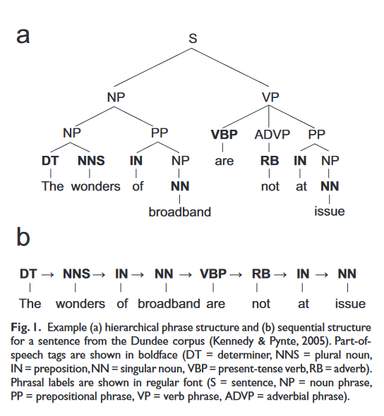
PSG vs. sequential representation
In ‘a’: assigning a structure from knowledge of grammar. Representing a hierarchy is implicit in this knowledge.
In ‘b’ representation of a linear sequence of elements
Notes:
“PSG models use hierarchical structures (see Fig. 1a), whereas Markov models and ESNs estimate probabilities that depend solely on the sentences’ sequential structure (as shown in Fig. 1b).”

Slide 44
Training set
‘Wall Street Journal’ corpus: 49K sentences
This corpus has a syntactic-structure tree annotation for each sentences. Ideal for training Probabilistic PSG.
For Markov models and ESNs, F&B replaced each word its Part of Speech category
The models learn to predict P.O.S not specific word. Improves accuracy for small datasets.
Also, no need for an algorithm to learn to predict highly specific semantics, as syntactic p.o.s is the target for prediction.

Slide 45
Probabilistic PSG (I)
They experiment with 4 types of PSG.
A classic which just considers what continuations can follow each phrase (memory-less)
Nth order versions, which consider which continuations can follow combinations of phrases.
“In a standard probabilistic context-free grammar, the probability that a parent node will produce a particular set of children is conditional only on the parent node, but it is well known that parsing accuracy can be improved by taking the grandparent node (e.g., in Fig. 1a, VP, or verb phrase, is the grandparent of the rightmost IN and NP) into account (Johnson, 1998). Likewise, a rule’s probability can be made conditional on information from even higher up in the parse tree”
Classic PSG NP -> N (P = 0.3) NP -> Det NP (P = 0.7) | Conditionalized on 2nd level VP NP -> N (P = 0.3) VP NP -> Det NP (P = 0.7) PP NP -> N (0.1) PP NP -> Det NP (P = 0.9)

Slide 46
Probabilistic PSG (II)
They make an effort of capturing as much structural knowledge as possible.
we obtained four different PSGs by varying the levels in the tree from which conditioning information was obtained: from only Level 1 (i.e., a standard probabilistic context-free grammar) up to Level 4, at most.
In addition, we induced four more PSGs, in which conditioning information was taken not only from ancestor nodes (e.g., grandparent nodes) but also from the ancestors’ left siblings (e.g., in Fig. 1a, the left sibling of VP is NP), again varying the maximum number of levels up in the tree from one to four. In this manner, we obtained highly structurally sensitive syntactic models.

Slide 47
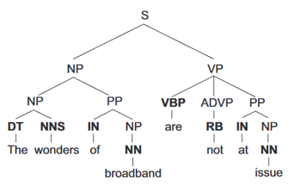
Types of PSG learned
Regular probabilities
Nth =2,3,4 order probabilities with left relation
Nth =2,3,4 order probabilities

Slide 48
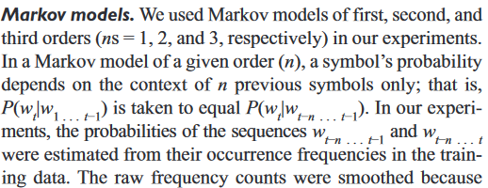
Markov Models

Slide 49
Markov models
First order Markov Model
 | V | Det | N
V | 0% | 70% | 30%
N | 40% | 40% | 20%
2nd order Markov Model
 | V | D | N
NV | 0% | 60% | 40%
VN
DN
NN
Notes:
Rows sum to 100%

Slide 50
Echo State Networks
A recurrent architecture that learns sequential relations between input elements without strict limitation on temporal integration window (long range relations as well)
Learns to predict a P.O.S
Output activations treated as probabilities over upcoming P.O.S tag, and the correct tag. True P.O.S of next word used as true target.

Slide 51
Model evaluation
From each of the computational systems they derive a measure of Surprisal for the next word (p.o.s). All 3 approaches produce p(w) in context.
They evaluate Linguist Accuracy: How Surprising is the p.o.s for each system. Presumably, the better a system learns stats of language, the less surprised it is by the future
They evaluate Psychological Accuracy: how well do the surprise ratings produced by each model predict word reading times
Reading times obtained with eye tracker for >2K sentences
Quantified by variance reduced when Surprisal is added as explanatory variable to a baseline model including just word-frequency and word-length

Slide 52
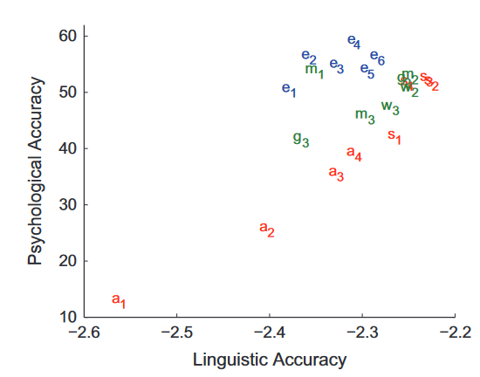
Results
A’s: PSGs with different constraint strength [Ss take left siblings) B’s Markov processes with different strength E’s echo-state networks
Notes:
M1 has low linguistic accuracy but quite high psych accuracy. Highest linguistic accuracy doesn’t necessarily mean psych accuracy.

Slide 53
Modern approaches for words in context and application to behavior
Modern computational approaches to language extend the Markov model and ESN to compute sophisticated quantities reflecting the meaning of a word in context
When the meaning of word-in-context is specified, it is possible to determine integration-difficulty in a sentential context.
It is also possible to evaluate the computational model as a cognitive or neurobiological model
We first will discuss how to describe the meaning of a word

Slide 54
The distributional hypothesis
The distributional hypothesis
words that occur in the same contexts tend to have similar
Meanings (Harris, 1954)
“You shall know a word by the company it keeps” (Firth, 1957)
Examples:
◦ Cucumber, sauce, pizza, ketchup → Tomato
◦ Soundtrack, lyrics, sang, duet → Song

Slide 55
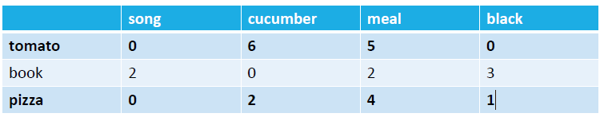
Representing words as vectors
Simple option
Each word is represented as a vector whose length is V: the size the entire vocabulary (unique entries)
The vector capture the co-occurrence of the target word with each other word in the Vocabulary, where co-occurrence is defined as adjacency within a certain distance window (e.g., x words away)
We expect words with similar meanings to have similar vectors
Given this representation it is simple to compute word similarity
The granularity of ‘adjacency’ is flexible: can be sentence/paragraph/document etc’

Slide 56
Representing words as vectors
Co occurrence frequencies using raw counts are intuitive, but problematic: some extremely frequent words can dominate the rows and make all words appear quite similar (‘dominate’) the representation.
So rather than raw counts we need a measure that quantifies how frequently 2 measure appear ‘together’, but normalized by how probable their co-occurrence would be if they were independent.
For this we use PMI: joint probability, divided by product.

Slide 57
Compressing the word vectors
There are two main problems with the word-vector matrices
They are massive (> 100K rows/columns)
They have many entries that are 0 because some words will not appear next to others: these are called sparse matrices
How do we compress this representation?
We can use dimensionality-reduction techniques like SVD.
From a 100K^2 matrix, we get a [100K x D] matrix with D < 100K, and D reflecting the latent dimensions on which each word receives a score.
Alternatively, we can use methods that compute directly the lower-dimensional vector: Word-Embedding methods

Slide 58
Principles of word-embedding
A lower-dimensional space is used to represent all words (e.g., 300-500 Dimensions).
All words are embedded into the same space
It ends up that: similar words have similar vectors

Slide 59
Word2vec: computing embeddings from adjacency
Principle: Words that appear in similar contexts should have similar vector representations
Word2Vec trains a system that predicts a TargetWord from the contexts in which it appears (e.g., the 2 words +- before/after it anywhere in the text)

Slide 60
Word2vec: computing embeddings from adjacency
The input: one-hot vectors
the: (1,0,0,0,0); cat: (0,1,0,0,0); sat: (0,0,1,0,0); on: (0,0,0,1,0); floor: (0,0,0,0,1)
A training item: The words before and after the target word
Example: the cat sat on floor
‘sat’ will be the word to be predicted;
This approach is called Continuous Bag of Words (CBOW). It ignores word order (shuffled context will give same result) but there’s sufficient info in the context to infer a miss word.

Slide 61
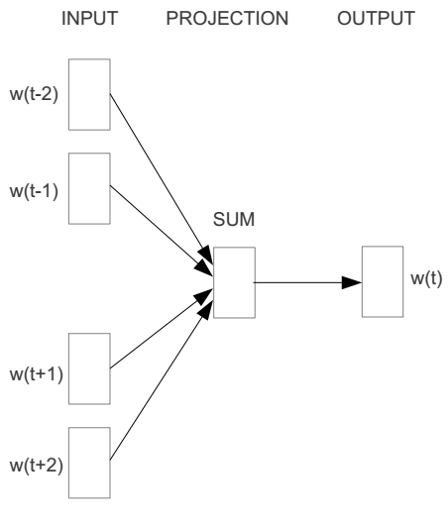
Word2vec – Continuous Bag of Word
E.g. “The cat sat on floor”
Window size = 2
the
cat
sat
on
floor
www.cs.ucr.edu/~vagelis/classes/CS242/slides/word2vec.pptx

Slide 62
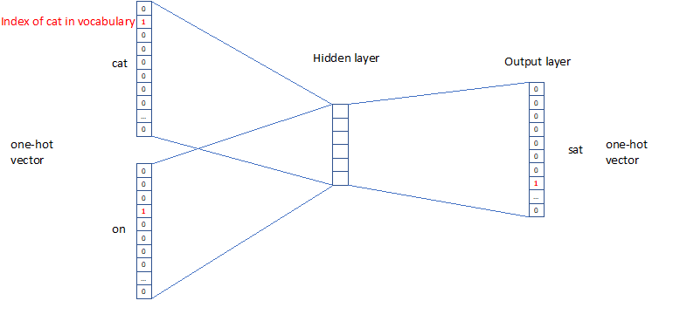

Slide 63



We must learn W and W’
Input layer
0
1
0
cat
0
$$W_{V×N}$$
Hidden layer
Output layer
0
0
0
0
0
0
V-dim
…
0
0
$${W′}_{N×V}$$
0
0
sat
0
0
0
0
1
0
$$W_{V×N}$$
N-dim
…
V-dim
1
0
on
0
0
N will be the size of word embedding vector
0
0
V-dim
…
0
V is the size of the vocabulary (1hot)
www.cs.ucr.edu/~vagelis/classes/CS242/slides/word2vec.pptx
Notes:
In this example, given w-1; w+1 we learn to predict w. Note that matrix W (also called the project matrix) is the same for all positions.

Slide 64
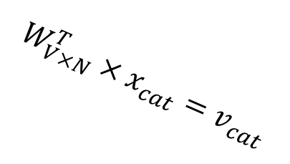

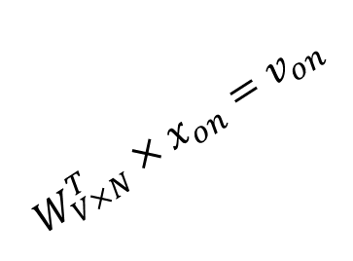
Input layer
0
1
0
x_{cat}
0
Output layer
0
0
$$W_{V×N}^{T}×x_{cat}=v_{cat}$$
0
0
0
0
V-dim
…
0
0
$$\hat{v}=\frac{v_{cat}+v_{on}}{2}$$
0
+
0
sat
0
0
0
0
$$W_{V×N}^{T}×x_{on}=v_{on}$$
1
0
…
V-dim
1
Hidden layer
0
x_{on}
0
0
N-dim
0
0
V-dim
…
0
Notes:
The 1-hot inputs for cat and on are each multiplied by VxN matrix to produce activation in the hidden layer, where they are averaged.
Then there’s a separate set of weights that take the hidden layer and converts it to activations in the output layer

Slide 65






Input layer
0
1
0
cat
0
$$W_{V×N}$$
Hidden layer
Output layer
0
0
0
0
0
0
V-dim
…
0
0
$$W_{V×N}^{′}×\hat{v}=z$$
0
$$\hat{y}=softmax(z)$$
0
0
0
0
0
$$\hat{v}$$
1
0
$$W_{V×N}$$
…
1
N-dim
0
on
0
${\hat{y}}_{sat}$
0
0
V-dim
0
V-dim
…
0
Notes:
(here we see an approximation to the correct response; obviously will be more noisy)

Slide 66




$$W_{V×N}^{T}$$
0.1 | 2.4 | 1.6 | 1.8 | 0.5 | 0.9 | … | … | … | 3.2
0.5 | 2.6 | 1.4 | 2.9 | 1.5 | 3.6 | … | … | … | 6.1
… | … | … | … | … | … | … | … | … | …
… | … | … | … | … | … | … | … | … | …
0.6 | 1.8 | 2.7 | 1.9 | 2.4 | 2.0 | … | … | … | 1.2
Contain word’s vectors
Input layer
0
1
0
x_{cat}
0
Output layer
0
0
$$W_{V×N}^{}$$
0
0
0
0
V-dim
…
0
0
$$W_{V×N}^{′}$$
0
0
sat
0
0
0
0
1
0
$$W_{V×N}^{}$$
…
1
0
V-dim
x_{on}
0
Hidden layer
0
N-dim
0
0
V-dim
…
0
We can consider either W or W’ as the word’s representation. Or even take the average.
Notes:
In red we see the weights linked to ‘cat’ in the transposed matrix. We can take that as the learned ‘meaning’ of the word.
W contains input word vectors.
W’ contains output word vectors.
Either W or W’ can be considered as the word’s representation. Or even take the average.

Slide 67
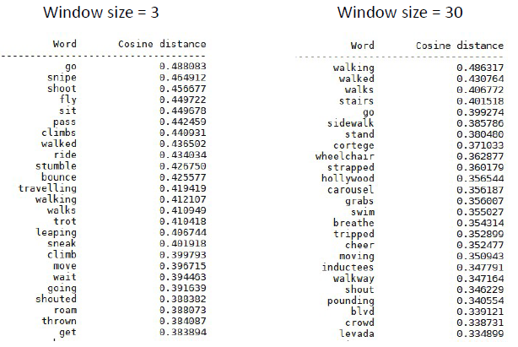
Sample results word2vec; different window sizes: word walk

Slide 68
Surprisal & word embeddings
As models of behavior

Slide 69
Can model-predictions from surprisal and word embeddings predict behavior?
Russo et al. 2020
Presented an audio narrative (in Italian) to 31 listeners
Compute surprisal for each word in narrative from probabilistic knowledge model
Computer vector-space representation (word embedding)

Slide 70


Def. surprisal

Slide 71

Def. vector space (word embedding) semantics
Define ‘word meaning’ in terms of adjacency of the word to each of 1000 ‘anchor’ words (similar to Mitchell).
The i-th component (1=1:1000) of the word vector w (c_{i}) is estimated as the ratio between the conditional probability of the context word c_{i} given the word w and the (unconditional) probability of the context word c_{i}
The adjacency window is set to 10 words
Semantic similarity between 2 words is quantified via cosine similarity.

Slide 72
Def. semantics-weighted surprisal (I)
Developed originally by Mitchell and Lapata (2009)
Integrates the probabilities obtained by the trigram model and the semantic similarity calculated from the vector space model:
the trigram probability (2nd Order Markov Estimate) is scaled by a positive factor depending on the semantic similarity of the current word with its recent history
Positive factor between 0 and INF.
i.e., upscales or downscales the trigram probability

Slide 73

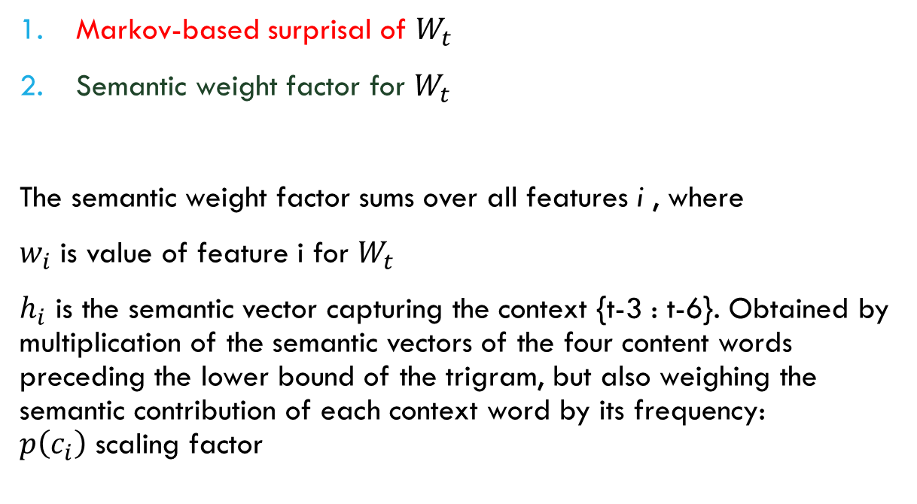
Def. semantics-weighted surprisal (II)
Markov-based surprisal of $W_{t}$
Semantic weight factor for $W_{t}$
The semantic weight factor sums over all features i , where
$w_{i}$ is value of feature i for $W_{t}$
$h_{i}$ is the semantic vector capturing the context {t-3 : t-6}. Obtained by multiplication of the semantic vectors of the four content words preceding the lower bound of the trigram, but also weighing the semantic contribution of each context word by its frequency: $p\left(c_{i}\right)$ scaling factor

Slide 74
Fmri investigation

Slide 75
Regression model
Predicting variables are descriptors associated with each words learned
Regressors of no theoretical interest:
Raw lexical frequency
Word duration
RMS (Energy) amplitude of word sound
Regressors of interest:
Surprisal
Semantic weighted surprisal
Control condition: Reversed speech stimuli with words coded in the exact same way.

Slide 76
Main results
Whole-brain, voxel-based fMRI data analysis
LS (LEFT) and SwS (RIGHT) predictors identify largely similar brain systems:
In all significant clusters BOLD is positively correlated to LS or SWS.
Model-fit analysis suggests that in many of these areas, SwS is a more accurate model.

Slide 77
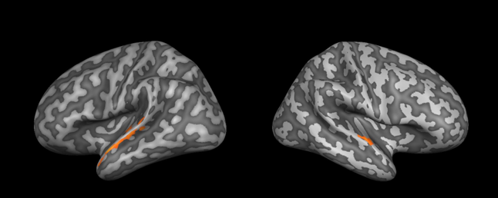
Do we need probability at all?
What happens if we just take the semantic component as predictor?
Semantics alone explains much less of brain activity

Slide 78
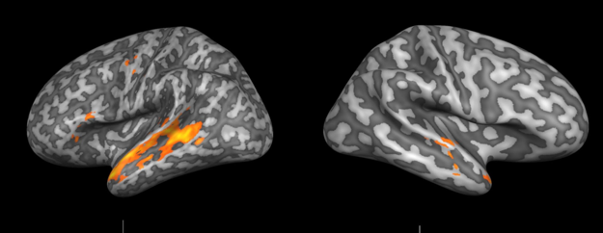
Do we need conditional probability?
Words that are less predictable given W-1; W-2 could just be less frequent in language.
Prediction from Lexical Frequency (Raw) does good job as well!

Slide 79
Considerations in discussion
Higher activity may reflect prediction errors, which are a signal to other brain areas to update based on errors
It may be difficult to dissociate different surprise models, as they may be highly correlated:
SwS and LS predictors were correlated at r = + 0.77.
Only SwS activated a cluster in the L-IFG

Slide 80
Summary of language Module
We covered three approaches for explaining the mental capacity for language:
1) memorizing which words or phrases go together;
2) (implicit) knowledge of abstract rules referred to as transformations;
3) statistical knowledge about co-occurrence of linguistic elements, where the main debate is on what these elements are: grammar-based structures as captured by probabilistic grammars, or parts of speech for which linear transitions are learned.
We have discussed ways in which words can be represented in computational systems via word embeddings
We have discussed a study that shows how contextual information can be modeled and used when accounting for human behavior, merging contextual semantic fit and contextual probability.

