Slide 1
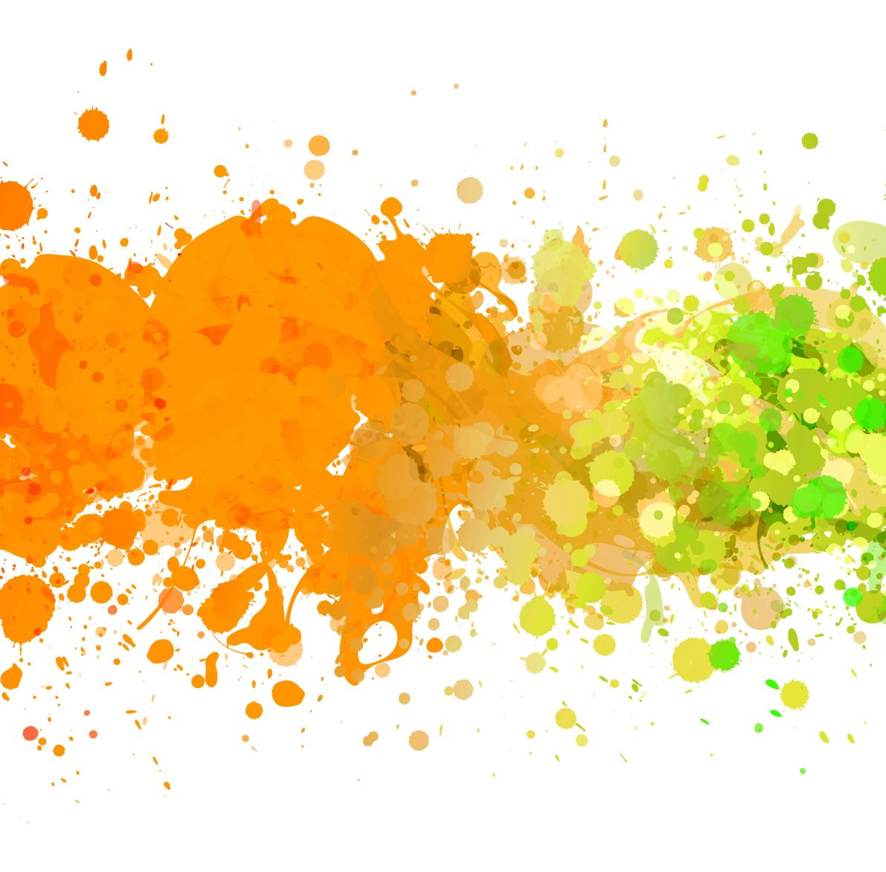
Overview of ML approaches to modeling cognitive neuroscience data

Slide 2
Barrett et al. analyzing biological and artificial neural networks: challenges with opportunities for synergy?

Slide 3
Background
Background: Revolution in the area of ML in form of DNNs.
Millions of parameters
No engineered features
Very high performance
Produces an analogy with neuroscience that are opportunities for synergy in analysis
1. At an abstract level, both fields need to answer a similar question: “how do neural networks, consisting of large numbers of interconnected elements, transform representations of stimuli across multiple processing stages so as to implement a wide range of complex computations and behaviours, such as object recognition “.
2. Both need to describe and analyze very high dimensional data
Notes:
Are these also opportunities for generating more abstract analogies about organization?

Slide 4
Their ‘analogies’
Receptive fields
Ablation
Dimensionality reduction
Representational geometries

Slide 5
Analogy: receptive fields
Neurons in the human visual cortex are specialized to process stimuli in specific spatial areas (retinotopy) or certain types of features.
The neurons in the initial processing regions of the visual cortex have small receptive fields; sensitive to stimuli in small areas of visual space.
As information is transmitted to higher level areas of visual processing, receptive fields become larger, enabling sensitivity to larger areas of space. These regions also encode more complex features, and there is evidence of "abstract" coding with invariance to small transformations.
“concept cells” sensitive to identity of objects but not to appearance. Example: simple ‘repetition priming’ effect for same faces repeated exactly, or with different orientation (but not different faces)

Slide 6
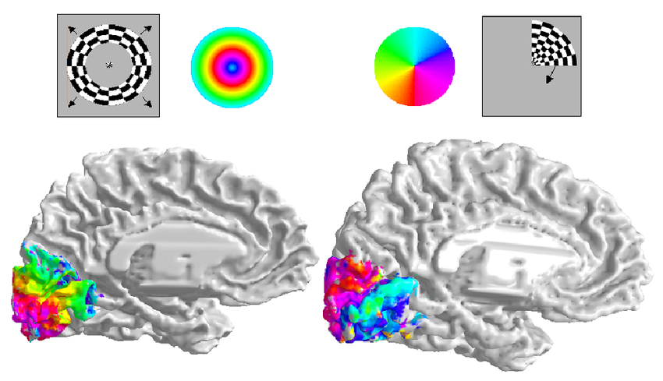
Retinotopy map
Notes:
Image source: Dougherty, Robert & Koch, Volker & Brewer, Alyssa & Fischer, Bernd & Modersitzki, J. & Wandell, Brian. (2003). Visual field representations and locations of visual areas V1/2/3 in human visual cortex. Journal of vision. 3. 586-98. 10.1167/3.10.1.

Slide 7
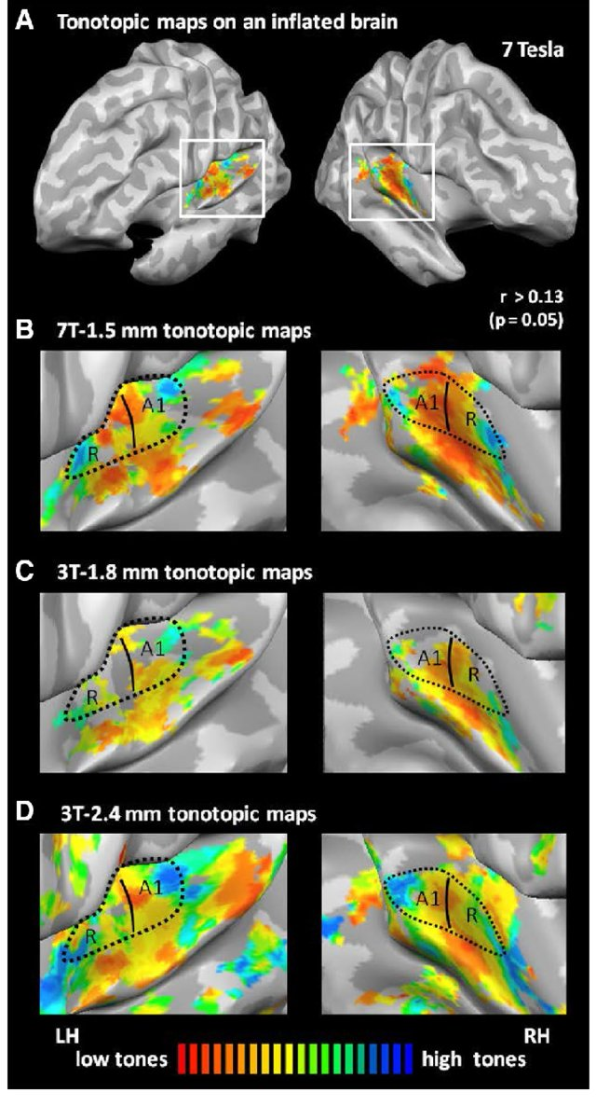
Tonotopy map
Notes:
This figure was uploaded by Wietske Van der Zwaag

Slide 8
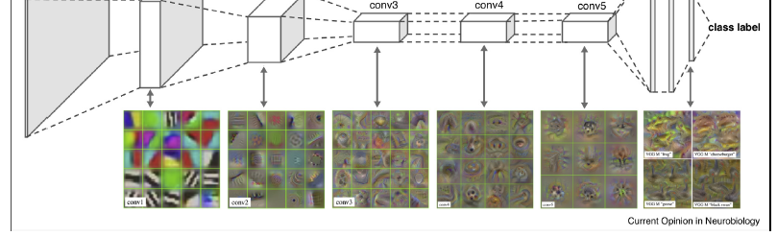
Analogy: receptive fields
(Some) AI researchers also think that DNN neurons may code for specific information, which can be studied via receptive field analysis.
This produces experiments investigating which types of images maximally activate a neuron. It also motivates studies examining how receptive fields change in deeper layer
Pooling just means that the receptive fields will become larger; but in what way are they more complex?
Notes:
Activation maximation approach to pre-trained net

Slide 9
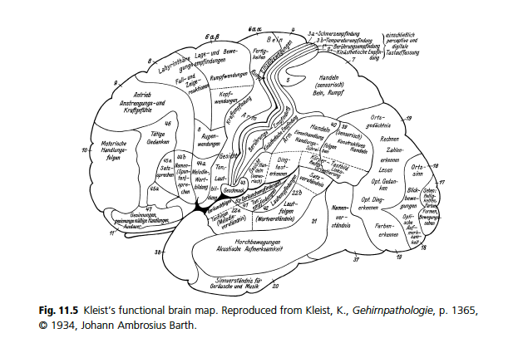
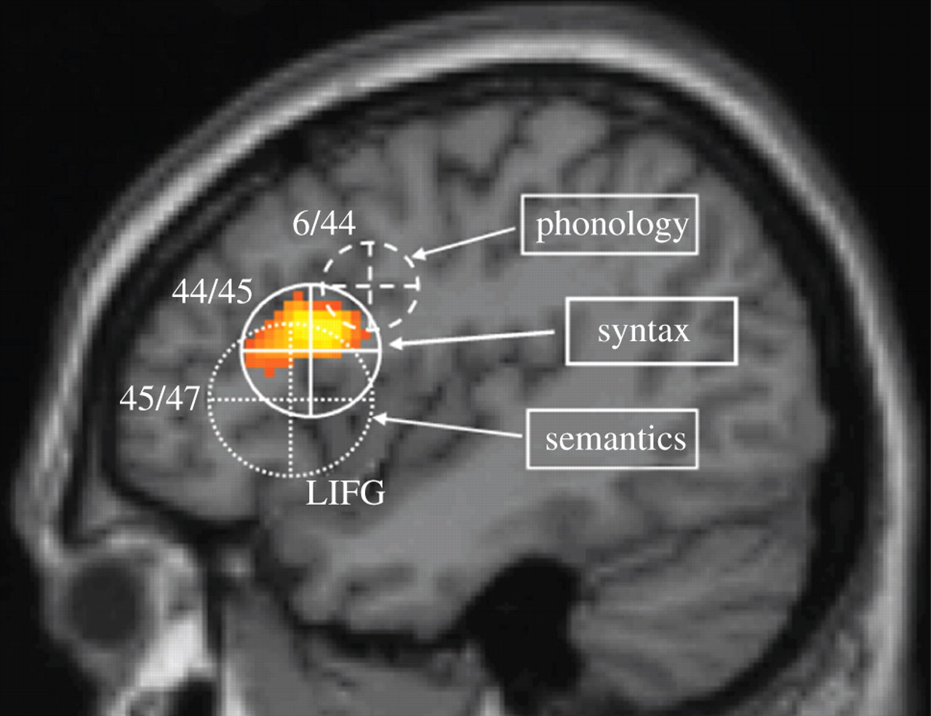
Analogy: Ablation
Brain lesions offer much information about potential function of brain areas.

Slide 10
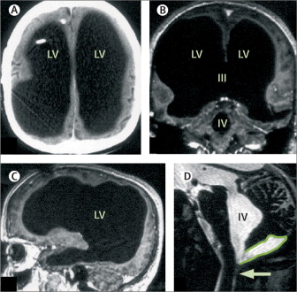
(And reorganization)
Notes:
Fine tuning? https://www.thelancet.com/journals/lancet/article/PIIS0140-6736(07)61127-1/fulltext

Slide 11
Analogy: Ablation
Ablation (lesioning) analysis applicable to DNNs. “Silencing neurons” and seeing how this impacts the network output.
Reversible or non-reversible silencing of neurons in a brain structure can be accomplished using various tools in humans.
In DNNs: structural pruning (removing of entire neuron with all its outgoing weights)
Networks trained for generalization (out of sample prediction) are more robust to ablation than those trained on memorizing labels.
The importance of a neuron is determined not by its class selectivity but perhaps by the sum of its effects
Pruning and fine tuning are active areas of research.

Slide 12
Analogy: dimensionality reduction for characterizing distributed representations
The brain codes information in a distributed manner, necessitating multivariate analysis
Multiple units encode information in the brain, leading to redundancy where two neurons may fire almost identically; OR
Information is coded in a distributed manner among multiple units (e.g., coding for 4 classes among 2 neurons, each coding 1/0); OR
Correlation among units could indicate that the activity can be described in a lower dimensional space.
In DNNs: An object-by-feature matrix from fully connected layer can be compressed by more than 80% while maintaining almost all variance. This means, few low dimensions explain differences between images.
Notes:
We will see evidence for excess dimensions when studying representational geometry.

Slide 13
Analogy: studying representational geometries
How are representations represented in different layers or change over time? How are different embedding spaces related to each other?
Given and object-by-feature matrices (2 layers, 2 networks, etc’) we can use Canonical Correlation Analysis or PLScorrelation to ‘compare representations across networks’. These methods identify lower-level factors that capture and maximize the correlations/covariance between the datasets. (Note: These methods can be seen as "supervised" as they reweight columns in both tables to maximize similarity.)
Representational Similarity Analysis involves comparing two similarity matrices, often constructed from object-by-feature matrices. This yields an object-by-object similarity matrix.
Neurobiological activation vectors can be predicted from DNN embeddings using linear regression ("brain score").

Slide 14
Spicer and Sanborn
Methods: spatial methods, logical methods and ANNs

Slide 15
Spatial methods
Spatial methods involve placing items in a multidimensional space and using their location to draw conclusions about categorization
Classification based on spatial methods can be determined by an item's location relative to a hyperplane or its similarity to different prototypes (means) or exemplars (centroids).
Prototype approaches assume that learning is based on similarity to the center of a category (mean), which is stored after training
Exemplar approaches calculate similarity as a ratio between the similarity of an item to all items within a class (i...n) and the similarity of that item to all other items. This provides a fit per class and requires storing item-level information.
Clustering organizes items into groups (cohorts), with quality often quantified by the distance between items within and between clusters. Clustering can be either hard (each item belongs to only one cluster) or soft (items can have multiple memberships, potentially fuzzy).

Slide 16
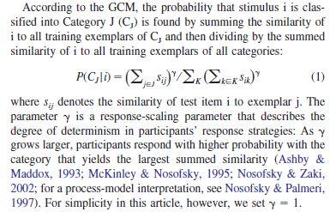
Spatial method: example. Nosofsky 1986. Generalized Context Model (GCM)

Slide 17
Logical methods and ANN
Logical methods: concepts are based on a definition that is applied to the features of the object. One embodiment: search for rules that maximizes discrimination between stimuli; the rule can be probabilistic.
Allow compositionality (e.g., use “AND”). Draw Hard boundaries (no fuzziness).
ANNs: do not make assumption about the representations involved, but offer an implementation method.

Slide 18
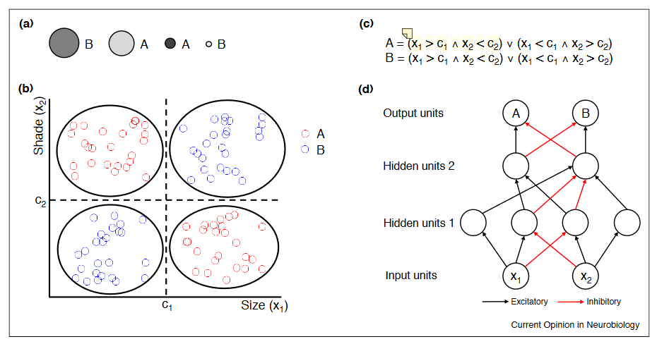
Notes:
“(x1 > c1 ∧ x2 < c2” (Spicer and Sanborn, 2019, p. 98) value on dimension 1 (X1) greater than its average and value on dimension 2 smaller than the average

Slide 19
Points for thought.
Is it useful to ask which model is the most accurate?
The authors: focus on whether they offer “useful explorations of the ways in which human learning operates”. The answer you prefer will depend on what area of science you work in.
Value depends not just on match to human behavior, but whether there is a need to understand the underlying representations.
Not just accuracy; but what confusions occur

