Slide 1
Using Human Brain Activity to guide Machine Learning Fong et al.
ABNS 2022

Slide 2
Outline
1. Introduction + context
a. Intro to methods
Intro to results
2. Methods + results
fMRI activity weight calculation
Experimental findings
3. Discussion + issues
Related work
Limitations

Slide 3
Introduction
Brain areas, Features, and Loss functions.

Slide 4
Guiding questions and premises
Is it impossible to improve ML performance by guiding performance with brain activity
Will such guidance make the representations themselves more ‘human like’
Here, the focus is not on performance but on representational geometry
If the human brain is a natural reference point (**for representation geometry) and performance (**that counts), and ANNs are a good algorithm for learning structure, we can attempt to leverage the ML algorithm with biological information.

Slide 5
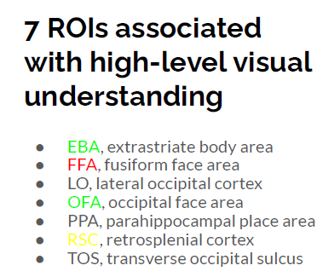
Brain areas considered
Different brain areas code for different information about the stimulus.
Here, the partitioning of brain areas that will supervise ML is done a-priori.
They focus mainly on visual regions

Slide 6
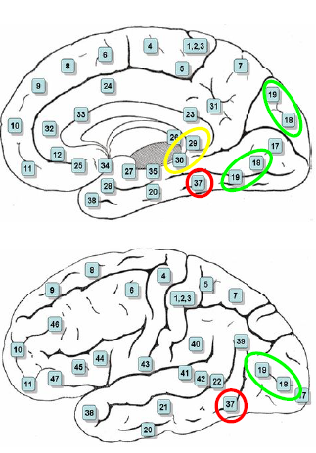

Slide 7
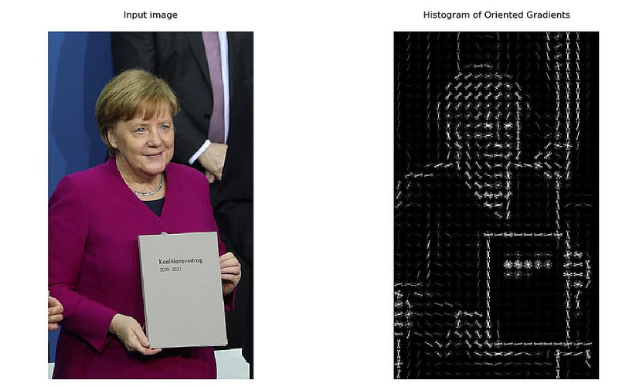
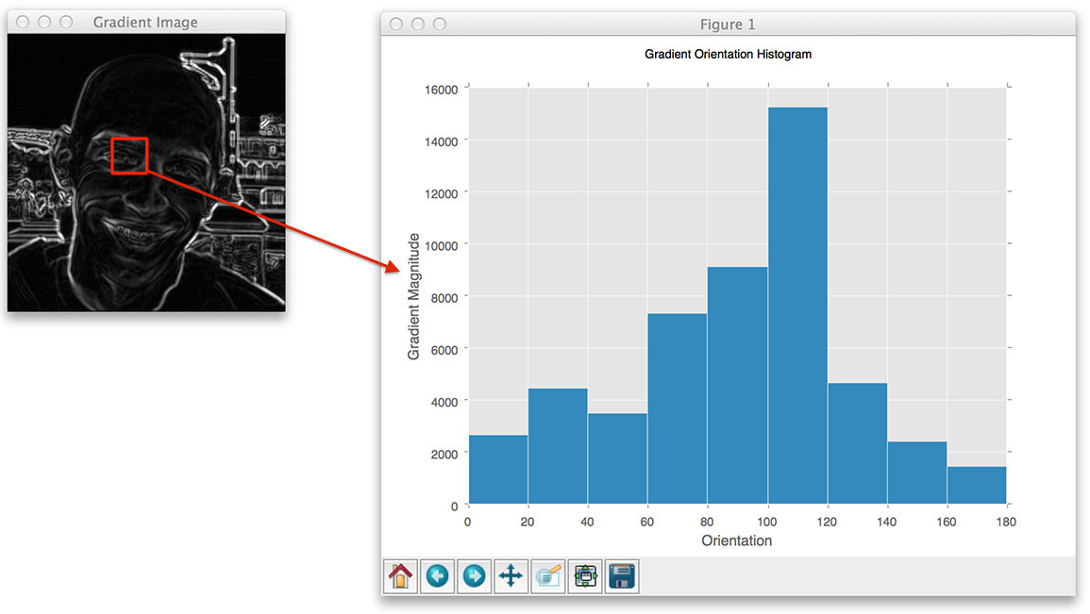
Types of models used: HOG and CNN
The histogram of oriented gradients (HOG) is a classic off-the-shelf algorithm for generating features that capture the local “slopeness” of different parts of an image
Convolutional NN.

Slide 8
Hinge Loss
Wikipedia: For binary classifier: For an intended output t = ±1 and a (raw) classifier (activation/predicted) score y, the hinge loss of the prediction y is defined as
Loss(y) = max(0, 1 – t*y)
When t=1, max=0 whenever y gte 1, positive otherwise
When t=-1, max=0 whenever y lte -1, positive otherwise
Loss is proportional to the distance from the SVM’s decision boundary.
Recall: the ‘hinge’ (max) ignores the distance of correct decisions (points) from the boundary. What matters are the closest points in the two classes and how they should be separated.

Slide 9
Activity Weighted Loss
Prelim: defined ‘response strength’ From brain fMRI activity data as the distance of an object from the decision boundary for a given binary classification task.
This produces a per-stimulus activity weight for each stimulus.
As input to the classifier, each coded as encoded as a vector of brain-activity values sampled from a given brain area.
No need to know the details of how the fMRI data is processed.

Slide 10
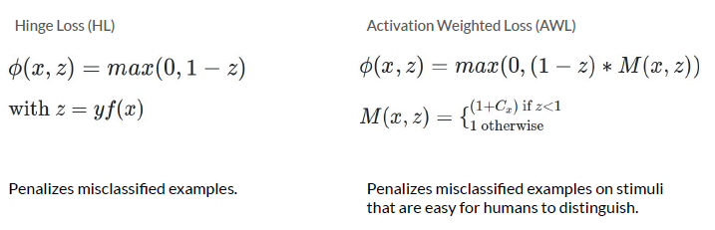
Notes:
Terminology in paper is different from Wikipedia. “z” here captures the match between true class and raw activation. Activation-weighted loss: whenever expression Z < 1 i.e the activation is on the wrong side of the boundary, the penalty term (for training) increases by Cz which is the human related activation.

Slide 11
TBD
What is the impact on ‘representational geometry’ or class representation?
What changes? In/out members; centroid. Identity of boundary members.
Kernel SVM projects to higher dimension where the classes are separable. How does this fit the representational geometry?
The Kernel function of two points x1, x2 in the new high-dimensional space is their inner product. In this sense, can be considered a measure of pair-wise similarity in the new features space. Can a human RDM be used directly to supervise a hyperplane that emulates that judgment?
Notes:
Terminology in paper is different from Wikipedia. “z” here captures the match between true class and raw activation. Activation-weighted loss: whenever expression Z < 1 i.e the activation is on the wrong side of the boundary, the penalty term (for training) increases by Cz which is the human related activation.

Slide 12
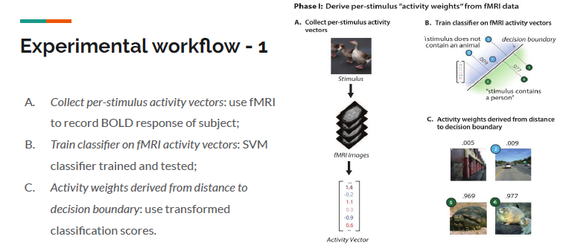
AWL: Step 1.
Notes:
Distances from boundary function (C) converted to probability function.

Slide 13
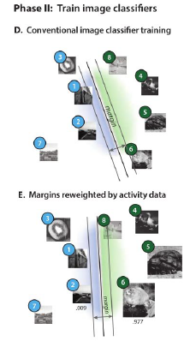
AWL: Step 2.
D: Conventional image classifier training: Radial Basis Function SVM classifier
E: Margins reweighted by activity data: SVM classifier with activity weighted loss function. NOTE: not all training samples require fMRI weight.
Notes:
One classifier was trained as usual. Another trained with Activity-weighting.
AFTER training, both are tested as usual, based on image features alone.

Slide 14
Other information
Use images from 5 categories
Humans -> 219 images
Animals -> 180 images
Buildings -> 151 images
Foods -> 59 images
Vehicles -> 37 images
Classification problems based on CNN or HOG features.
Information from the higher-level cortical regions combined in all possible combinations to produce feature sets.

Slide 15
Results

Slide 16
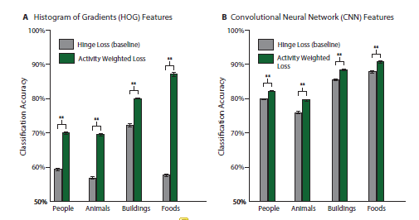
Classification accuracy: all brain areas used together
Notes:
“brain activity compensates for poor feature representation”? Their explanation for large boost in HOG.

Slide 17
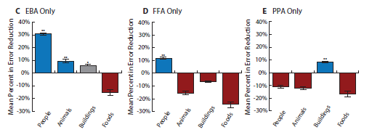
Does information from different brain areas differentially discriminate different information?
EBA, FFA, and PPA == body parts, faces, places?
“Given the overlap between these visual cues and the four object categories used, we hypothesized that activity weights derived from brain activity in these three regions would significantly improve classification accuracy for the humans, animals, and buildings categories”
Notes:
Why not just look at direct classification accuracy for categories in that region? What does the error reduction score add in particular?

Slide 18
Conclusions
Information measured directly from brain can guide an ML algorithm “to make better human-like decisions”.
One can harness measures of the internal representations employed by the brain to guide machine learning.

