Slide 1
Interpretable Semantic Vectors from a Joint Model of Brain- and Text-Based Meaning
ABNS 2022

Slide 2

Vector Space Model (VSM)
Construction and use

Slide 3
Vector Space Model
VSMs represent lexical meaning by assigning each word a point in high dimensional space. The high dimensional space can be any vectorial representation associated with each word.
VSMs are typically created using a large text corpora. When this it he case, the VSM represent word semantics as observed in text
In the VSM, the distance between any two words is taken to indicate their semantic similarity (matching, e.g., that observed and rated by speakers)
Corpus-based VSMs have been criticized as being noisy or incomplete representations of meaning

Slide 4
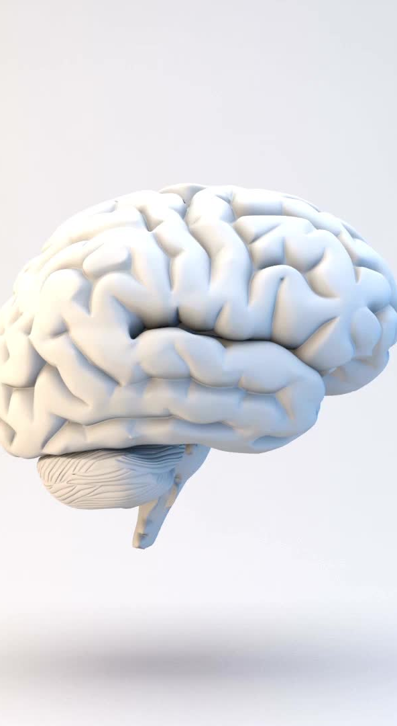
VSM from brain activity?
When a person is reading or writing, the semantic content of each word necessarily produces patterns of activity over neurons/voxels/sensors
In principle then, brain activity could be used instead of corpus data to construct VSM.
If brain activation data encodes semantics, including brain data in a model of semantics could result in a more effective model.
“The inclusion of brain data will only improve a text-based model if brain data contains semantic information not readily available in the corpus.”
Notes:
The last note is a bit of a mis-nomer. What if some dimensions in the text model are not related to the task on which its tested, and the brain data just prunes those dimensions?

Slide 5
Challenges of the project
Create
Create a database of human-annotated word semantics and create a brain-informed VSM that better predicts this database
Predict
Predict corpus representations of withheld words more accurately by infusing brain data into the learning model
Map
Map semantic concepts onto the brain by jointly learning neural representations

Slide 6
Data
Corpus and Brain data

Slide 7
Corpus Data
The corpus data are compiled from a 16 billion word subset of ClueWeb09 and contain two types of corpus features: dependency and document features.
Dependency statistics were derived by dependency parsing the corpus and compiling counts for all dependencies incident on the word.
Count thresholding was applied to reduce noise, and positive pointwise mutual-information (PPMI) was applied to the counts. SVD was applied to the document.

Slide 8
Brain Data
fMRI data and MEG data for 18 subjects (9 in each imaging modality)
Each read 60 concrete nouns. The 60 words span 12 word categories

Slide 9
Method
NNSE and JNNSE

Slide 10
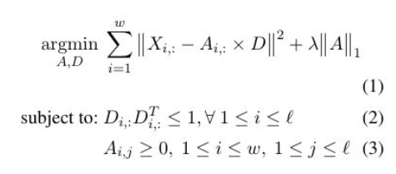
NNSE
Notes:
Approximate the X cooccurrence matrix [word by features] as a multiplication of two matrices: matrix A[i words by l latent dimensions] multiplied by D [l latent dimensions time by c features]. Penalize values of A [entries of A?]
Eq1: sparsity in A by penalizing the sum of absolute values in the matrix.
Eq 2: constrain to l dimensions to not make A too large
Eq : A non negative.
They write: “NNSE’s sparsity constraint dictates that each word can have a non-zero score in only a few dimensions, which aligns well to previous feature elicitation experiments in psychology. In feature”

Slide 11
Interpretability of A matrix
What’s the ‘meaning of a word?
Find top scoring dimensions for the word (i., e row).
Then, find words that score highest on those dimensions
“For example, the word chair has the following top scoring dimensions:
1. chairs, seating, couches;
2. mattress, futon, mattresses;
3. supervisor, coordinator, advisor. These dimensions cover two of the distinct meanings of the word chair (furniture and person of power)”

Slide 12
JNNSE: adding brain-activity information
Corpus stat per word
Activity per word
Notes:
Now we minimize an expression that is based on decomposition of matrix X mentioned above, and matrix Y, which is a [word by voxel] Matrix. Matrix A is the same word by l_latent_dimensions in both expressions. Db is latent_dimensions by brain features.
Advantage over CCA, PLSR others: no need for completely paired data. Matrix Y can be a subset of X.

Slide 13
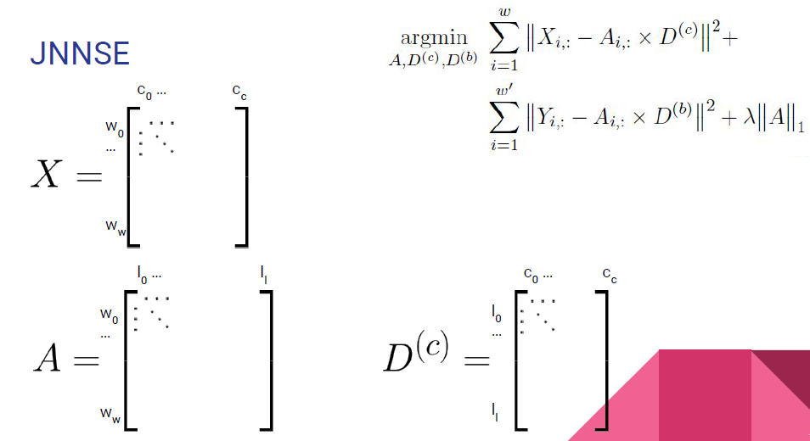
Corpus stat per word
As many words as words in corpus ‘w’

Slide 14
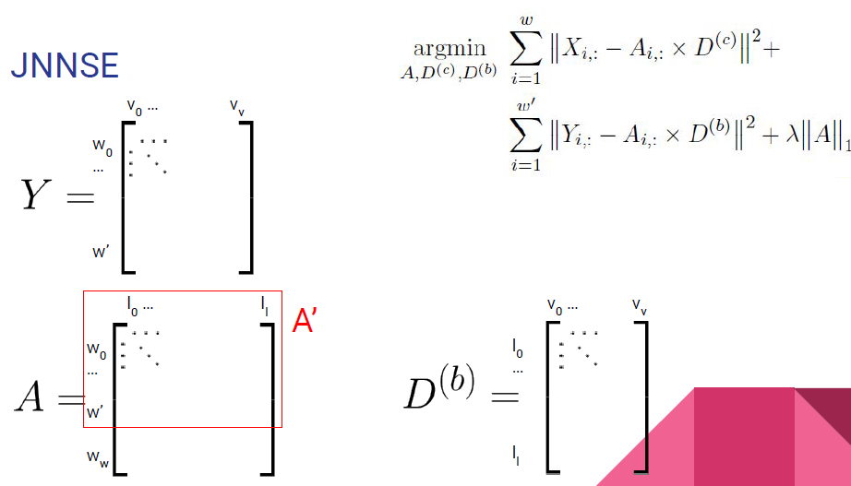
Activity per word
W’ is subset of words for which we have brain data
Notes:
Notice the difference in summation. The upper expression goes over all the words in the corpus, and the lower, over the subset for which we have brain data.
A’ is the subset of the A matrix that is relevant for reconstructing Y. is a subset of the rows in X.

Slide 15
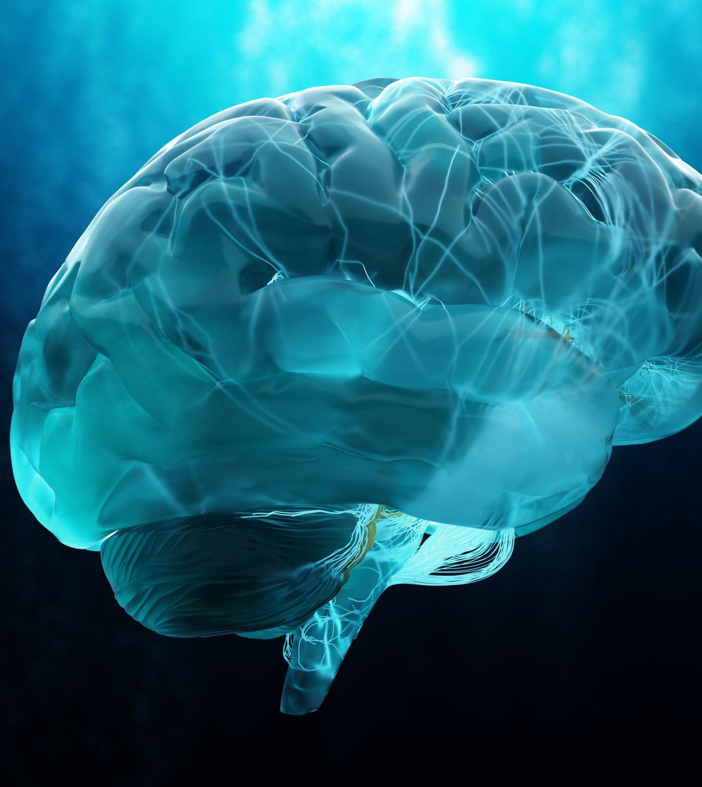
Advantages of JNNSE
Handle partially paired data. Vs Canonical Correlation Analysis or Partial Least Squares that require data about the same observations in both cases.
No need to have a common average brain (can concatenate activation across subjects in the Y matrix, per word)
Merge different brain imaging experiments adding a specific loss

Slide 16
Experiments

Slide 17
Prediction of semantic annotations.
Step1: obtain behavioral measure of semantics
Step2: try predicting the behavioral measures using VSMsa
Step1: 60 words; each with 218 semantic annotations.
Step2: learn to predict the 60x218 matrix from 60xA matrix obtained from
JNNSE(Brain+Text); [using 250, 500 or 1000 latent D]or
NNSE(text alone).
Assessment: pairwise (Euclidean) distances in 218D space (JNNSE vs. Human Behavior)

Slide 18
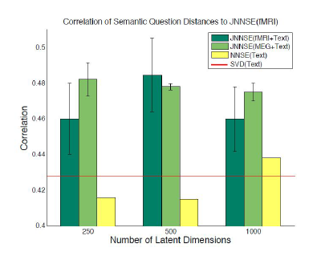
Correlation with behavioral data
Notes:
Joint embedding improves prediction of human sim space vs. NNSE. Could this be just another addition of constraint set?
Baseline (SVD) = SVD matrix for original corpus.

Slide 19
Word prediction from brain data.
Matrix A from JNNSE or NNSE used as outcome variable
For each lower-dimension, there is a set of values over words (Y)
Regression is used to predict the value of that dimension l over the Y words.
This is repeated for all l dimensions..
Thus producing a predictive l-dim vector per word.
They train the regression on Matrix A (JNNSE / NNSE) consisting of 58 words. They then produce predictive vectors for 2 left out words and evaluate their similarity to the ground truth of those embeddings in A.

Slide 20
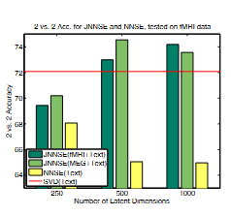
Notes:
Word prediction from brain data improves when the embedding space itself A is constrained by brain data.

Slide 21
Prediction of corpus data
Context of application: produce X-matrix (“raw”) entries for words for which there is not enough corpus data required for creation of corpus statistics. That is, predict actual corpus data.
Principle, use JNNSE to obtain A-entries for words appearing in X and Y (corpus and brain), but also some words appearing only in Y (brain).
Using the D(c) in Eq 4, recreate the entries for those words.
They compute a rank accuracy measure (*? Similar to rank based correlation) which shows that the predicted row of X corresponds well to the true entry (my read: typically correct vector in top 33% of rank)
Notes:
* Details unclear.

