Slide 1

/HOW WE MADE FRONTLINECODE

Slide 2
/INTRODUCTION
We used the following programming languages to develop the Frontlinecode project: Python, JavaScript and SQL.
The libraries used are: requests, os, pathlib, secrets, sqlite3, subprocess, sys, flask, flask_mysqldb, datetime, google.auth.transport.requests. Of these, Flask in particular served us for creating the web app, while, google.auth.transport.requests for logging in via Google Account.
To create the pages we used Html, Css and Bootstrap for the graphical elements of them.
Our project is published on github.

Slide 3
/PAGES
/01
/INDEX
/06
/CHANGE_USERNAME
/02
/LOGIN
/07
/GAME
/03
/CHOOSE_USERNAME
/08
/GAMESAVED
/04
/PROTECTED_AREA
/09
/QUERY
/05
/PROFILE

Slide 4
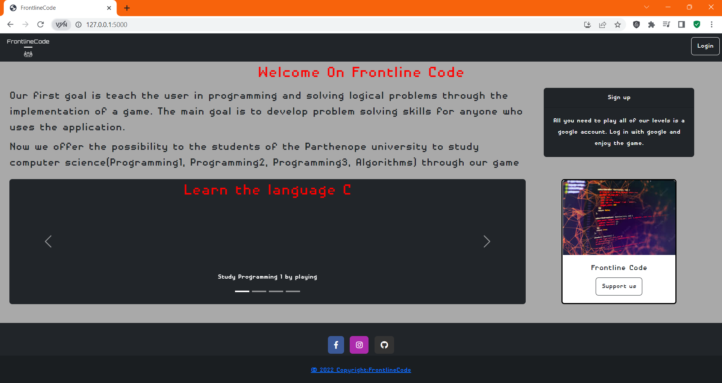
/01
/INDEX
Homepage of the web app that guides the user to the game.

Slide 5
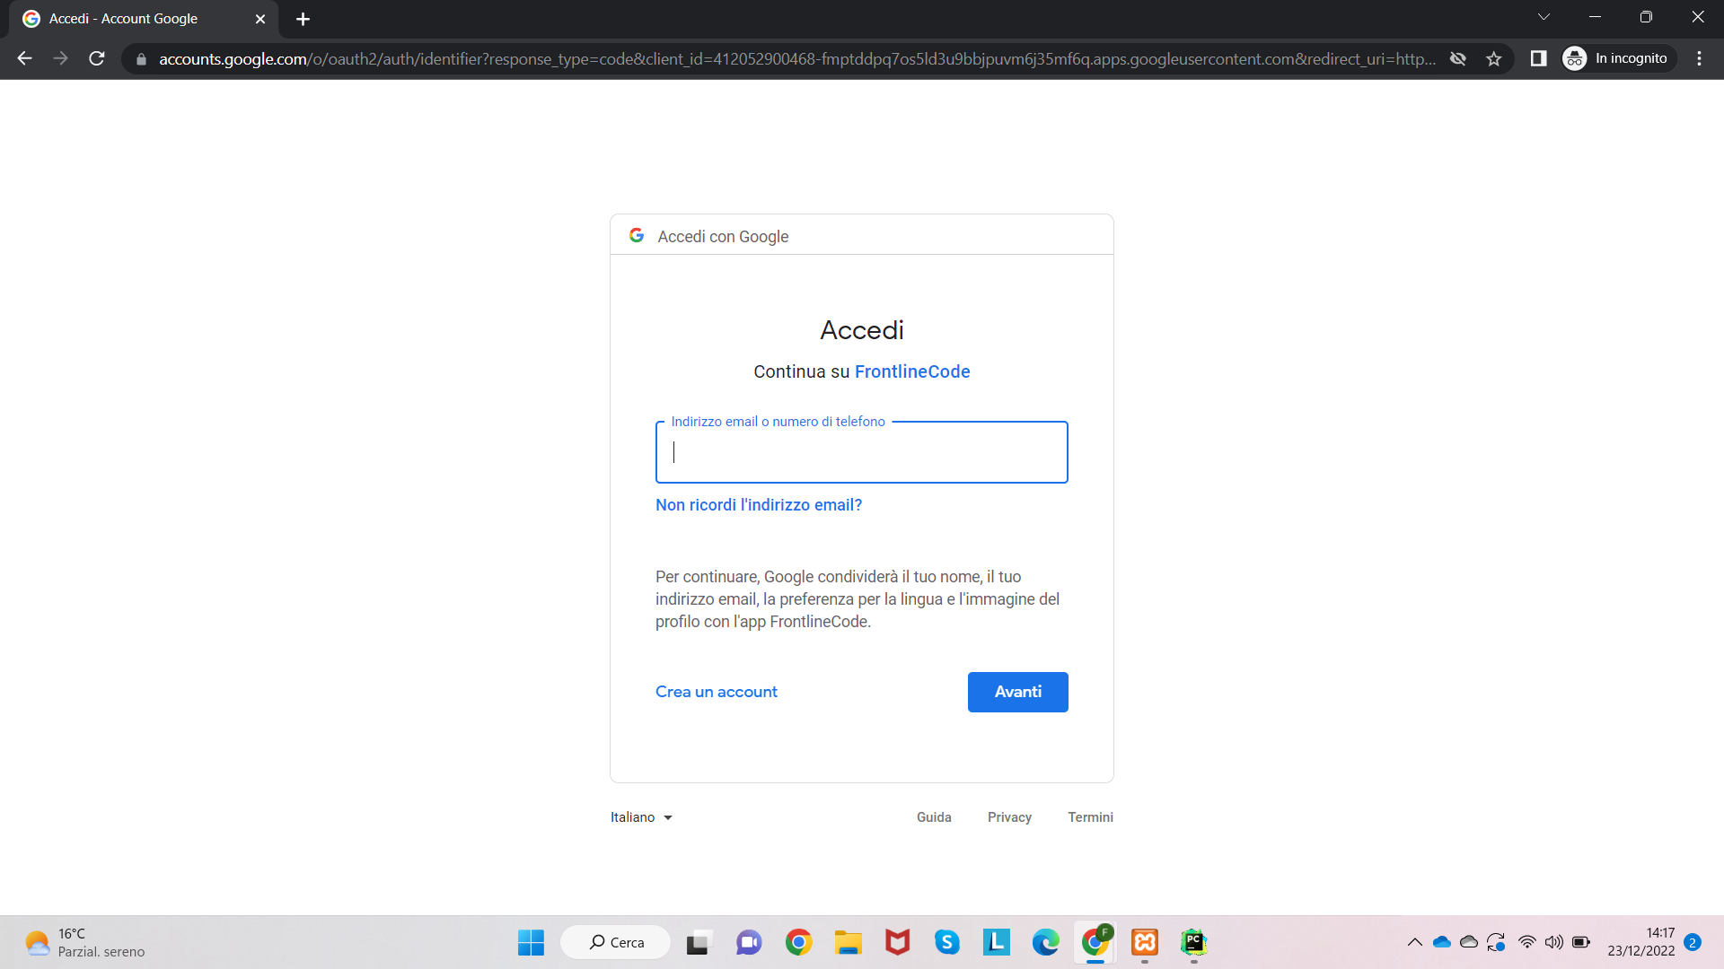
/LOGIN
/02
Google authentication

Slide 6
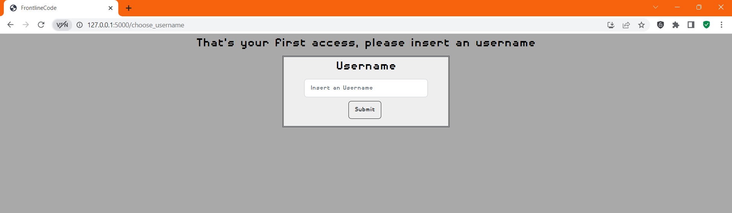
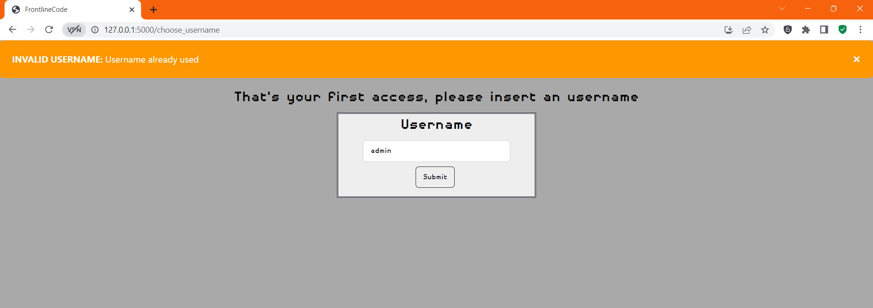
/03
/CHOOSE_USERNAME
Page where the user must choose the username to be used.

Slide 7
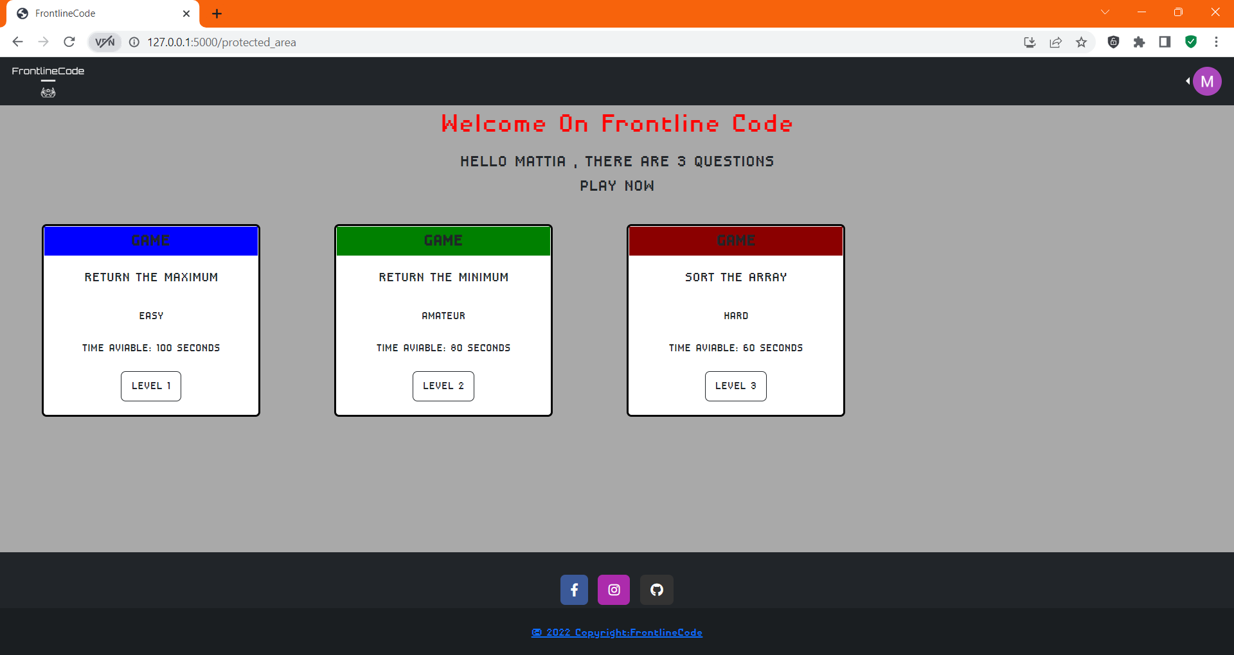
/PROTECTED_AREA
/04
Restricted user area where he/she can access the levels of the game.

Slide 8
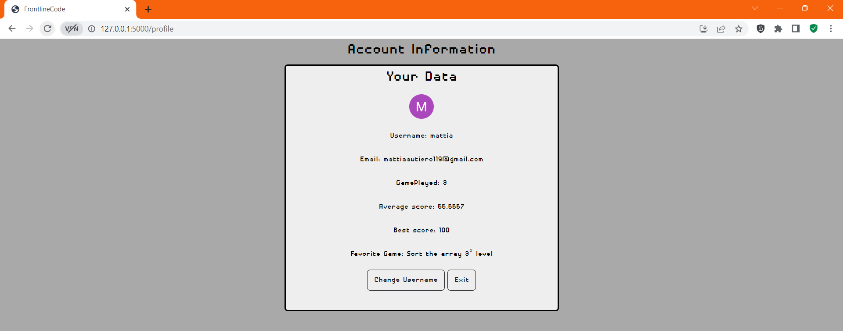
/05
/PROFILE
Recap of player credentials and statistics.

Slide 9
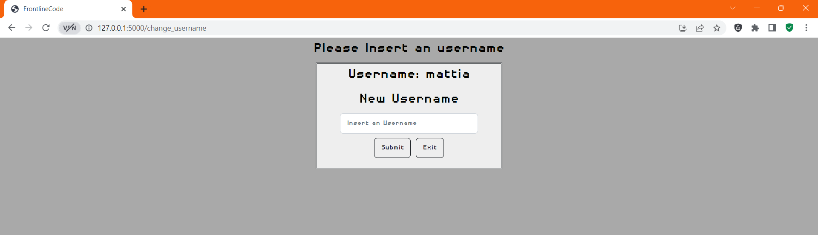
/CHANGE_USERNAME
/06
Page where the user can change his username.

Slide 10
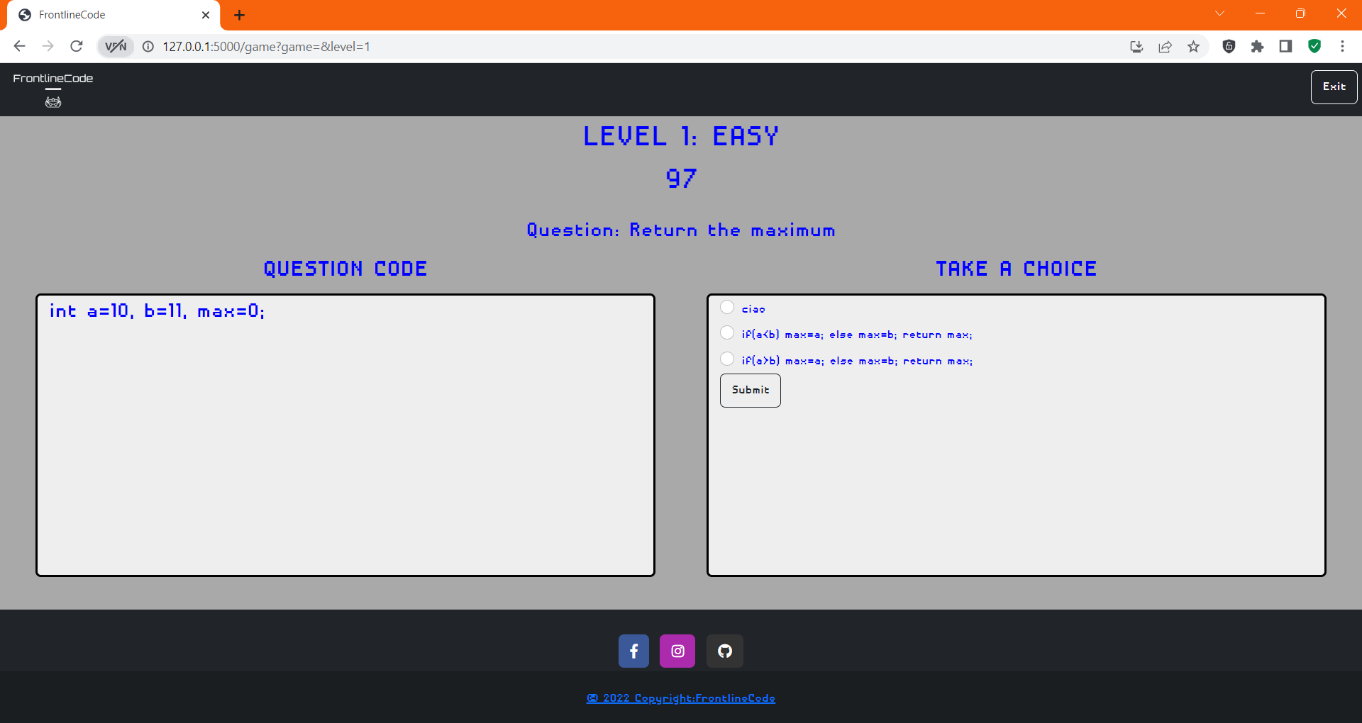
/GAME
/07
Play area.

Slide 11
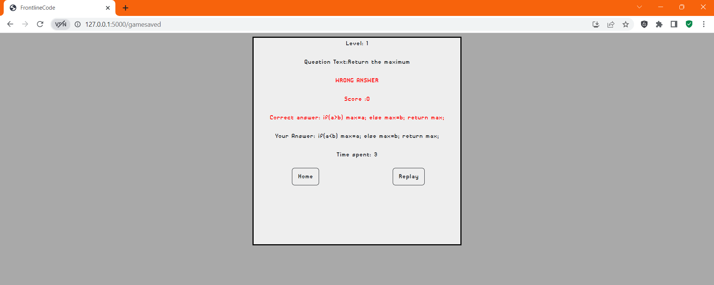
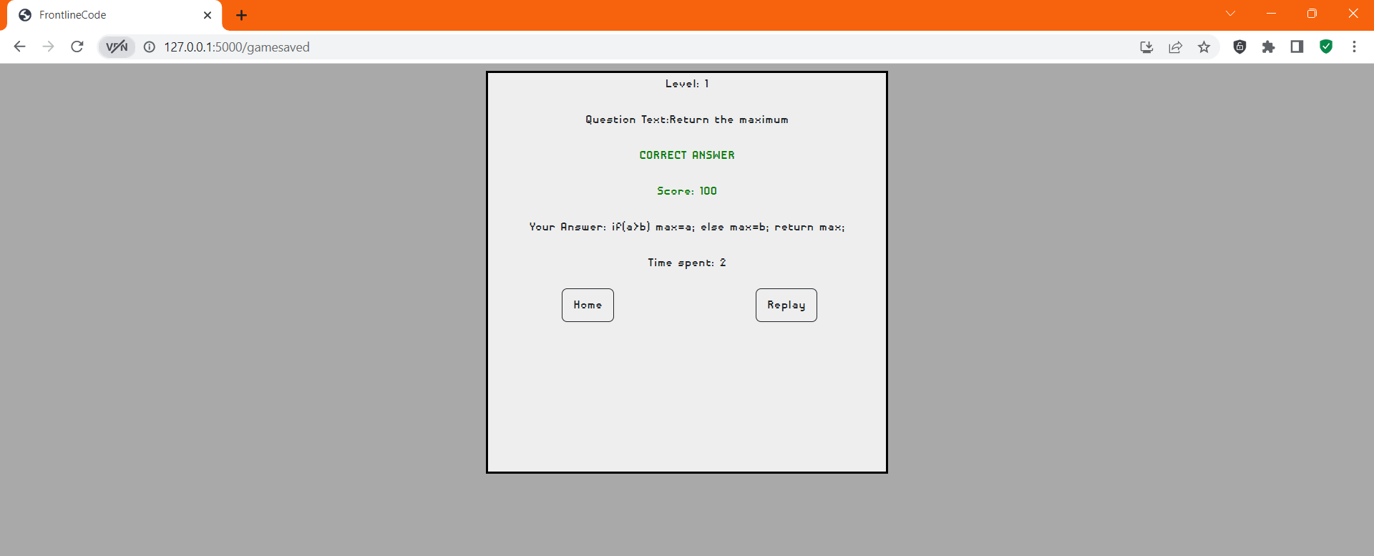
/08
/GAME_SAVED
Page where the user displays the score obtained, the correct answer of the question, and the answer given.

Slide 12
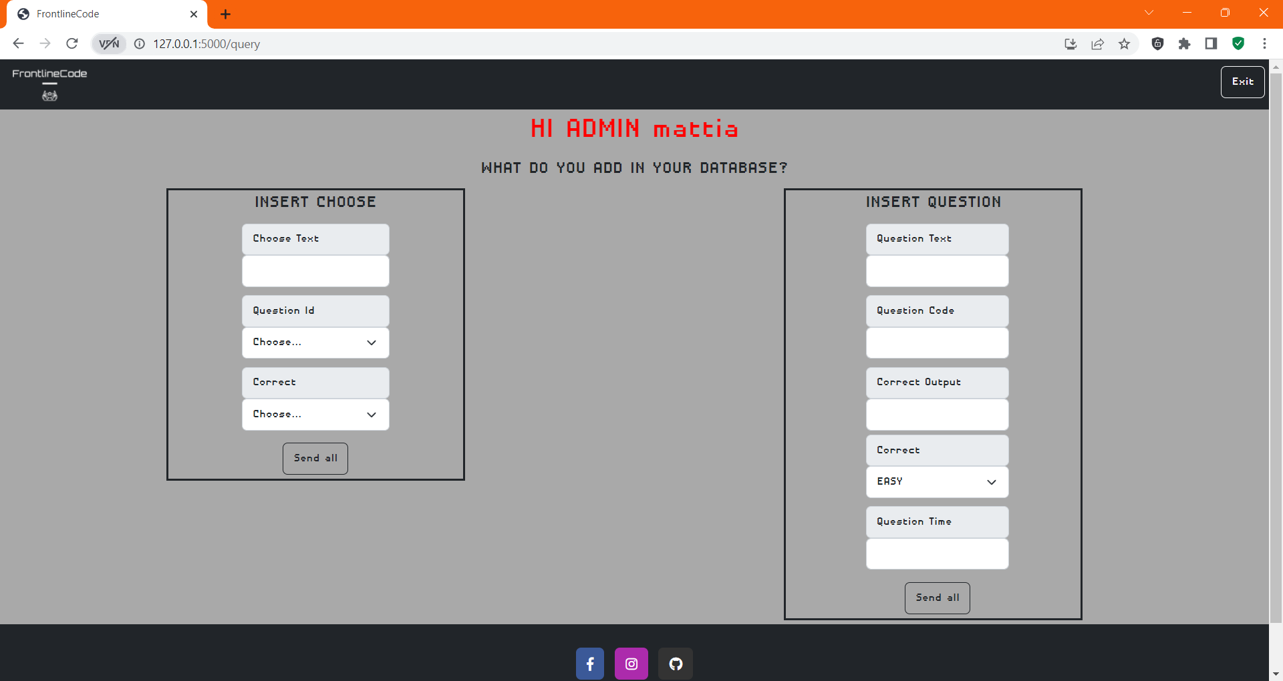
/QUERY
/09
Area that can be viewed only by those who have the privileges to do so,namely the admins.
It also allows you to add data to the database.

Slide 13
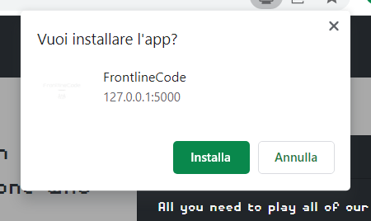

PWA
Finally, you can install Frontlinecode directly from the browser.

