Slide 1
Data Science Lab in Biosciences
Multimodal Deep Learning
for Breast Cancer Classification
CNN · Radiological Features · Late Feature-Level Fusion · Explainability

Slide 2



Dataset & Critical Audit
BUSI + METABRIC
Critical Audit Finding
780
ultrasound images
Patient IDs follow the METABRIC format (MB-XXXX), not BUSI's original naming.
437 / 210 / 133
benign / malignant / normal
Patients labelled 'normal' show avg tumour size of 27 mm and invasive carcinoma diagnoses.
3
target classes
Two CSV files (clinical + molecular) were provided alongside the images — from the METABRIC genomic study (UK/Canada, 2000–2005).
No significant correlation between class label and clinical variables (p > 0.05).
Conclusion: the image–tabular linkage is artificial.
Solution: extract tabular features directly from the images →
both modalities refer to the same patient by construction.

Slide 3






Pipeline Overview
Data
Audit
CNN
Feature
Extraction
MLP
Fusion
Evaluation
XAI
Statistical verification
that the image–clinical
linkage is artificial.
EfficientNet-B0
(7 of 9 blocks frozen;
transfer learning).
11 features: 7 intensity
statistics + 4 GLCM
texture descriptors.
MLP 11→64→32→3
on radiological features.
Late feature-level
fusion. Frozen encoders;
only head trained (2.1%).
Accuracy, F1-macro,
per-class recall;
same test set for all.
Grad-CAM on CNN;
SHAP on MLP.

Slide 4
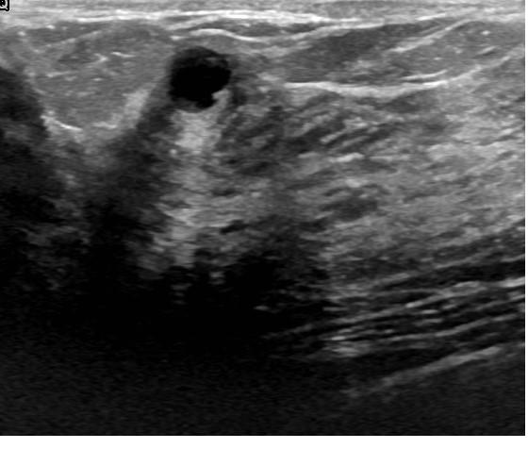
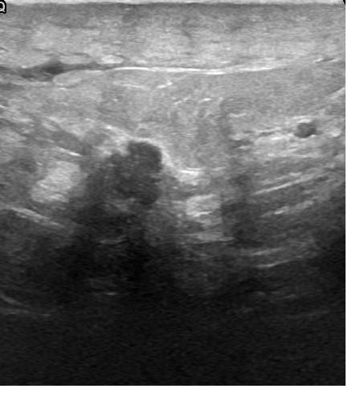
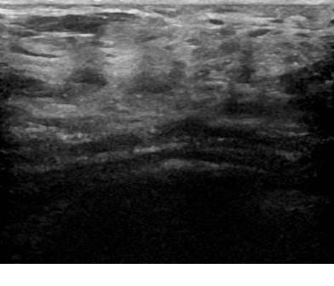
CNN — EfficientNet-B0 (Transfer Learning)
Architecture & training choices
Sample ultrasound images from the dataset
Pre-trained on ImageNet — reuses learned filters for edges, textures and shapes.
First 7 of 9 blocks frozen: prevents catastrophic forgetting on a small dataset.
Last 2 blocks + head trainable (~28 % of parameters).
Benign
Malignant
Normal
Class-weighted CrossEntropy loss + early stopping.
Input: 224×224 px, ImageNet normalisation
Augmentation (train only): horizontal flip, ±15° rotation
Exposes a 1280-dim feature vector used by the fusion model.
Result: Accuracy 0.761 — F1-macro 0.752
Malignant recall: 1.000 | Benign recall: 0.621

Slide 5
Radiological Feature Extraction (11 features)
Features are extracted from raw pixel values only — no segmentation mask used.
First-order statistics (×7)
GLCM texture descriptors (×4)
Computed from the global intensity histogram of the image.
Each pixel is treated independently.
Gray-Level Co-occurrence Matrix captures local texture by counting how often pixel pairs of given intensities appear adjacent. Computed in 4 directions (0°, 45°, 90°, 135°) and averaged for rotational invariance.
mean_intensity
Average pixel brightness — overall brightness level of the image.
glcm_contrast
std_intensity
Measures how much adjacent pixel values differ.
High = rough texture (common in malignant lesions).
Spread of pixel values — high std = high contrast between regions.
glcm_correlation
skewness
Measures predictability of local patterns.
High = regular, structured texture.
Asymmetry of the distribution — positive = many dark pixels with few bright ones.
kurtosis
glcm_energy
Tail weight — high value = many extreme pixels (very dark or very bright).
Measures uniformity (Angular Second Moment).
High = few dominant grey-level transitions.
percentile_10 / 90
10th and 90th percentile — robust bounds of the intensity range.
glcm_homogeneity
Measures similarity of adjacent pixels.
High = smooth, gradual transitions.
dynamic_range
Max − min pixel value — overall contrast span of the image.
Ref: Haralick et al. (1973) — standard radiomics descriptors.

Slide 6
Multimodal Fusion Model
Late feature-level fusion with frozen encoders
CNN encoder
(frozen, 1280-dim)
Concatenation
1312-dim
Fusion head
1312→64→3
3 classes
MLP encoder
(frozen, 32-dim)
Both modalities derive from the same image → genuine linkage, no artificial cross-patient assignment.
Encoders are frozen: only the fusion head (~84K params, 2.1 % of total) is trained.
Fusion head learns interactions between CNN spatial patterns and MLP global statistics.
Why not early fusion? Raw pixels and 11 statistics have incompatible scale and structure.
Why not decision fusion? Concatenating intermediate vectors allows learning of feature interactions.

Slide 7
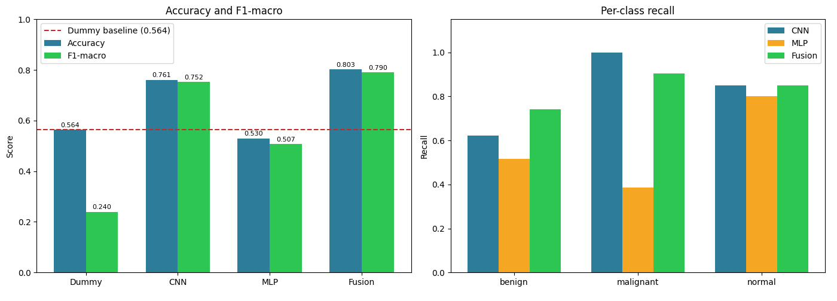
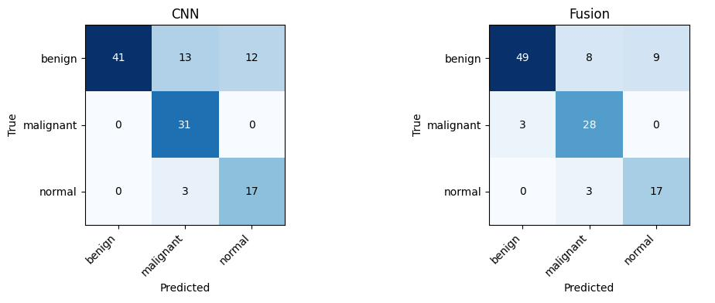
Results
Confusion matrices — CNN vs Fusion

Slide 8
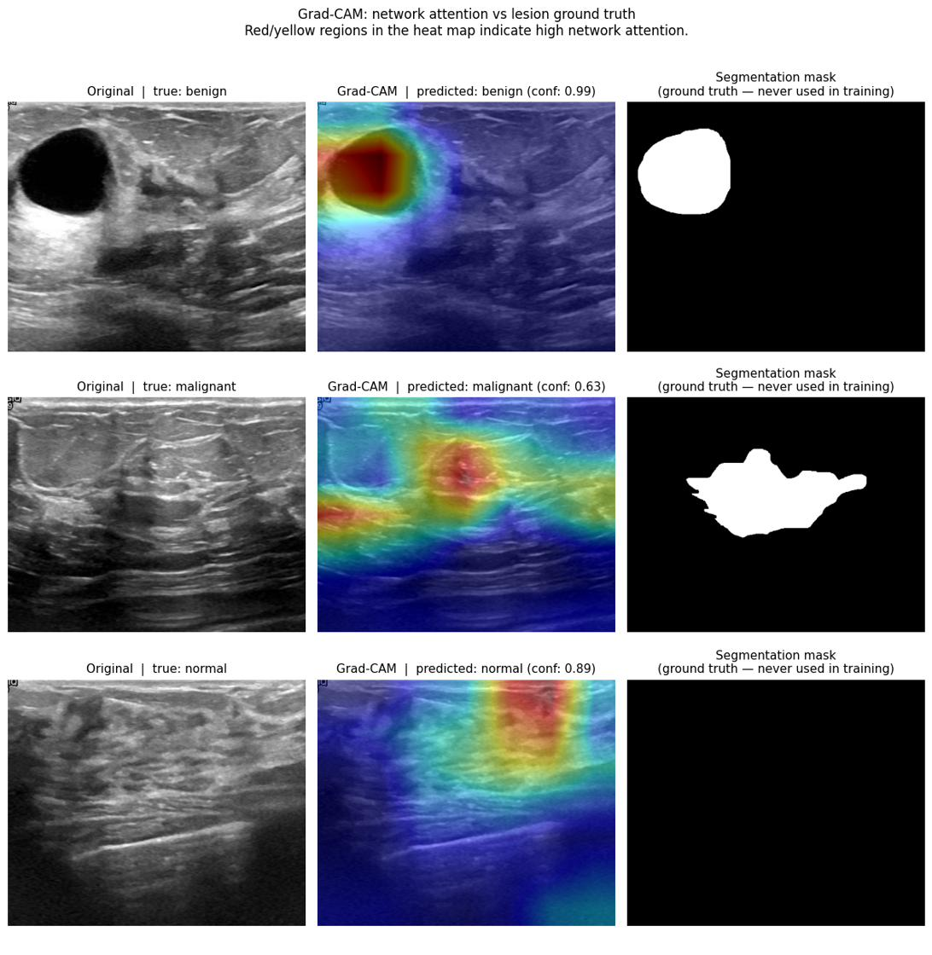
Explainability — Grad-CAM
How to read
Red/yellow
Region most attended by the network when making its prediction.
Blue
Little or no influence on the decision.
Third column
Segmentation mask — ground truth never seen during training.
Good result
Warm region overlaps the lesion → the model localises it without supervision.
Bad result
Warm region on borders or artefacts → decision based on spurious features.

Slide 9
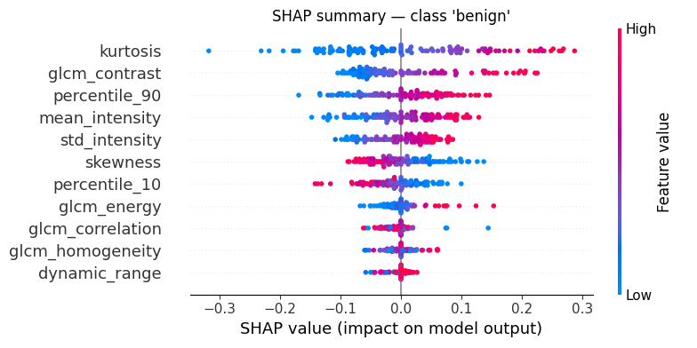
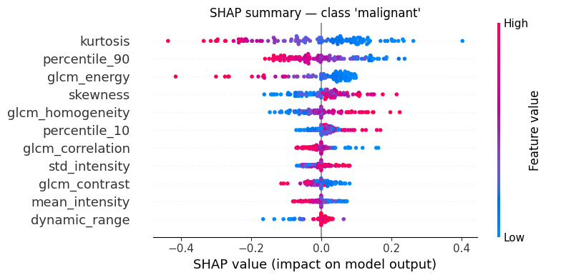
Explainability — SHAP (MLP)
Class 'benign'
Class 'malignant'
Class 'normal'
How to read the summary plots
Vertical axis
Example — benign
Features ranked by mean |SHAP value| — most important at the top.
High kurtosis (red dots) on the right → high kurtosis increases the probability of benign.
Horizontal axis
Example — malignant
Right of zero → feature pushes toward that class; left → pushes against it.
Low glcm_energy (blue dots) on the left → low energy pushes against malignant; high energy (red) pushes toward it.
Dot colour
Red = high feature value; blue = low. Combining position and colour reveals the direction of the effect.

Slide 10
Conclusions
The dataset linkage is artificial — and we proved it.
Three independent statistical tests showed that the class label (from ultrasound images) is not explained by the clinical variables: patients labelled 'normal' carry invasive carcinoma diagnoses with an average tumour size of 27 mm.
Extracting features from raw images solves the cross-modal linkage problem.
By deriving both modalities from the same image, we guarantee that CNN and MLP always refer to the same patient — something that external tabular datasets cannot provide.
The MLP alone is insufficient — but it adds value in combination.
On its own, the MLP (accuracy 0.530) underperforms the dummy baseline (0.564): global intensity and texture statistics lack the spatial resolution needed for localised lesion classification. However, when combined with the CNN, the fusion reaches 0.803 — a +4.2 pp gain over CNN alone.
The CNN learns to localise lesions without explicit supervision.
Grad-CAM heat maps concentrate on the lesion region visible in the segmentation masks — masks that were never shown to the model during training. This confirms the CNN extracts clinically relevant spatial patterns, not background artefacts.
Kurtosis and GLCM energy are the most discriminative radiological features.
SHAP analysis shows these two features have the largest and most consistent impact across patients for the malignant class — high kurtosis (many extreme pixel values) and low GLCM energy (heterogeneous texture) both push toward malignancy.
Thank you

