Slide 1
Adoptable dogs in the US
Mattia Dell’Oca

Slide 2
Dataset statistics
What’s in this
dataset?
Number of rows
Usability
About 58k+ rows
9.41 rating on Kaggle
Entry
Data
Every entry represent an adoptable dog
The data where taken on Semptember 2019 from Petfinder.com

Slide 3


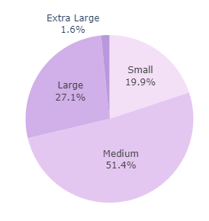
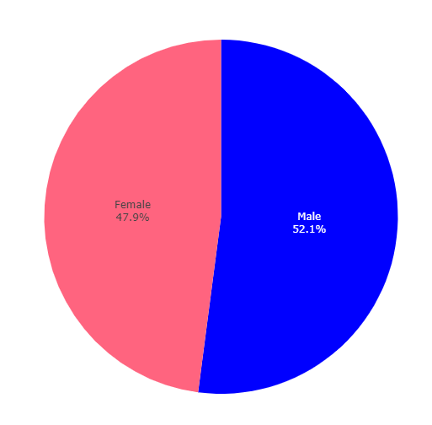
General Data

Slide 4



General Data

Slide 5
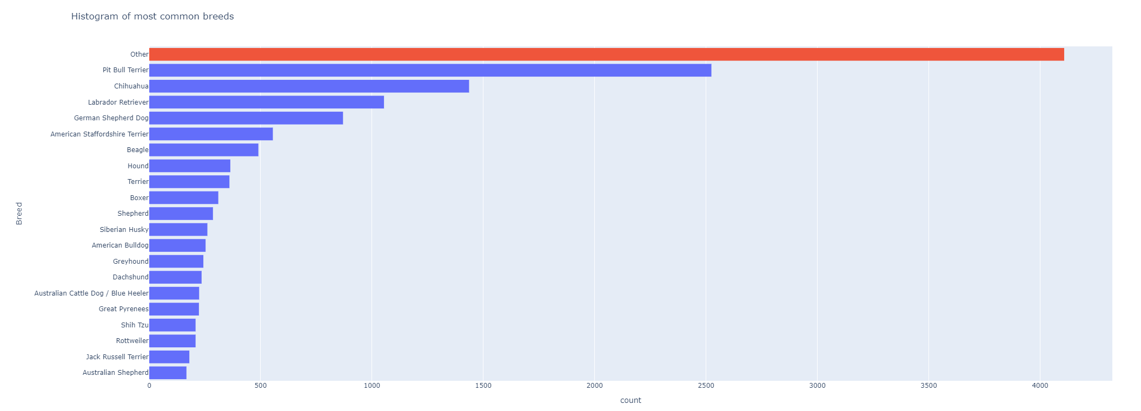
Most common breeds

Slide 6
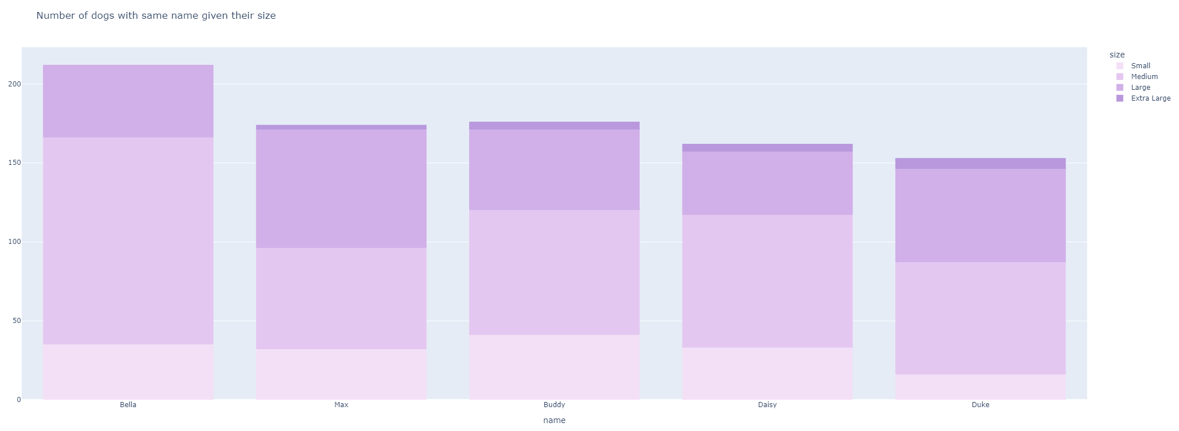
Bivariate Analysis

Slide 7


Bivariate Analysis

Slide 8

Bivariate Analysis

Slide 9


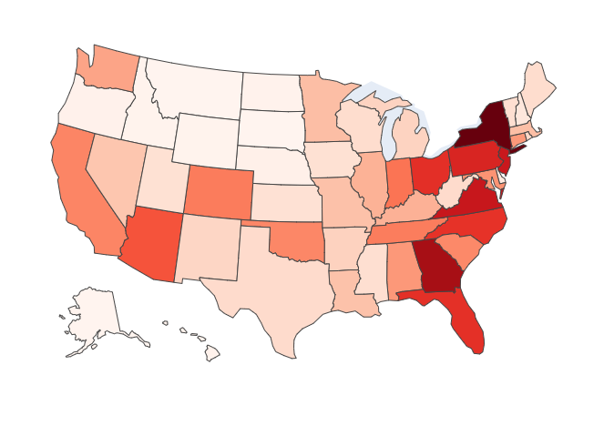
Maps

Slide 10

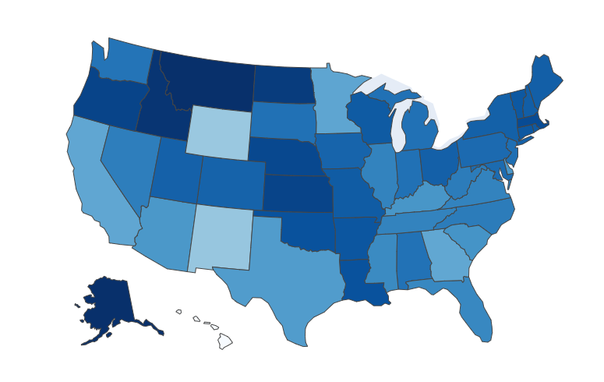
Maps

Slide 11


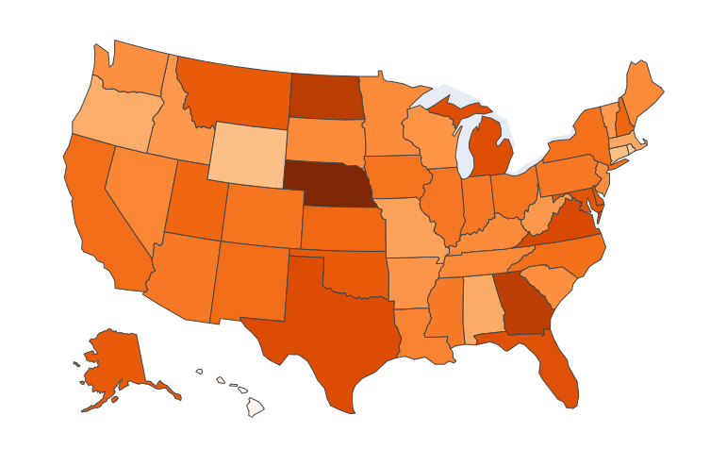
Maps

Slide 12

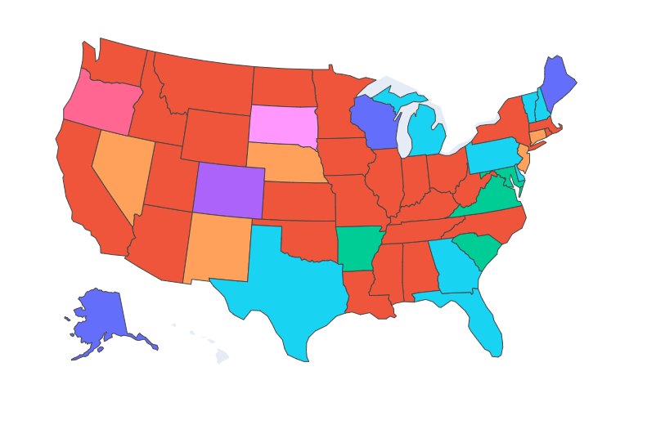
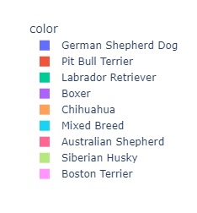
Maps

Slide 13
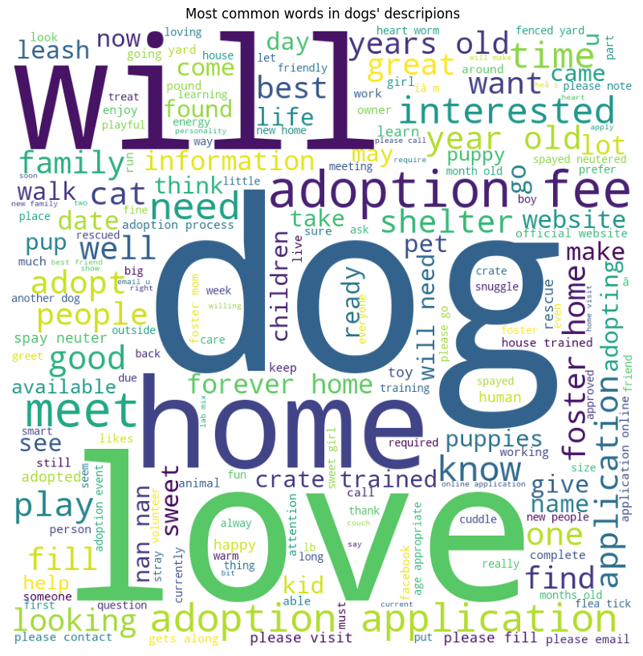
WordClouds

Slide 14
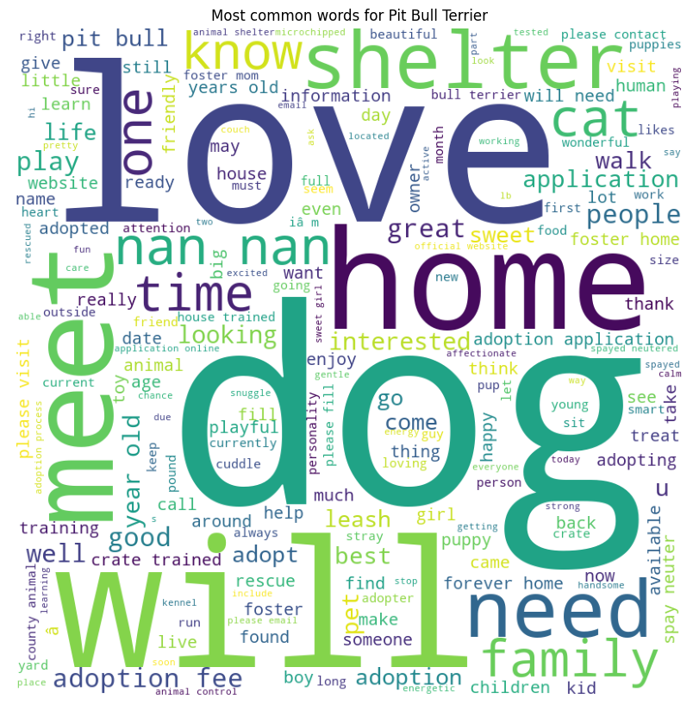
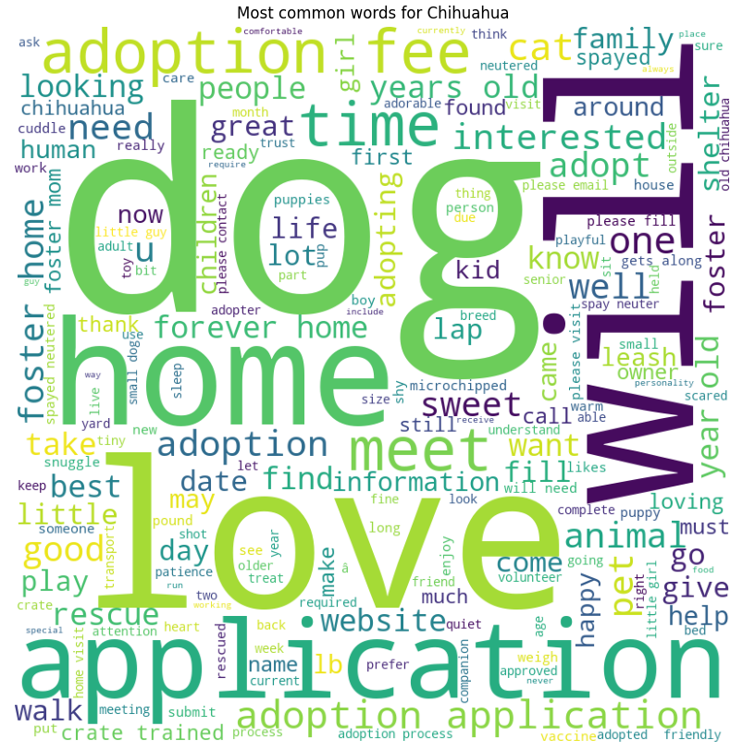
WordClouds

Slide 15
That’s it
Thank you for your time!
Do you have any question?

