Slide 1
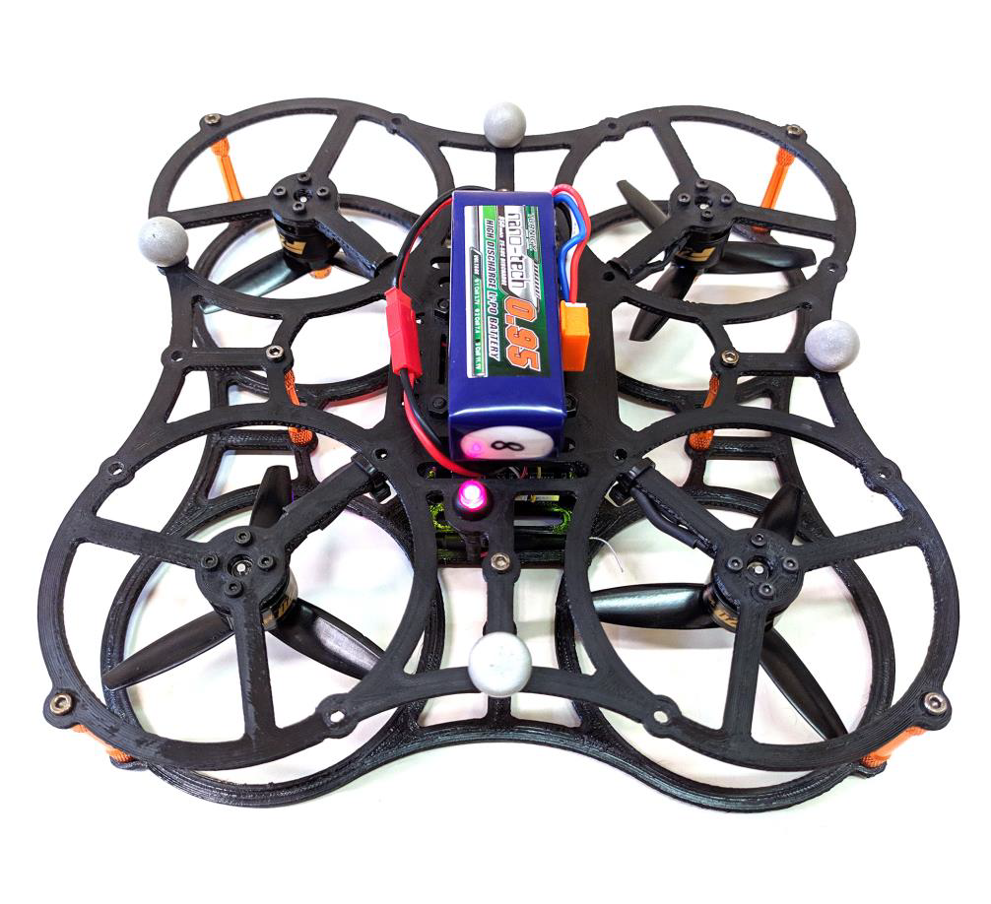

Estimation and Learning in Aerospace
2025/2026 exam project
Boschini Marianna · Cavalli Filippo · Mattia Di Mauro
Professor: Marco Lovera

Slide 2
Objectives
Project tasks
Task 1
➤ System identification of longitudinal dynamics from simulated data, using the frequency-domain grey-box method
Task 2
➤ Sensitivity analysis to perturbations in measurement noise properties
Task 3
➤ Analysis of the best model in a Monte Carlo study
Boschini · Cavalli · Di Mauro – Estimation and Learning in Aerospace project, 25/26
POLITECNICO MILANO 1863

Slide 3
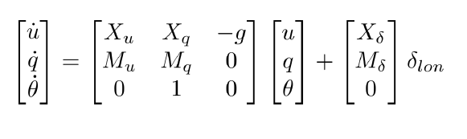
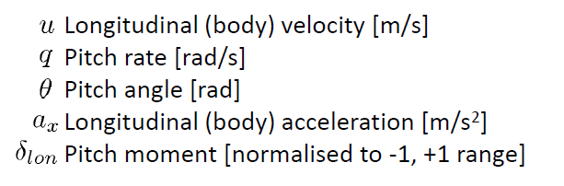
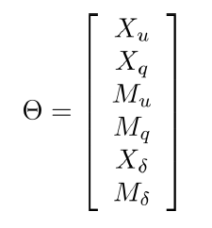
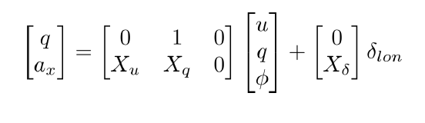
Linearised model for longitudinal dynamics
State equation
Output equation
Model Parameters
Boschini · Cavalli · Di Mauro – Estimation and Learning in Aerospace project, 25/26
POLITECNICO MILANO 1863

Slide 4
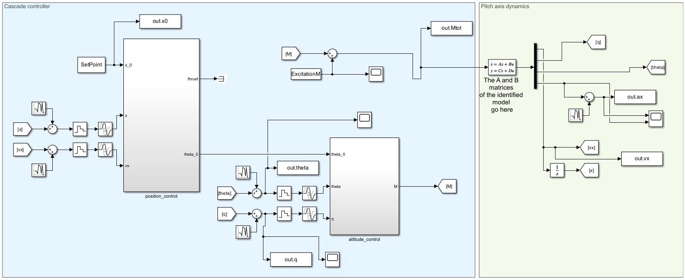
Scenario: Simulink Model
Boschini · Cavalli · Di Mauro – Estimation and Learning in Aerospace project, 25/26
POLITECNICO MILANO 1863

Slide 5
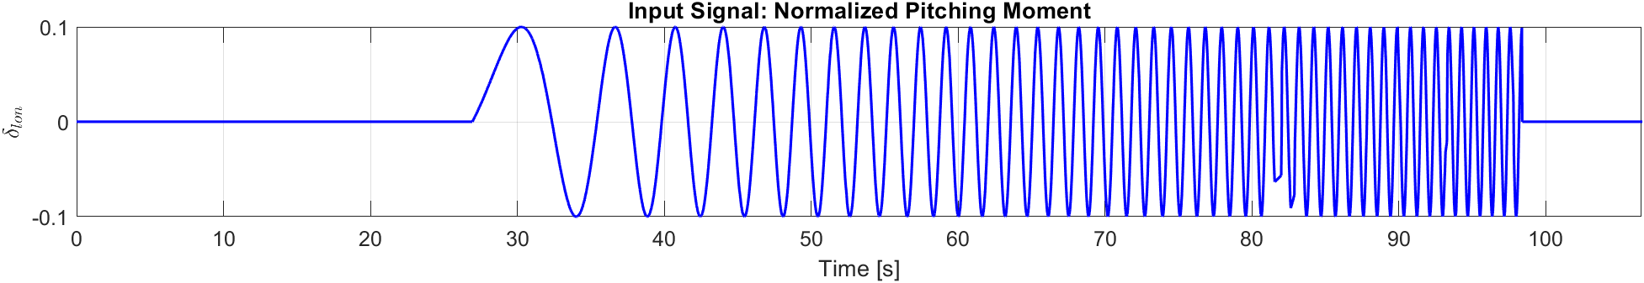
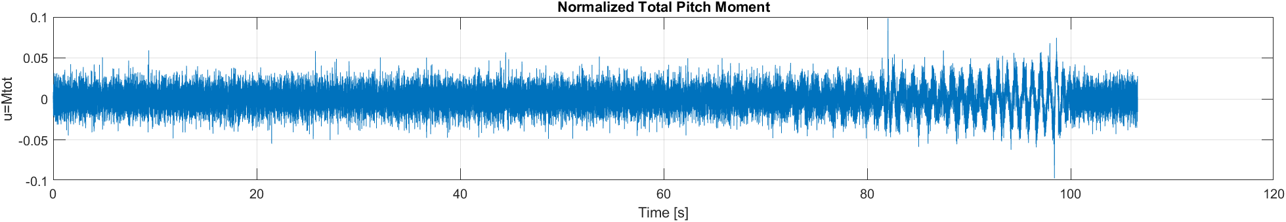
Inputs
It is necessary to select a specific time interval on which to perform the input–output analysis, because it is seen from the figure above that not the full time range is meaningful to be considered
Boschini · Cavalli · Di Mauro – Estimation and Learning in Aerospace project, 25/26
POLITECNICO MILANO 1863

Slide 6
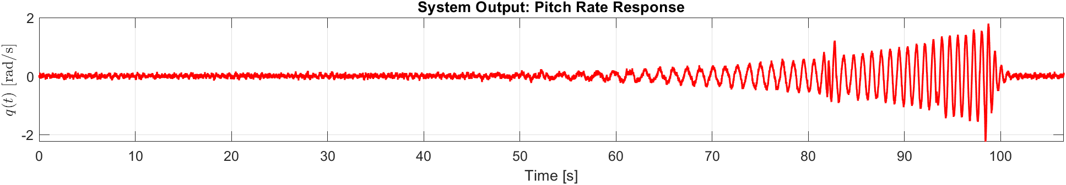
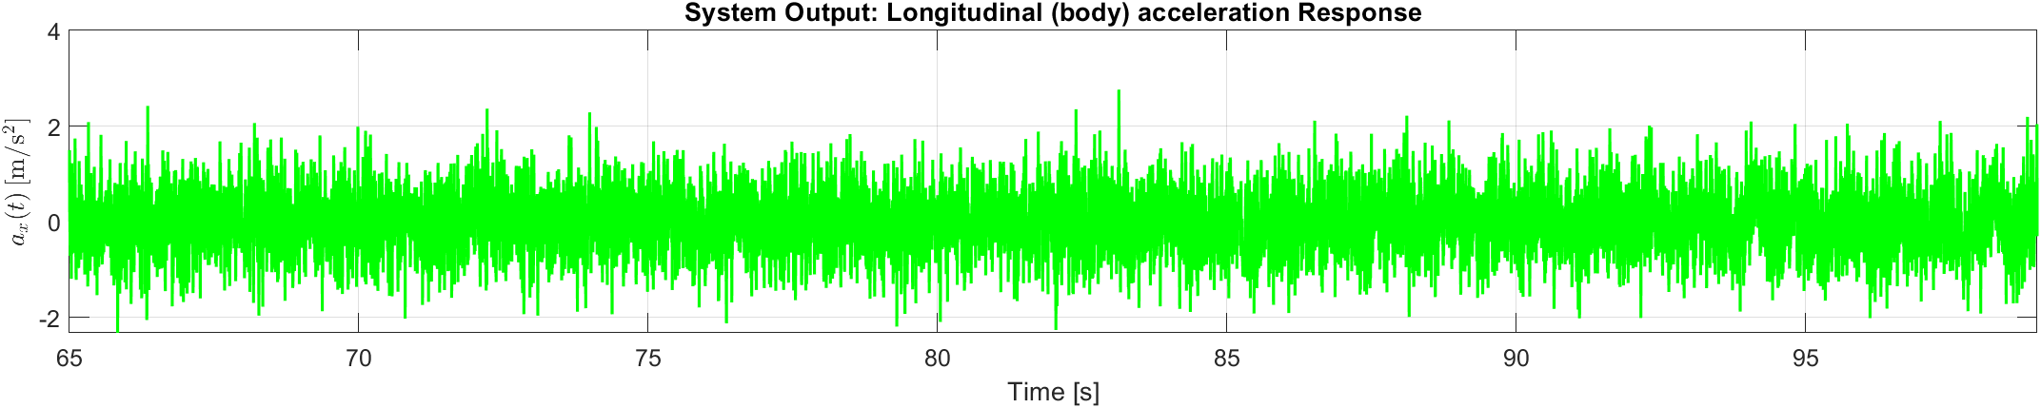
Outputs
The pitch rate signal is cleaner than the vertical acceleration signal, therefore it is expected to allow a more reliable estimation of the system dynamics
Boschini · Cavalli · Di Mauro – Estimation and Learning in Aerospace project, 25/26
POLITECNICO MILANO 1863

Slide 7
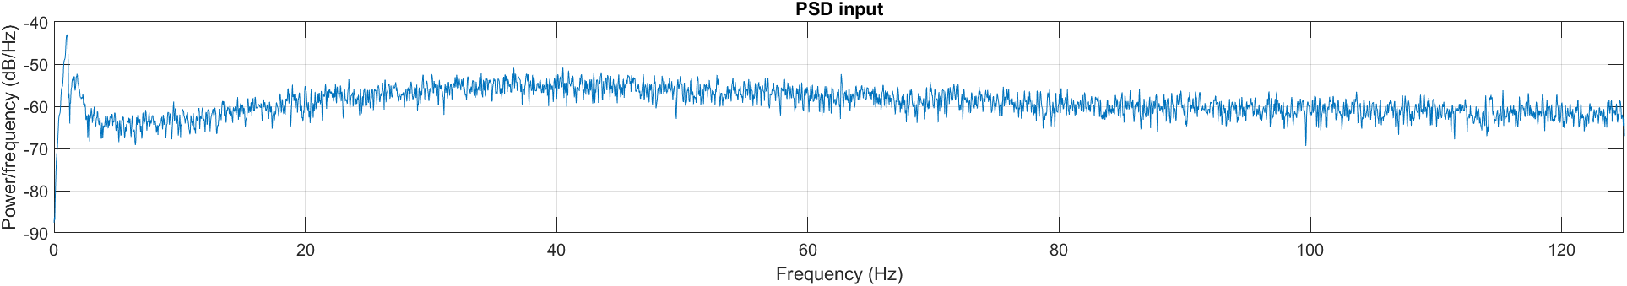
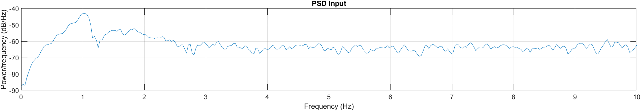
Time Interval Selection: PSD
The PSD is estimated using the Welch method and from the analysis, the highest spectral content of the input is concentrated at very low frequencies, approximately in the 0–2 Hz range
Boschini · Cavalli · Di Mauro – Estimation and Learning in Aerospace project, 25/26
POLITECNICO MILANO 1863

Slide 8
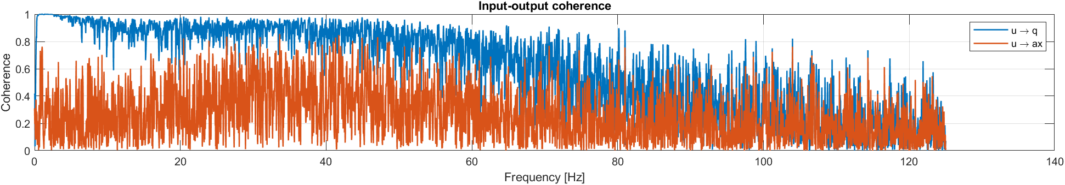
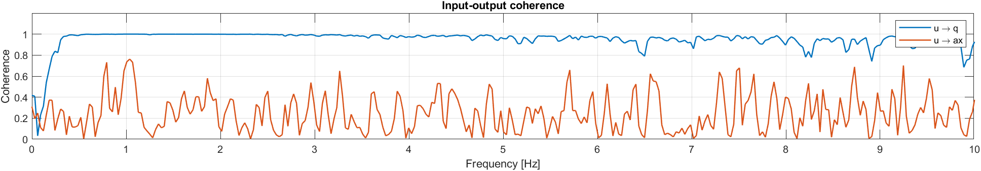
Time Interval Selection: Coherence
The coherence function measures how linearly correlated an output is with an input at each frequency: it quantifies how well the input explains the output in each frequency band, using mscohere function
[coh_q,f] = mscohere(u,yq,[],[],[],Fs);
[coh_ax,~] = mscohere(u,yax,[],[],[],Fs);
In the same frequency interval identified, the coherence shows a value close to 1 for the pitch rate, indicating a very strong correlation and a good coherence for the acceleration signal, around 0.8
Boschini · Cavalli · Di Mauro – Estimation and Learning in Aerospace project, 25/26
POLITECNICO MILANO 1863

Slide 9
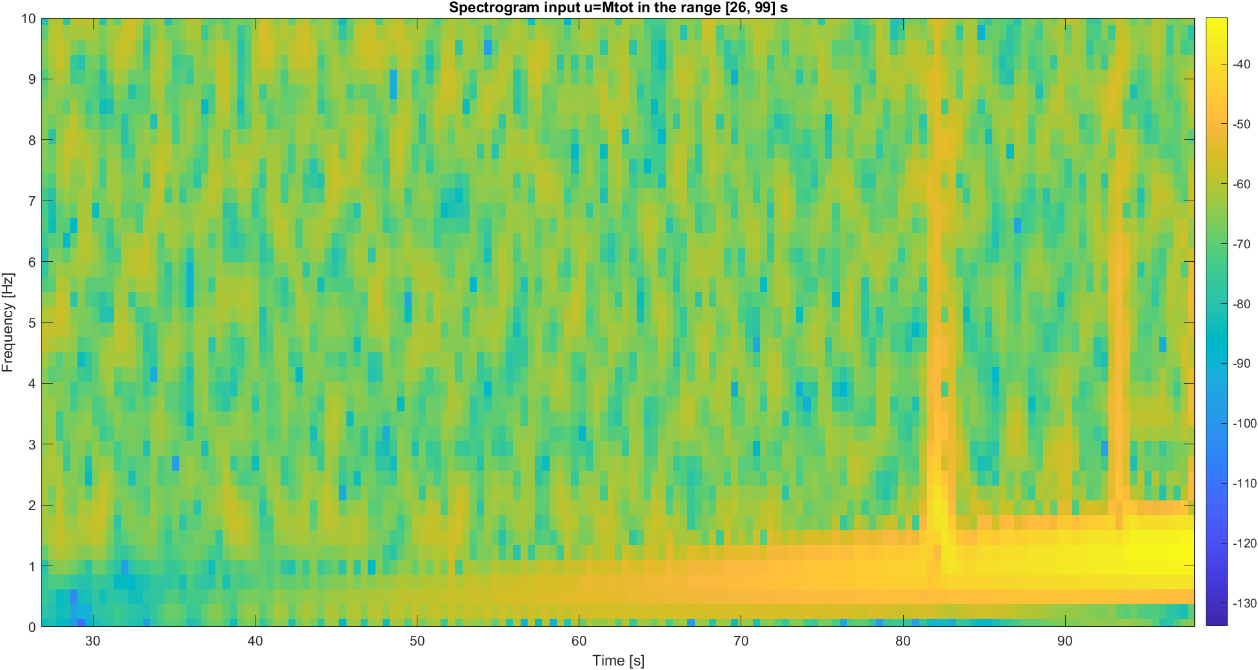
Time Interval Selection: Spectrogram
Considering the figure showed, the selected time interval for the analysis is [65 99] s
Boschini · Cavalli · Di Mauro – Estimation and Learning in Aerospace project, 25/26
POLITECNICO MILANO 1863

Slide 10
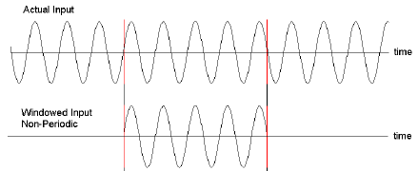
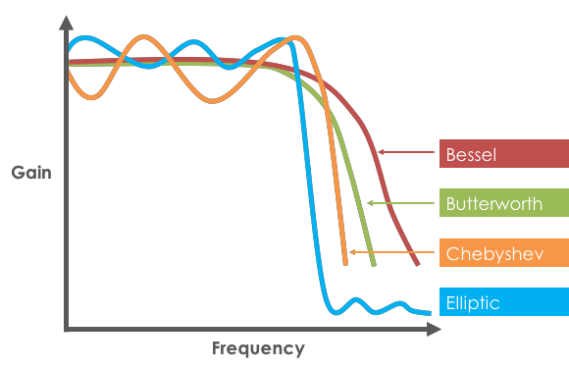
Identification methodology
Chosen Approach: Temporal Windowing
In this work, preprocessing is performed in the time domain by selecting only the portion of the signal corresponding to the active maneuver (65–99 s), thereby removing pre- and post-maneuver segments. The FFT is then computed on the windowed dataset and used as input to greyest, without introducing an explicit filtering stage.
Alternative Approach: Frequency-Domain Filtering
An alternative strategy consists in retaining the full dataset and applying a band-pass filter to both input and output signals prior to identification. This approach requires the selection of appropriate cut-off frequencies and filter order. The FFT of the filtered iddata object is then computed and provided to greyest for parameter estimation.
Boschini · Cavalli · Di Mauro – Estimation and Learning in Aerospace project, 25/26
POLITECNICO MILANO 1863

Slide 11
Identification methodology
Advantages of the proposed temporal windowing approach:
Avoids the introduction of filter-induced artifacts, such as passband ripple or residual phase distortions, which may arise even when zero-phase filtering is employed
Eliminates the need for a computationally demanding filter design and parameter tuning stage
Ensures that the identification procedure relies exclusively on physically meaningful signal segments associated with the excitation maneuver
Removes the risk of unintentionally attenuating relevant frequency components due to a suboptimal filter design
Provides a simple and effective preprocessing strategy for the identification task
Boschini · Cavalli · Di Mauro – Estimation and Learning in Aerospace project, 25/26
POLITECNICO MILANO 1863

Slide 12
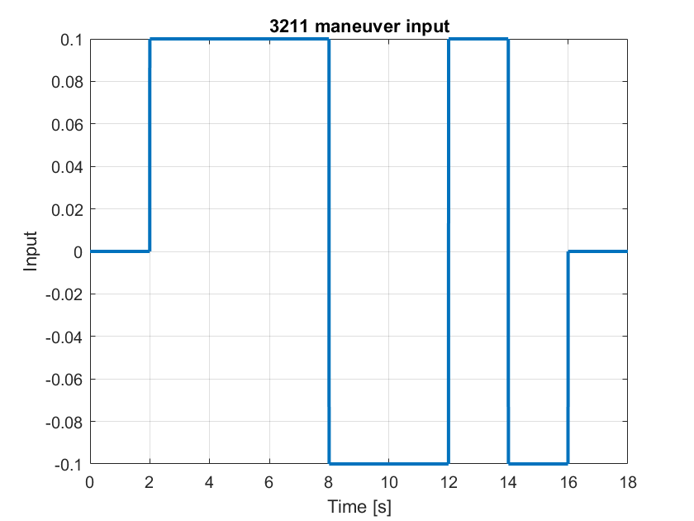
Task 1: Grey-Box model identification
Use the simulator and the provided baseline excitation to:
➤ T1.1 : Identify a grey-box model for the longitudinal dynamics of the multirotor(input: total pitching moment; outputs: pitch rate and longitudinal acceleration) using the response to the sweep provided in the ExcitationM.mat file
➤ T1.2 : Assess the uncertainty of the identified model in terms of asymptotic variance of the parameter estimates
➤ T1.3 : Implement the following 3211 sequence and use it to validate the identified model
Boschini · Cavalli · Di Mauro – Estimation and Learning in Aerospace project, 25/26
POLITECNICO MILANO 1863

Slide 13






Task 1: Identification procedure & Uncertainties
% Grey-Box System Identification
sys_id_model = iddata(output_model, input, sample_time);
sys_ft = fft(sys_id_model);
init_parameters={ 'Xu_g', 0; 'Xq_g', 0; 'Mu_g', 0; 'Mq_g', 0; 'Xd_g', 0; 'Md_g’, 0 };
sys_init = idgrey(@sys_init_creat, init_parameters, 'c');
grey_id = greyest(sys_ft, sys_init); % Estimate parameters
cov_matrix = getcov(grey_id); % Asymptotic covariance
% Extract and reassign estimated values
params = getpvec(grey_id)';
Xu_g = params(1); Xq_g = params(2); Mu_g = params(3);
Mq_g = params(4); Xd_g = params(5); Md_g = params(6);
% Compute absolute and percentage errors
abs_errors = abs(params - true_params);
percent_errors = 100 * abs_errors ./ abs(true_params);
% Compute RMSE
rmse = sqrt(mean((params' - true_params).^2));
rmse_percent = sqrt(mean(percent_errors.^2));
A_grey = grey_id.A; B_grey = grey_id.B; C_grey = grey_id.C; D_grey = grey_id.D;
% Identified model
grey_idsys = ss(A_grey, B_grey, C_grey, D_grey, sample_time);
grey_idtf = tf(grey_idsys);
The system dynamics are identified using a grey-box identification approach, where the structure of the model is derived from the known physics of the longitudinal dynamics, while the aerodynamic derivatives are estimated from input–output data.
The MATLAB greyest function is used for the identification procedure, with initial parameters:
0 | 0 | 0 | 0 | 0 | 0
Boschini · Cavalli · Di Mauro – Estimation and Learning in Aerospace project, 25/26
POLITECNICO MILANO 1863

Slide 14
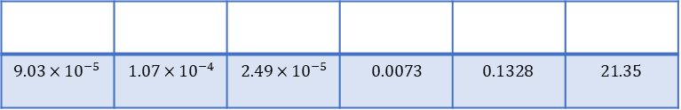
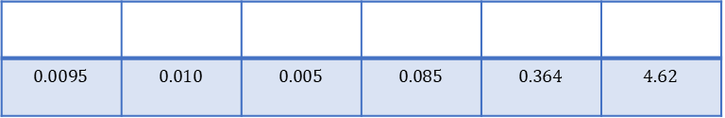
Task 1: Identification procedure & Uncertainties
% Grey-Box System Identification
sys_id_model = iddata(output_model, input, sample_time);
sys_ft = fft(sys_id_model);
init_parameters={ 'Xu_g', 0; 'Xq_g', 0; 'Mu_g', 0; 'Mq_g', 0; 'Xd_g', 0; 'Md_g’, 0 };
sys_init = idgrey(@sys_init_creat, init_parameters, 'c');
grey_id = greyest(sys_ft, sys_init); % Estimate parameters
cov_matrix = getcov(grey_id); % Asymptotic covariance
% Extract and reassign estimated values
params = getpvec(grey_id)';
Xu_g = params(1); Xq_g = params(2); Mu_g = params(3);
Mq_g = params(4); Xd_g = params(5); Md_g = params(6);
% Compute absolute and percentage errors
abs_errors = abs(params - true_params);
percent_errors = 100 * abs_errors ./ abs(true_params);
% Compute RMSE
rmse = sqrt(mean((params' - true_params).^2));
rmse_percent = sqrt(mean(percent_errors.^2));
A_grey = grey_id.A; B_grey = grey_id.B; C_grey = grey_id.C; D_grey = grey_id.D;
% Identified model
grey_idsys = ss(A_grey, B_grey, C_grey, D_grey, sample_time);
grey_idtf = tf(grey_idsys);
To assess the parameter uncertainty, the covariance matrix of the estimated parameters is computed. The diagonal terms represent the variance of each parameter estimate.
$$9.03×{10}^{−5}$$ | $$1.07×{10}^{−4}$$ | $$2.49×{10}^{−5}$$ | $$0.0073$$ | $$0.1328$$ | $$21.35$$
The standard deviation is the square root of the variance:
$$0.0095$$ | $$0.010$$ | $$0.005$$ | $$0.085$$ | $$0.364$$ | $$4.62$$
Boschini · Cavalli · Di Mauro – Estimation and Learning in Aerospace project, 25/26
POLITECNICO MILANO 1863

Slide 15
Task 1: Validation through 3211 input
% Generate the 3211 input
amplitudes = [0, 0.1, -0.1, 0.1, -0.1, 0];
time_step = 2; % [s]
durations = time_step*[1, 3, 2, 1, 1, 1];
dt = sample_time;
t_end = sum(durations);
t_3211 = 0:dt:t_end;
u_3211 = zeros(size(t_3211));
t_start = 0;
for i = 1:length(amplitudes)
t_end_segment = t_start + durations(i);
idx = (t_3211 >= t_start) & (t_3211 < t_end_segment);
u_3211(idx) = amplitudes(i);
t_start = t_end_segment;
end
Boschini · Cavalli · Di Mauro – Estimation and Learning in Aerospace project, 25/26
POLITECNICO MILANO 1863

Slide 16
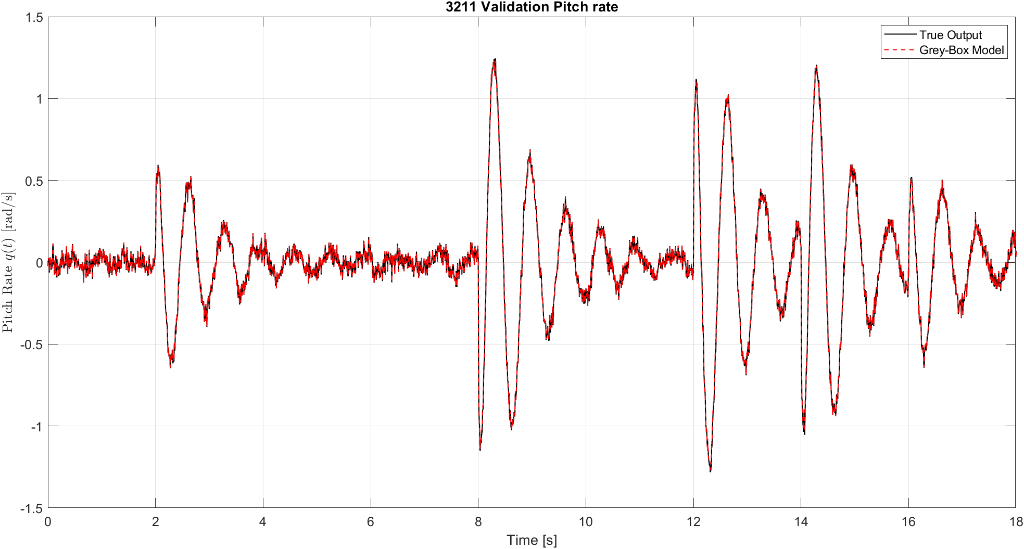
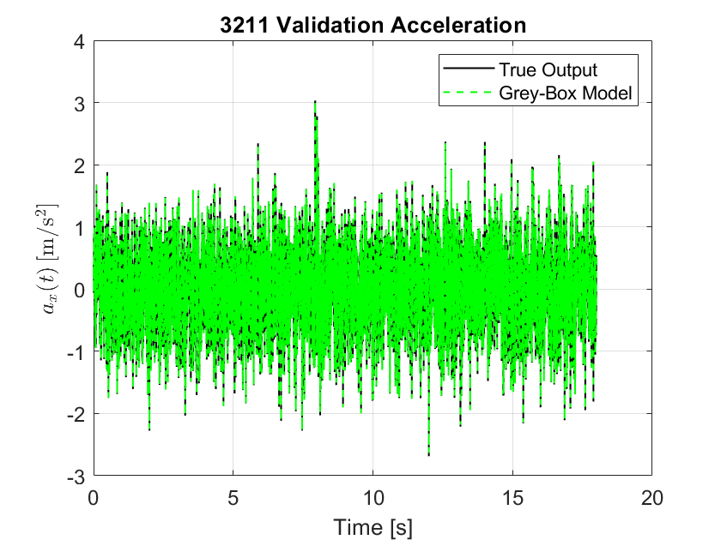
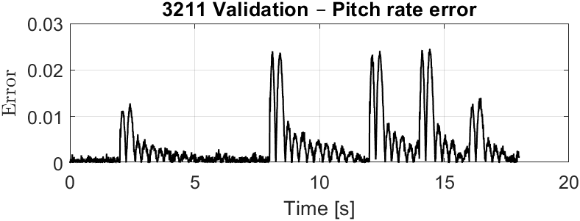
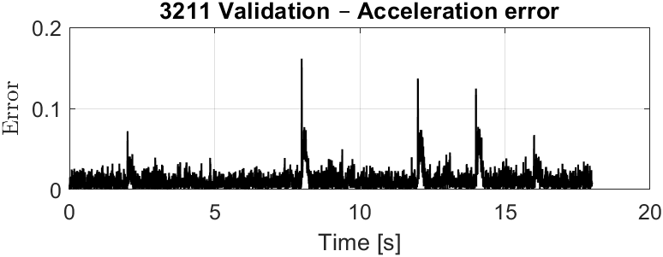
Task 1: Validation through 3211 input
Boschini · Cavalli · Di Mauro – Estimation and Learning in Aerospace project, 25/26
POLITECNICO MILANO 1863

Slide 17
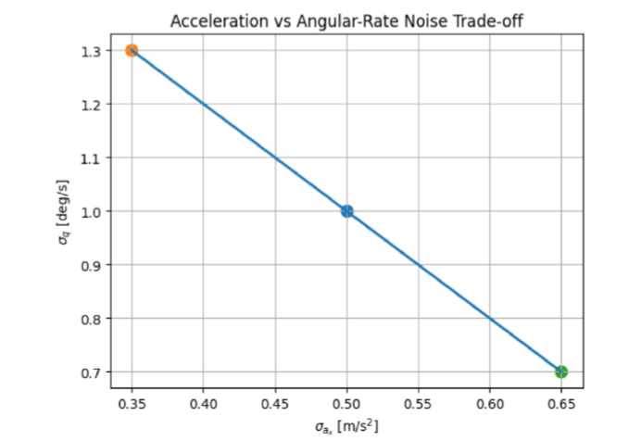
Task 2: Sensitivity analysis to perturbations in measurement noise properties
➤ T2.1 : The standard deviations of the sensors are modified as in the plot by a different tuning of the sensors mount and repeat tasks T1.1 – T1.3 for each of the two perturbed conditions:
➤ T2.2 : Define a criterion to select the measurement setup leading to the best model and motivate the choice
➤ T2.3 : Assess the uncertainty of the best identified model in terms of asymptotic variance of the parameter estimates
Boschini · Cavalli · Di Mauro – Estimation and Learning in Aerospace project, 25/26
POLITECNICO MILANO 1863

Slide 18
Task 2: Noises Scenario
 | σ_{ax} [m/s²] | σ_{q} [deg/s]
Case 1 | 0.35 | 1.3
Case 2 (default) | 0.5 | 1
Case 3 | 0.65 | 0.7
The identification procedure was repeated for two alternative sensor configurations. Modifying the sensor setup changes the standard deviation of the measurement noise of the accelerometer and gyroscope, resulting in different identified models.
Boschini · Cavalli · Di Mauro – Estimation and Learning in Aerospace project, 25/26
POLITECNICO MILANO 1863

Slide 19
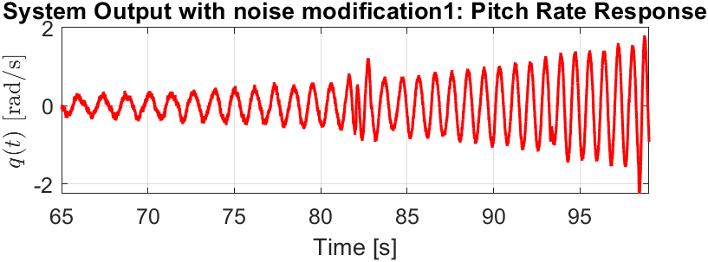
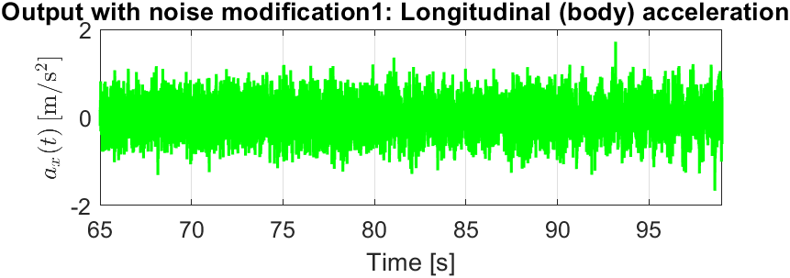
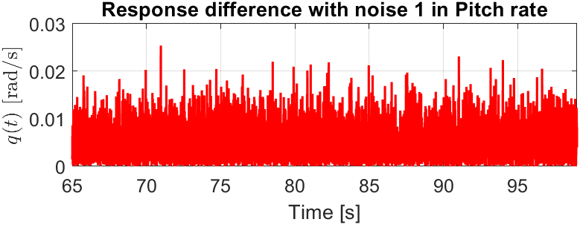
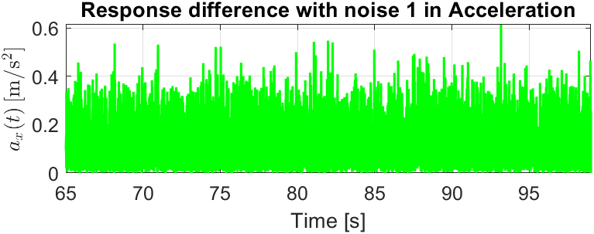
Task 2: Case 1
The absolute difference between the response obtained with Setup 1 and the response of the baseline model identified using Setup 2 is shown below.
Boschini · Cavalli · Di Mauro – Estimation and Learning in Aerospace project, 25/26
POLITECNICO MILANO 1863

Slide 20
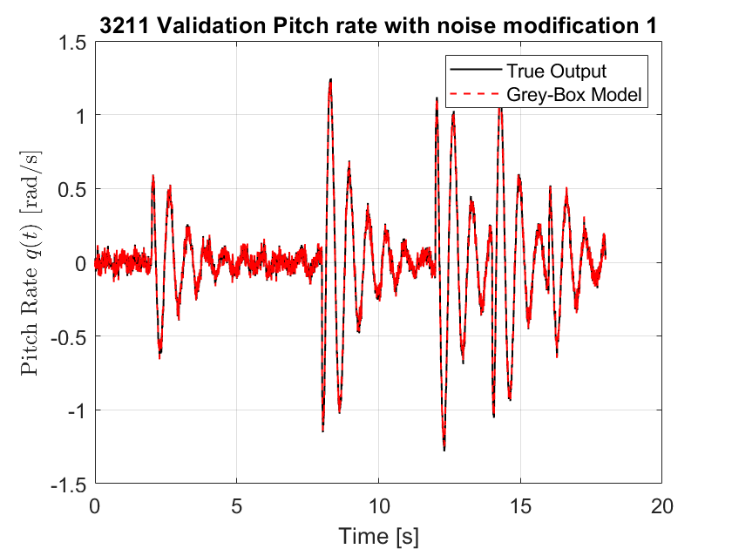
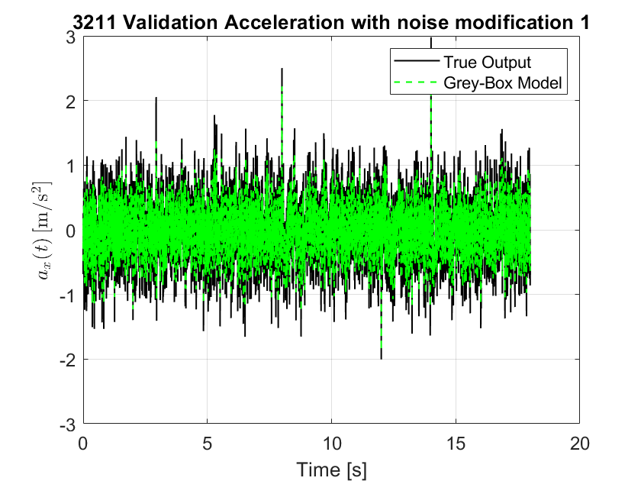
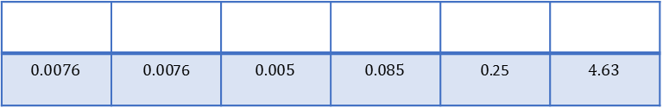
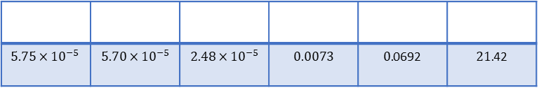
Task 2: Case 1
The validation using the 3-2-1-1 maneuver is repeated for the identified model obtained under Noise Setup 1.
The variance of each parameter estimate:
$$5.75×{10}^{−5}$$ | $$5.70×{10}^{−5}$$ | $$2.48×{10}^{−5}$$ | $$0.0073$$ | $0.$0692 | $21.$42
The standard deviation:
$$0.0076$$ | $0.00$76 | $$0.005$$ | $$0.085$$ | $0.$25 | $$4.63$$
Boschini · Cavalli · Di Mauro – Estimation and Learning in Aerospace project, 25/26
POLITECNICO MILANO 1863

Slide 21

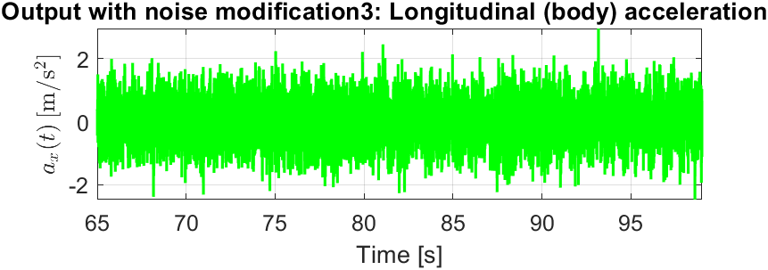

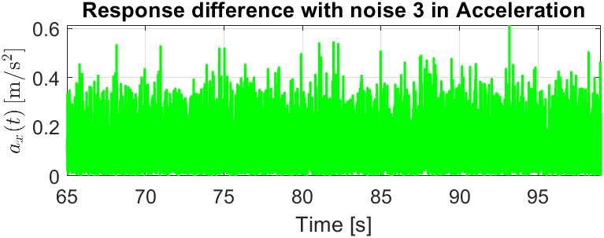
Task 2: Case 3
The absolute difference between the response obtained with Setup 3 and the response of the baseline model identified using Setup 2 is shown below.
Boschini · Cavalli · Di Mauro – Estimation and Learning in Aerospace project, 25/26
POLITECNICO MILANO 1863

Slide 22

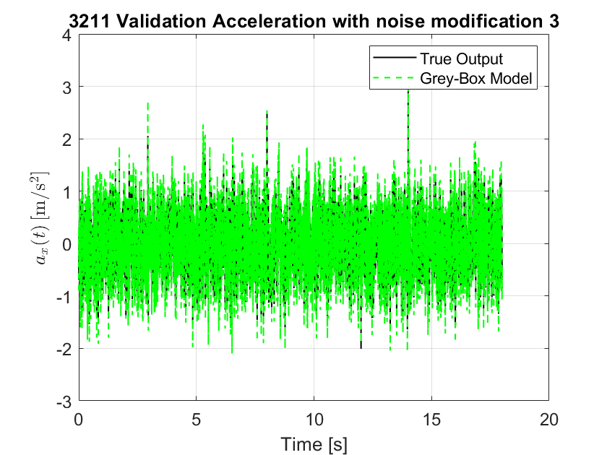
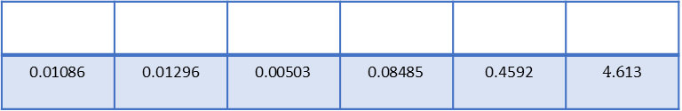
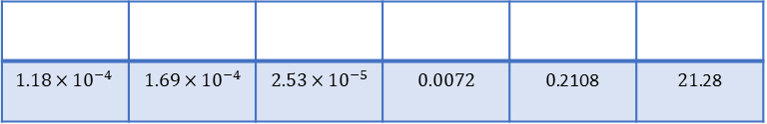
Task 2: Case 3
The validation using the 3-2-1-1 maneuver is repeated for the identified model obtained under Noise Setup 3
The variance of each parameter estimate:
$$1.18×{10}^{−4}$$ | $$1.69×{10}^{−4}$$ | $$2.53×{10}^{−5}$$ | $$0.0072$$ | $0.$2108 | $21.$28
The standard deviation:
$$\text{0.01086}$$ | 0.01296 | $$\text{0.00503}$$ | $$\text{0.08485}$$ | 0.4592 | $4.6$13
Boschini · Cavalli · Di Mauro – Estimation and Learning in Aerospace project, 25/26
POLITECNICO MILANO 1863

Slide 23
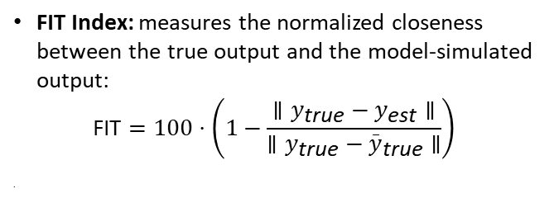
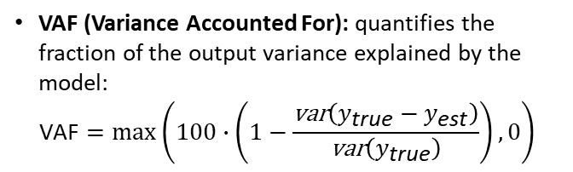
Task 2: Comparison & Selection of the best model
The 3211 input was preferred over the sine sweep for validation purposes, as its step-wise structure produces sharper and more clearly interpretable transient responses in the outputs, making model discrepancies more readily detectable.
FIT Index: measures the normalized closeness between the true output and the model-simulated output:
$$\text{FIT}=100⋅\left(1−\frac{∥y_{\text{true}}−y_{\text{est}}∥}{∥y_{\text{true}}−{\overset{_}{y}}_{\text{true}}∥}\right)$$
.
VAF (Variance Accounted For): quantifies the fraction of the output variance explained by the model:
$$\text{VAF}=\max\left(100∙\left(1−\frac{\text{var}\left(y_{\text{true}}−y_{\text{est}}\right)}{\text{var}\left(y_{\text{true}}\right)}\right),0\right)$$
y=true_output_validation(:,1);
y_true_mean = mean(true_output_validation(:,1));
FIT = 100 * (1 - ((norm(true_output_validation(:,1) - output_validation_grey(:,1))) / (norm(true_output_validation(:,1) - y_true_mean))));
VAF = max(diag(100*(eye(size(y,2))-cov(y-y_est)./cov(y))),0);
Boschini · Cavalli · Di Mauro – Estimation and Learning in Aerospace project, 25/26
POLITECNICO MILANO 1863

Slide 24
Task 2: Comparison & Selection of the best model
 | FIT_{q} | VAF_{q}
Case 1 | 96.888 | 99.9032
Case 2 (default) | 98.1364 | 99.9653
Case 3 | 97.4887 | 99.9370
 | FIT_{ax} | VAF_{ax}
Case 1 | 71.4651 | 91.8627
Case 2 (default) | 96.9919 | 99.9095
Case 3 | 71.216 | 91.7200
The best measurement set up is the CASE 2
Boschini · Cavalli · Di Mauro – Estimation and Learning in Aerospace project, 25/26
POLITECNICO MILANO 1863

Slide 25
Task 3: analysis and Monte Carlo study
➤ T3.1 : Execute T1.1 – T1.3 to identify N models for the longitudinal dynamics with the best setup for the sensors, using the ExcitationM.mat file for excitation input and changing the realisations of the noise processes; Justify the choice of N appropriately
➤ T3.2 : Carry out a statistical analysis of the set of identified models in terms of hystograms of estimated parameters, hystograms of poles and zeros, dispersion of the corresponding frequency response function
Boschini · Cavalli · Di Mauro – Estimation and Learning in Aerospace project, 25/26
POLITECNICO MILANO 1863

Slide 26
Task 3: Monte Carlo setup
The Monte Carlo study assesses the robustness of the identified model with respect to different noise realisations, verifying that the estimated parameters remain consistent across runs.
N=300 independent identification runs are performed, each with a different noise seed
The choice of N is justified by monitoring the convergence of the running mean of each estimated parameter, ensuring that the sample statistics are representative and stable
In order to obtain a different noise realisation for each run, the seed value inside each Simulink white noise block is varied at every iteration
for i = 1:N
seed.x = i;
seed.vx = i + 1;
seed.theta = i + 2;
seed.q = i + 3;
seed.ax = i + 3;
load_system('Simulator_Single_Axis');
set_param('Simulator_Single_Axis', "FastRestart", "off");
simulation = sim('Simulator_Single_Axis', 'SrcWorkspace', 'current’);
…….
end
Boschini · Cavalli · Di Mauro – Estimation and Learning in Aerospace project, 25/26
POLITECNICO MILANO 1863

Slide 27
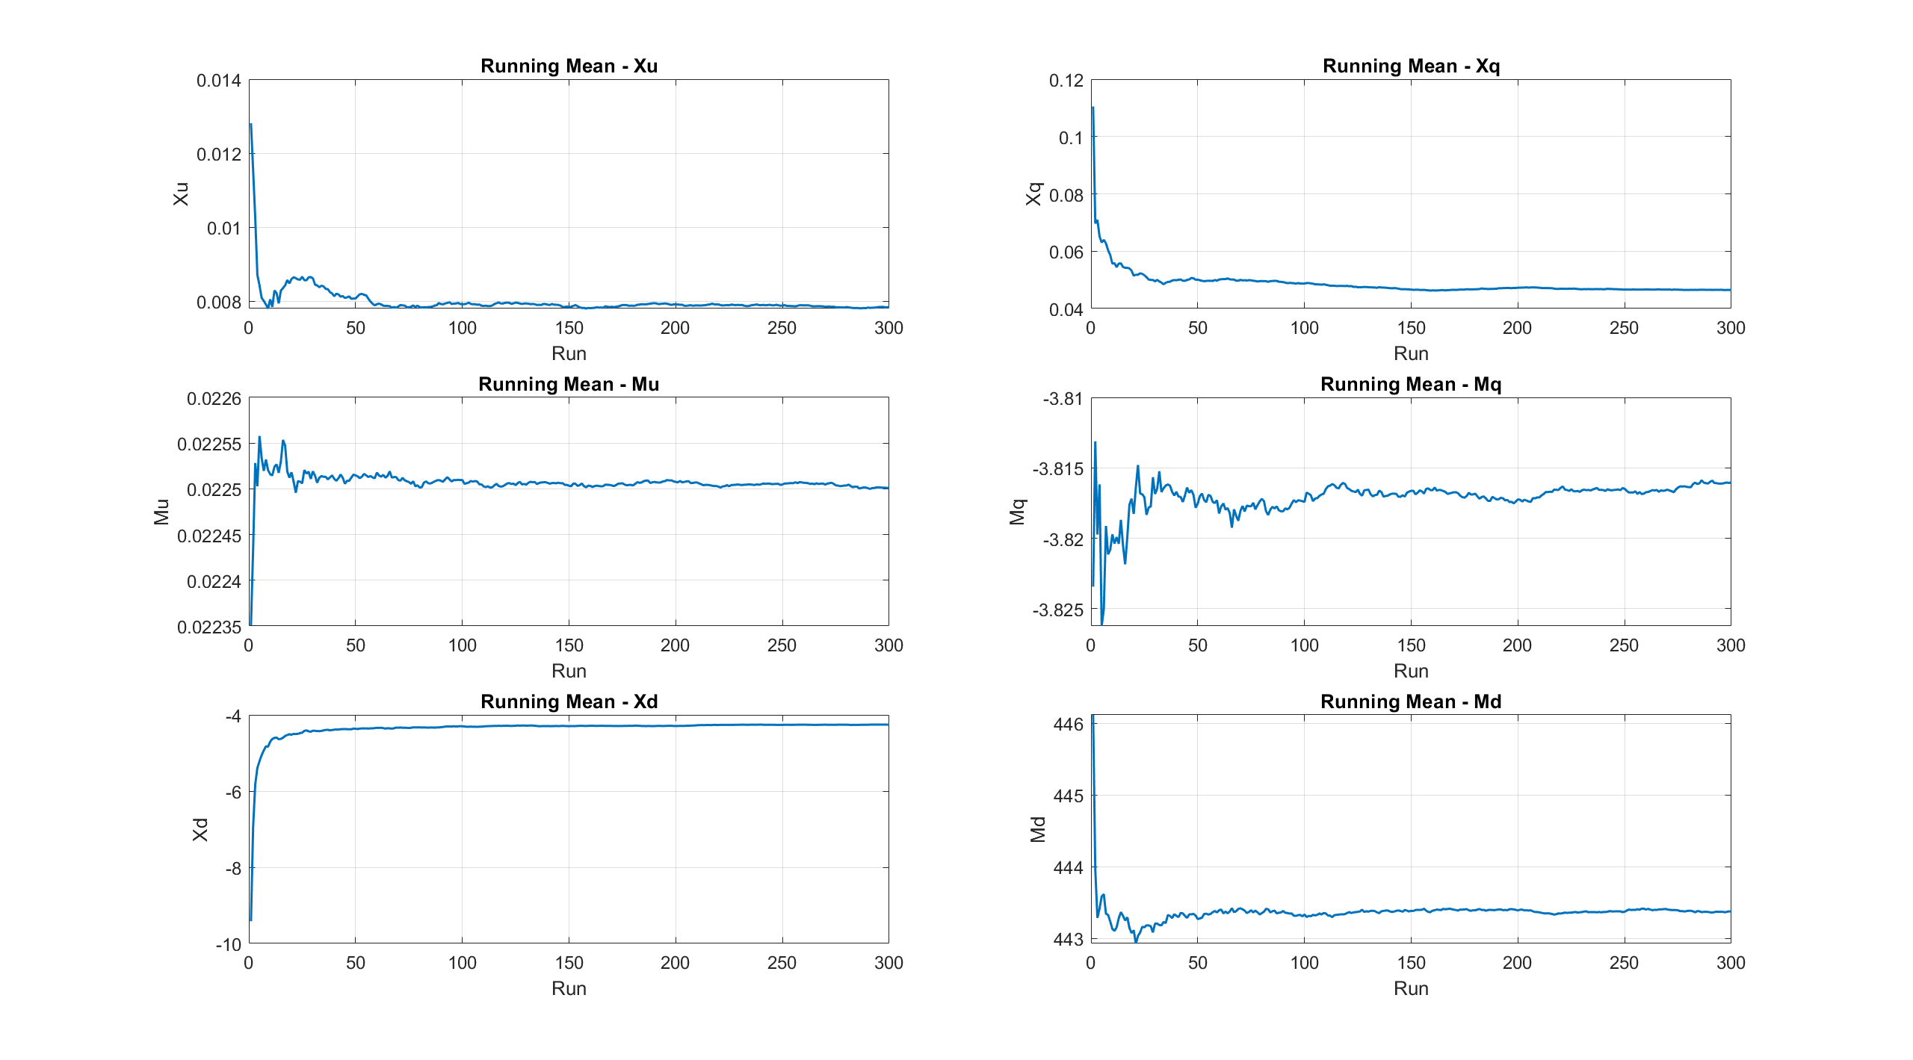
Task 3: Monte Carlo convergence
Boschini · Cavalli · Di Mauro – Estimation and Learning in Aerospace project, 25/26
POLITECNICO MILANO 1863

Slide 28
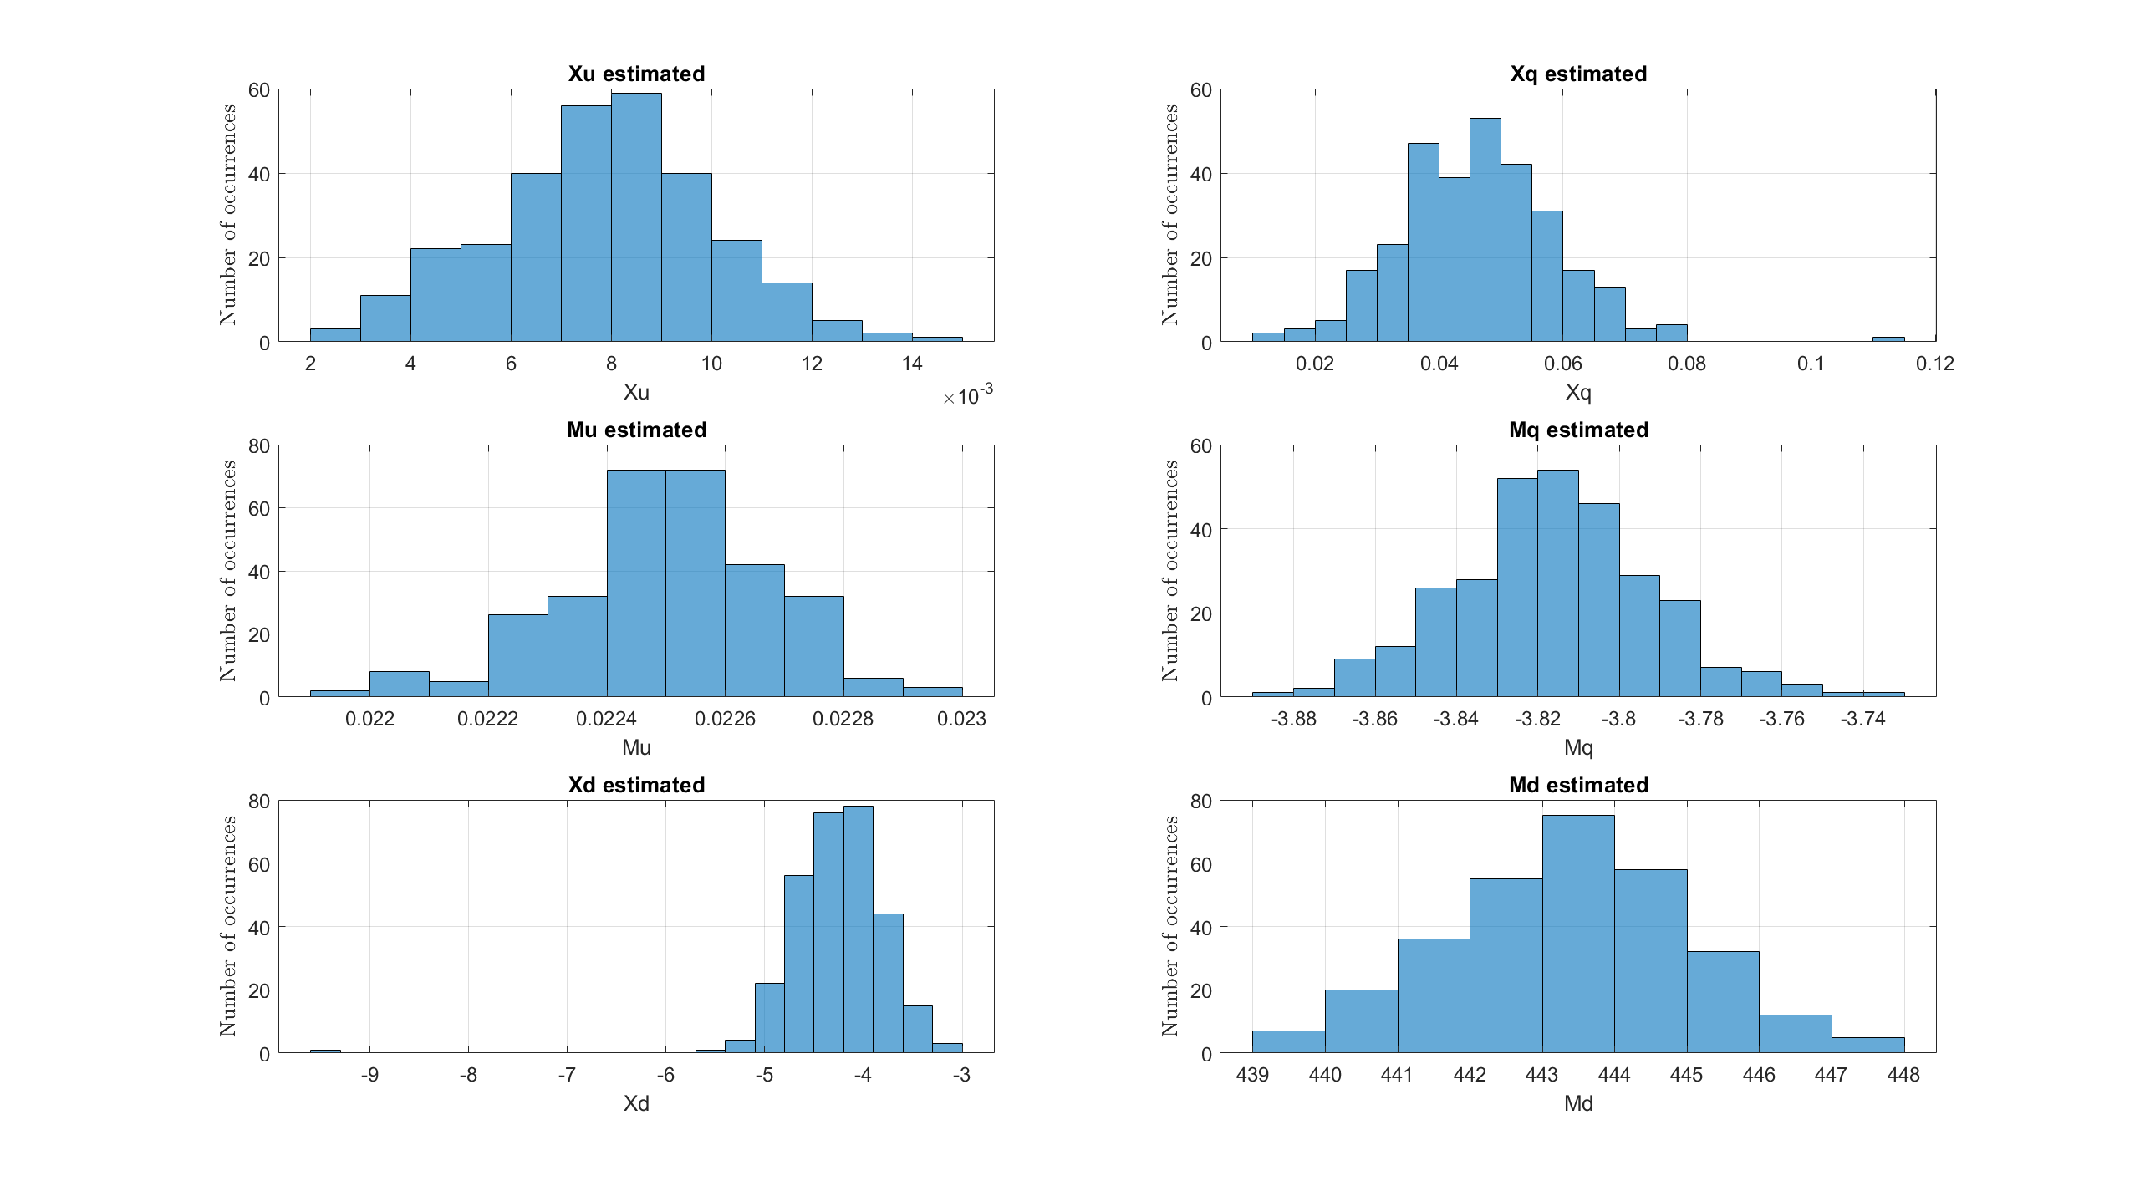
Task 3: Monte Carlo parameters
Boschini · Cavalli · Di Mauro – Estimation and Learning in Aerospace project, 25/26
POLITECNICO MILANO 1863

Slide 29
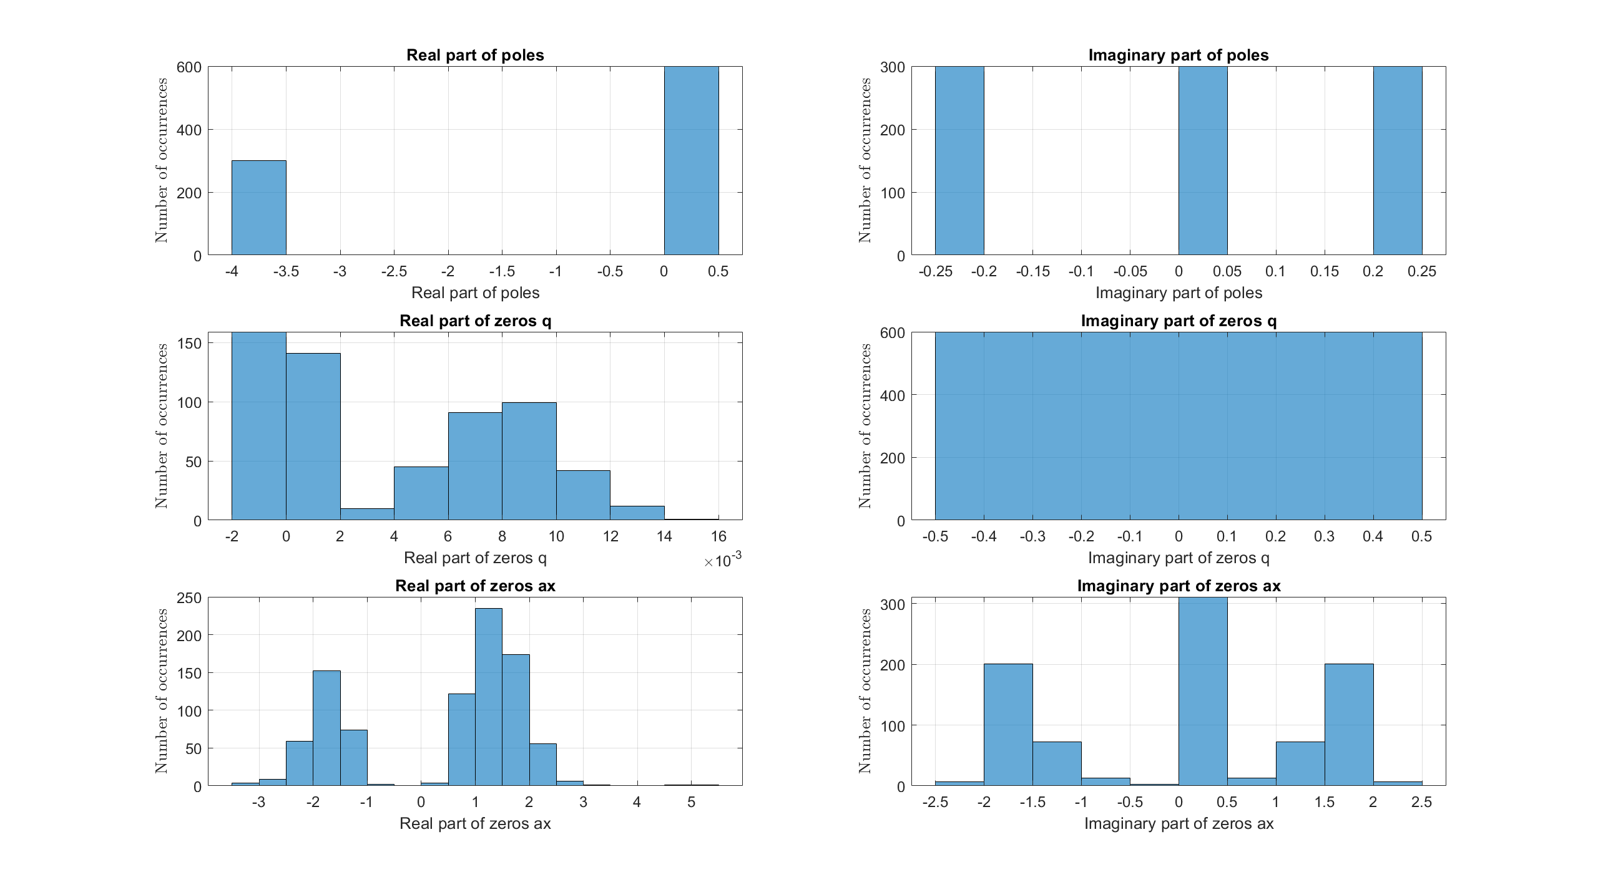
Task 3: Monte Carlo poles & zeros
Boschini · Cavalli · Di Mauro – Estimation and Learning in Aerospace project, 25/26
POLITECNICO MILANO 1863

Slide 30
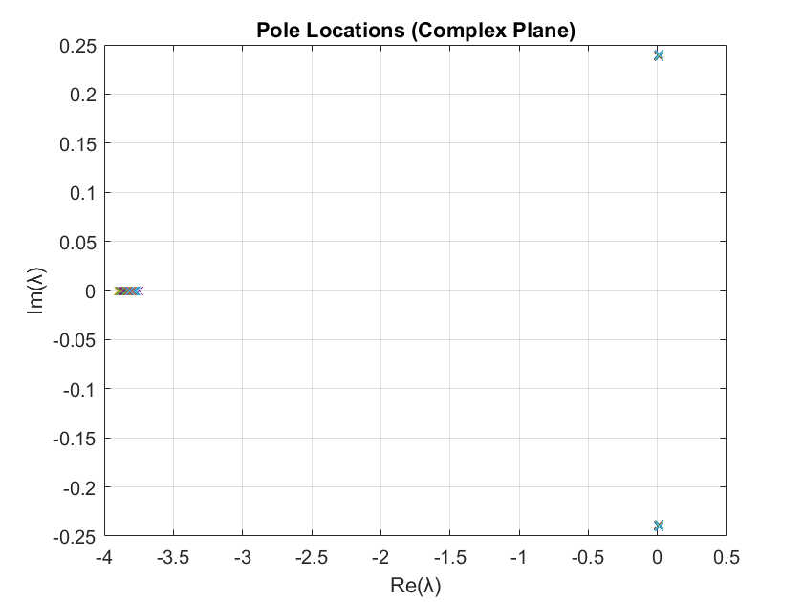
Task 3: Monte Carlo poles & zeros
Boschini · Cavalli · Di Mauro – Estimation and Learning in Aerospace project, 25/26
POLITECNICO MILANO 1863

Slide 31
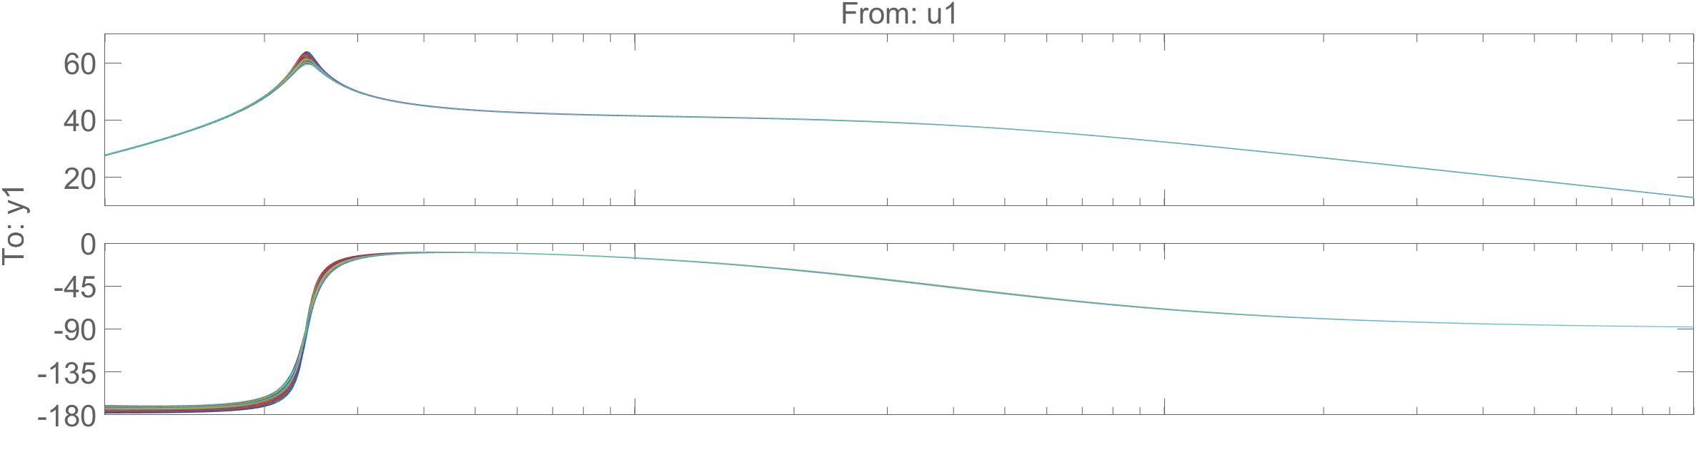
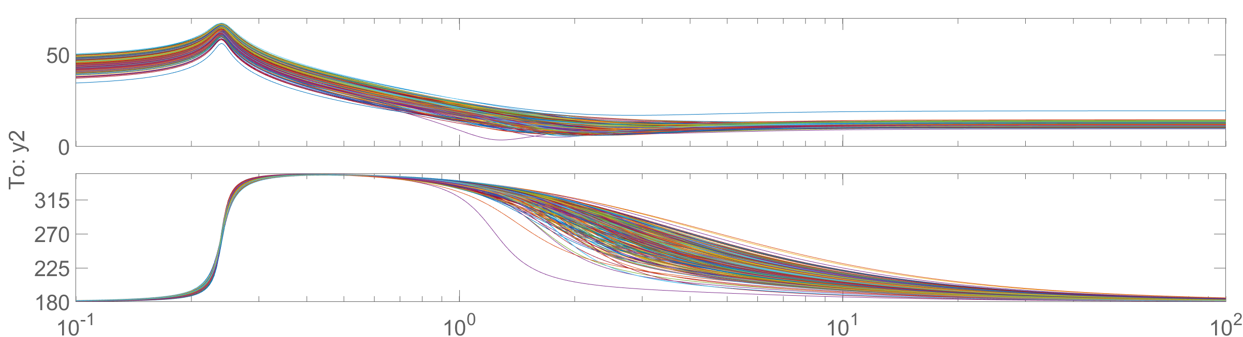
Task 3: Monte Carlo FRFs
Boschini · Cavalli · Di Mauro – Estimation and Learning in Aerospace project, 25/26
POLITECNICO MILANO 1863

Slide 32
References
➤ Marco Lovera (Politecnico di Milano): "Estimation and Learning for Aerospace - course slides", a.y. 2025-
2026
➤ Wei Yuan & Jay Katupitiya (UNSW): "A Grey-Box System Identification Procedure for Scale Model
Helicopters based on Frequency-Domain Estimation Methods", ICAS 2012
➤ B. J. Noppe: "Grey-box modelling of a quadrotor unmanned aerial vehicle using frequency-domain
system identification", IEEE 2016
Boschini · Cavalli · Di Mauro – Estimation and Learning in Aerospace project, 25/26
POLITECNICO MILANO 1863

Slide 33
Thanks for the attention!
Boschini Marianna · Cavalli Filippo · Mattia Di Mauro
Professor: Marco Lovera

