Slide 1
N-gram Histogram Computation
Parallel text analysis using OpenMP
Candidato: Mattia Manneschi

Slide 2
Introduction - Problem Statement
The Challenge:
Computing n-gram frequencies is a computationally intensive task when dealing with massive text corpora (Big Data).
The primary bottleneck is the Memory Wall: high frequency of memory accesses (hash map updates) compared to actual computation.
The Problem:
Vocabulary Explosion: As n increases (from bigrams to trigrams), the number of unique sequences grows exponentially, leading to cache misses and high memory consumption.
Synchronization Overhead: Multiple threads trying to update the same global counter create "contention," slowing down the system.
Project Goals:
Design and implement different parallelization patterns (OpenMP).
Analyze how performance scales with the number of threads and the size of the workload.
Identify the best strategy based on the n value and the data distribution.
Introduction

Slide 3

Theoretical Background
N-gram Definition:
A contiguous sequence of n items from a given sample of text or speech.
In this project, we focus on Bigrams (n=2) and Trigrams (n=3).
For a text with W words, the number of possible n-grams is W - n + 1.
Zipf's Law:
The frequency of any word (or n-gram) is inversely proportional to its rank in the frequency table:
Implication: A few n-grams are extremely common (e.g., "of the"), while the vast majority are very rare.
Key Statistical Metrics:
Hapax legomena: N-grams that appear only once in the entire corpus.
Dis legomena: N-grams that appear exactly twice.
These metrics help characterize the sparsity and complexity of the vocabulary.
Theoretical background

Slide 4
Architecture
Hardware Specifications:
Processor: AMD Ryzen™ 7 2700X (Zen+ Architecture).
Cores/Threads: 8 Physical Cores, 16 Logical Threads (Simultaneous Multithreading - SMT).
Clock Speed: Base 3.70 GHz, Max Boost up to 4.30 GHz.
RAM: 32 GB DDR4.
Memory & Cache Hierarchy:
L1 Cache: 768 KB.
L2 Cache: 4 MB.
L3 Cache (Shared): 16 MB (Divided into two 8MB CCX clusters).
OS: Ubuntu 24.04 LTS.
Architecture

Slide 5
Implementation - Sequential
The sequential implementation processes the entire corpus in a single thread. For each position in the word array, it constructs the n-gram string and updates a hash map counter. This version serves as the baseline for speedup calculations.
Histogram count_seq(const std::vector<std::string>& words, const int n_gram_size)
{
Histogram hist;
if (words.size() < static_cast<size_t>(n_gram_size)) return hist;
for (size_t i = 0; i <= words.size() - n_gram_size; ++i)
{
std::string n_gram = words[i];
for (int j = 1; j < n_gram_size; ++j)
{
n_gram += " " + words[i + j];
}
hist[n_gram]++;
}
return hist;
}
Implementation

Slide 6
Implementation - Thread Scaling - SR TLS
A single thread reads all documents using #pragma omp single while other threads wait, then all threads process the loaded texts in parallel with thread-local histograms.
#pragma omp parallel
{
Histogram thread_hist;
#pragma omp single // Un solo thread legge
for (auto& doc : directory_iterator("data/Texts"))
texts.push_back(read_file(doc));
#pragma omp for schedule(dynamic,1) // Tutti processano
for (auto& text : texts)
UpdateHistogram(thread_hist, text, n);
#pragma omp critical
merge(hist, thread_hist);
}
Implementation

Slide 7
Implementation - Thread Scaling - On the Fly
Each thread reads and processes documents independently as they are assigned. This maximizes parallelism but may cause I/O contention on slow storage systems.
#pragma omp parallel
{
Histogram thread_hist;
#pragma omp for schedule(dynamic,1)
for (int i = 0; i < doc_count; i++) {
string content = read_file("data/Texts/" + to_string(i) + ".txt");
UpdateHistogram(thread_hist, content, n);
}
#pragma omp critical
merge(hist, thread_hist);
}
Implementation

Slide 8
Implementation - Thread Scaling - HP TLS
Each thread loads documents into its own local vector, then processes them sequentially. This combines parallel I/O with complete thread isolation for both data and histograms.
#pragma omp parallel
{
vector<string> local_texts;
Histogram thread_hist;
#pragma omp for schedule(dynamic,1)
for (int i = 0; i < doc_count; i++)
local_texts.push_back(read_file(i));
for (auto& text : local_texts)
UpdateHistogram(thread_hist, text, n);
#pragma omp critical
merge(hist, thread_hist);
}
Implementation

Slide 9
Implementation - Workload Scaling - DL
Documents are tokenized in parallel first, then each thread processes a subset of documents using dynamic scheduling. This strategy pre-allocates histogram capacity based on estimated n-gram count.
#pragma omp parallel for schedule(dynamic)
for (int i = 0; i < num_docs; i++)
tokenized_docs[i] = tokenize(read_file(files[i]));
#pragma omp parallel
{
Histogram& my_hist = local_hists[omp_get_thread_num()];
#pragma omp for schedule(dynamic, 4)
for (int task = 0; task < num_docs * multiplier; task++)
count_ngrams(tokenized_docs[task % num_docs], my_hist);
}
Implementation

Slide 10
Implementation - Workload Scaling - FGL
Uses a sharded hash table with 1024 independent shards, each protected by its own OpenMP lock. N-grams are hashed to determine the shard, reducing lock contention compared to a single global lock.
constexpr int NUM_SHARDS = 1024;
std::vector<Histogram> shards(NUM_SHARDS);
std::vector<omp_lock_t> shard_locks(NUM_SHARDS);
for (auto& l : shard_locks) omp_init_lock(&l);
#pragma omp parallel for schedule(static)
for (size_t i = 0; i <= limit; ++i) {
std::string n_gram = build_ngram(all_words, i, n);
size_t shard_id = std::hash<std::string>{}(n_gram) % NUM_SHARDS;
omp_set_lock(&shard_locks[shard_id]);
shards[shard_id][n_gram]++;
omp_unset_lock(&shard_locks[shard_id]);
}
for (auto& l : shard_locks) omp_destroy_lock(&l);
Implementation

Slide 11
Implementation - Workload Scaling - CB
The corpus is divided into chunks with size automatically determined based on thread count. Uses dynamic scheduling for load balancing, with each thread maintaining a local histogram.
// Calculate adaptive chunk size
size_t chunk_size = std::max(1000UL, num_ngrams / (num_threads * 6));
size_t num_chunks = (num_ngrams + chunk_size - 1) / chunk_size;
#pragma omp parallel num_threads(num_threads)
{
Histogram& my_hist = local_hists[omp_get_thread_num()];
#pragma omp for schedule(dynamic)
for (size_t chunk_id = 0; chunk_id < num_chunks; ++chunk_id) {
size_t start = chunk_id * chunk_size;
size_t end = std::min(start + chunk_size, num_ngrams);
for (size_t k = start; k < end; ++k) {
build_ngram_inplace(corpus, k, ngram_size, buffer);
my_hist[buffer]++;
}
}
}
Implementation

Slide 12
Implementation - Tokenization
This function converts raw text to a vector of lowercase words, using SIMD vectorization for character processing.
std::vector<std::string> tokenize_text(const std::string& text)
{
std::vector<std::string> words;
std::string processed_text = text;
#pragma omp simd
for (size_t i = 0; i < processed_text.length(); ++i)
processed_text[i] = std::tolower(processed_text[i]);
#pragma omp simd
for (size_t i = 0; i < processed_text.length(); ++i)
{
char c = processed_text[i];
if (std::ispunct(c) || c == '\n' || c == '\t')
processed_text[i] = ' ';
}
std::stringstream ss(processed_text);
std::string word;
while (ss >> word)
if (!word.empty())
words.push_back(word);
return words;
}
Implementation

Slide 13
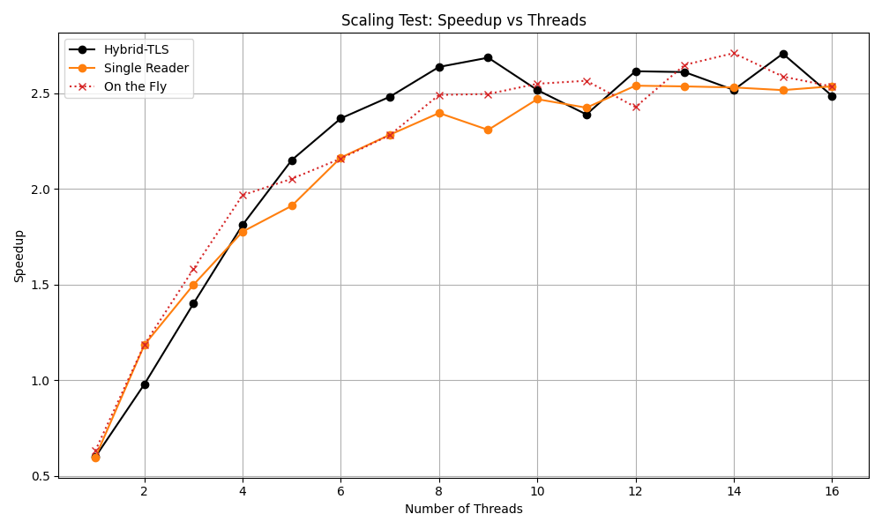
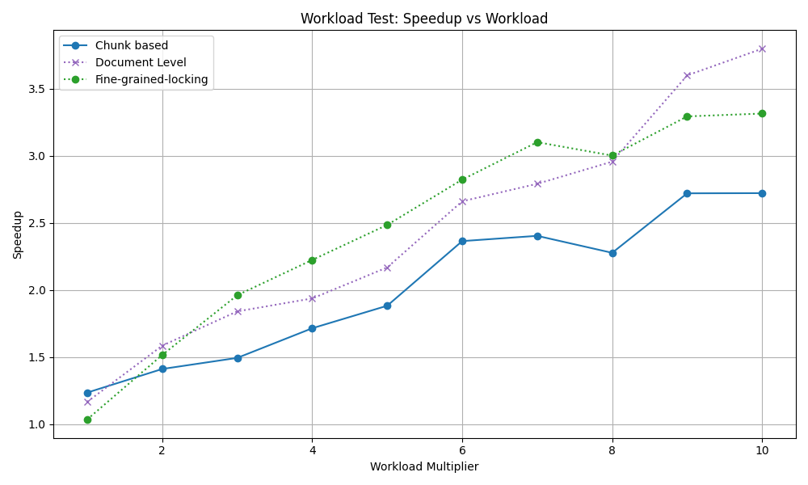
Experimental Results - Bigrams
All three strategies show similar scaling behavior, reaching maximum speedup around 2.5-2.7x with 8-10 threads. The Hybrid-TLS strategy achieves slightly better peak performance (2.7x at 9 threads). Beyond 10 threads, speedup plateaus due to memory bandwidth saturation.
Document Level achieves the best speedup at high workloads (3.9x at 10x multiplier), followed by Fine-grained-locking (3.3x) and Chunk-based (2.7x). Larger problem sizes better amortize parallelization overhead.
Experimental Results

Slide 14
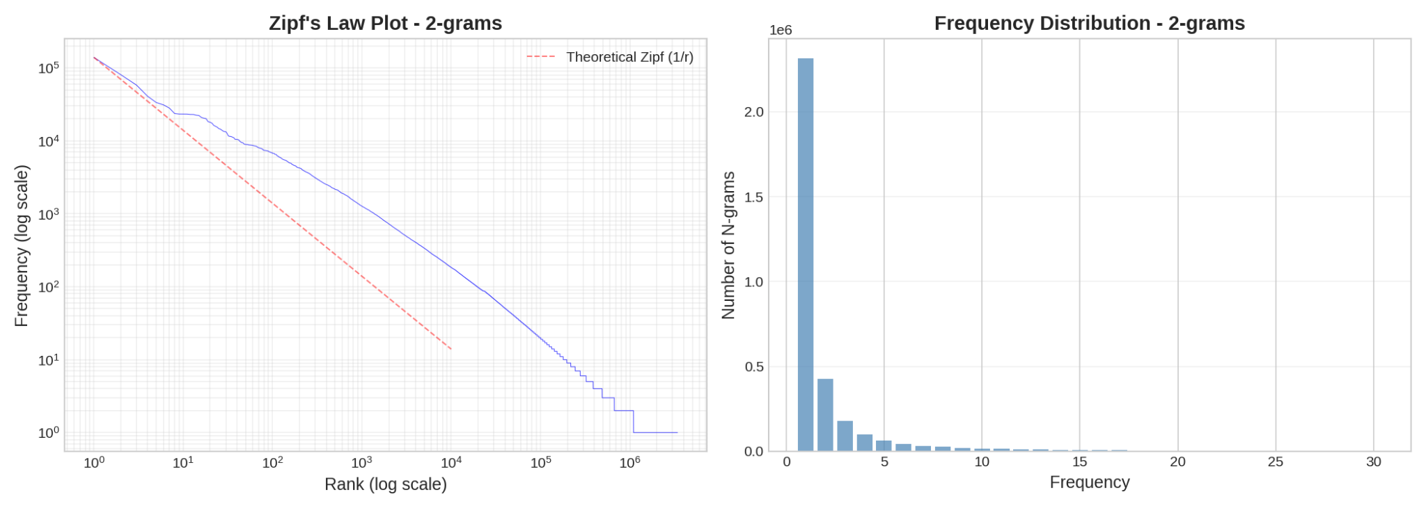
Experimental Results - Bigrams - Statistics
The data closely follows the theoretical Zipf distribution. The histogram shows extreme skewness: over 2.3 million bigrams appear only once.
Experimental Results

Slide 15
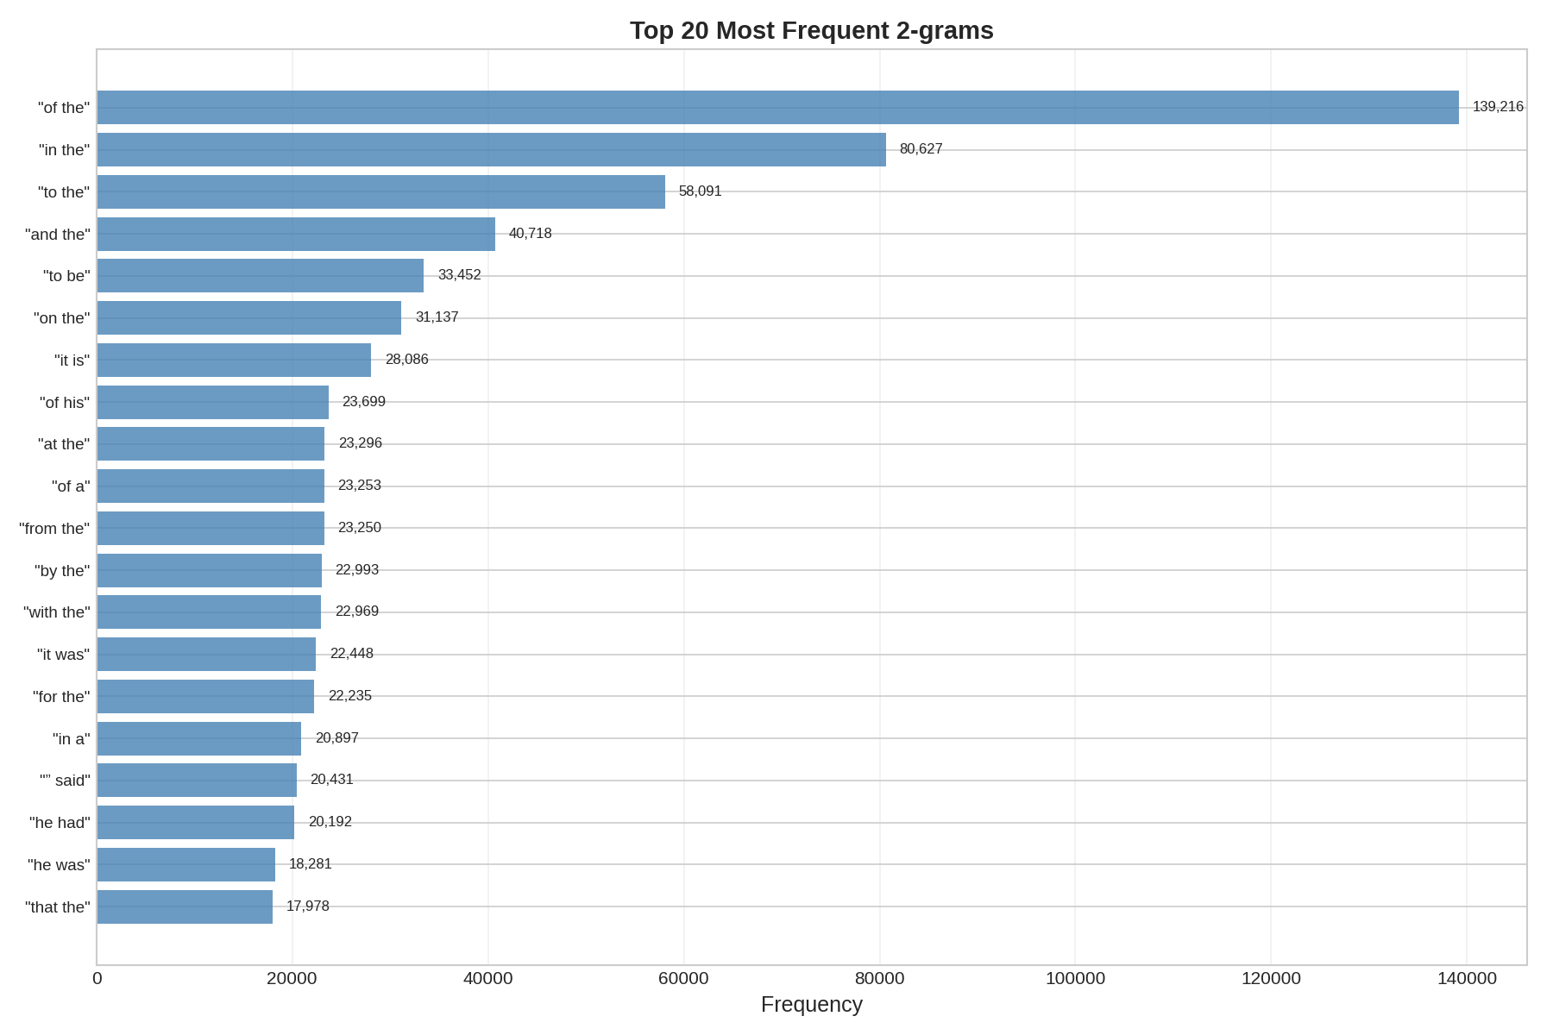
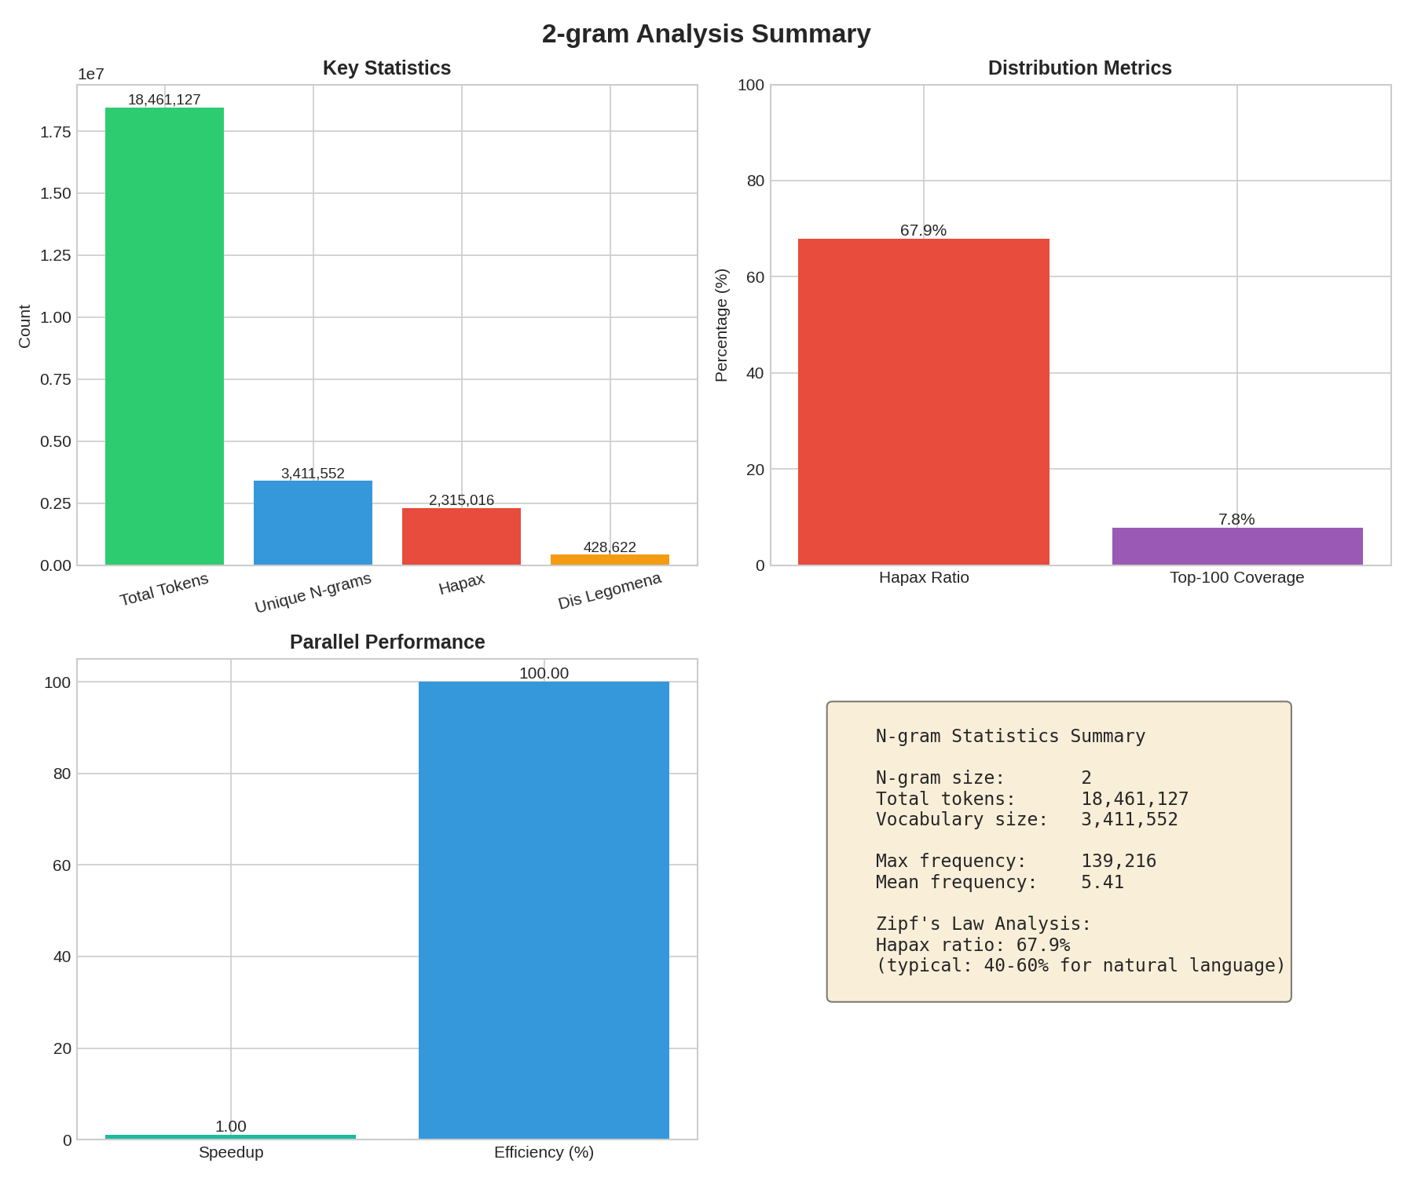
Experimental Results - Bigrams - Statistics
The most frequent bigram is "of the" with 139,216 occurrences, followed by "in the" (80,627) and "to the" (58,091). These function word combinations dominate English text.
Key statistics: 18,461,127 total tokens, 3,411,552 unique bigrams, 67.9% hapax ratio, mean frequency 5.41.
Experimental Results

Slide 16
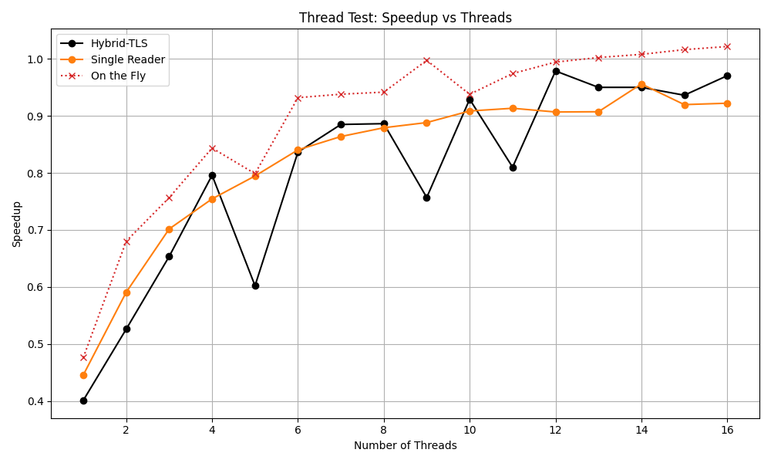
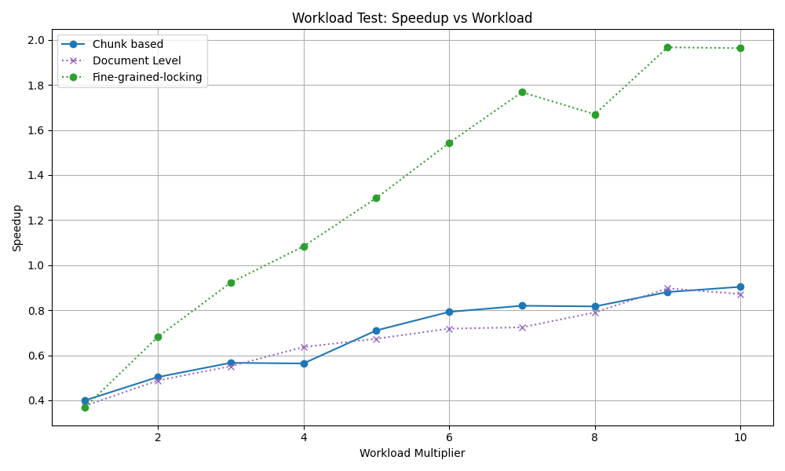
Experimental Results - Trigrams
Trigram counting shows speedup values below 1.0 for lower thread counts, indicating the parallel overhead exceeds the benefits. Performance improves gradually, reaching approximately 1.0x speedup at 16 threads. This is due to the much larger vocabulary causing significant hash table overhead and cache misses.
Fine-grained-locking performs best for trigrams, reaching 1.95x speedup at 10x workload. This strategy better handles the larger vocabulary by distributing lock contention across shards. Document Level and Chunk-based strategies struggle with the merge overhead of 10M+ entry hash tables.
Experimental Results

Slide 17
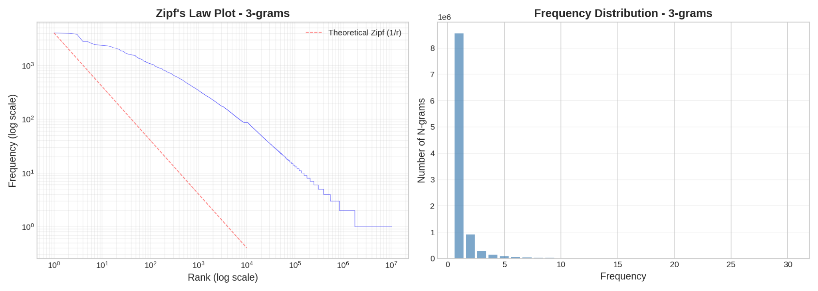
Experimental Results - Trigrams - Statistics
Trigrams show steeper Zipf decay than bigrams, with the vast majority appearing only once. The frequency histogram is even more skewed, with over 8.5 million hapax legomena.
Experimental Results

Slide 18
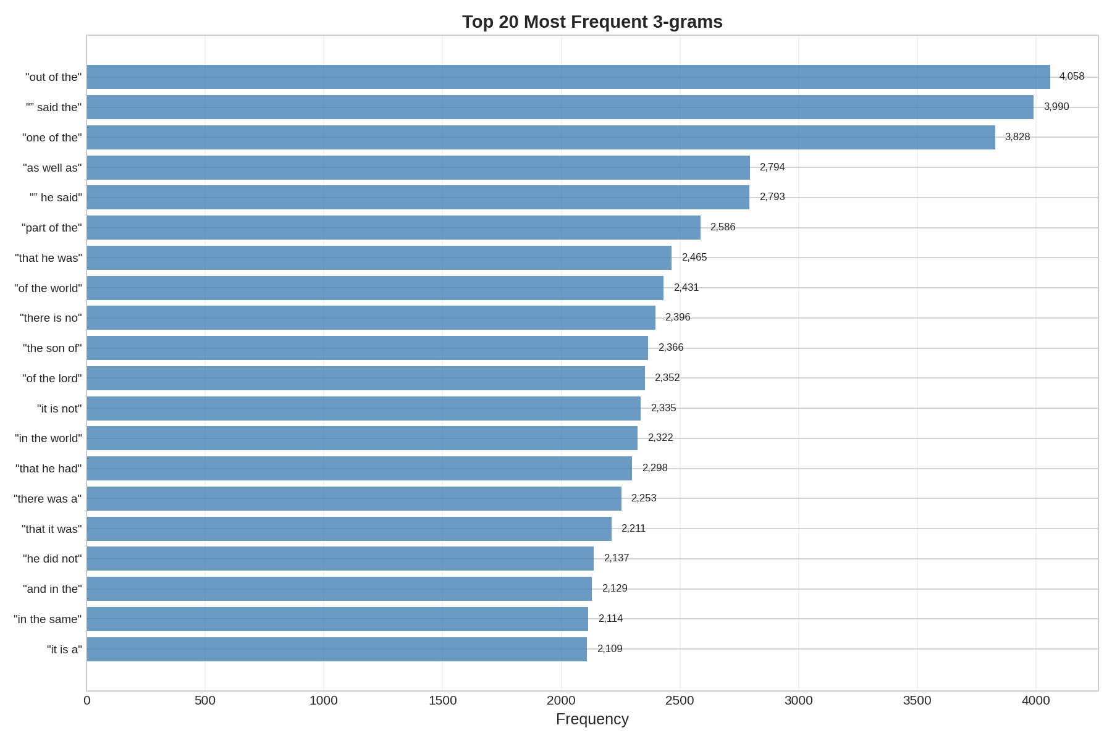
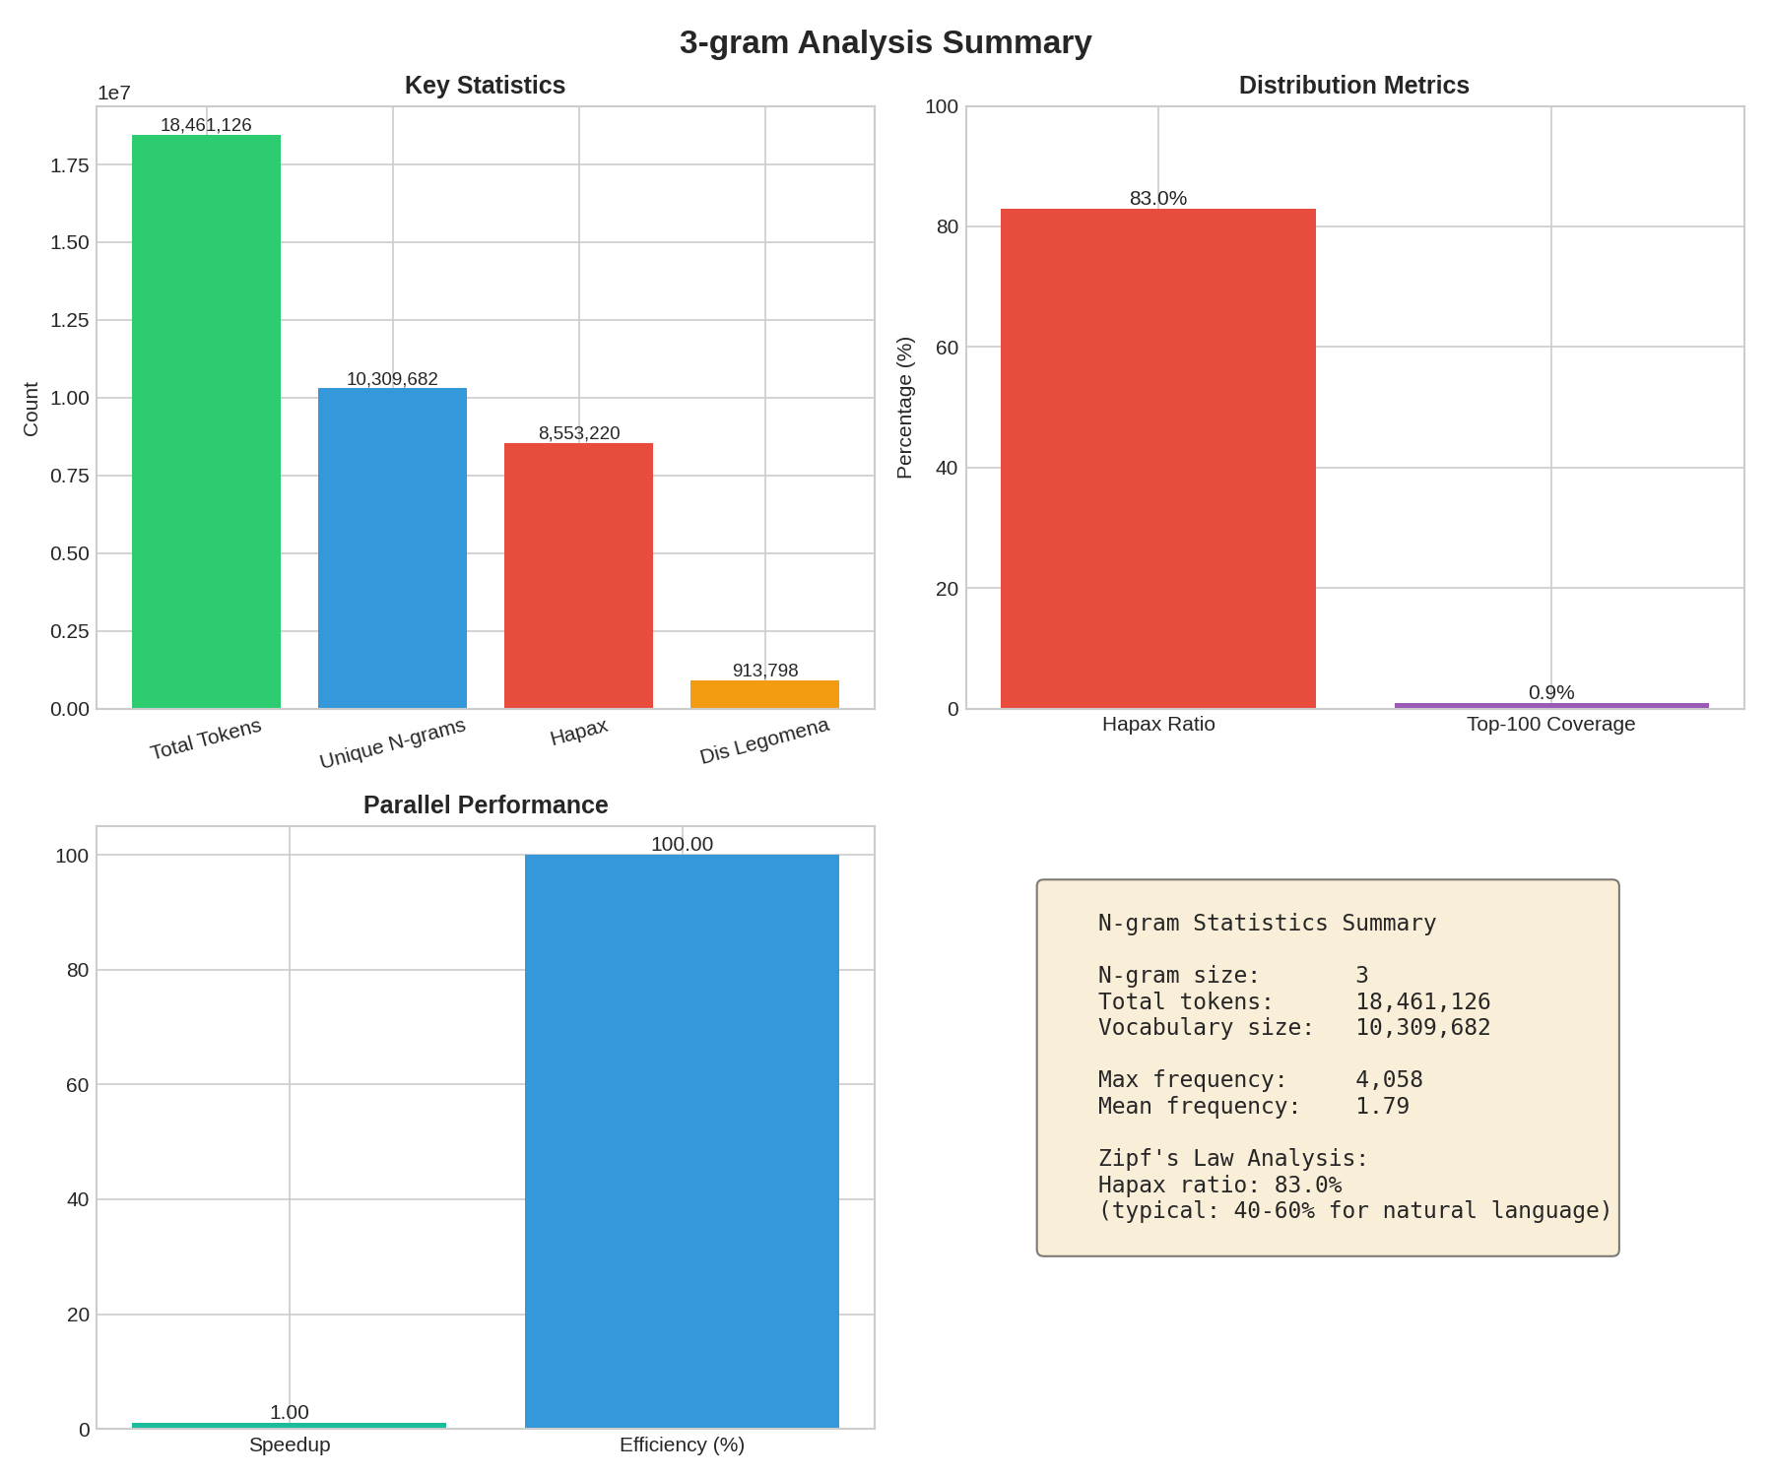
Experimental Results - Bigrams - Statistics
The most frequent trigram is "out of the" with 4,058 occurrences, followed by phrases like "one of the" (3,828) and "as well as" (2,794). Unlike bigrams, trigrams show more semantic content.
Key statistics: 18,461,126 total tokens, 10,309,682 unique trigrams (3x more than bigrams), 83.0% hapax ratio (vs 67.9% for bigrams), mean frequency only 1.79. The much larger vocabulary explains the reduced parallel efficiency.
Experimental Results

Slide 19
Conclusion
Conclusione

