Slide 1

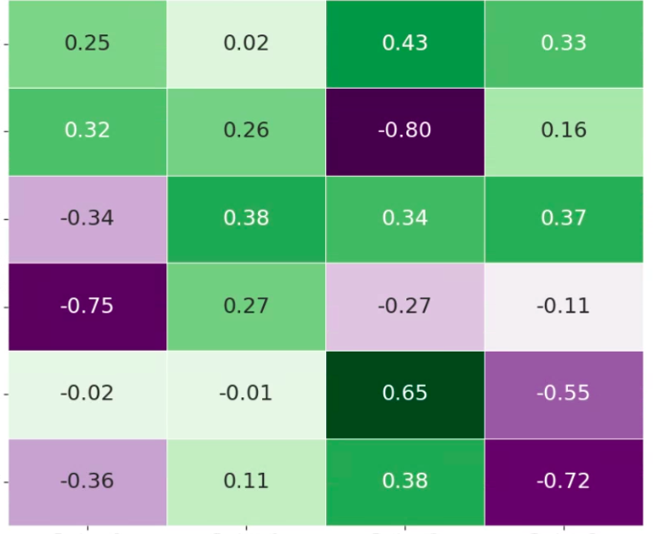
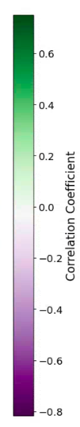
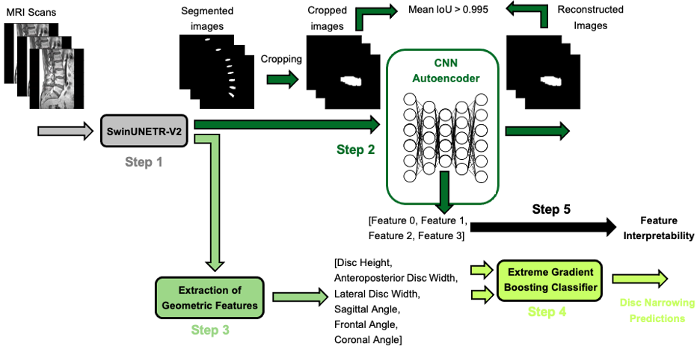
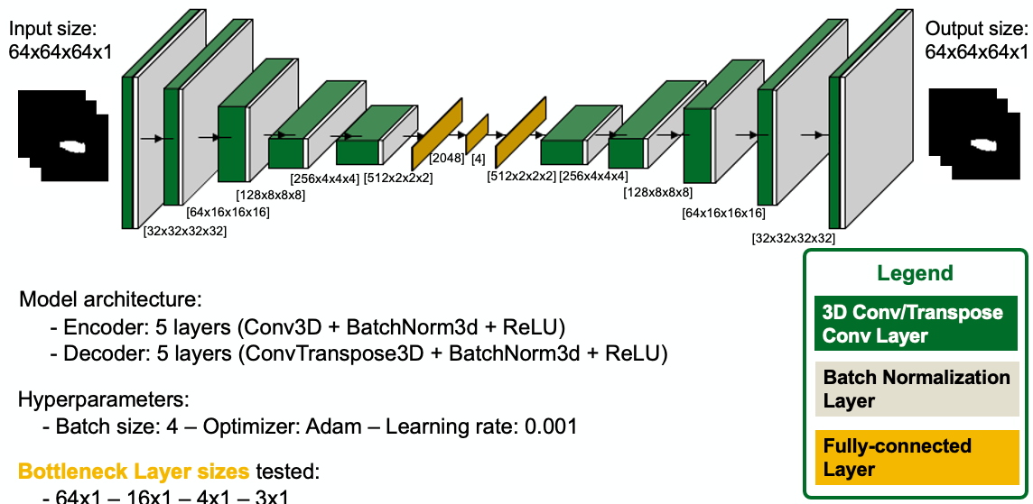
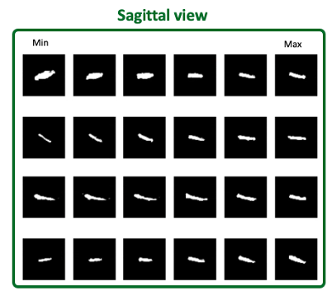
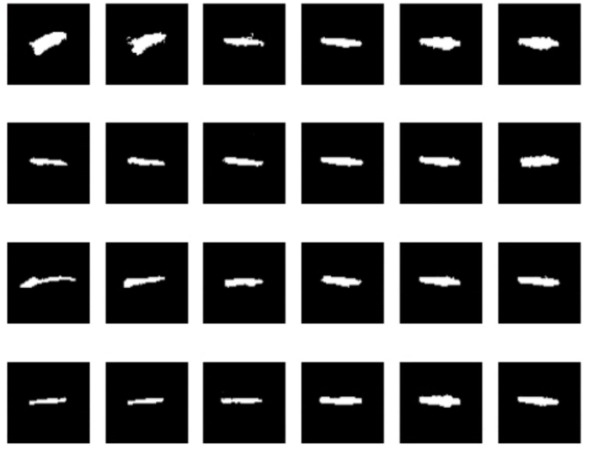


An Image Autoencoder for Learning Latent Disc Geometry from Segmented Lumbar Spine MRI
Mattia Perrone¹, D’Mar Moore¹, Daisuke Ukeba¹, John T. Martin¹
¹Rush University Medical Center, Chicago, IL
Introduction
Results & Discussions
Pathology of the lumbar intervertebral discs is frequently considered a driver of low back pain
Geometric determinants of the disc provide insight to its mechanical behavior and pathological state – e.g. disc narrowing is a classic feature of degenerative disc disease¹
Autoencoder deep learning architectures reduce data to the minimum set of latent features necessary to describe them (dimensionality reduction)
Aim of the study:
Extract latent geometric features from segmented disc MRI using an image autoencoder
Determine a relationship between latent features and disc anatomy
Results
Segmentation Model
IoU: 0.82 (0.80-0.84)
Dice: 0.90 (0.89-0.91)
CNN autoencoder
disc height
ap width
 | Epochs for convergence
Bottleneck layer=8 | 199
Bottleneck layer=4 | 350
Bottleneck layer=3 | No convergence
lat width
Methods
sag angle
axial angle
front angle
feature 0
feature 1
feature 2
feature 3
Table 1: Epochs required for convergence at different bottleneck layer sizes.
-0.8
-0.6
-0.4
-0.2
0
0.2
0.4
0.6
Correlation coefficient
Discussions
Fig 3: Correlation matrix between geometric and latent features
Image segmentation performance matched published values²
An autoencoder with bottleneck layer = 4 ensured convergence and minimized multicollinearity (4)
Latent features encoded disc height (F2), anteroposterior and lateral width (F1, F2) frontal curvature (F3), sagittal curvature (F0), and axial curvature (F2) (Fig. 2, Fig. 3)
Latent features improved disc narrowing prediction over geometric features alone, matching literature on disc pathology predictions^{4,5} (Table 2)
A
Features | F1-score (95% CI) | AUC-ROC (95% CI)
Latent features | 0.81 (0.77 – 0.85) | 0.75 (0.71 – 0.79)
Geometric features | 0.79 (0.77 – 0.81) | 0.66 (0.63 - 0.69)
Geometric and latent features | 0.81 (0.79 – 0.83) | 0.76 (0.73 – 0.78)
Lin et al.⁴ | 0.78 | /
Hung et al.⁵ | / | 0.75 (0.71-0.79)
[32x32x32x32]
[64x16x16x16]
CNN Autoencoder
[128x8x8x8]
[64x16x16x16]
[32x32x32x32]
[128x8x8x8]
[256x4x4x4]
Bottleneck layer
[256x4x4x4]
[4]
B
[512x2x2x2]
[2048]
[512x2x2x2]
3D convolutional layer
Fully-connected layer
Batch normalization layer
3D deconvolutional layer
Table 1: Predictions of disc narrowing using latent and geometric features. Comparisons made to relevant examples in literature.
Dataset & Pipeline
Fig 1: (A) Pipeline followed in the current study. (B) Architecture of the CNN Autoencoder
Dataset: Multi-institutional dataset (5 institution)²
195 sagittal T1-weighted MRI (39 for test set)
Make: Siemens, Philips / Field Strength: 1.5–3T / Echo Time: 8ms–124ms / Repetition Time: 446–5570ms / Flip Angle: 80–160 degrees
Pipeline: (Fig. 1A)
Segmentation model³ (Swin Transformer)
Training parameters: 200 epochs / batch size=4 / Loss: DSC+BCE
CNN Autoencoder
Bottleneck=4 units / IoU>0.95 for convergence
Manual analysis of geometric features
Disc Narrowing predictions
XGBoost: # of estimators=200 / max depth=3
Feature interpretability (Fig. 2)
Correlations between latent & geometric features
Conclusions and References
Conclusions
Proposed a CNN-autoencoder to extract latent features from segmented lumbar disc MRI images
Demonstrated improved disc narrowing prediction by combining latent and geometric features. Provided interpretability of latent features
Future work includes integrating latent variables related to disc voxel intensity to capture insights into disc composition
References
References: ¹Raastad, JSAR, 2015; ²Van der Graaf, Nature, 2024; ³He, MICCAI proceedings, 2023; ⁴Lin, Diagnostic, 2024; ⁵Hung, IJERPH, 2021.
Acknowledgements: NIH R00AR077685
Fig 2: Visualization of reconstructed masks across sagittal view (central slice)
Scan here for a 3-minute overview of the poster
mattia_x_perrone@rush.edu
www.rushu.rush.edu/orthoresearch
Notes:
POSTER SESSION #: PS1-040 POSTER CATEGORY: Hip - Structure, Function and Mechanics POSTER #: 0800 POSTER TITLE: A Novel Shape-Fitting Method Aids In Virtual Surgical Correction Planning For Cam-Type Femoroacetabular Impingement Syndrome AUTHORS: Martina Guidetti; Alexander Newhouse; Thomas Alter; Alejandro Espinoza Orias; Shane Nho; Philip Malloy
POSTER SESSION INFORMATION Poster Session 1 (PS1): Posters displayed Saturday and Sunday You are expected to be at your poster during the designated times noted below: If your POSTER # is EVEN you will present on Saturday, February 5, 10:15 AM - 11:15 AM If your POSTER # is ODD you will present on Sunday, February 6, 10:15 AM - 11:15 AM A Poster Reception will be held on Saturday, February 5, 5:30 PM - 7:00 PM
POSTER FORMAT: Poster size is 45'' x 45" (Maximum) Poster must reflect the material summarized in your submitted abstract. For all posters we suggest that you embed a QR code that can be used for those visiting your poster to hear your personal presentation, and to include your email for any questions your colleagues may have about your work. Information for poster presenters - including poster set-up, removal, etc. is available on the 2022 Annual Meeting website at https://www.ors.org/2022-poster-presenter-speaker-moderator-info.
POSTER PRINTING SERVICE ORS will offer a Poster Printing Service through a third-party vendor. Poster presenters (Presenting authors) will receive an email in December with information on the poster printing service. Poster presenters wanting to take advantage of this service will be able to pick up their poster upon arrival to the Tampa Convention Center.

