Slide 1
An Image Autoencoder for Learning Latent Disc Geometry from Segmented Lumbar Spine MRI
Mattia Perrone¹, John T. Martin¹
¹ Rush University Medical Center
We have no disclosures

Slide 2
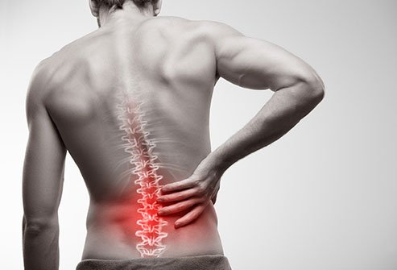
Introduction: Clinical Problem
Low back pain (LBP):
619 million people in 2020 worldwide^{[1]}
843 million people by 2050 worldwide ^{[1]} (projections)
Disc degeneration is linked to low back pain^{[2]}, but the factors causing degeneration remain unclear
Possible causes include:
Subject demographics^{[3]} (age, sex, BMI)
Genetics^{[4]}
Biomechanics and disc geometry^{[5]}
[1] Ferrera et al. 2023, [2] De Schepper et al. 2010, [3] Akeda et al. 2015, [4] Videman et al. 2008, [5] Fleps et al. 2024

Slide 3
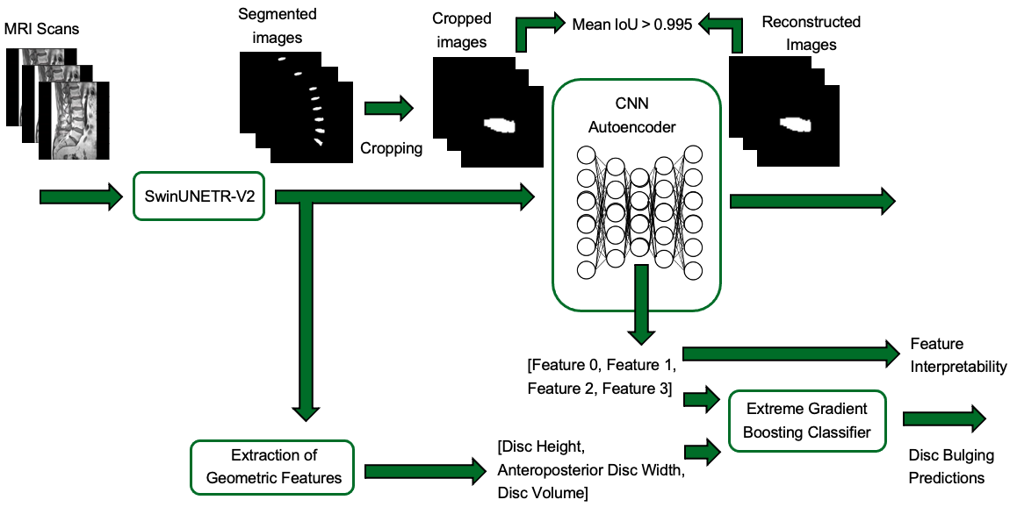
Introduction: Machine Learning in Spine Research
Machine learning is widely used to assess disc pathologies and autoencoders are among the most common architectures used
Autoencoder
Input data
Output data
Encoder
Decoder
Segmentation task

Slide 4
Introduction: Machine Learning in Spine Research
Autoencoders map input data into a lower-dimensional space known as the latent space
Autoencoder
Input data
Latent space
Output data
Encoder
Decoder
Feature extraction task

Slide 5

Introduction
Study Objective
Develop an autoencoder to extract latent features from segmented lumbar disc MRI for predicting disc bulging
Explore the interpretability of latent features by linking them to structural disc features

Slide 6
Methods

Slide 7
Methods
Dataset
195 sagittal T1-weighted MRI sequences from a publicly available multi-institutional dataset^{[1]} of people with LBP
Heterogeneous dataset:
make: Siemens, Philips
field strength: 1.5-3T;
Echo time (TE): 8 ms-124 ms;
Repetition time (TR): 446-5570 ms;
flip angle: 80-160 degrees
Preprocessing steps
Isotropic resampling to voxel size of [1,1,1] mm
Padding/Cropping
Input size: 192 x 128 x 96
Z-score normalization
Data splitting
Segmentation (spine level): 195 spines -> 70% training (137) – 10% validation (19) – 20% test (39)
Disc bulging prediction (disc level): 202 discs -> 152 samples for training – 40 samples for testing (5-fold cross validation)
[1] Van der Graaf et al. 2024
Notes:
Batch size: 4 – Optimizer: Adam – Learning rate: 0.001 – Number of epochs: 50

Slide 8
Methods: Pipeline
Notes:
Batch size: 4 – Optimizer: Adam – Learning rate: 0.001 – Number of epochs: 50

Slide 9
Methods: Pipeline
1 - Segmentation
Notes:
Batch size: 4 – Optimizer: Adam – Learning rate: 0.001 – Number of epochs: 50

Slide 10

Methods: Pipeline
2 – Latent features extraction
Notes:
Batch size: 4 – Optimizer: Adam – Learning rate: 0.001 – Number of epochs: 50

Slide 11
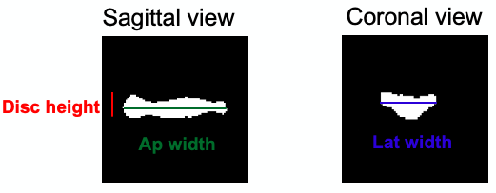
Methods: Pipeline
3 – Extraction of geometric features, Disc bulging predictions and
Feature interpretability
Notes:
Batch size: 4 – Optimizer: Adam – Learning rate: 0.001 – Number of epochs: 50

Slide 12
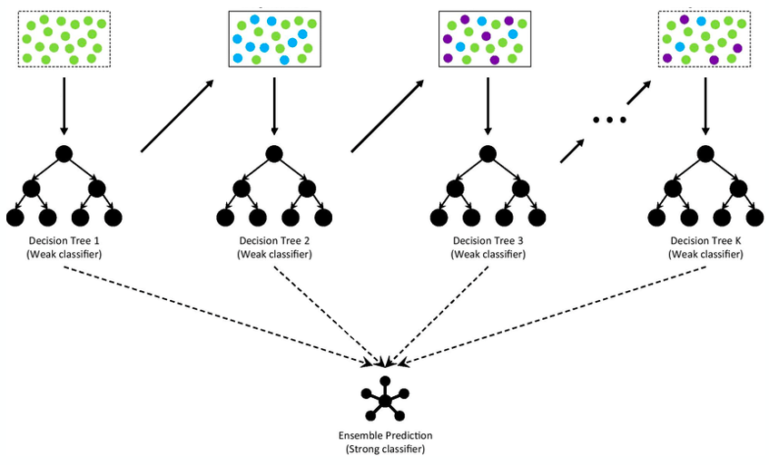


Methods: 3) Pipeline End Stage
Extraction of geometric features
Disc bulging predictions – Gradient boosting
Sagittal view
Coronal view
Disc height
Ap width
Lat width
- Disc height: mean height across all pixels within the segmented disc region (sagittal plane)
- Anteroposterior width: distance between the two lateral edges of the segmented disc (sagittal plane)
Hyperparameters:
Maximum depth of estimators: 3
Numbers of estimators: 200
Learning rate: 0.1
- Lateral width: distance between the two lateral edges of the segmented disc (coronal plane)

Slide 13
Results and Discussions

Slide 14
Results
1 - Segmentation
Test IoU (95% CI) | Test DSC (95% CI)
0.74 (0.71-0.78) | 0.85 (0.83-0.87)
Results are consistent with those reported in the van der Graaf^{[1]} study (DSC = 0.85, SD = 0.1)
2 – Latent features extraction
Latent space dimension | IoU (95% CI) | Epochs for convergence
64x1 | 0.9981 (0.9976-0.9986) | 190
8x1 | 0.9983 (0.9979-0.9987) | 199
4x1 | 0.9984 (0.9979-0.9989) | 350
3x1 | between 0.6 and 0.8 | No convergence
The model is considered to have converged when the IoU exceeds 0.995
[1] Van der Graaf et al. 2024

Slide 15
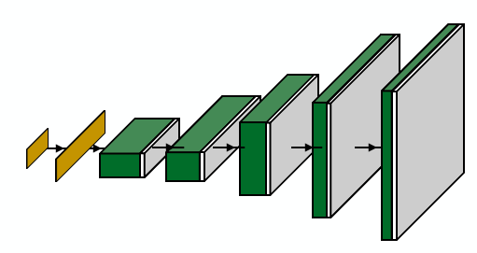
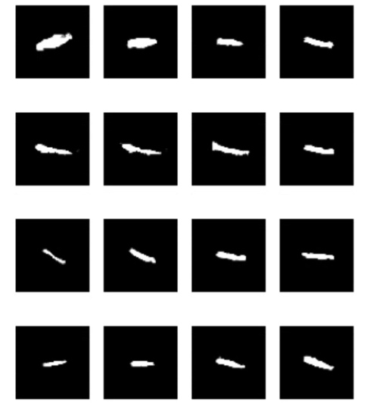
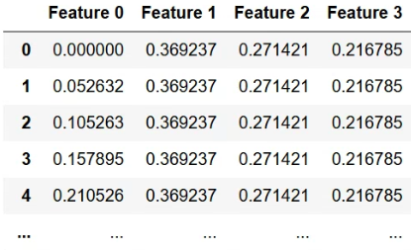
Methods: 3) Pipeline End Stage
Feature interpretability
- Understanding the relationship between latent features and disc anatomical structures
Sagittal view
Synthetic dataset

Slide 16
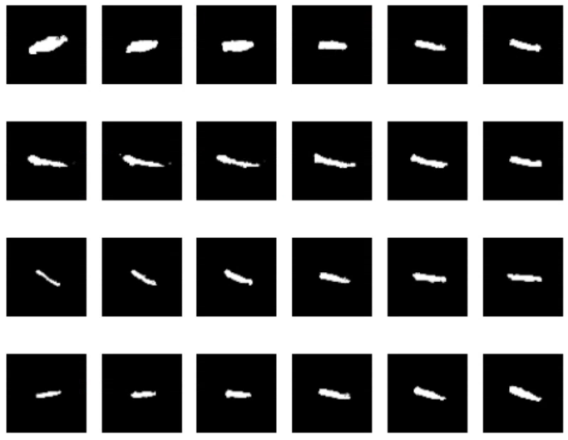
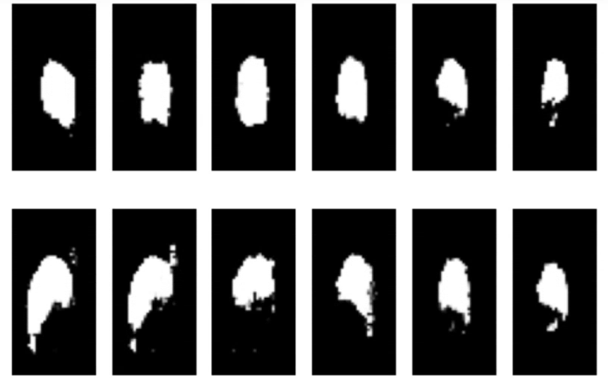
Results
3 – Feature interpretability and Disc bulging predictions
Sagittal plane
Axial plane
Min
Max
Min
Max
Feature 0
Feature 1
Feature 2
Feature 3

Slide 17
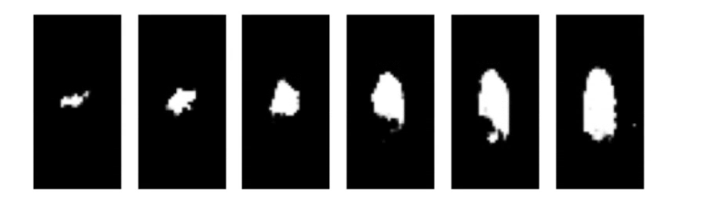
Results
3 – Feature interpretability and Disc bulging predictions
Sagittal plane
Axial plane
Min
Max
Min
Max
Feature 0
Feature 1
Feature 2
Feature 3

Slide 18
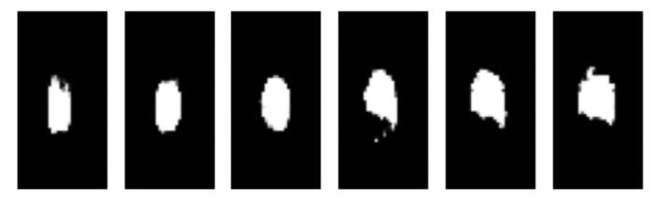
Results
3 – Feature interpretability and Disc bulging predictions
Sagittal plane
Axial plane
Min
Max
Min
Max
Feature 0
Feature 1
Feature 2
Feature 3

Slide 19
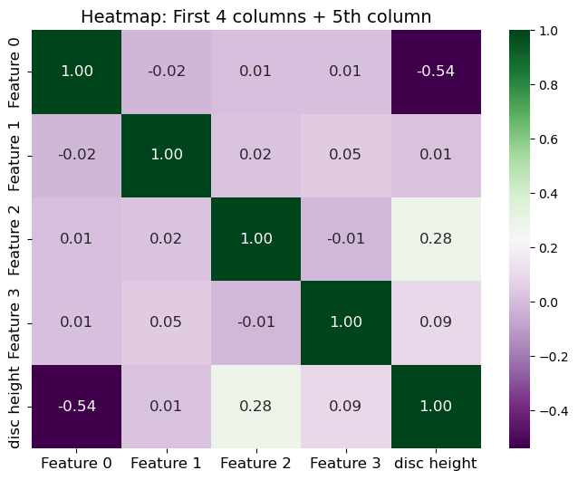
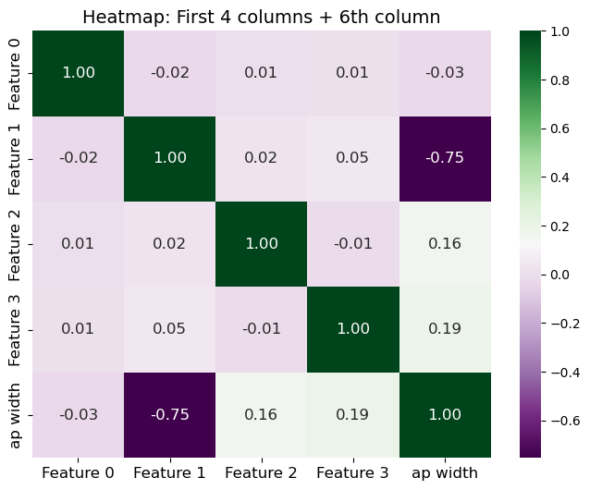
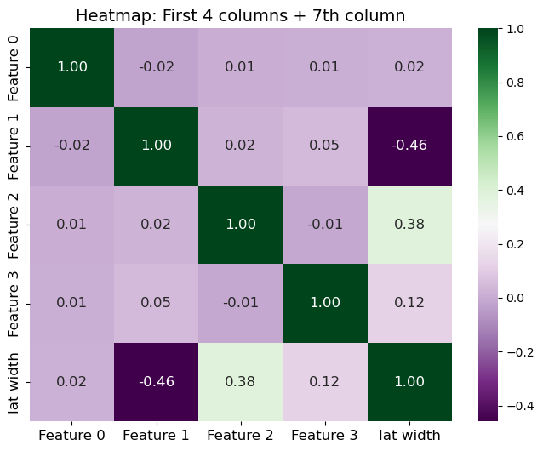
Discussions
3 – Feature interpretability and Disc bulging predictions
Pearson correlation coefficient
Disc height and latent features
Ap width and latent features
Lat width and latent features

Slide 20
Discussions
3 – Feature interpretability and Disc bulging predictions
Disc height and latent features
Ap width and latent features
Lat width and latent features

Slide 21
Results
3 – Feature interpretability and Disc bulging predictions
 | F1-score (95% CI) | AUC-ROC (95% CI)
Latent features | 0.65 (0.63-0.66) | 0.71 (0.69-0.71)
Geometric features | 0.71 (0.70-0.72) | 0.77 (0.76-0.77)
Geometric and latent features | 0.74 (0.73-0.74) | 0.80 (0.79-0.81)
Lin et al. 2024 | 0.78 | /
Hung et al. 2021 | / | 0.75
Predictions of disc bulging using latent and geometric features from ground truth masks. Comparisons made to relevant examples in literature

Slide 22
Results
3 – Disc bulging predictions and Feature interpretability
 | F1-score (95% CI) | AUC-ROC (95% CI)
Latent features | 0.65 (0.63-0.66) | 0.71 (0.69-0.71)
Geometric features | 0.71 (0.70-0.72) | 0.77 (0.76-0.77)
Geometric and latent features | 0.74 (0.73-0.74) | 0.80 (0.79-0.81)
Lin et al. 2024 | 0.78 | /
Hung et al. 2021 | / | 0.75
Predictions of disc bulging using latent and geometric features from ground truth masks. Comparisons made to relevant examples in literature
 | F1-score (95% CI) | AUC-ROC (95% CI)
Latent features | 0.67 (0.66-0.69) | 0.71 (0.69-0.73)
Geometric features | 0.62 (0.61-0.63) | 0.67 (0.66-0.68)
Geometric and latent features | 0.70 (0.70-0.71) | 0.73 (0.73-0.74)
Predictions of disc bulging using latent and geometric features from predicted masks

Slide 23
Discussions
Take-home Messages
Disc bulging predictions
Feature interpretability
Predictions comparable to the literature
High correlation between latent and geometric features
Achieved better performance with real masks compared to predicted masks.
Disc segmentation results can be summarized using 4 features
Latent features improve predictions compared to using geometric features alone.
Two latent features are highly correlated to geometric determinants analysed

Slide 24
Conclusions

Slide 25
Conclusions
Developed a CNN-autoencoder to extract latent features from segmented lumbar disc MRI for predicting disc bulging and provided interpretability of these latent features
Developed a framework that encodes disc geometry from a high-dimensional pixel-based representation to four key features, expanding on previous studies^{[1]}
Next steps include investigating the relationship between latent variables and patient outcomes
[1] Peloquin et al. 2014

