Slide 1



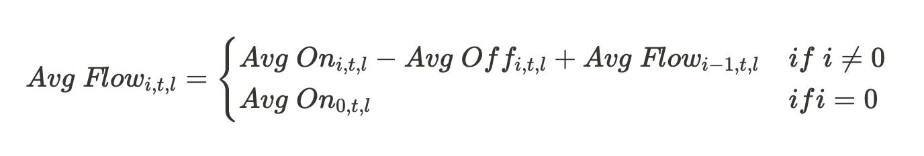
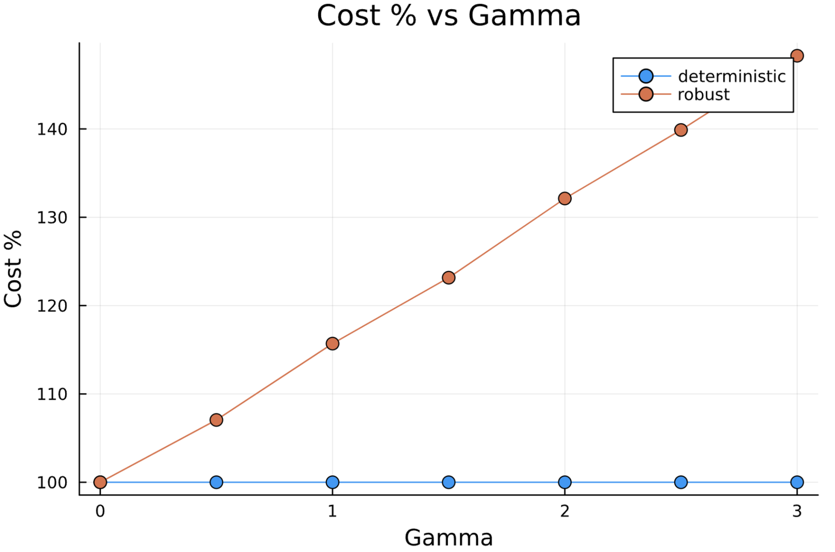
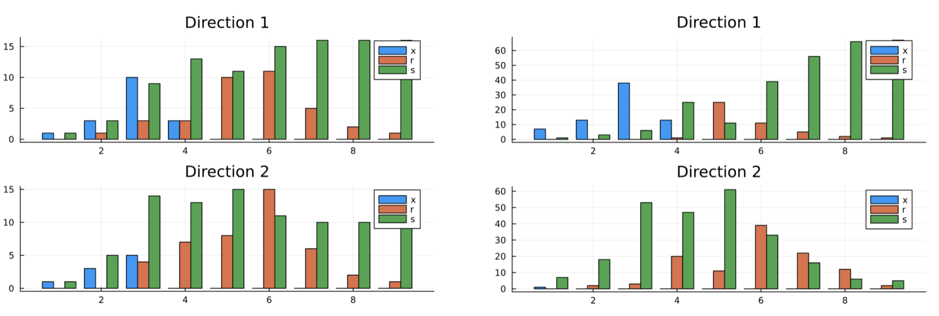
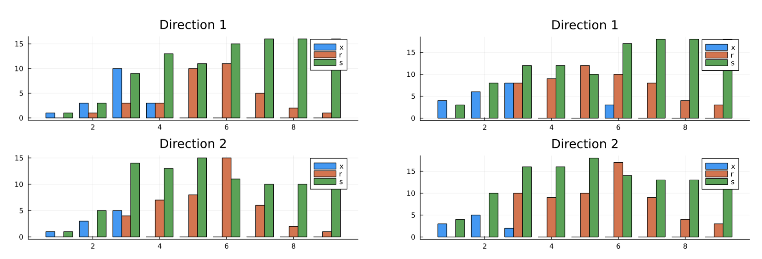
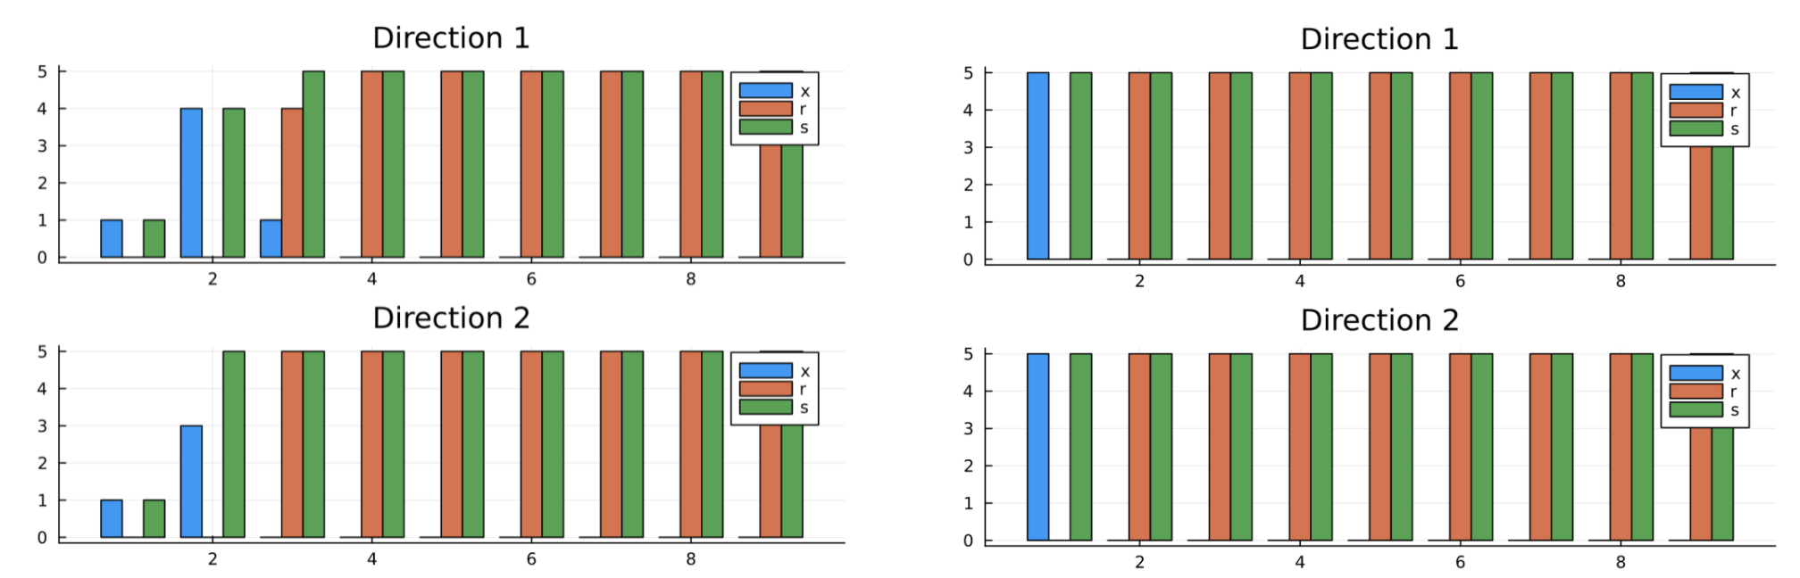
The MBTA underground trains case
Zachary Bell (MBAn)
Mattia Ravasio (MBAn)
Executive summary
The data
What is the impact?
The MBTA faces a customer demand that is subject to seasonal trends and uncertainty.
We developed a robust optimization framework to model the number of trains to run where we could also model decisions under a limited fleet.
We used data reporting the Average Flow per station in the 2019 Fall season.
Cost and capacities of trains for each line were found online.
Optimize the model in order to reduce MBTA running costs
Modelling uncertainty according to a conservative robust framework in a way that favors the customers
Understand where to run trains in the case of limited fleet when the MBTA needs to best decide how to allocate their trains across different sublines or which trains to rest versus keep in depot
Problem Statement
Minimize the cost of running trains and the cost of unmet demand, while ensuring that the unmet demand and the capacity of the trains are greater or equal than the demand of customers, and there is a balance in the train flow.
Model the total number of trains to be less than a certain value, to explore solutions under a limited fleet.
Model uncertainty in the demand using a polyhedral uncertainty set.
Run different models for different lines
Key findings
Symmetrical vs Asymmetrical
Deterministic vs Robust
Models under limited fleet
What would we do with an extra week?
Why do we care?
Implement a new variable to model the number of trains in the depot
Brainstorm how to model a train’s ability to travel in more than one direction during a given time period
This project has potential to impact both the MBTA, by achieving reduced costs, and its riders, who will have a better train schedule at their favorite station.

