Slide 1
Optimal k-means clustering
Mattia Ravasio, Hamza Zerhouni
December 9, 2022
M. Ravasio, H. Zerhouni

Slide 2
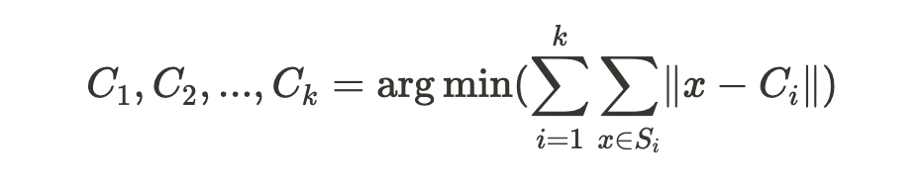
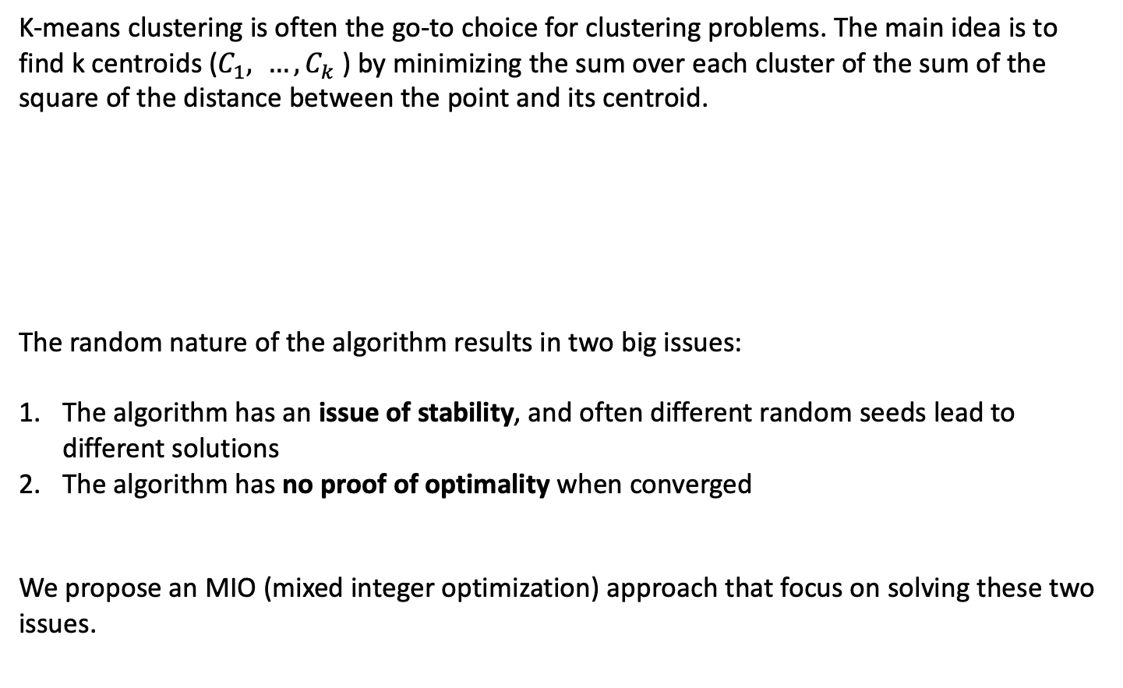
Problem statement
K-means clustering is often the go-to choice for clustering problems. The main idea is to find k centroids ($C_{1}, …, C_{k}$) by minimizing the sum over each cluster of the sum of the square of the distance between the point and its centroid.
The random nature of the algorithm results in two big issues:
The algorithm has an issue of stability, and often different random seeds lead to different solutions
The algorithm has no proof of optimality when converged
We propose an MIO (mixed integer optimization) approach that focus on solving these two issues.
M. Ravasio, H. Zerhouni

Slide 3
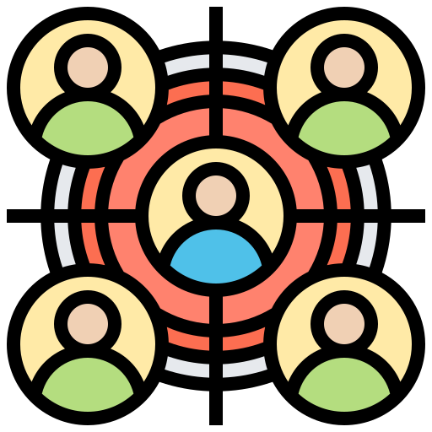



Why do we care?
Clustering has many applications:
Customer segmentation
Financial markets
Political campaigns
Genetic data
We need a reliable method that is guaranteed to find a stable and provable optimal solution.
The effect of such a method can impact all the different applications of clustering.
M. Ravasio, H. Zerhouni

Slide 4
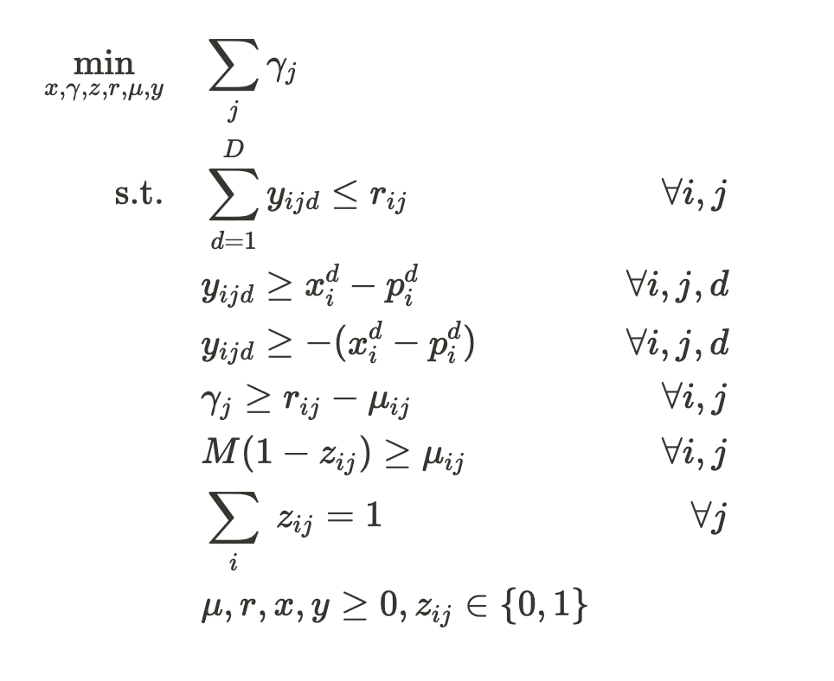
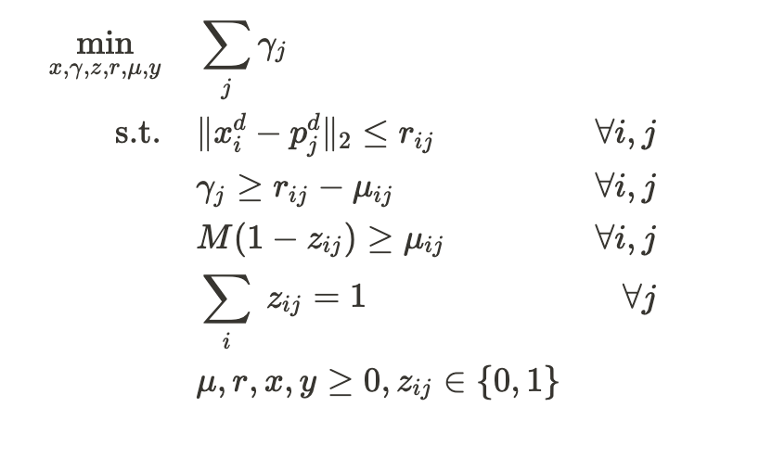
Proposed formulations
Manhattan Distance
Euclidean Distance
We also implemented a Warm Start solution that leverages k-means and an outlier detection system
M. Ravasio, H. Zerhouni

Slide 5
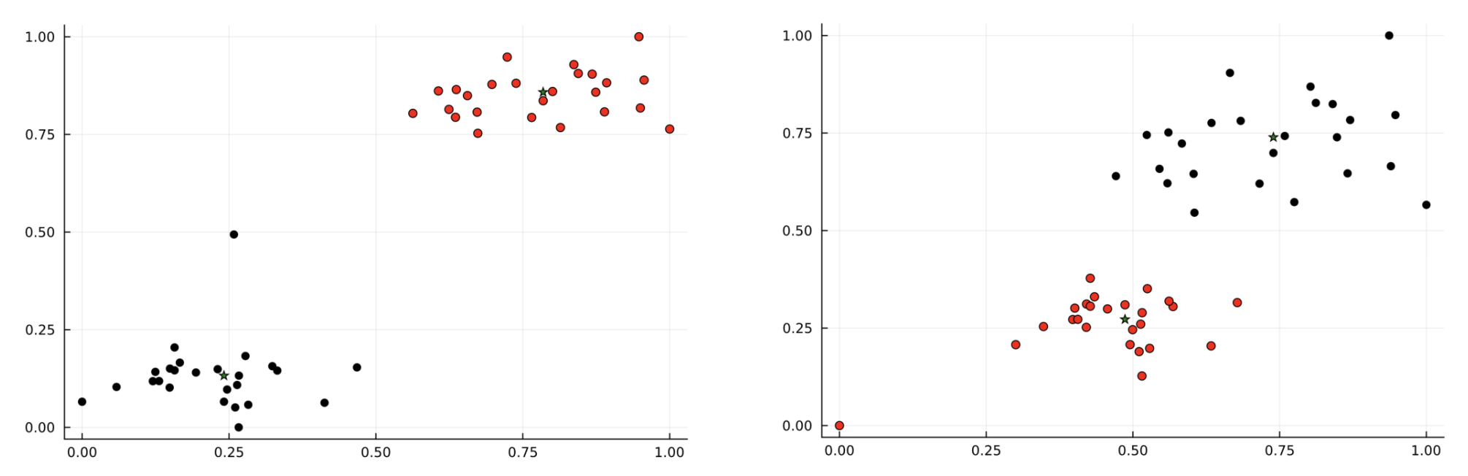
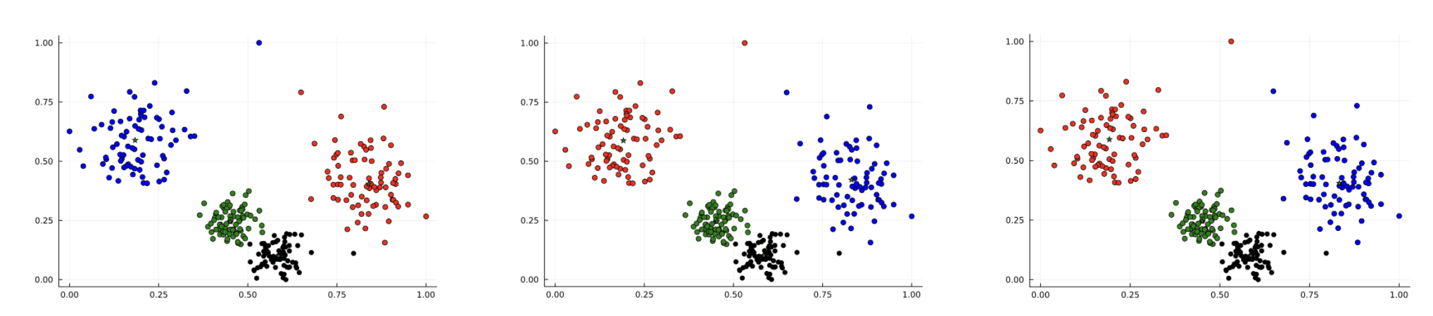
Convergence issues
“Easier” vs “Harder” problem
Solutions found under 5 minutes
Cold-Start Manhattan distance
K-means with random restart
Warm-start Manhattan distance
M. Ravasio, H. Zerhouni

Slide 6
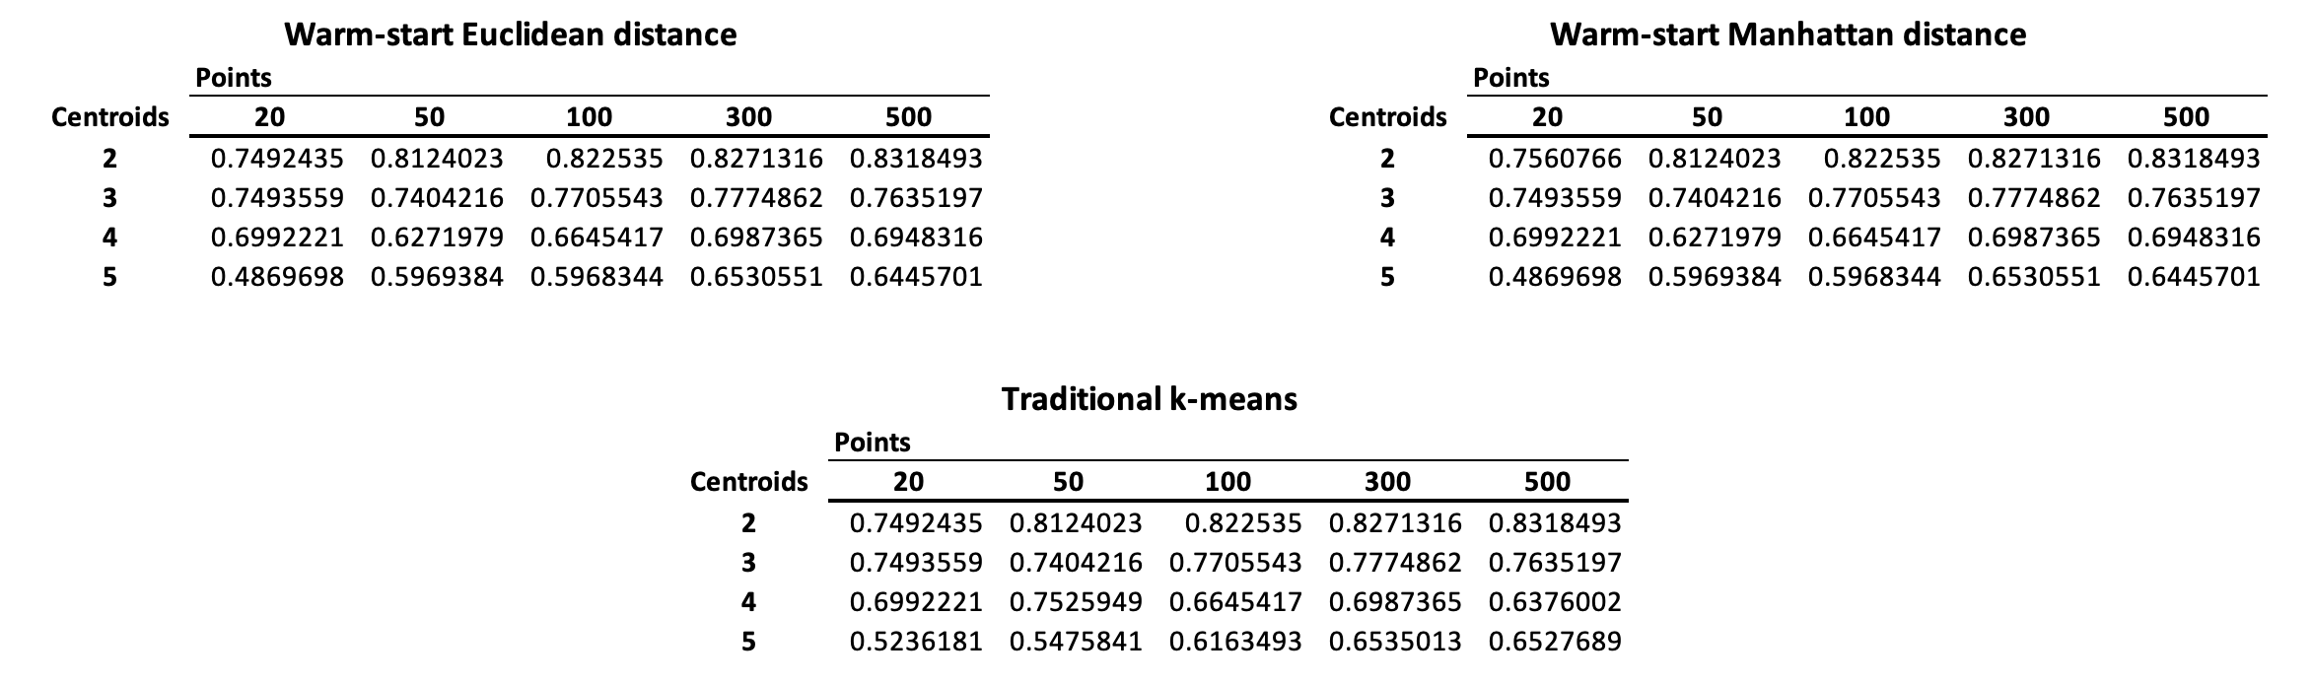
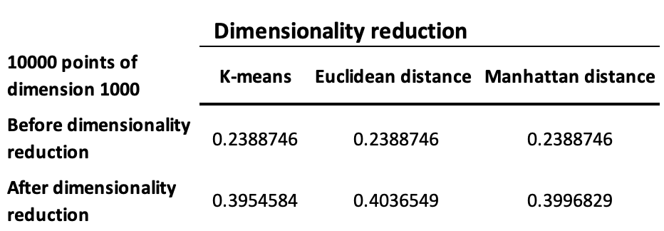
Results
Using synthetic data we evaluated the proposed formulations (using a 5 minutes limit for the run time) and compared them to k-means with random restarts. As evaluation metric we used the Silhouette score.
Even with a limit on the run time the models tend to outperform the traditional approach
We also evaluated the performance of models in High dimensionality problems. When in high dimension (1000) our models perform as k-means, but when the dimensionality is reduced, with an autoencoder, our models outperform k-means.
Dataset with 10,000 in dimension 1,000
M. Ravasio, H. Zerhouni

