Slide 1
HW&SW Codesign Academy Case Study - ACME
Team 2
Martina Corda, Tomaz Maia Suller, Mattia Sironi

Slide 2
Agenda
Goal 1
Topology and Message Definition
Implementation
Challenges Faced during Implementation
Conclusions and Lesson Learned
Goal 2
Recap on the Requirements
Syntethic Data Generation
Challenges with GenAI
Forecast Analysis
Threshold Estimation

Slide 3
Goal 1: Distributed Line Control

Slide 4
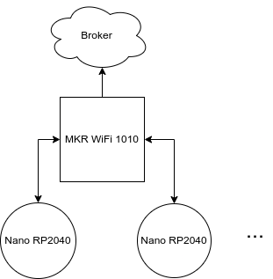
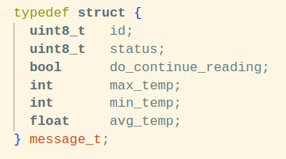
Topology and Message Definition
Shared format for reading messages
No need to define extra format for status
Bigger message with "dummy" fields for Alert and Fault
Control messages
Broker sends temperature threshold to gateway, which forwards to line controllers
Gateway forwards sampling frequency to contorllers

Slide 5
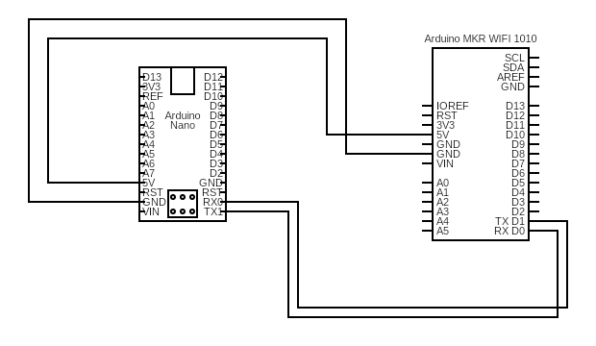
Implementation
On Arduino Nano RP2040:
Temperature measurement
Inner state switch logic
Serial message preparation (UART)
On Arduino MKR WIFI 1010:
Received message parser
State switch for other lines logic
MQTT server connection

Slide 6
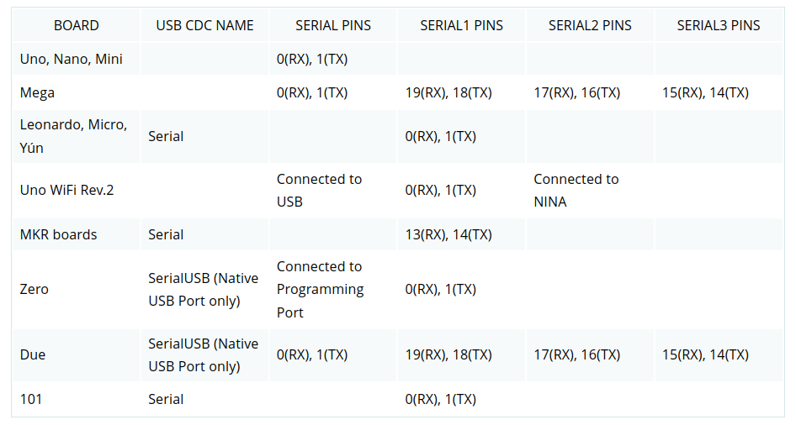
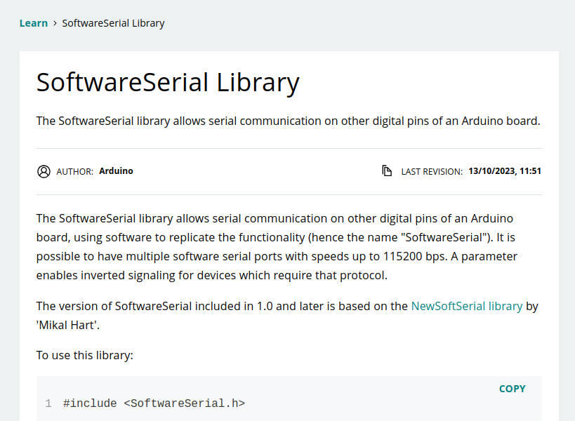
Challenges Faced during Implementation (1)
Understanding capabilities of provided HW
Arduino documentation not explicit on how serial communication lines are distributed
Number of UART controllers constrains design
SoftwareSerial not supported by Arduino Nano RP2040

Slide 7
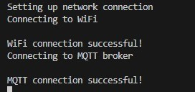
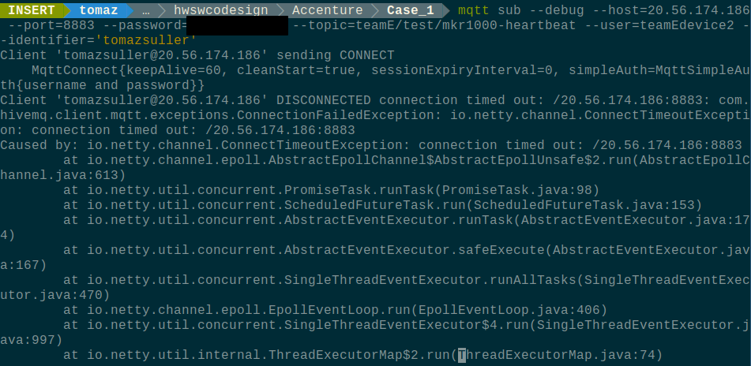

Challenges Faced during Implementation (2)
Debugging external issues
Connection to MQTT server successful initially
No connection possible since Saturday
Conclusion: MQTT server down (?)

Slide 8
Conclusions and Lessons Learned
Results
Lesson Learned
Code implementation not complete
Working communication that involves both boards
Even a sample use case in embedded systems could cause big problems

Slide 9
Demo Time!

Slide 10
Goal 2: Adaptive Thresholding using ML

Slide 11
Recap on the Requirement
Identify and develop an adaptive solution to monitor plant historical data, to forecast the optimal temperature thresholds according to site location and to adapt the plant configuration.
Synthetic Data creation:
The data should cover a realistic sample of data (at least one each 10 minutes) simulating realistic temperature range within the 24h day and within the day of the year
Part of the data (e.g. sample from the last year) should be used to test the forecasting capabilities of the chosen algorithm.
Timeseries Forecasting

Slide 12
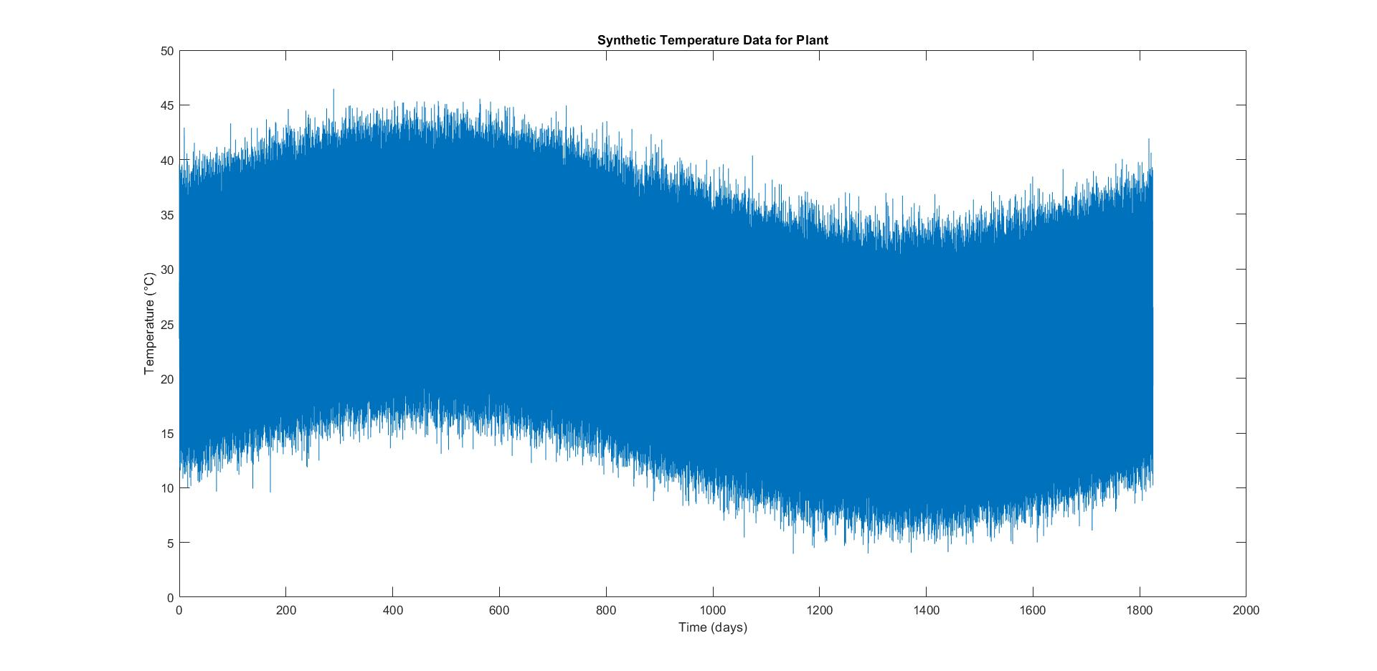
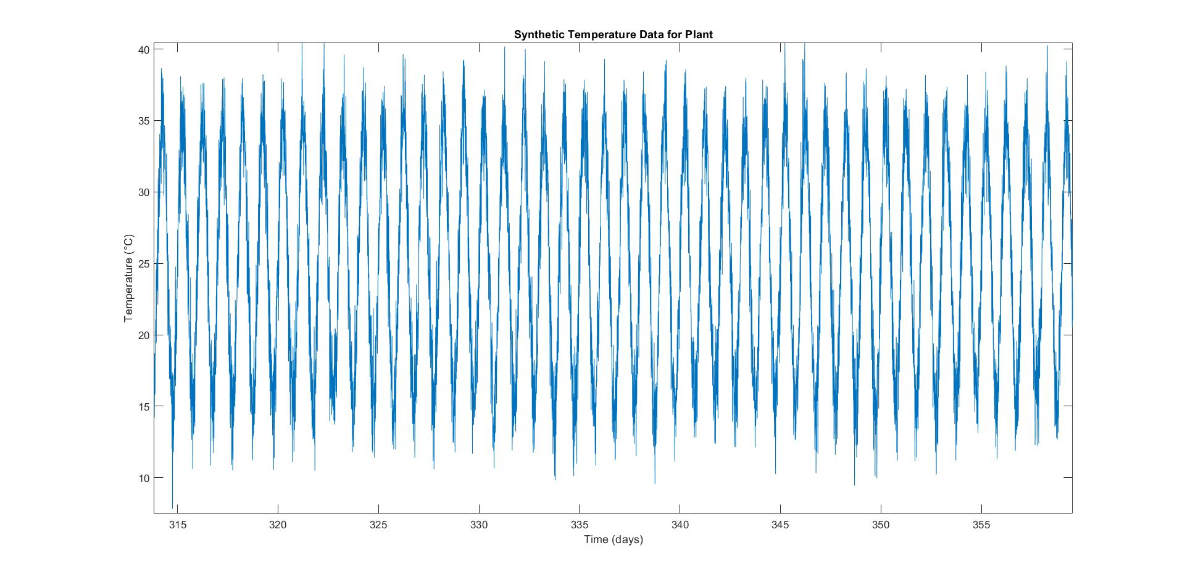
Synthetic Data Generation (1)
We asked chatGPT to create a code for generating synthetic data
Sinusoidal behaviour + random noise

Slide 13
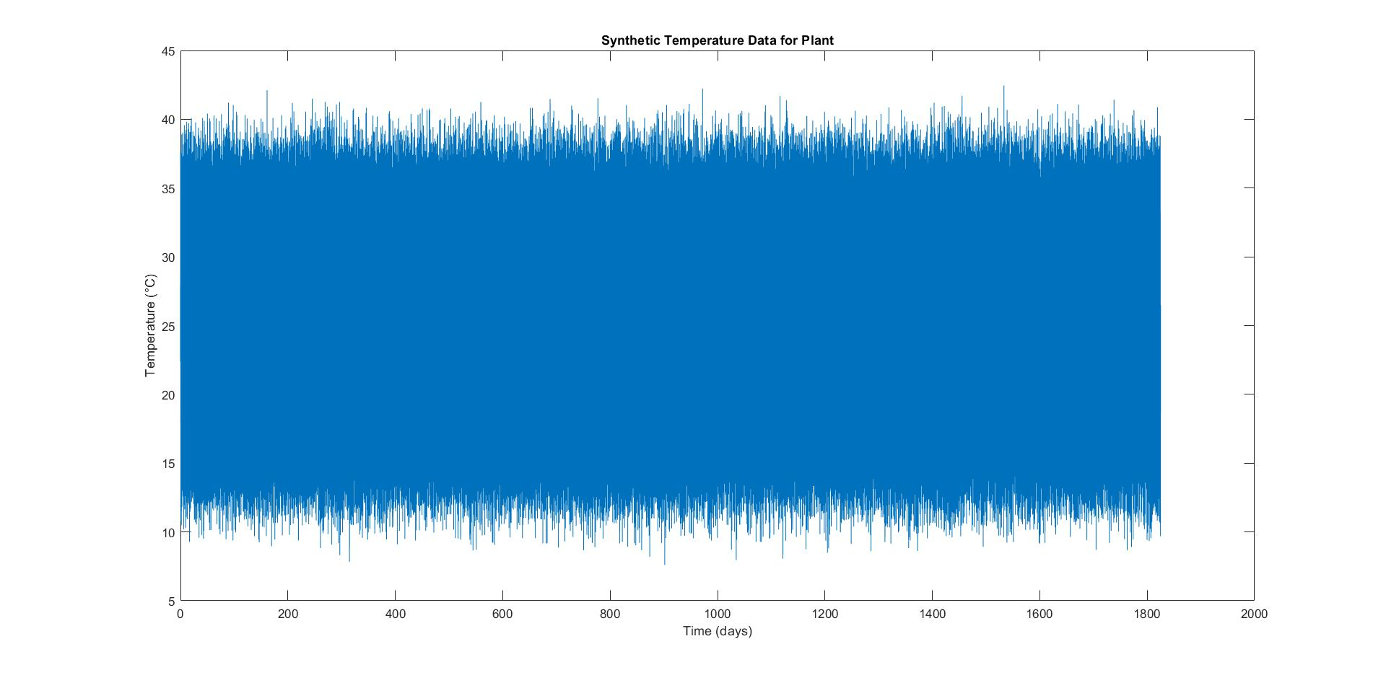
Synthetic Data Generation (2)
We didn’t like the sinusoidal behaviour across the years so we changed the code and we obtained the following pattern

Slide 14
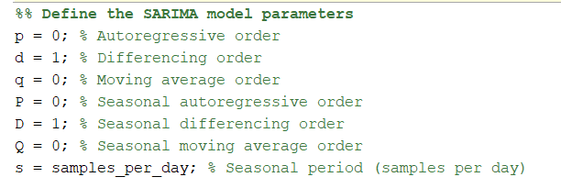
Challenges with GenAI
Unstability problems in the code generated via ChatGPT
Modification of the model order parameters

Slide 15
Time Series Forecasting
Timeseries forecasting
The dataset generated was split into
training set = 80% of dataset
test set = 20% of the dataset
SARIMA model estimation using the training set
The test set was further divided into two dataset
test set = 99.9% of the test set
validation set = 0.01% of the test test ( to assess the quality of the forecasting)

Slide 16
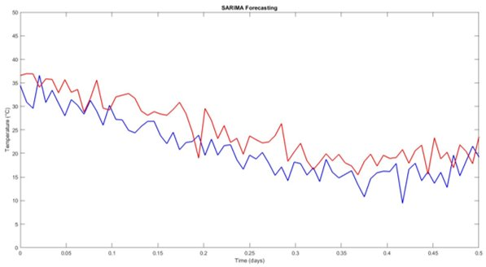
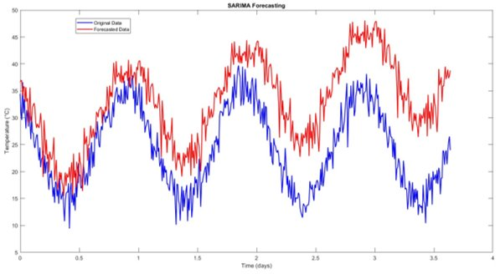
Forecast Analysis
The first days are well predicted but the drift is present as the number of days increase

Slide 17
Threshold Estimation
Fixed approach based on estimated average daily temperature
Given lack of data from plant, no specific algorithm was designed

Slide 18
Thank you!
Questions?

