Slide 1
First Sprint presentation
Group n. 04

Slide 2
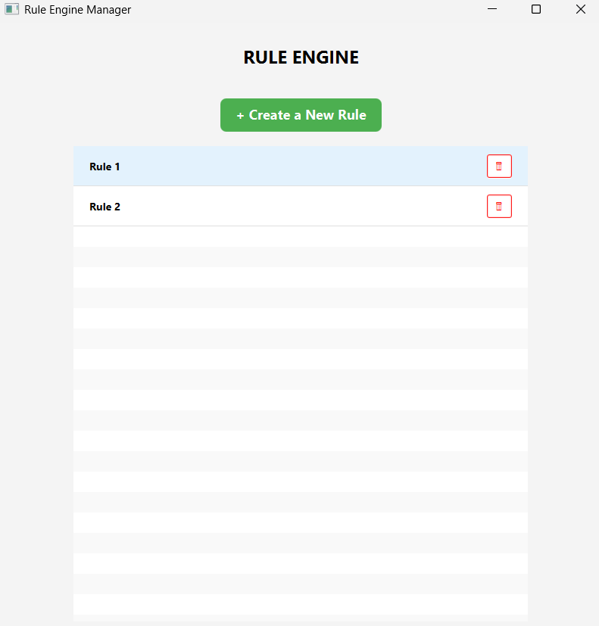
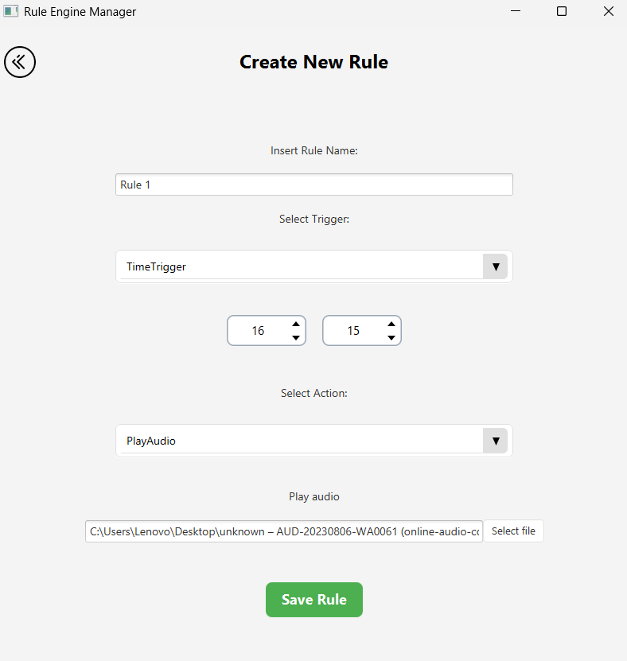
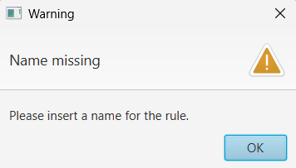
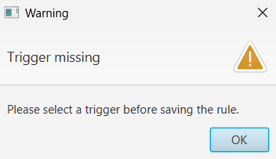
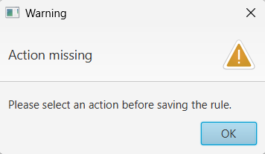
1° Sprint release

Slide 3
Sprint backlog
User stories selected (SP = 30min)
6 story pts
As a User I want to have a button called “NewRule” that allows me to open a new page to create a New Rule when I click it (2 SP)
As a User I want a list of rules that shows me all rules i have created (2 SP)
As a User I want to have a button with a symbol of a bin that allows me to delete the Rule. (1 SP)
As a User i want to be able to give a name to the Rule when i create it (1 SP)
4 story pts
As a User I want to be able to select a TimeTrigger from a list of triggers to fire an Action at an established time (4 SP)
4 story pts
As a User i want to be able to select an action that allows me to play an audio from a list of action when the rule is triggered (3 SP)
As a User i want to have a button to stopthe audio (1 SP)
4 story pts
As a User i want to be able to select an action to show a notification from a list of action when the rule is triggered (3 SP)
As a User i want to use a button to close the notification (1 SP)

Slide 4
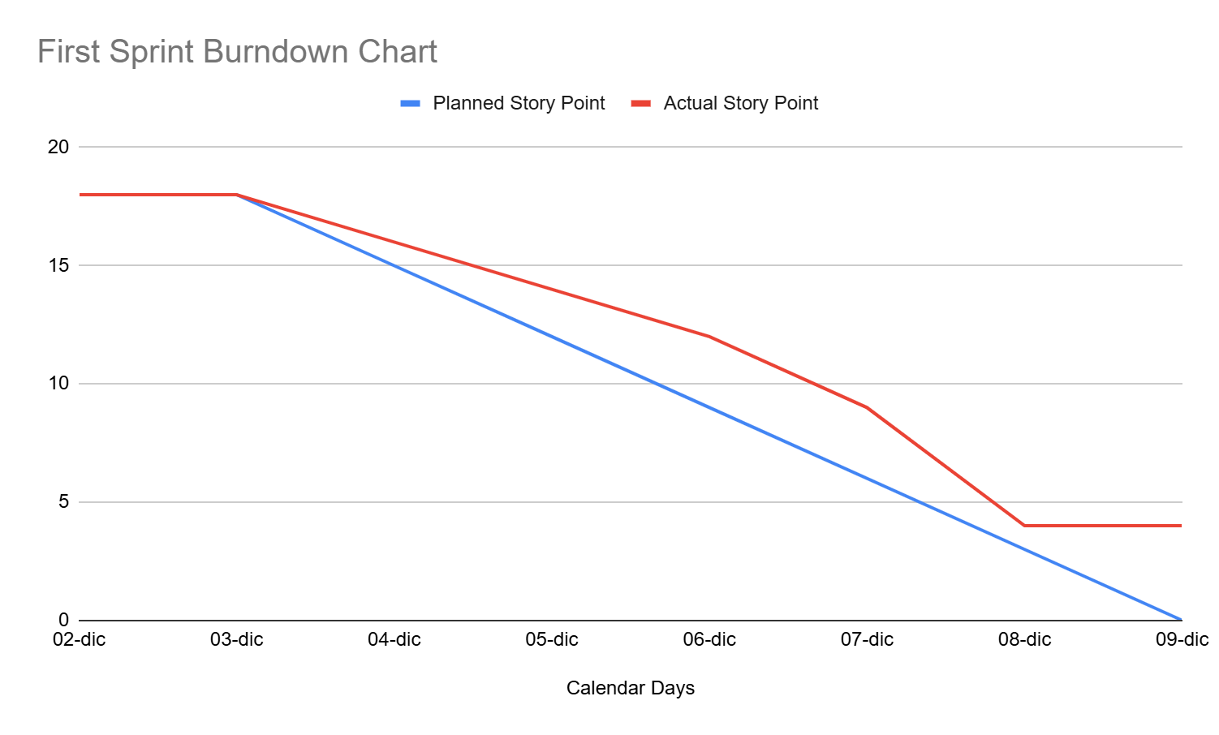
Burndown Chart

Slide 5
Sprint review report
All completed successfully except the notification actions
Any user stories rejected by the Product Owner: None
Project Velocity measured: 18
Project Velocity respected: 14

Slide 6
First sprint retrospective
Stop (things to stop doing)
None
Less of
Write code without having a global idea of what we are going to do.
Keep doing
Talk before pulling/pushing the code.
Follow patterns.
Talk to link components in the best way.
More of (more things to do)
Increase the time spent cross-reviewing code before the pull request.
Start (things to start doing)
Start defining Test Cases for each User Story before starting development.

