Slide 1
Second Sprint presentation
Group n. 04

Slide 2
Sprint backlog
User stories selected (SP = 30min)
4 story pts
As a user I want to decide if a rule can be fired only one time or can be repeated more times after a sleep period (4 SP)
4 story pts
As a user I want that all rules are saved and every time that I open the app all rules are shown in a list (4 SP)
4 story pts
As a user I want a button to activate/deactivate the rules (4 SP)
4 story pts
As a User I want to be able to select an action to show a notification from a list of action when the rule is triggered (3 SP)
As a User I want to use a button to close the notification (1 SP)

Slide 3
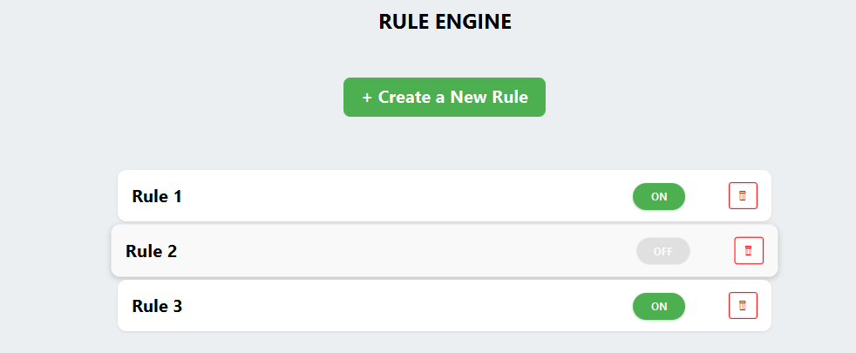
Activation/deactivation
US 3: Activate/Deactivate Rule
Extend the Rule domain model to support activation and deactivation.
Ensure that deactivated rules are ignored by the RuleEngine.
Provide a clear and intuitive UI control to activate or deactivate rules.
Ensure consistent synchronization between the UI and the rule model.
Allow rules to restart their execution cycle when reactivated by the user

Slide 4
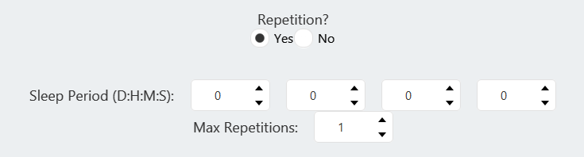
Repetition
US 1: Times of Repetition
Create a dedicated Repetition model to encapsulate all repetition-related data and logic, in order to keep the Rule class simple and maintainable.
Update the rule execution engine to correctly evaluate repetition constraints before firing a rule.
Provide a user interface that allows users to choose between one-time execution and repeated execution with a configurable sleep period.
Connect repetition configuration from the UI to rule creation logic.
Design repetition handling in a way that supports future extensions without modifying core rule logic.

Slide 5
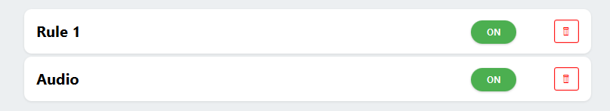
Saving Rule
US 2: Saving of the Rules
Extend the RuleEngine to support saving and loading rules from persistent storage.
Define a consistent and readable format for rule persistence.
Ensure all saved rules are restored when the application starts.
Prevent data loss by persisting rules when the application closes.

Slide 6
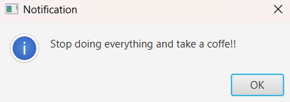
Notification Action
US 4: Select Notification Action
Create a new FXML file Notification.fxml containing a TextField for the message content.
Create a NotificationController implementing ActionControllerInterface.
Create a NotificationAction class implementing the Action interface.
Update ActionFactory to include the creation of NotificationAction.
Add "Notification" to the ActionController ComboBox options.
US 5: Close Notification Button
Implement a generic showNotificationDialog method in DialogManager using the Alert class.
Call DialogManager.showNotificationDialog inside the execute() method of NotificationAction.
Ensure the RuleEngine invokes this action on the JavaFX Application Thread.
Verify that the standard "OK" button successfully dismisses the notification.

Slide 7
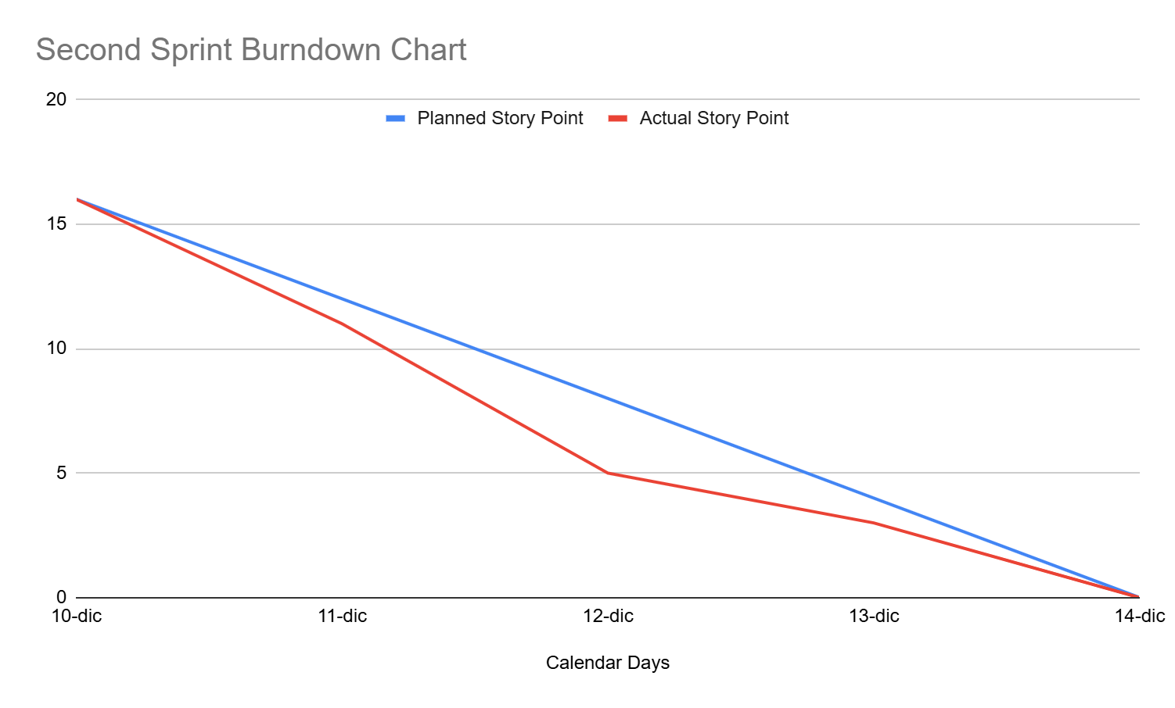
Burndown Chart

Slide 8



Sprint review report
All tasks completed successfully
Any user stories rejected by the Product Owner:
None
Project Velocity measured and respected:
16

Slide 9
First sprint retrospective
Stop
(things to stop doing)
Define too generic style classes.
Less of
None.
Keep doing
Talk before pulling/pushing the code.
Follow patterns.
Talk to link components in the best way.
Write code having a global idea of the project.
More of
(more things to do)
Increase the time spent cross-reviewing code before the pull request.
Define Test Cases for each User Story before starting development.
Start
(things to start doing)
Add more detailed comments.

